Slide 1
A PROPOSED FRAMEWORK OF SCIENCE TEACHER COMPETENCY TO TEACH STEM-ESD
Ari Widodo¹, Youngsun Kwak², NamHwa Kang²
¹Universitas Pendidikan Indonesia
²Korea National University of Education

Slide 2
Outline of the Presentation
STEM and ESD
Attempts to integrate STEM and ESD
Teacher readiness to teach STEM-ESD
Developing a framework of teacher competency
The importance of the framework

Slide 3
STEM and ESD

Slide 4
STEM
Science
Technology
Engineering Processes
Identify problems
Think of technological solutions
Design a technology
Create a prototype
Test a prototype
Re-design
Scientific processes
Identify problems
Design investigation
Conduct investigation
Analyse data
Communicate

Slide 5
What is SDGs?
A blueprint for peace and prosperity for people and the planet, now and into the future.

Slide 6
Sustainable Development Goals (SDG’s)

Slide 7
What is ESD?
Education that encourages Changes in knowledge, skills, values and attitudes to enable a more sustainable and just society for all

Slide 8
ESD Key Competencies
System thinking
Anticipatory
Normative
Strategic
Collaboration
Critical thinking
Self-awareness
Integrated problem solving

Slide 9
Attempts to integrate STEM and ESD

Slide 10
OUR RESEARCH PROJECT
STEM-ESD Projects
Awareness and Action
Food Preservation
SDG 2
Zero Hunger
Grey Water & Rain Water Harvesting
SDG 6
Clean Water and Sanitation
Waste to energy
SDG 7
Affordable and Clean Energy
Food lost/Food Waste & Mindful Eating
SDG 12
Responsible Consumption and Production
40 Days Challenge on Climate Change Action
SDG 13
Climate Action
Phytoremediation
SDG 14
Life Below Water

Slide 11
STEM for ESD
System thinking
Scientific Processes and Engineering process
Anticipatory
Normative
Strategic
Project-based problem solving
Collaboration
Collaboration
Critical thinking
Self-awareness
Problem solving

Slide 12
Teacher Readiness to Teach STEM-ESD

Slide 13
Exposure to STEM-ESD Training

Slide 14
The Importance of STEM-ESD Lesson

Slide 15
Difficulty of Implementing STEM-ESD

Slide 16
Developing a Framework of Science Teacher Competency to Teach STEM-ESD

Slide 17
Science Teacher Competencies to Teach STEM-ESD
Competencies
to Teach STEM
Competencies
To Teach ESD
STEM-ESD
Science Teacher Competencies

Slide 18
Science Teacher Competencies (summary of documents published by several countries)
Content knowledge
Content pedagogy
Inquiry
Professional practice
Assessment and evaluation
Professional development
Attitude

Slide 19
ESD Teacher Competencies
Facilitate learning
Continue to learn and create
Connect, collaborate and engage
Guide for the Effective Dissemination of the Asia Pacific ESD Teacher Competency Framework

Slide 20
Integration of ESD teacher competency into science teacher competency

Slide 21
Teacher competencies to teach STEM-ESD
STEM-ESD Content Knowledge
STEM-ESD Pedagogical Knowledge
Technological Knowledge
STEM-ESD Technological Pedagogical Content Knowledge
Professional development

Slide 22
The Importance of the Framework

Slide 23
Teacher Career Pathway
Leader teacher
Expert teacher
Experienced teacher
Beginner teacher
Science Teacher Education

Slide 24
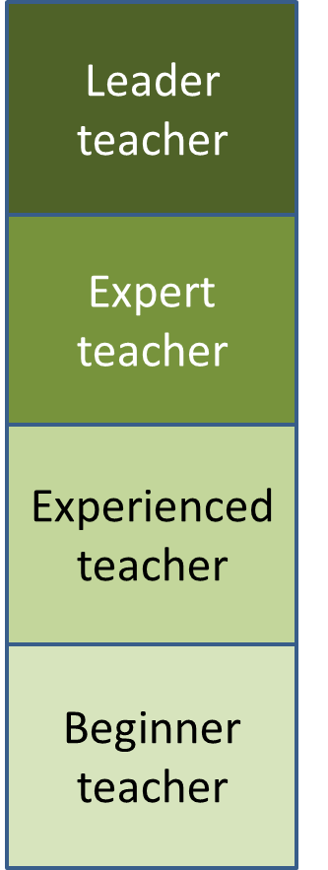
Teacher Professional Development
Develop to be what?
Competencies
Competencies
Competencies
What to be
developed?
Competencies

Slide 25
Application of the framework
Leader teacher
Mapping teachers’ competencies
Expert teacher
Designing and asessing PD
Career Planning
Experienced teacher
Promotion
Beginner teacher
Minimum standard for science teacher education

Slide 26
Thanks for your attention

