Slide 1
Challenges and Potential on Science Curriculum Development in Northern Laos
Research team
Ms. Kinnaly THIPPHAPHONE
Mr. Saiphone KHOTSAIGNO
Mr. Somchay PHAYAVONG
Mr. Thongtheine VATHAANAVONG
Mr. Yang Xang

Slide 2
1. Background
Lao PDR is one of the developing countries with an economic base mainly based on agriculture, forestry, tourism and energy industry, mainly hydropower and geothermal energy. Along with these economic sectors, the Lao government also has a policy to encourage foreign investors to invest in other industrial sectors such as the consumer goods industry and other light industries by designating many areas as special economic zones and industrial estates.
However, from the statistics of foreign direct investment in Laos in the recent period, it can be seen that the investment in the industrial sector is still focused on hydropower and mining, while the investment in other industrial sectors related to the application of science and technology is still minimal.
In fact, there are many factors that impact to the minimal of industry, and one of those important part is the lacking of technical or scientific labor in Laos.
According to the overall context of the educational policy in Lao PDR refer that need to be align and support to the national planning of economic development, and this is a guide line of every curriculum development

Slide 3
1. Background
Since January 2022, scientific sessions have been introduced into mobile library activities, offering students experimental and hands-on practice to understand better​ the information contained in their textbooks. (Action education;2023).
In Lao PDR, science is taught from the 1st grade as a part of the subject “World Around Us” that consists of topics not only in Science but as well as in Social Science (Geography and History),Environment and Health (e.g., Abe 2007). As expected from the subject name, topics in textbooks for elementary school children are introduced with strong connection with everyday life in Lao PDR. (KHANTHAVY, 2016)
However, this is for the secondary school where also has a science subject to learn along with other general subject.

Slide 4
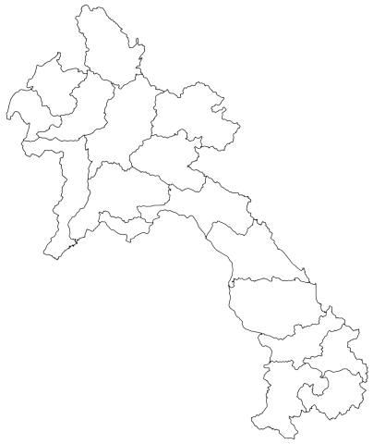
1. Background
The over view of Higher educational in Lao PDR.
National University of Laos (NOUL)
Souphanouvong University (SU)
Savannakhet University (SKU)
Champasack University (CU)
University of Health science

Slide 5
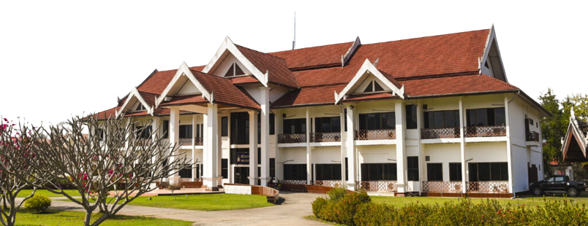
1. Background
Souphanouvong University (SU) was established in accordance with the Prime Minister, Decree No. 169/PM, dated 4th November, 2003 as a national university in Luangprabang. SU officially held an inauguration ceremony on 5th November,
According to the Decree No.099/PM dated 3rd April 2009, on the organizational and functional of SU; Souphanouvong Universty is a national education and cultural center supervised by the Ministry of Education and Sports (MoES) with the main focus of the northern provinces.

Slide 6
Faculties in Souphanouvong University
1. Background
Faculty of Education
Faculty of Economic and Tourism
Faculty of Architecture
Faculty of Engineering
Faculty of Agriculture and forestry
Faculty of Languages
Faculty of Science and Innovation

Slide 7
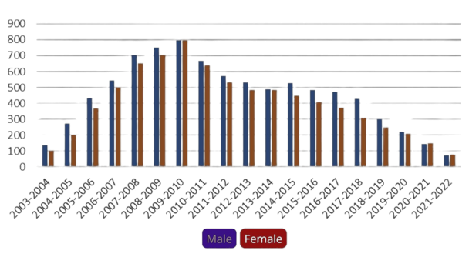
Student trending at faculty of education
1. Background

Slide 8
Faculty of Education and Faculty of Science and Innovation
1. Background
Current Teacher education programs
New science curriculum developing
Program of Math teacher
Program of Physics teacher
Program of Chemistry teacher
Program of ICT teacher
Applied Mathematics
Mathematic and Computer
Statistic science
Industrial physics
Physics Metallurgy and Applications
Environmental Management Science
Multimedia technology

Slide 9
1. Background
This study is intended to disclose the challenge and potential of science education in northern Laos; it is part of the primary data analyses for the requirement of need assessment in science education within 8 northern provinces of Lao PDR. as a master plan to develop science education curriculum and step up to establishing the new faculty of science and innovation in Souphanouvong University.

Slide 10
2. Purpose of study
This study aim to analyses the challenges and potential of new science curriculum development by the following activities:
Need assessment on science education in Northern Laos
Processing analyses SWOT on the development of science curriculum

Slide 11
3. Methodology
This study conducted with various sample to finding of
Need assessment on science curriculum
SWOT
Government sector
Industrial company
Entrepreneur
High school students
University academic council
Policy analyses

Slide 12
3. Methodology
Recording of the University academic council conference
Policy study
SWOT
Contents analyses with 45 interviewee
Descriptive analyses with the data with 1481 student
This study conducted a data collection as below:

Slide 13
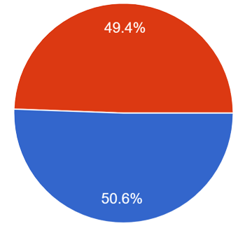
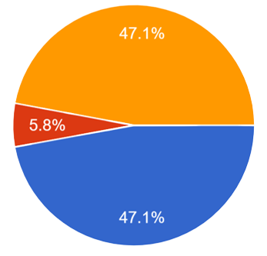
4. Result
Need assessment for science curriculum:
Total 1,481 responses:
Male 732
YES 698
Female 732
NO 86
Not decide

Slide 14
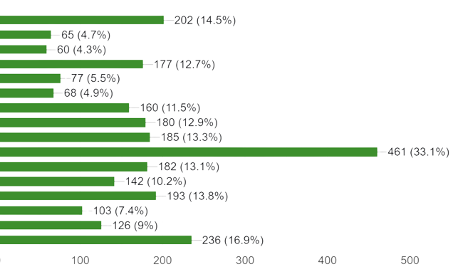
4. Result
Need assessment for science curriculum:
Total 1,481 responses:
Mathematic and Computer
Statistic science
Physics
Physics AI
Industrial Physics
Chemistry
Environmental management science
Multimedia technology
Local innovation development
English for business
English for social development
Political science
Political and administration
Cultural management
Language And Archaeology
Others

Slide 15
4. Result
Content Analyses from University academic council and stakeholders
Total 45 interviewee:
Science education need specific teacher
High investment
Facility and technology
More invest in teacher
Cooperate with industrial partner
People don’t understand
Science curriculum are necessary
Human resources
Facility and technology
Collaboration
Acknowledgement

Slide 16
4. Result
Policy study
STRENGTH
WEAKNESS
OPPORTUNITY
THREAT
Government support
Infrastructure
Human resources
Exist science teacher program
Facility
Curriculum development
STEM trending
High career
Technology
Number of student
Sustainability
Strength, Weakness, Opportunity, and Threat (SWOT)

Slide 17
4. Result
The student expectation on their future career
No | Career expectation | Average | Variance | Result
1.1 | Engineering | 3.75 | 0.53 | Need
1.2 | Researcher or Scientist | 3.09 | 1.19 | Median
1.3 | Government staffsdfd | 2.24 | 1.18 | Not important
1.4 | Entrepreneur | 4.64 | 0.98 | Strongly need
1.5 | Freelance | 3.15 | 1.11 | Median
1.6 | Working abroad | 4.72 | 1.00 | Strongly need

Slide 18
5. Discussion
Challenges on Science curriculum development
Human resource
“the number of teacher in Laos are minimal, we still lack of specific teacher especially the natural science and foreign languages; there are many schools where teacher tough different subject from their majority” (Ministry of Education and Sport, 2022)
Also in the higher education institution, the number of science teacher are quite low and with some academic issue. Many teacher did not continue their majority on the master on the higher degree
Facility investment
Since 2021, due to the economic crisis, the government ordered to stop an infrastructure planning or investment except the necessary construction;
The aid from international organization or program would be an efficient afford to developing the facilities for science teaching; “SU Academic council, 2022”
Student
the number of student is the most challenges in science curriculum development; now currently we have to stop some of our program due to the less number of enroll student

Slide 19
6. Conclusion
Science education in Northern Laos
To develop the science curriculum for the student in northern part of Laos, we still face many challenges and barrier in order to make it efficiency and sustainable
However, currently now we have four curriculum that develop by our lecturer and in processing of approval from the ministry name as:
Math thematic and Computer
Physics Metallurgy and Applications
Environmental management science
Multimedia technology

Slide 20
7. Reference
Ministry of Education and Sport. (2022). Annual report to National parliament. Vientiane.
Souphanouvong University. (2020). Strategic and master plan 2020-2025. LuangPrabang: Souphanouvong University.
Souphanouvong University. (2020). Strategic and master plan 2020-2025. LuangPrabang: Souphanouvong University.
Souphanouvong University. (2021). President agreement on faculty of science and technology establishment LuangPrabang: Souphanovong University
Souphanouvong University. (2022). Research Report. LuangPrabang: Souphanovong University Funded by HANDONG GLOBAL UNIVERSITY AND UNITWIN.
TAMURA Kazuyuki and KHANTHAVY Houmphanh. (2016). Review of Science Education in Lao People‟sDemocratic Republic:. Academia, 1. Retrieved from https://www.academia.edu/10627533/Review_of_Science_Education_in_Lao_People_s_Democratic_Republic_Aims_and_Issues_with_the_Curriculum

