Slide 1
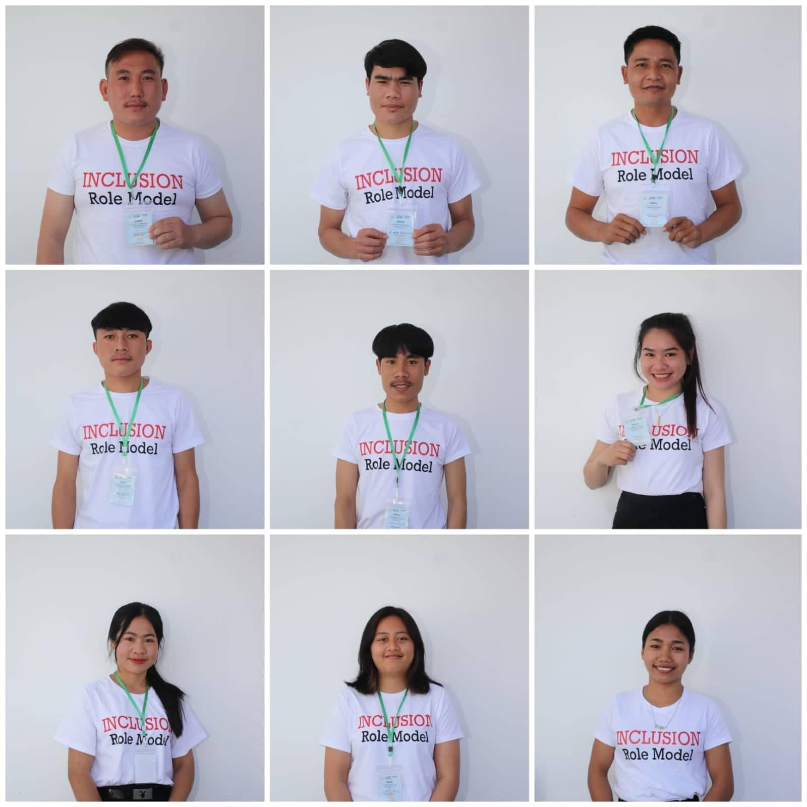
Pre-service teachers' perceptions towards disability inclusive education:
A training survey of the intensive disability inclusion role model training
Research Team
Vikate Phannalath
Yang Xang
Phonesavanh Vandalak
Paoxiong Xuada
Noy Her
Lounny Phothiyalai
Fongmany Onsengtavanh
Toulakone Souliya

Slide 2
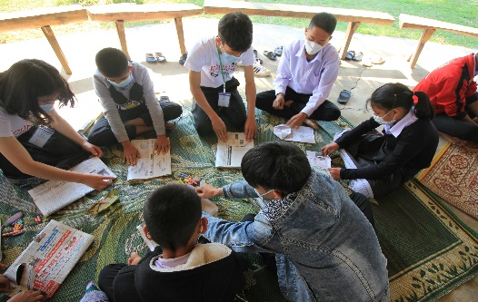
Background
Among the population aged 5+, there are 160,881 people who have a disability, and the overall prevalence of disabilities in Lao PDR is 2.77 percent (Lao Statistics Bureau, 2015). According to the report of the education development implementation plan for academic year 2019-2020, the total number of children with disabilities (deaf, hard of hearing and unable to speak) enrolled in special schools was 169, and nine students were studying different majors at the National University of Laos.
Though inclusive education policies have been endorsed. In Laos, only a few students with visual impairment attended inclusive schools in the capital city (MOES, 2020), and the group of children who are least likely to attend school is the one with disabilities.
The key challenge that has been raised in many education sector reports is that teachers feel concerned about accepting children with disabilities in their mainstream classroom due to a lack of experience and necessary training in inclusive special education (MOES, 2020).

Slide 3
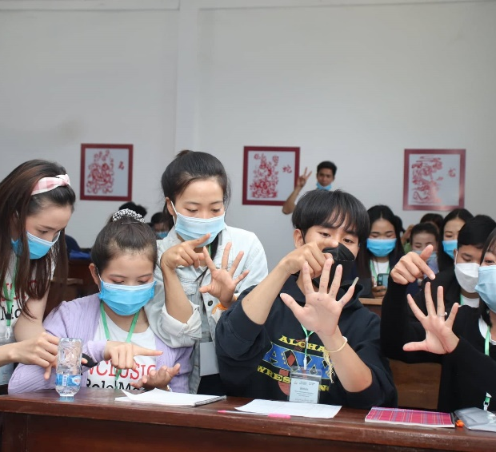
the Objectives
To identify the existing knowledge and experience towards disability inclusive education among pre-service teachers
To determine how intensive disability inclusion role model training enhances pre-service teachers’ confidence in implementing disability inclusive education

Slide 4
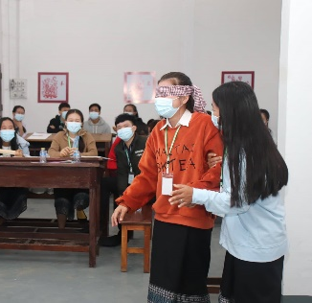
Research Questions
What is pre-service teachers' current knowledge and experience with disabilities inclusive education?
How can intensive disability inclusion role model training enhance pre-service teachers’ confidence in implementing inclusive education?

Slide 5
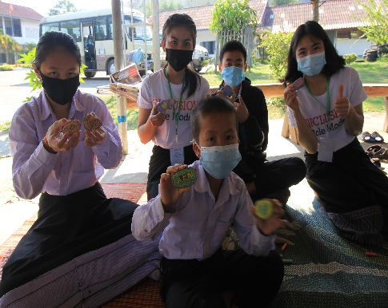
Research Materials and Methods

Slide 6
Research Materials and Methods (cont.)
Statements | Pre-Training |  | Post-training
 | Yes | No | Levels of confidency in adapting the content learned
Inclusive Education (IE) Training Experience |  |  | 1 (very low) | 2 (low) | 3 (medium) | 4 (high) | 5 (very high)
Knowledge of IE legislation
Having positive and welcoming attitudes
Knowledge of child to child strategies
Knowledge of Individual Education Plan
Knowledge of curriculum differentiation
Knowledge of using free and low-cost materials
Knowledge of working with other teachers
Knowledge of working with parents
Knowledge of working with communities
Knowledge of disbilities
Types of disabilities
Knowledge of autism
Supporting children with autism
Knowledge of special education

Slide 7
Research Findings
Pre-Training | Yes | No
Inclusive Education (IE) Training Experience | 0 | 50 (100%)
Knowledge of IE legislation | 0 | 50 (100%)
Having positive and welcoming attitudes | 8 (16%) | 42 (84%)
Knowledge of child to child strategies | 10 (20%) | 40 (80%)
Knowledge of Individual Education Plan | 7 (14%) | 43 (86%)
Knowledge of curriculum differentiation | 8 (16%) | 42 (84%)
Knowledge of using free and low-cost materials | 7 (14%) | 43 (86%)
Knowledge of working with other teachers | 5 (10%) | 45 (90%)
Knowledge of working with parents | 13 (26%) | 37 (74%)
Knowledge of working with communities | 11 (22%) | 39 (78%)
Knowledge of disabilities | 27 (44%) | 23 (46%)
Types of disabilities | 19 (38%) | 31 (62%)
Knowledge of autism | 6 (12%) | 44 (88%)
Supporting children with autism | 1 (2%) | 49 (98%)
Knowledge of special education | 7 (14%) | 43 (86%)
Knowledge of sign language | 6 (12%) | 44 (88%)

Slide 8
Research Findings (cont.)
Post-Training | Confidence Levels of Using the Lesson Learned
 | Average | Criteria
Adapting the existing legislation | 3.88 | high
Adapting positive and welcoming attitudes | 4.38 | high
Adapting child to child strategies | 4.28 | high
Adapting Individual Education Plan | 3.68 | high
Adapting curriculum differentiation | 3.58 | high
Adapting free and low-cost materials use | 3.96 | high
Adapting working with other teachers | 4.06 | high
Knowledge of working with parents | 4.38 | high
Knowledge of working with communities | 4.06 | high
Understanding disabilities | 4.22 | high
Supporting children with autism | 3.88 | high
Understanding special and inclusive schools | 4.14 | high
Being inclusion role models | 4.26 | high

Slide 9
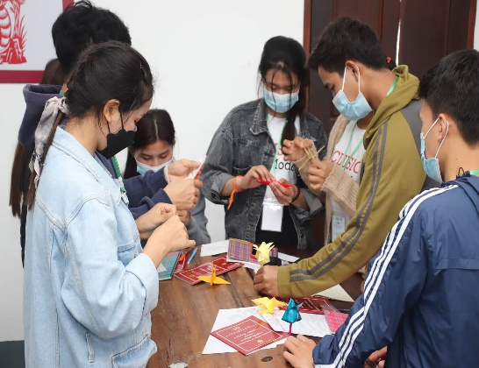
Discussion
The evidence demonstrates how pre-service teachers perceive inclusive education for children with disabilities, and this may contribute to positive changes after receiving the training.
Ozel et al. (2018) claimed that teachers who have completed the adapted program will have the required abilities to conduct effective teaching in inclusive classrooms.
The attitudes of teachers towards children with disabilities significantly improved after they had participated in at least one class on inclusive special education (Bradshaw & Mundia, 2006).
Forlin and Sin (2017) believe that good practises are obvious when a teacher is properly trained, has a good attitude, and has access to appropriate resources and support.

Slide 10
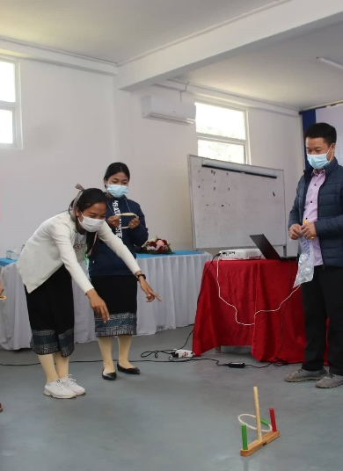
Further Studies
Further studies on how the training impacts the participants' teaching practises are required to generalise the findings.

Slide 11
References
Ackah-Jnr, F. R. (2020). The teacher should be learning: In-service professional development and learning of teachers implementing inclusive education in early childhood education settings. International Journal of Whole Schooling, 16(2), 93-121. https://eric.ed.gov/ ?id=EJ1289803
Azam, S., Goodnough, K., Moghaddam, A., Arnold, C., Penney, S., Young, G., & Maich, K. (2021). Becoming inclusive teacher educators: self-study as a professional learning tool. International Journal for the Scholarship of Teaching and Learning, 15(2), 1-9. https://doi.org/10.20429/ijsotl.2021.150204
Bailey, L., Nomanbhoy, A., & Tubpun, T. (2014). Inclusive education: Teacher perspectives from Malaysia. International Journal of Inclusive Education, 19(5), 547-559. https://doi.org/ 10.1080/13603116.2014.957739
Bradshaw, L., & Mundia, L. (2006). Attitudes to and concerns about inclusive education: Bruneian inservice and preservice teachers. International Journal of Special Education, 21(1), 35-41. https://www.researchgate.net/publication/289831066
Forlin, C., & Sin, K. F. (2017). In-service teacher training for inclusion. Oxford research encyclopedia of education. https://doi.org/https://doi.org/10.1093/acrefore/ 9780190264093.013.161
González-Gil, F., Martín-Pastor, E., Flores, N., Jenaro, C., Poy, R., & Gómez-Vela, M. (2013). Teaching, learning and inclusive education: The challenge of teachers’ training for inclusion. Procedia - Social and Behavioral Sciences, 93, 783-788. https://doi.org/ 10.1016/j.sbspro.2013.09.279
Jordan, A., Schwartz, E., & McGhie-Richmond, D. (2009). Preparing teachers for inclusive classrooms. Teaching and Teacher Education, 25(4), 535-542. https://doi.org/10.1016/ j.tate.2009.02.010
Krolak-Schwerdt, S., Cate, I. M. P.-t., Markova, M., & Krischler, M. (2018). Promoting inclusive education: the role of teachers’ competence and attitudes. Insights into Learning Disabilities, 15(1), 49-63. https://eric.ed.gov/?id=EJ1182863
Kurniawati, F. (2021). Exploring teachers’ inclusive education strategies in rural Indonesian primary schools. Educational Research, 63(2), 198-211. https://doi.org/10.1080/ 00131881.2021.1915698
Makoelle, T. M., & Burmistrova, V. (2021). Teacher education and inclusive education in Kazakhstan. International Journal of Inclusive Education, 1-17. https://doi.org/10.1080/ 13603116.2021.1889048
MOES. (2010). National Policy on Inclusive Education. Ministry of Education and Sports
MOES. (2011). National Strategy and Plan of Action on Inclusive Education. Ministry of Education and Sports
MOES. (2018). Annual Report on Educationa and Sports Sectors. Ministry of Education and Sports
MOES. (2020). Annual Report on Educationa and Sports Sectors. Ministry of Education and Sports
Ozel, E., Ganesan, M. Z., Daud, A. K. M., Darusalam, G. B., & Ali, N. A. B. N. (2018). Critical issue teacher training into inclusive education. Advanced Science Letters, 24(7), 5139-5142. https://doi.org/10.1166/asl.2018.11288
Pijl, S. J. (2010). Preparing teachers for inclusive education: Some reflections from the Netherlands. Journal of Research in Special Educational Needs, 10, 197-201. https://doi.org/10.1111/j.1471-3802.2010.01165.x
Shani, M., & Hebel, O. (2016). Educating towards inclusive education: Assessing a teacher-training program for working with pupils with special educational needs and disabilities (SEND) enrolled in general education schools. International Journal of Special Education, 31(3). https://eric.ed.gov/?id=EJ1120685
Song, J. (2016). Inclusive education in Japan and Korea - Japanese and Korean teachers’ self-efficacy and attitudes towards inclusive education. Journal of Research in Special Educational Needs, 16, 643-648. https://doi.org/10.1111/1471-3802.12324
Yada, A., & Savolainen, H. (2017). Japanese in-service teachers’ attitudes toward inclusive education and self-efficacy for inclusive practices. Teaching and Teacher Education, 64, 222-229. https://doi.org/10.1016/j.tate.2017.02.005

