Slide 1
Fostering prospective teachers' global competence through an international teaching practicum
The 7th UNESCO UNITWIN International Conference on Quality Teacher Education 2023
Mahidol University, Salaya Campus.
6 July 2023
Tuszie Widhiyanti, Ph.D.
Chemistry Education Study Program
Faculty of Mathematics and Science Education
Universitas Pendidikan Indonesia

Slide 2
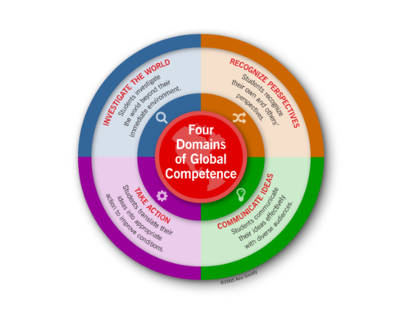
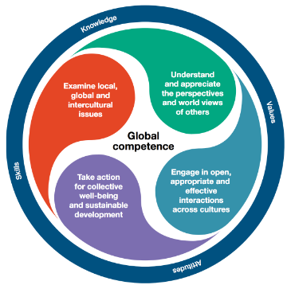
Global Competence
Teaching for Global Compeence in a Rapidly Changing World
Asia Society, Center for Global Education

Slide 3
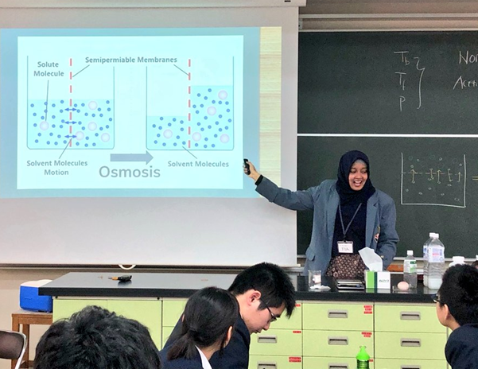
International Teaching Practicuum for Preservice Teacher
Preservice teachers spend one to three months as a student teacher in a classroom
Classroom placement forces preservice teachers to work in a new linguistic and cultural setting.
Teaching in situations with limited or unfamiliar resources compels preservice teachers to collaborate, to be flexible, and to creatively teach academic concepts.

Slide 4
International Teaching Practicuum
Benefit and Challenges when Teaching Internationally
Journal of Research in International Education, 2020 Vol 19(1) 38-53
Point of View | Benefit | Challenges
Intercultural Matters | Cross-cultural awareness Respect for diverse cultures | Socializing Language Barriers
Professional matters | Professional development opportunities Reflective teaching Confidence | Classroom Management Parent Conferences Lack of support from schools Ineffective Mentoring
Personal matters | English Proficiency Independence | Being away from family Settling Down
Living and Teaching Internationally: Teachers Talk about Personal Experiences, Benefits, and Challenges
Nelly Sierra Ospina and Sergio Lopera Medina
Universidad de Antioquia, Colombia

Slide 5
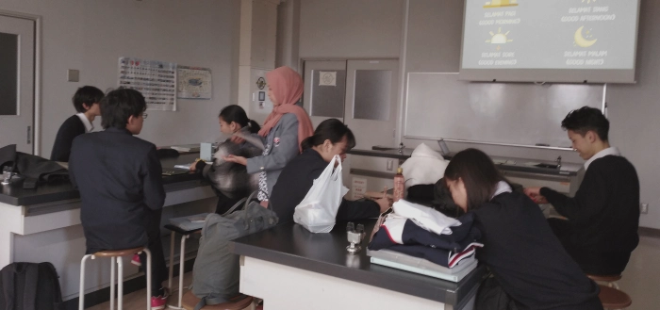
International Teaching Practicum at UPI
Teaching Practicum at :
SI Bangkok
SRI Tokyo
SI Davao
SI Kota Kinabalu
SI Den Haag
SEA Teacher Program (Thailand, Philippines, Vietnam, Japan)

Slide 6

Number of Participants per Batch

Slide 7
STEPS OF SEA TEACHER ACTIVITIES
ORIENTATION
CULTURE
IMPLEMENTATION
TEACHING OBERVATION
REPORTING
CAMPUS
SCHOOL
TEACHING PRACTICE
LESSON PLAN
DAILY REPORT
PRESENTATION
FINAL REPORT (BLOG)
TEACHER REFLECTIVE JOURNAL

Slide 8
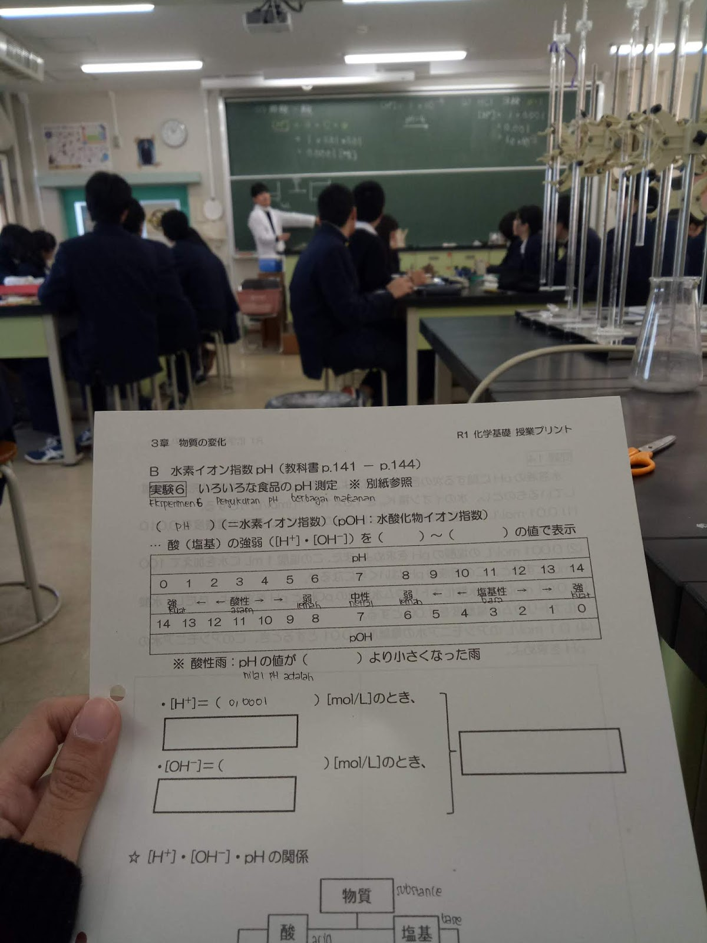
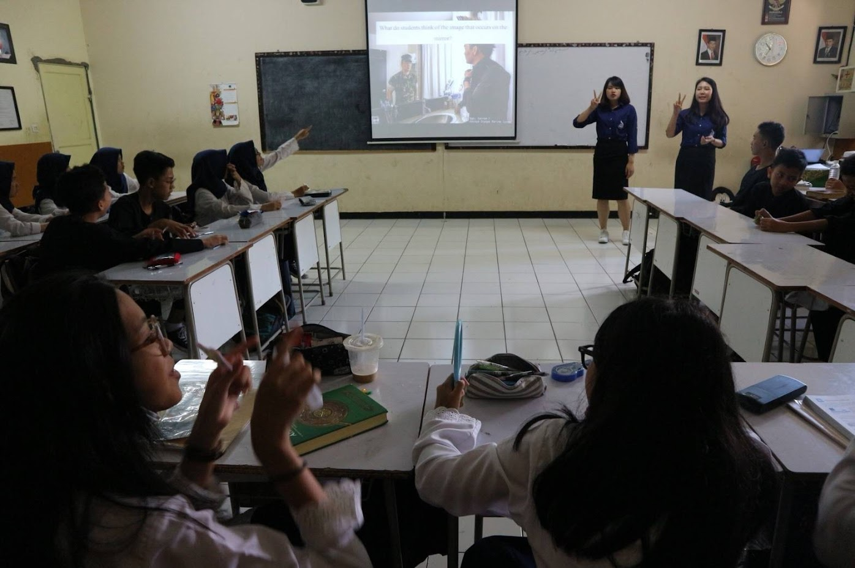
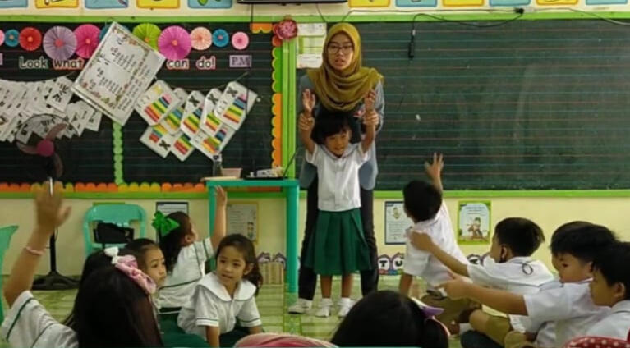
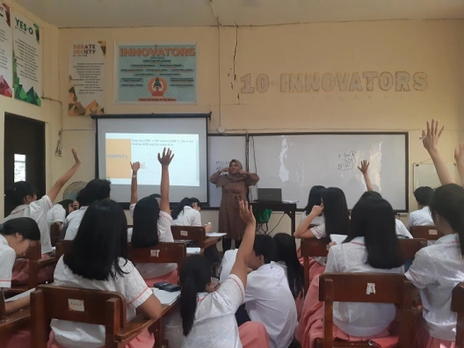
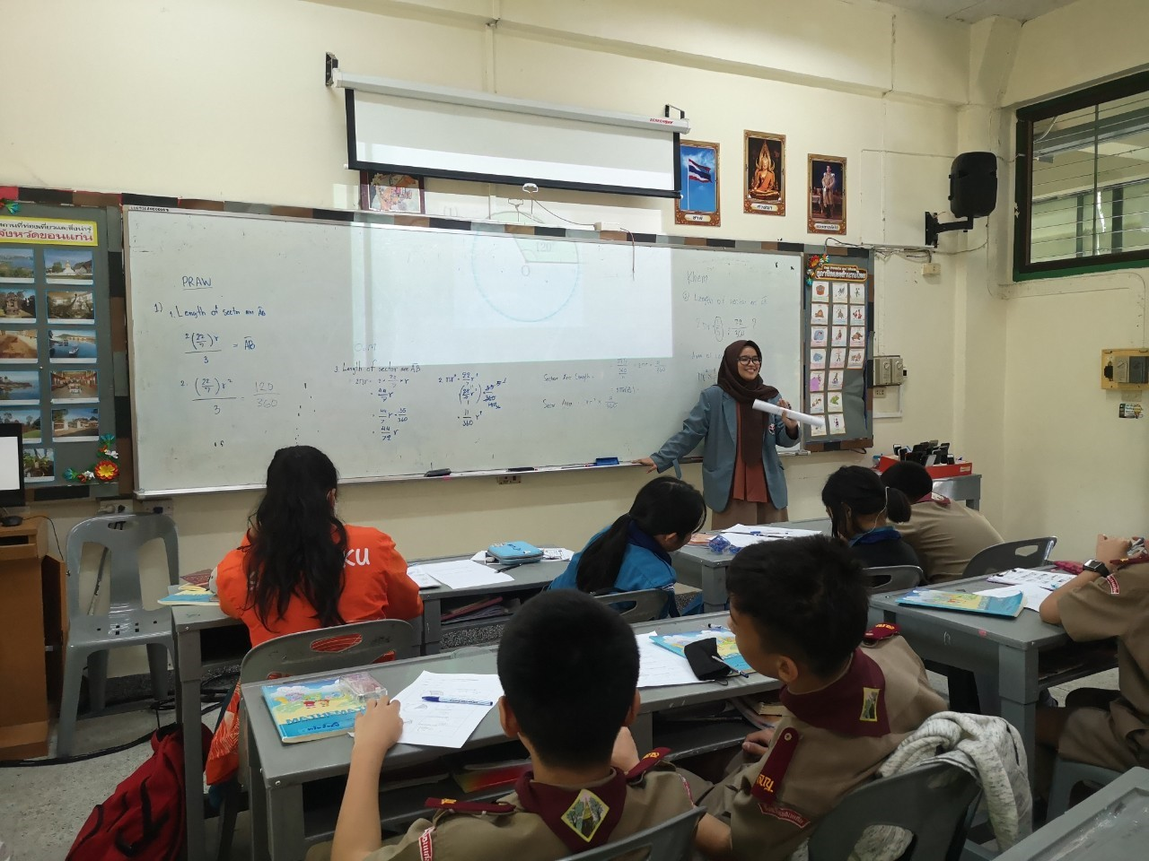
Advantages of International Teaching Practicum for the Pre-service Teachers
Learning different teaching skills and pedagogy, including lesson plans and raising various issues
Learning different school situations and implementing digital learning in various ways
Improving their English language proficiency
Getting engaged with students from different cultural backgrounds

Slide 9
ขอบคุณ
감사합니다
Thank you
Terima Kasih

