Slide 1
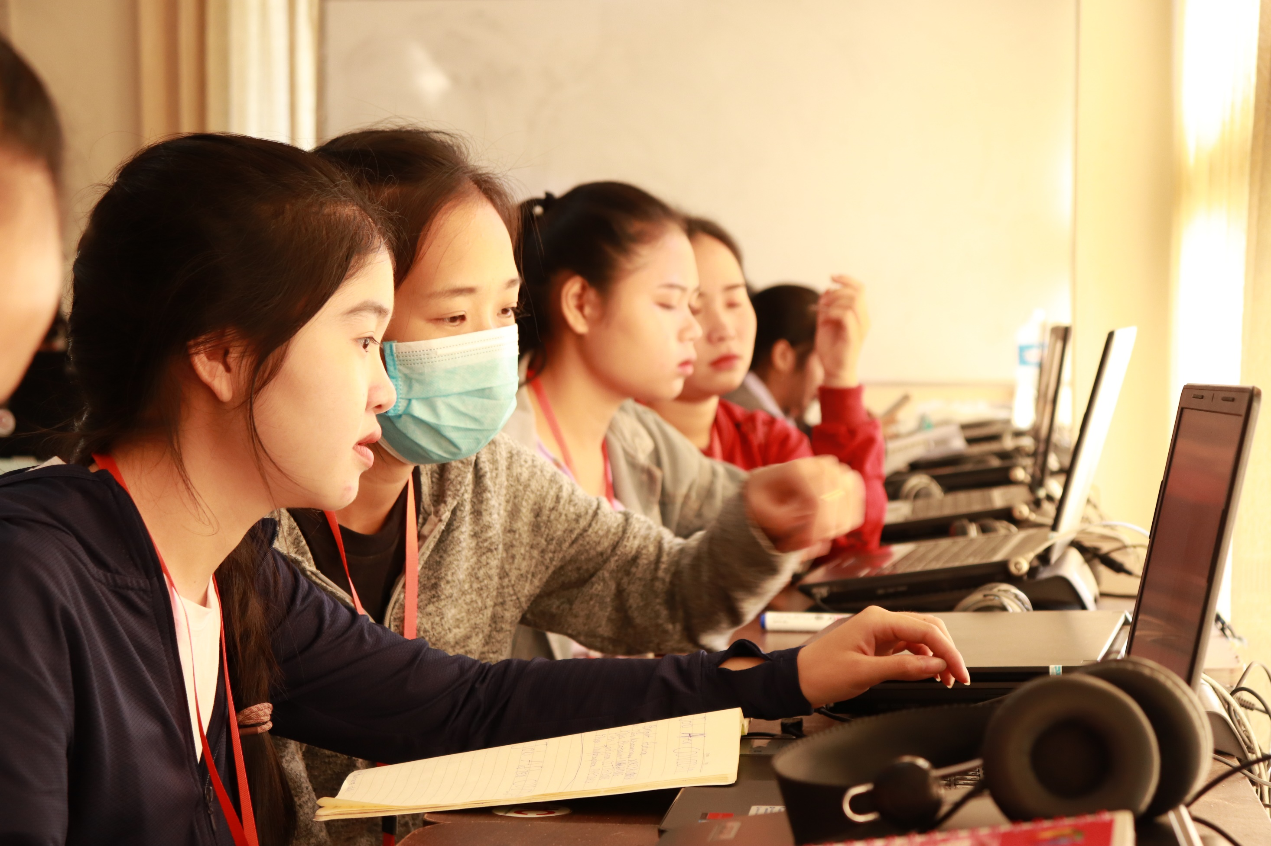

THE STUDENT’S ATTITUDE TOWARD ONLINE LEARNING
Case study: Student at Faculty of Education, Souphanouvong University
Lao PDR; Academic year 2022-2023
By: Saiphone KHOTSAIGNO

Slide 2

Content
Contents
1. Background
2. Objective and Hypothesis
3. Literature review
4. Methodology
5. Outcome
6. Discussion
7. Conclusion

Slide 3
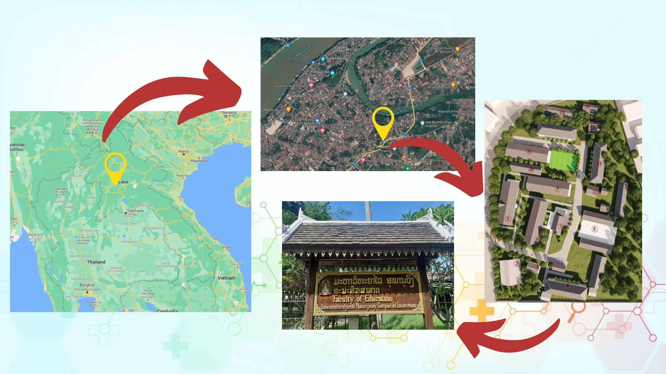
1. Background

Slide 4
1. Background
The Faculty of Education is one of the three original faculties of Souphanouvong University which it established under the Act No, 169/PM of the Prime Minister on 4 November 2003.
The Faculty of Education provided the teacher education aims to produce technicians with all the requirements of a teacher professionally such as the Code of Ethics, Morals, Diligence of Teaching Profession, producing the researcher and providing academic service to the community

Slide 5
1. Background
Vision
"to become a center of excellence for education professional and production for sustainable development in northern Laos"
Slogan
"Educating the student with quality instructors and local development"
1) Providing the degree of bachelor of education in programs
2) Teacher and educational entrepreneur development
3) Professional research and development
4) Academic service for the community
5) Faculty administration development
6) Conservation and support of local culture as a unique nationalist and globalist
7) Preparation for linking with regional and international institute

Slide 6
1. Background
Faculty and online learning
Pre pandemic
During pandemic
After pandemic
Government supporting
Policy
Decree
Capacity building
The faculty of education are also conducting a large scale of online instruction for student, Many lecturers used their individual resources to launching an online activities

Slide 7
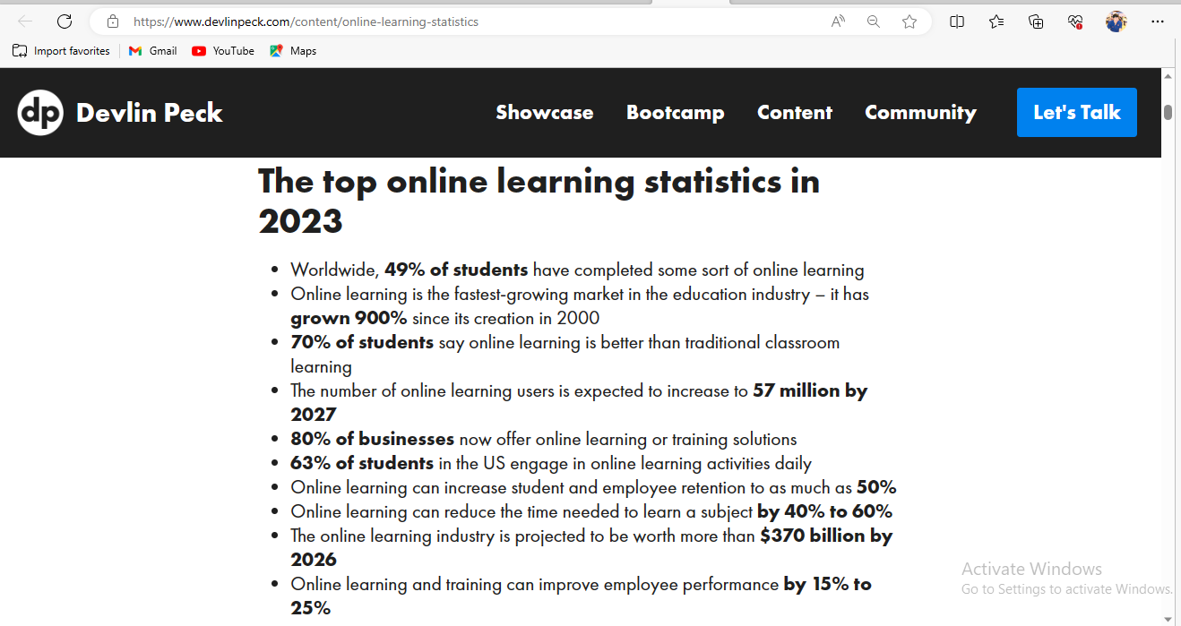
1. Background
Global trend

Slide 8
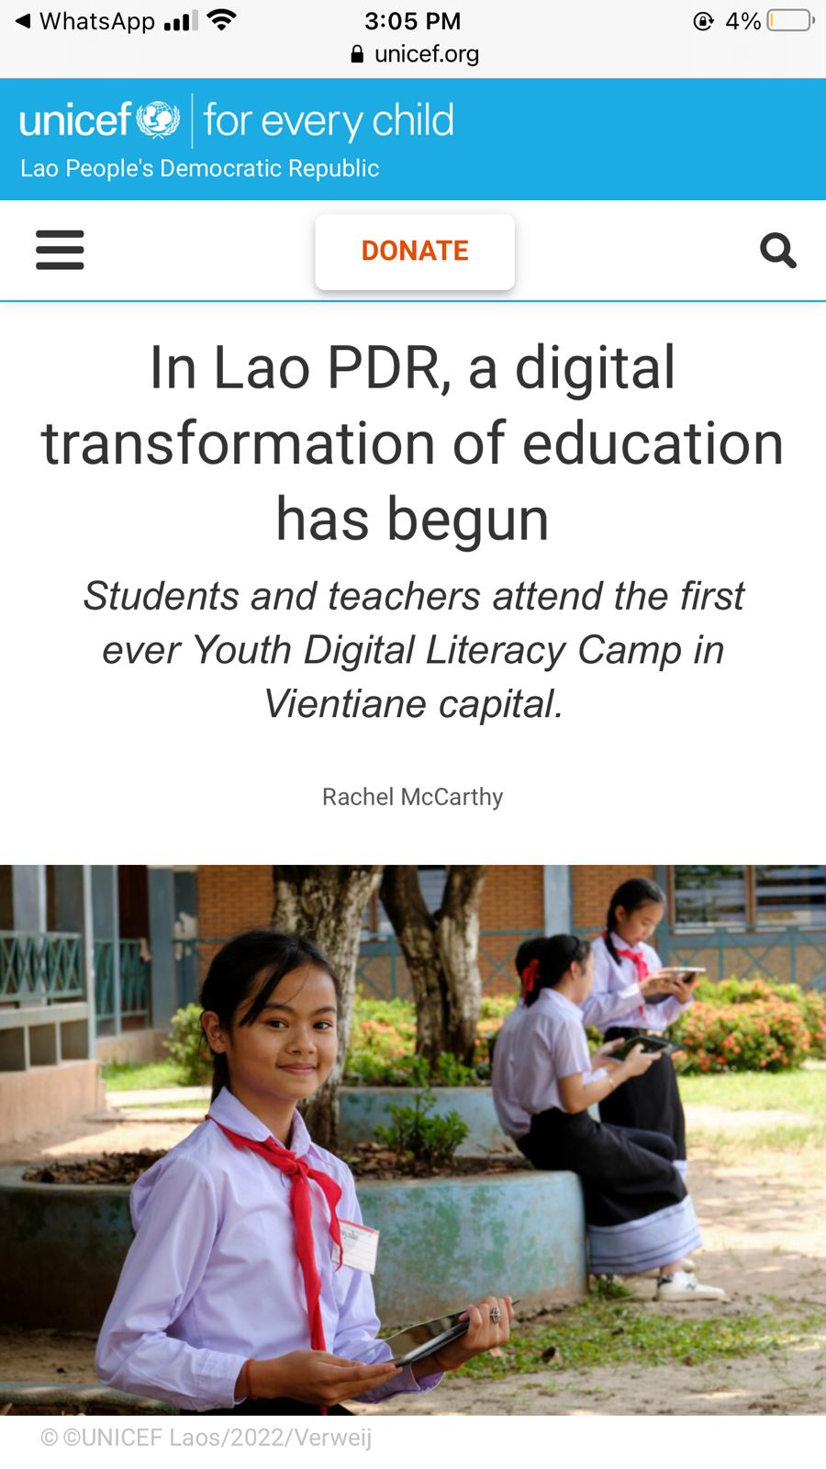
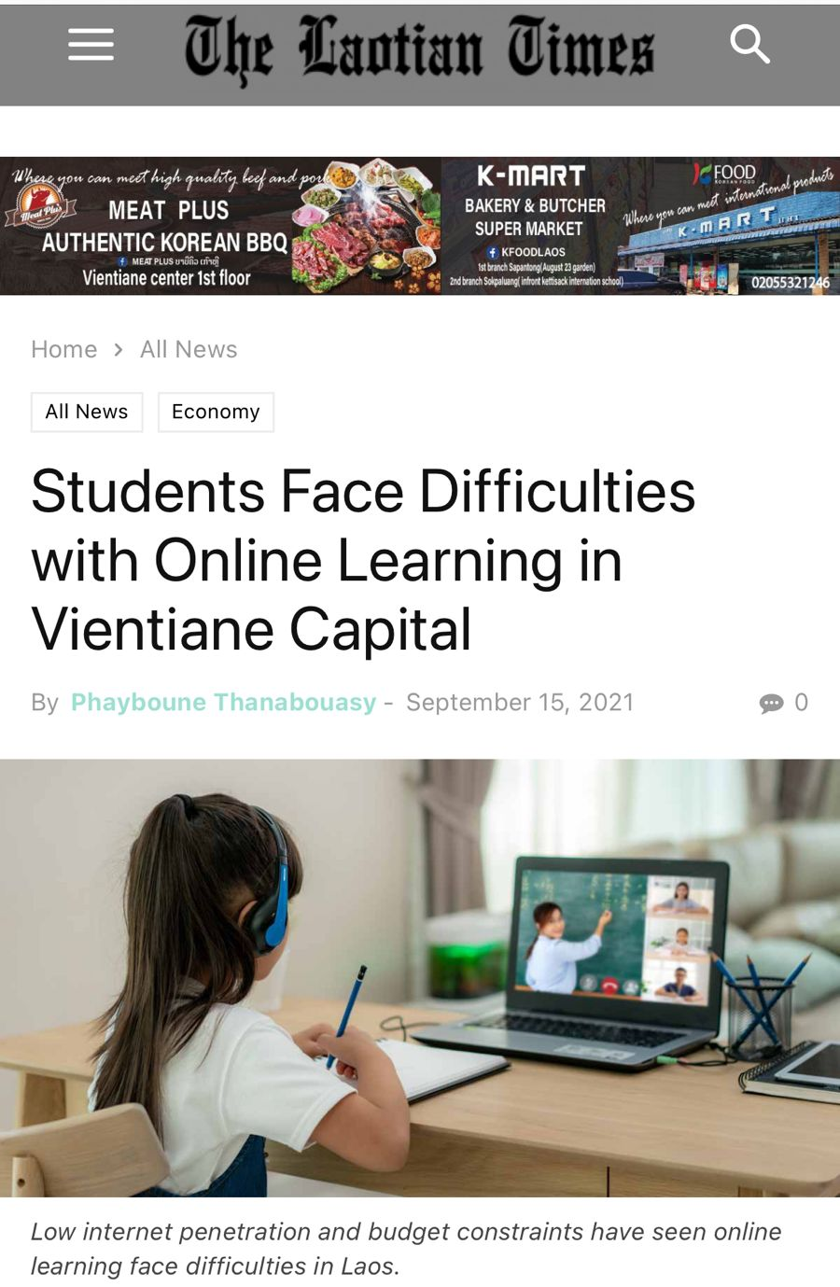
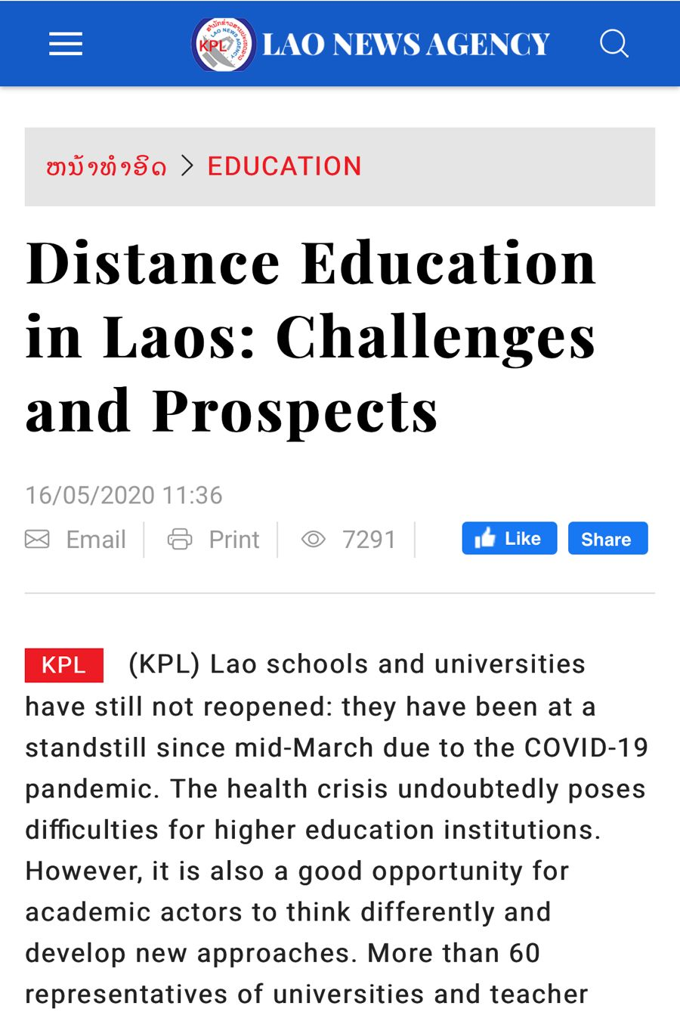
1. Background
Laos Context
In fact, there are hardly any computers or smart devices in primary or secondary schools and even less so in rural areas where some schools still lack access to electricity. No digital literacy classes are offered and as a result, very few girls and boys carry out any ICT activities.
(NESCO, 2021)
“While teachers were well prepared for the new academic year, many schools face difficulties with online learning systems due to an insufficient budget for supporting the infrastructure required,” said Deputy Director.
(Laotian times, 2021)
"Higher distance education is a new concept for Lao universities. The national television channels give priority to school education instead. Internet access is difficult, if not impossible, for students in remote areas, while in the big cities, the connection is very expensive,"
(Laos New Agency, 2020)

Slide 9
1. Background
Challenges
Hardware
Software
Methodology
Ethnic students and Technology
Poverty
Fundamental skill
Adaptation
FACT, almost 80 precents of student in the faculty comes from the rural and provincial and most of them are minority ethnic group with low income

Slide 10
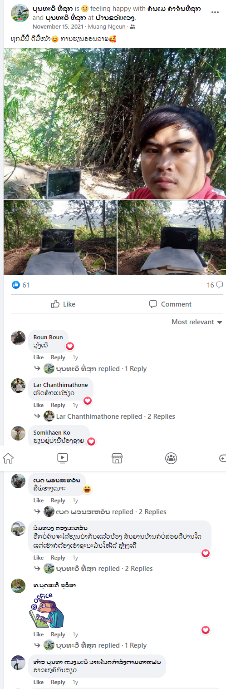
1. Background
Challenges

Slide 11
2. Objective and Hypothesis
Objectives
❶ To Study the student’s attitude toward online learning
❷ To investigate the student’s attitude with different residential
Hypothesis
❶ The overall attitude of ethnic student toward online learning could be in high average, representing agree level
❷ The student with different residential would represent different attitude about online learning

Slide 12
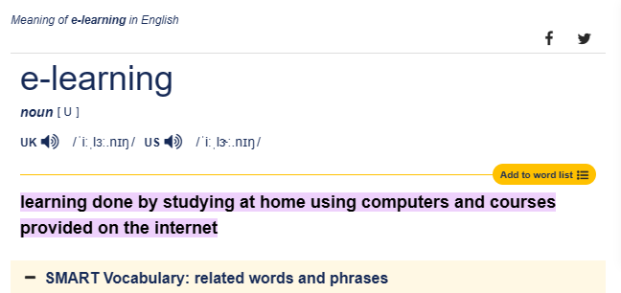
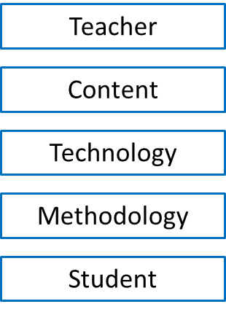
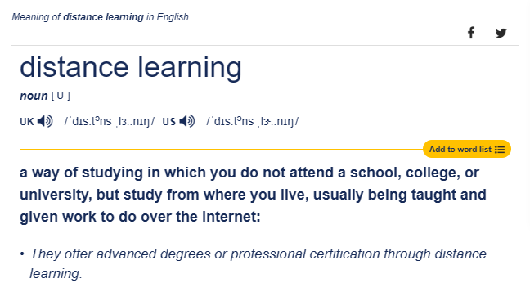
3. Literature review
Online Learning

Slide 13
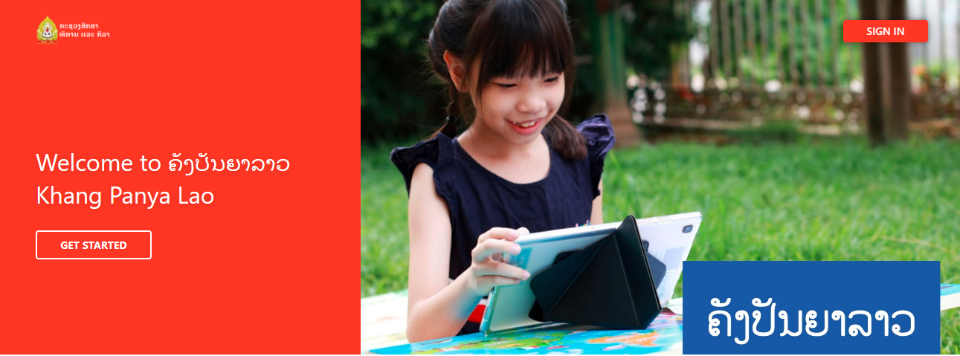
3. Literature review
Learning platform
Udemy Business
Skillshare
LinkedIn Learning
Coursera
edX
iSpring Market
Kajabi
Podia
iSpring Learn
SAP Litmos
LearnUpon
Blackboard Learn
Canvas
Moodle

Slide 14
3. Literature review
Attitude measurement
Definition
Attitude is a psychological, a mental and emotional entity that describes a person. It is complex and acquired through experience. It is an individual’s predisposed to think, feel, perceive and behave towards a cognitive object. It is personal disposition which impels an individual to react towards some objects or situation whether favorable, unfavorable or neutral (Kerlinger, 1964).
Likert scale
An assessment item using a Likert scale response format (i.e., a Likert-type question or Likert-type item) might include the following statement choices: strongly disagree, disagree, neither disagree nor agree, agree, and strongly agree. [Rensis Likert (1903–1981), U.S. psychologist]
Questionnaire
A Scale to Measure the Attitude of Students towards Online Learning
(V. Jyothi and B. Vijayabhinandana; 2021)
Indian Res. J. Ext. Edu. 21 (2&3), April & July, 2021 and Thurstone, L. L. and Chave, E. J. (1929).

Slide 15
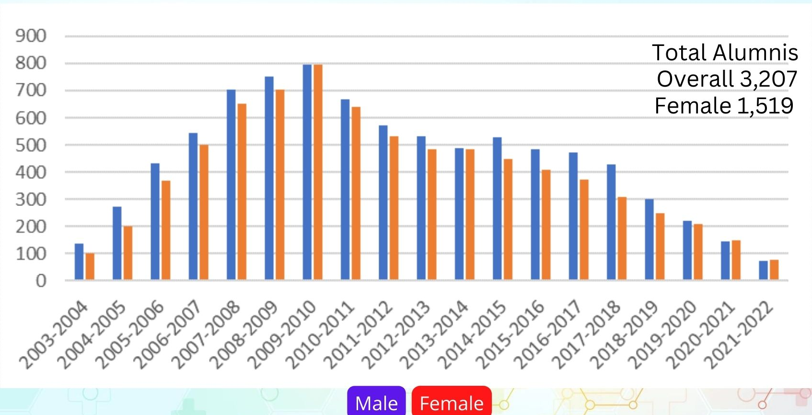
4. Methodology
Population and target sampling
The research conducted with 165 sampling students which has selected from the total of 283 students currently studying in the campus are the target sample
(Yamane, 1967)

Slide 16
4. Methodology
Instrument
The instrument of research was an attitude questionnaire with five rating scales [Rensis Likert (1903–1981), U.S. psychologist]. Prior to using the questionnaire, it was tested by the IOC = 1 and reliability of .964
The Attitude questionnaire composed of 2 part of question including:
Residential information
Online learning Experiences
Attitude about online learning

Slide 17
4. Methodology
Data collection
Distributing the questionnaire instead the group test for student
Data analyses
Using descriptive analyses for Residential information and learning experience
Analyzation of Mean and Standard Deviation to indicate the level of student’s attitude
Using t-Test: Two-Sample Assuming Equal Variances to compare mean with different residential

Slide 18
5. Outcome
Residential Information
35,8%
63.6%

Slide 19
5. Outcome
Learning Experience
4,42%
1,82%
12,73%
4,24%
20,21%
47,27%
93,3%
19,39%
93,94%

Slide 20
5. Outcome
Platform
7,27%
0,61%
2,42%
20,61%
69,09%

Slide 21
5. Outcome
Online Learning Attitude
Statement | Count | Sum | Average | Variance | Result
Online learning enhances the knowledge level | 159 | 544 | 3.421384 | 0.283337 | Neutral
Online learning is effective than conventional learning | 160 | 494 | 3.0875 | 1.413679 | Neutral
Opportunity of interaction with the teacher is enhanced | 161 | 362 | 2.248447 | 1.400388 | Disagree
Online learning increased attention towards lecture | 163 | 392 | 2.404908 | 0.946149 | Disagree
Sometimes I feel online learning lacks practical learning | 162 | 508 | 3.135802 | 1.223679 | Neutral
I find online learning saves time as I need not travel to class room | 162 | 522 | 3.222222 | 0.981366 | Neutral
Online learning helps in exploring more about the subject | 158 | 396 | 2.506329 | 1.449004 | Neutral
I am diverted in online learning | 159 | 423 | 2.660377 | 1.137091 | Neutral
I believe online learning helps in exploring more about the subject | 160 | 424 | 2.65 | 1.386164 | Neutral
I think flipped classroom approach would be better | 163 | 514 | 3.153374 | 0.99485 | Neutral
I feel I am disconnected with my class mates in online learning | 163 | 506 | 3.104294 | 1.131031 | Neutral
I find online learning includes increased workloads | 163 | 526 | 3.226994 | 1.225933 | Neutral
No much learning takes place in online classes | 155 | 435 | 2.806452 | 1.066192 | Neutral
I hardly concentrate in online classes | 161 | 473 | 2.937888 | 1.108618 | Neutral
I believe online learning enhanced the quality of teaching | 163 | 469 | 2.877301 | 1.108309 | Neutral
Sometimes I find lower retention rate for online learning | 160 | 446 | 2.7875 | 1.237579 | Neutral
Online learning provides flexible environment | 162 | 447 | 2.759259 | 0.916839 | Neutral
There is no substitute for online learning | 161 | 483 | 3 | 1.1625 | Neutral
I find the online learning made learning easy | 162 | 479 | 2.95679 | 1.258991 | Neutral
I feel online learning makes students less responsible and less accountable in class | 163 | 490 | 3.006135 | 0.845641 | Neutral
I find note taking is avoided in online learning | 163 | 537 | 3.294479 | 0.826327 | Neutral
I find in online learning it is difficult to manage study time at home | 163 | 438 | 2.687117 | 0.907672 | Neutral
Online learning made studying easy and comfortable | 163 | 446 | 2.736196 | 0.775657 | Neutral
My platform skills are reduced due to online learning | 163 | 469 | 2.877301 | 1.157691 | Neutral
I think online learning made me tech savvy | 163 | 457 | 2.803681 | 0.689616 | Neutral
Total | 165 | 825 | 2.89 | 1.07 | Neutral

Slide 22
5. Outcome
Online Learning Attitude
 | Rural | Urban
Mean | 2.793462 | 3.085451
Variance | 0.085073 | 0.099336
Observations | 25 | 25
Pooled Variance | 0.092205
Hypothesized Mean Difference | 0
df | 48
t Stat | -3.39974
P(T<=t) one-tail | 0.000683
t Critical one-tail | 1.677224
P(T<=t) two-tail | 0.001366
t Critical two-tail | 2.010635
Independent Variables | Dependent Variables | Average | Variance | df | t | P-value
Attitude | Rural | 2.793462 | 0.085073 | 48 | -3.39974 | 0.001366
 | Urban | 3.085451 | 0.099336

Slide 23
6. Discussion
Learning Experience
4,42%
1,82%
12,73%
4,24%
During the pandemic the faculty has conducting a large scale of online instruction for student
After the pandemic the online instruction are often conduct in subjects and lecturers
20,21%
47,27%
93,3%
19,39%
93,94%

Slide 24
6. Discussion
Learning Experience
"According to statistics, 70% of our students are unable to follow distant teaching. According to the statistics, 70% of our students are unable to follow distance learning courses," said Ms. Somchanh Bounphanmy - Vice-President of the National University of Laos. (Laos New Agency, 2020)
4,42%
1,82%
12,73%
4,24%
20,21%
47,27%
93,3%
19,39%
93,94%
93,94%

Slide 25
6. Discussion
Learning Experience
1,82%
12,73%
4,42%
limited online resources and inadequate infrastructure
Major of ethnic student are from low income family
Lack of resources to access a proper specificity device for online learning
4,24%
12,73%
20,21%
47,27%
93,3%
19,39%
20,21%
47,27%
93,94%
19,39%

Slide 26
6. Discussion
Online Learning Attitude
(Kammee VANG et al, 2020) found that English student at the faculty of education has satisfy on learning English via E-learning in moderate level;
(Somsack SANTISOUK et al, 2020); the level of online engagement of the student in the city or urban area is in high level
(Ladavanh SAMOUNTY, 2020) the student in the town are also satisfy with the high speed of network
(Xuerong Liu, 2022) negative attitudes could predict poor learning performance
(Ryan Michael Oducado, 2022) Graduate students are positive about online learning and are in favor of adapting to a different modality of instructional delivery

Slide 27
7. Conclusion
The student’s attitude toward online learning in the faculty of education, Souphanovong University was in Neutral level representing most student are still not acknowledgement with this method of learning as much as they should do
❷ The student from different resident Urban and Rural has different attitude about online learning with statistical significant .05

Slide 28
8. Reference
Kammee VANG et al. (2020). Using E-learning in English instruction at facuty of educatio, Souphanouvong University Laos. Souphanouvong Journal: Multi-disciplinary Research of Souphanouvong University, 6(1), 119-129.
Ladavanh SAMOUNTY. (2020). Student's Behavoir and Satastify on internet service in DongDok Campus, National University of Laos. Vientiane: National University of Laos.
Somsack SANTISOUK et al. (2020). student's behavoirs on social media using in Vientiane capital City . Humanities & Social Sciences, 37(2 May - August 2020), 120-142.
Ryan Michael Oducado. (2022). Graduate students are positive about online learning and are in favor of adapting to a different modality of instructional delivery.
Xuerong Liu. (2022). Attitude and Performance for Online Learning during COVID-19 Pandemic: A Meta-Analytic Evidence. International Journal of Environmental Research and Public Health.
Srinivas, A., Rani, S. V., Archana, P and Manasa, G. (2014). A scale to measure attitude of farmers towards biofertilizers. Indian J.of Social Res., 55(5):965-976.
Thurstone, L. L. and Chave, E. J. (1929). The measurement of attitude. Chicago University Press, USA. pp 39-40
Likert, R. A. (1932). A technique for the measurement of attitude. Arc. Psycho.

