Slide 1

CLIMATE CHANGE THROUGH STEM EDUCATION: A CASE STUDY OF TEACHING FLOODWATER TOPICS FOR STUDENTS IN THE NORTHERN MOUNTAINOUS AREAS OF VIETNAM
Assoc.Prof. Pham Kim Chung - University of Education, VNU, Vietnam
July, 2003, Thailand

Slide 2
Introduction
Adapting to climate change is one of the most problems facing humanity.
Education on climate change adaptation and disaster prevention is necessary for students.
Teaching STEM offers many opportunities for students to learn about climate change and adapt to it.
Northern Vietnam has high mountainous terrain. Climate change causes mountain floodwater and creates many disasters for people.
STEM teaching for students in mountainous areas for the ability to adapt and avoid danger caused by flash floodwater.

Slide 3
STEM in climate change education
The global climate continues to change rapidly, global average temperature has warmed approximately 1°C since the 1880s
Understanding our current and future climate are questions that are too large and too complex.
Human influences on climate change.
The consequences of climate change have seriously affected human life and ecosystems.
Research and advances in Science, Technology, Engineering, and Math (STEM) are able to offer methods and tools to developt solutions that mitigate and adapt to these global catastrophes.
STEM education can be structured to give teacher suport to stuent understanding climate change as a global and transform their classrooms and curricula into oriented STEM learning adaption to climate change

Slide 4
Climate change in mountainous of Vietnam
Vietnam is a country heavily affected by climate change, causes extreme weather events that increase in frequency and are often difficult to predict.
Flash floodwater often occur in mountainous river and stream basins with strongly dissected terrain, steep slopes, loss of vegetation cover, and the surface is easily eroded when heavy rains fall. Usually occurs in the northern mountains. Greatly affect the lives of the people.

Slide 5
Teaching STEM “Causes and impacts of floodwater” in high school for students in the northern mountains Vietnam Objective
Explain the cause of flood water flow.
Identify the energy of flood water
Describe the structure and bonding of water molecules.
Determine the flow velocity, the ability to work, the ability to destroy the flood water.
Explain the concepts of kinetic energy, potential energy, mechanical energy and the ability to do work of an object.
Identify the types of flood water, the degree of destruction of each type.
State the extent of damage and consequences of places where flood water flows through.
Proposing solutions to prevent natural disasters, storms, extreme weather patterns that can form floodwaters.

Slide 6
Teaching STEM “Causes and impacts of floodwater” in high school for students in the northern mountains Vietnam Knowledge related to the topic
Physics | Chemistry | Biology | Geography | Math
+ Mass + Motion + Velocity + Work + Gravity + Kinetic energy | + PH + Acidic environment, alkaline environment, neutral + Redox reaction; + Metal corrosion; | + Structure of the water molecule + Bonding of water molecules + Polarity | + Terrain in the mountains + Plants + The law of unity and completeness of the geographical crust + Types of terrain | + Equations, functions + Calculations +Vectors

Slide 7
STEM theme design
Causes and impacts of floodwater
Floodwater
Forms
Causes
Impacts
Nature
People
Flood come
Solution
flood recedes
Destroy
casualty
Disease
Polluted
Physics
Geography
Math
Biology
Chemistry
Chemistry
Biology

Slide 8
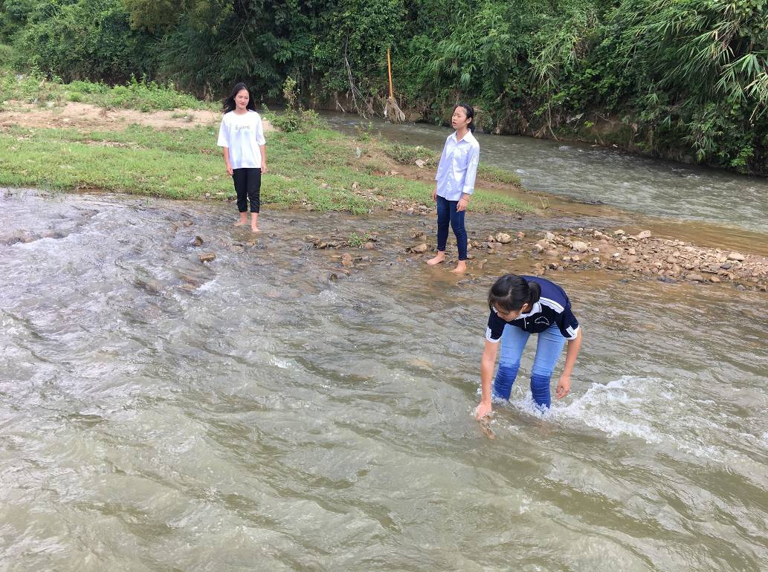
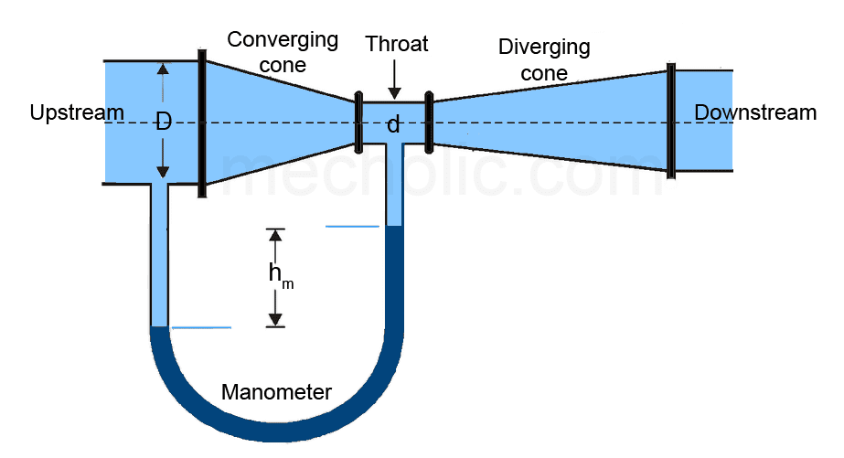
Learning activities
Measure the speed of water movement

Slide 9
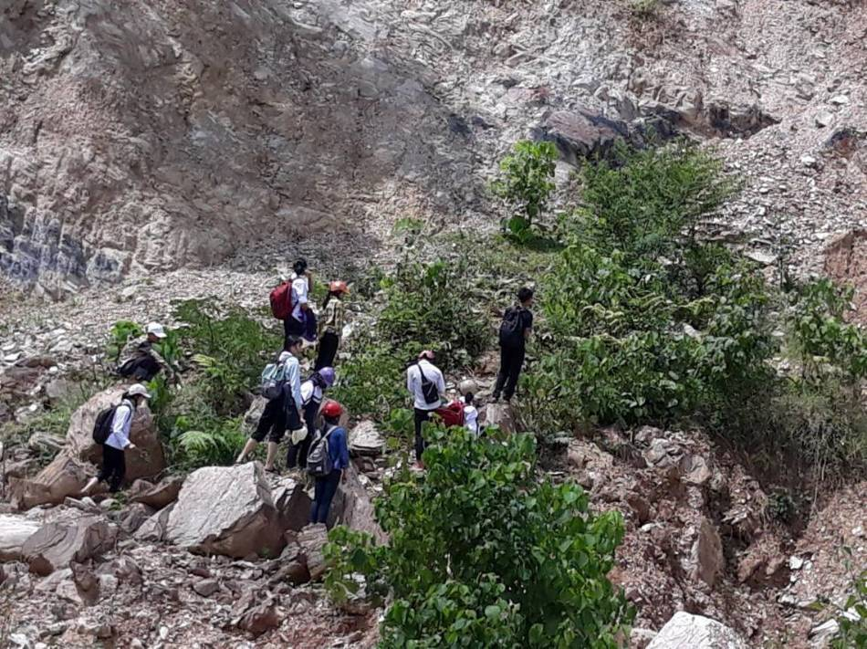
Learning activities
Analysis topographical features, advantages and disadvantages when floods occur in mountainous areas

Slide 10
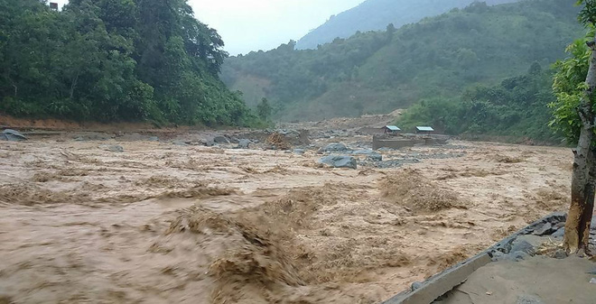
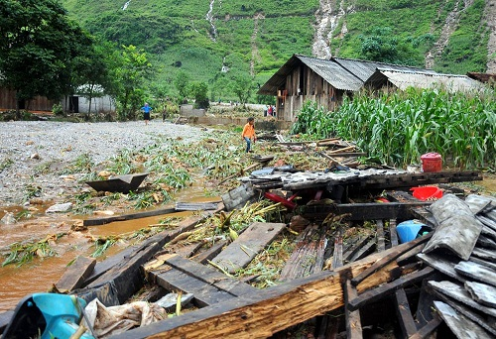
Learning activities
Analysis of causes and effects of floods in mountainous areas

Slide 11
Learning activities
Treating the environment after the flood recedes

Slide 12
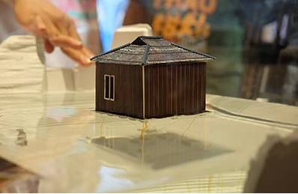
Learning activities
Flood proof house design

Slide 13
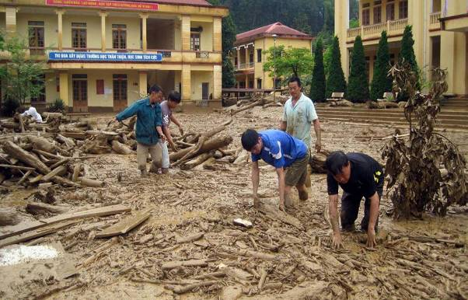
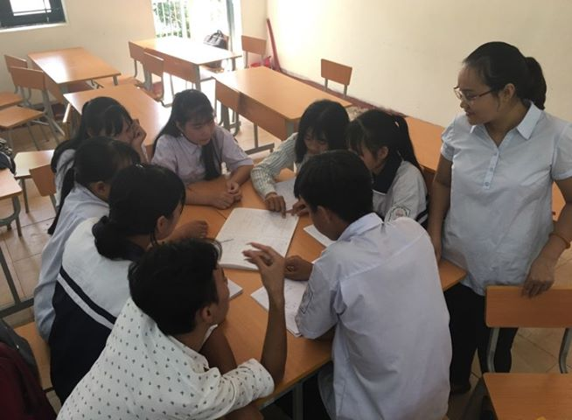
Learning activities
Find solutions to handle environmental pollution and diseases after floods

Slide 14
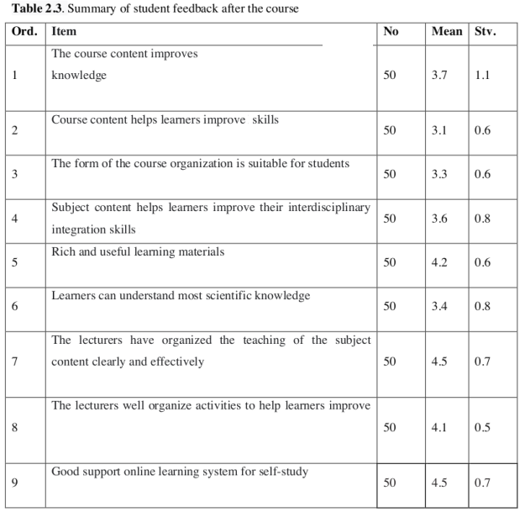
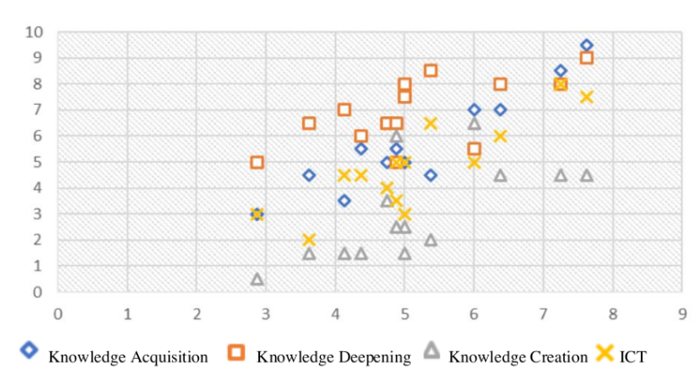
Results and discussion

Slide 15
CONCLUSION
According to this orientation, STEM has created opportunities for learners to achieve results in related STEM subjects such as Mathematics, Science, Electronics, Mechanics, Geography.
All these important academic skills impact students learning such as critical thinking, collaboration, problem-solving.
STEM teaching for students in mountainous areas for the ability to adapt and avoid danger caused by flash floodwater.

Slide 16
Thank you for your listening !

