Slide 1
Enhancing pre-service teachers’ pedagogical professional skills: the case of Natural Science Education at VNU University of Education
The 7th UNESCO UNITWIN International Conference on Quality Teacher Education 2023
A New Horizon Towards Digital Transformation in Teacher Education
Do Thuy Linh,
VNU University of Education

Slide 2
Contents of Presentation
01
02
03
04
Pedagogical Professional Skills
Context of Natural Science Education in Vietnam
Influencing factors on Pedagogical Professional Skills
The current status of Pedagogical Professional Skills of Preservice Students

Slide 3
01
Context of Natural Science Education in Vietnam

Slide 4
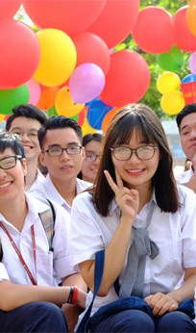
The 2018 General Education Curriculum
On December 26th,2018, the Ministry of Education and Training unveiled the New General Education Curriculum which aims to reduce pressure on students and allow them to choose subjects they enjoy.
Image source: https://en.qdnd.vn/social-affairs/news/wb-highlights-vietnamese-students-academic-records-490909

Slide 5
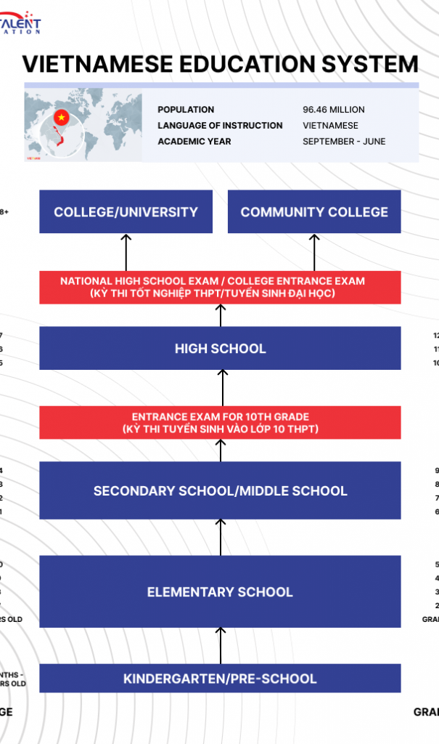
Compulsory subjects: literature, math, a foreign language, civic education, natural science, history and geography, technology, physical education, arts and computer science.
Two new subjects: natural science, history and geography
Vocation-Oriented Education
Basic Education

Slide 6


Natural Science Education – VNU UEd

Slide 7
Natural Science Education – VNU UEd
Duration: 4 years
Objectives:
Analysis, systematization, and application of integrated knowledge from natural sciences, practical skills, internships, foreign languages, and computer science into practical teaching as well as applying them to research work, constructing educational projects, and studying issues related to natural sciences.
Developing active teaching methods, constructing effective assessment and evaluation processes for students' learning, considering and selecting appropriate teaching methods and technologies for practical teaching.
Developing skills to analyze knowledge about the school environment, students' psychological characteristics, social activities, and creative experiential activities to propose appropriate measures and organize educational activities that align with the conditions of the school.
Ability to analyze educational programs and processes, determine the development direction of educational programs, and apply them to the construction and development of the school's and local educational programs as well as curriculum design.

Slide 8
Research questions?
Students majoring Natural Sciences Education at the VNU UEd assess their own academic skills at what level to meet the requirements of the General Education Program 2018?
What factors influence pedagogical professional skills for students majoring in Natural Sciences Education at the VNU UEd?
What proposed solutions can be implemented to enhance students’ pedagogical professional skills for the Natural Sciences Education major at the VNU UEd?

Slide 9
02
Pedagogical Professional Skills

Slide 10
Pedagogical Professional Skills
The ability to integrate psychological qualities and professional expertise of teachers in specific pedagogical situations in order to effectively achieve teaching and educational objectives.
Du et. al, 2021
http://vjes.vnies.edu.vn/sites/default/files/baiso10_so43.pdf

Slide 11
Pedagogical professional skills
Knowledge competence
Competence of using teaching methodology
Management ability
Awareness of discipline, professional etiquette
Other skills: pronunciation, voice, writing, spelling, etc.
Professional passion, learning motivation.
Tran et. al, 2020
https://tapchigiaoduc.moet.gov.vn/vi/magazine/491-ki-i-thang-12/11-thuc-trang-va-giai-phap-nang-cao-chat-luong-hoat-dong-dao-tao-nghiep-vu-su-pham-cho-sinh-vien-su-pham-truong-dai-hoc-an-giang-7705.html

Slide 12
Pedagogical professional skills
The skill of writing on the board;
Presenting lectures, delivering speeches, designing instructional content;
Handling pedagogical problems, communication in pedagogy
Using teaching tools, equipment;
Pedagogical skills in organizing extracurricular activities.
Nguyen et. al, 2015
https://journal.hcmue.edu.vn/index.php/hcmuejos/article/view/476

Slide 13
Pedagogical professional skills
Skill of lesson design;
Skill of organizing teaching activities in the classroom;
Skill of educating students;
Skill of scientific research practice.
Do et. al, 2004
https://repository.vnu.edu.vn/handle/VNU_123/21564

Slide 14
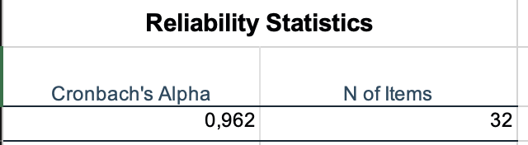
Pedagogical professional skills
(32 skills)
Tools | Survey – Google Forms
Number of samples | 107 samples
Gender ratio | 80,4% female – 19,6% male
Teaching skills
Education skills
Skills of applying pedagogical knowledge to reality
Skills of acquiring knowledge and auxiliary skills
Moral qualities

Slide 15
Pedagogical professional skills
In our research, the pedagogical professional skills contain:
Teaching skills | Using teaching methods and tools/equipment suitable to the content of knowledge to be taught
 | Building learner competency assessment portfolios
 | Anticipate the level and actions of students taking place in your lesson
 | Anticipate possible situations in the lesson
 | Analyze course content and curriculum
 | Methods of imparting knowledge
 | Skill of writing on the board

Slide 16
Pedagogical professional skills
In our research, the pedagogical professional skills contain:
Education skills | Design and organize educational activities
 | Counseling and supporting students to build personal profiles
 | Using pedagogical measures to educate students
 | Partnering with parents and peers in student education
 | Take charge of your own behavior in relation to students, parents, and colleagues
 | “Treat” pedagogically and skillfully with students' parents and colleagues

Slide 17
Pedagogical professional skills
In our research, the pedagogical professional skills contain:
Skills of applying pedagogical knowledge to reality | Apply teaching methods and tools/equipment suitable to the content of knowledge to be taught
 | Applying knowledge and skills in teaching and educating activities, testing and assessing students' abilities and qualities
 | Handling pedagogical situations
 | Skill of Using information technology
 | Update new knowledge in the field of teaching

Slide 18
Pedagogical professional skills
In our research, the pedagogical professional skills contain:
Skills of acquiring knowledge and auxiliary skills | Ability to self-study, explore, discover knowledge
 | Thinking and problem-solving abilities
 | Ability to apply knowledge in practice
 | Creativity
 | Personal skills (time management, adapting skills, lifelong learning)
 | Teamwork (collaboration)
 | Management skills and leadership
 | Communication skills
 | Language skills
 | Establish community relationships
 | IT applications

Slide 19
Pedagogical professional skills
In our research, the pedagogical professional skills contain:
Moral qualities | Personal moral qualities
 | Professional ethical qualities
 | Social moral qualities

Slide 20
03
The current status of Pedagogical Professional Skills of Preservice Students

Slide 21
The current status
Skills achieved at good to very good level
Skills achieved at Not good to No very good level
All skills related to moral qualities of students account for over 90%..
Skill of apply IT in education (84,11%).
Update new knowledge in the field of teaching (83,18%).
Analyze course content, curriculum (80,73%).
Foreign language proficiency skills (43.93%).
Building learner competency assessment portfolios (59.81%).
Anticipate the level and actions of students taking place in your lesson. (65,42%).
Skills of writing on the board
Personal skills (time management, adapting skills, lifelong learning) (63.55%).
Notes:
Good to very good:
Skills related to the moral character of KHTN students account for over 90%, which can be easily understood because the University of Education always emphasizes ethics and character. The admission criteria for teacher training programs at the university require students to achieve a "Good" conduct rating throughout three years of high school [8].
Information and Communication Technology (ICT) skills (84.11%). The majority of KHTN students are confident in their ability to use ICT. Starting from their first year, students at the University of Education are taught and study subjects related to ICT [9]. In addition, ICT is applied in teaching through lesson planning, resource searching, lesson delivery, multimedia support, assessment of learning outcomes, sharing teaching resources and content, and student learning applications.
Updating knowledge in the field of teaching (83.18%).
Analyzing content and curriculum of subjects (80.37%). The KHTN field is an integrated subject that incorporates knowledge from various fields and is organized into four content strands: Matter and its transformations, Living organisms, Energy and its transformations, Earth and the universe [10]. As a relatively new specialization, it is constantly updated and evolving, allowing KHTN students to access and update knowledge related to teaching in their field.
Not very good to not good:
The language skills of pedagogical students are generally weak, mostly due to students' self-study abilities and partly due to the university's requirement for English language certificates as part of the graduation approval process [11]. As a result, students typically start self-studying and taking certification exams in their fourth year.
Skills such as board writing, time allocation, anticipating situations, and predicting students' level and actions require frequent and regular practice. Pedagogical students need an environment and situations to develop these skills. The practice provided through courses in the training program is not sufficient for students to become proficient in practical skills, mainly due to large student numbers and limited practice time.

Slide 22
04
Influencing factors on Pedagogical Professional Skills

Slide 23
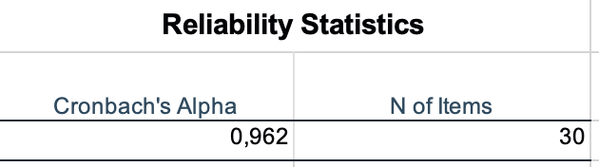
Influence factors on training Pedagogical professional skills
Tools | Survey – Google Forms
Number of samples | 107 samples
Gender ratio | 80,4% female – 19,6% male
Training curriculum
Professional training
Intrinsic factors
Training activities in university
Attitudes toward profession
University professors
School and social support

Slide 24
Influence factors on training Pedagogical professional skills
Training curriculum | Knowledge of natural sciences: Calculus, Thermomechanical, Electro-optical; Teaching the theme of earth and sky; Teaching the topic of living things; Vertebrates, Energy and Transformation…
 | Pedagogical knowledge: ICT application in education; Methods of scientific research; Teaching theory; Educational program development

Slide 25
Influence factors on training Pedagogical professional skills
Professional training | Training in high school
 | Practice through regular pedagogical modules
 | Training at the University of Education

Slide 26
Influence factors on training Pedagogical professional skills
Intrinsic factors | Methods of self-training of students
 | Motivation for students’ professional practice
 | Self-efficacy of each student

Slide 27
Influence factors on training Pedagogical professional skills
Training activities in university | Participate in pedagogical professional competitions
 | Participate in Club activities in university
 | Participate in scientific research
 | Attend pedagogical conferences, seminars
 | Participate in volunteering and social activities

Slide 28
Influence factors on training Pedagogical professional skills
Attitudes toward profession | Interest in pedagogy
 | Realizing the importance of pedagogical competence
 | Understanding the pedagogical competence
 | Understanding the goal of pedagogical competence
 | Take measures to form appropriate pedagogical capacity

Slide 29
Influence factors on training Pedagogical professional skills
University professors | Interest in Attention to the ability to form pedagogical skills for students
 | Practicum instructors have not placed high demands on students
 | Lecturers give measures to form pedagogical capacity for students

Slide 30
Influence factors on training Pedagogical professional skills
School and social support | Teaching facilities and equipment
 | Policy to support tuition fees, living expenses
 | Regularly organize activities to develop pedagogical capacity
 | Clearly define the system of pedagogical skills that need to be developed for students
 | The synchronous management of the departments in the process of organizing activities to develop pedagogical capacity for students
 | Organizing the examination and evaluation of the development of pedagogical capacity
 | The close cooperation between the University of Education and the secondary and high schools in the process of developing pedagogical capacity

Slide 31
Influence factors on training Pedagogical professional skills
Teachers in secondary and high schools | The connection between students and teachers at high school
 | Requirements of teachers and schools on testing and assessing pedagogical competence for preservice students

Slide 32
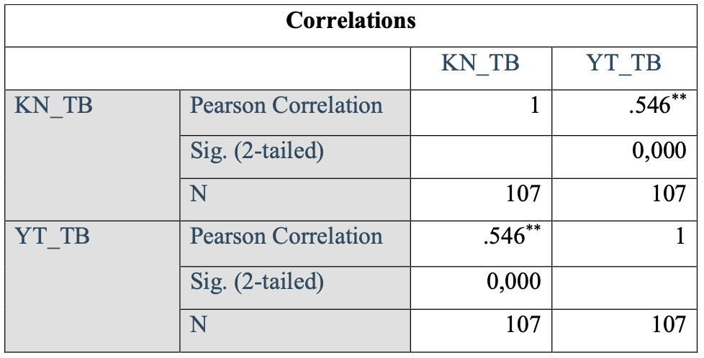
The relation between pedagogical professional skills and the influence factors
Notes:
The research team directly analyzed the correlation coefficients between professional skills and influence factors. The results showed a positive correlation with a strong intensity (Correlation coefficient Sig < 0.05 => Statistically significant, all Pearson correlation coefficients are positive => the two variables - professional skills and factors influencing professional skills - are positively correlated). Based on the data, it is observed that the factors influencing pedagogical professional skills also have a positive impact on the basic professional skills . Therefore, measures can be taken to enhance professional skills for students.

Slide 33
Recommendations
Strengthening the work of educating students' consciousness, awareness, and career orientation
Enhancing professionalism in pedagogical practicum periods and teaching internships at secondary schools
Increasing the application of information technology and language use in training
Combining theoretical training with regular practice
Engaging in teaching practice (students practice lesson planning, video recording, assessment, etc.)
Close coordination between departments, the university, and secondary schools
Regularly planning and conducting periodic assessments to evaluate the pedagogical skills of students.

Slide 34
Thank you for you listening!
Do you have any questions?
dothuylinh@vnu.edu.vn
+84-96-256-0709
https://education.vnu.edu.vn/

