Slide 1

Teaching and Learning Model for Preservice Teachers: Teacher Competency for Digital Age
Nam-Hwa Kang
Director, Innovation Institute for Future Education

Slide 2
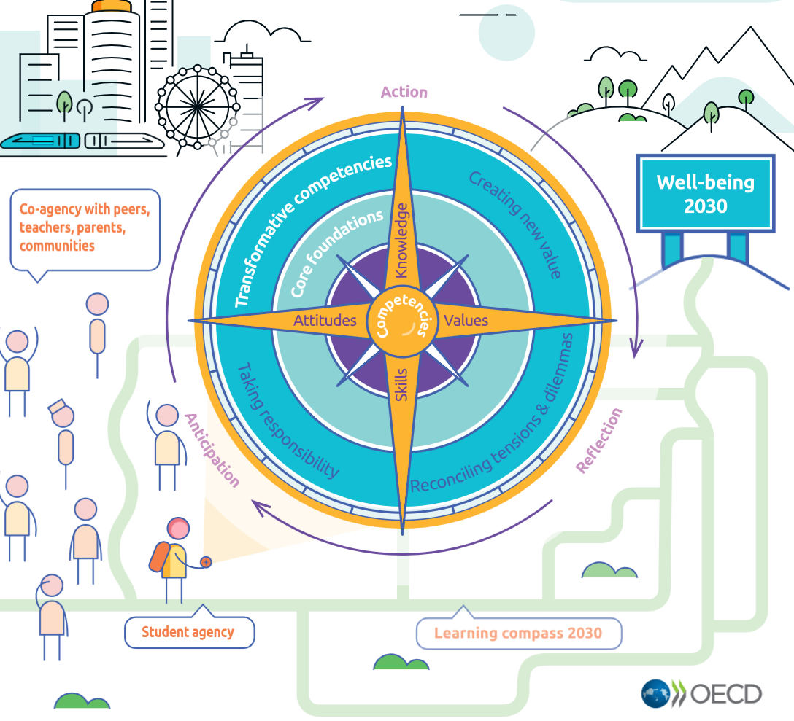
Changing goal of Education
OECD Future of Education and skills 2030
Learning Compass 2030
https://www.oecd.org/education/2030-project/teaching-and-learning/learning/core-foundations/

Slide 3
Digital Competency and Teacher Education
Teachers need to update their competence profiles for 21st century challenges.
Teaching strategies need to change and so do the competences teachers need to develop for 21st‐century learners.

Slide 4
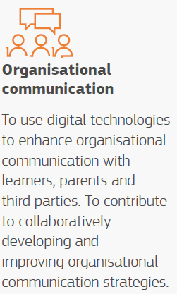
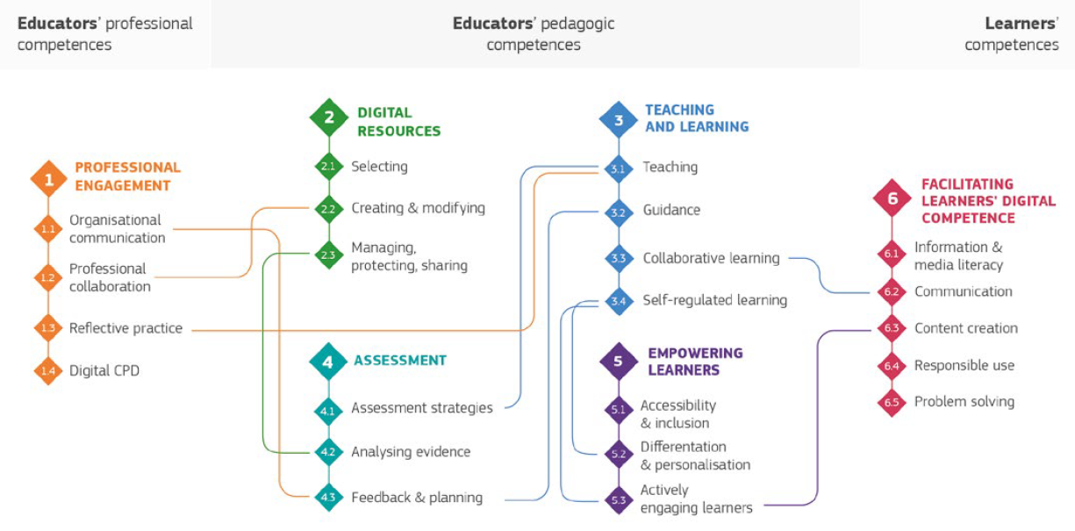
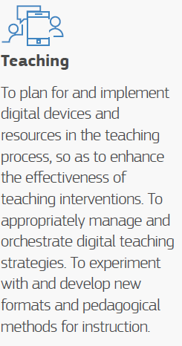
The European Framework for the Digital Competence of Educators (DigCompEdu) (2017)
https://joint-research-centre.ec.europa.eu/digcompedu_en
22 digital competences in 6 areas

Slide 5
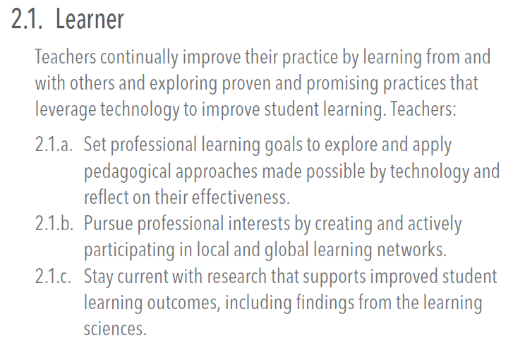
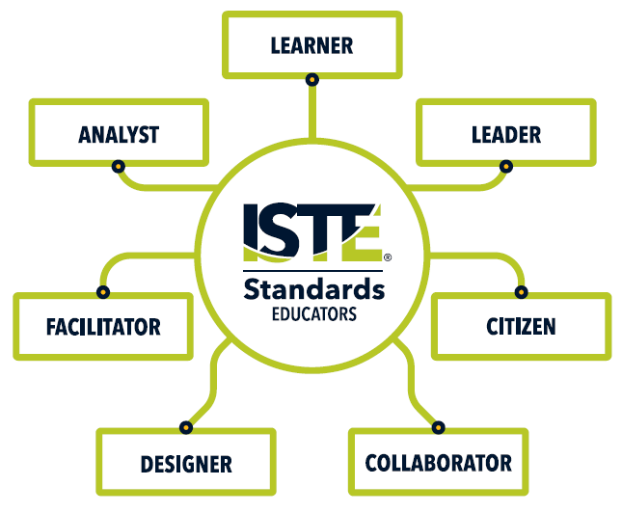
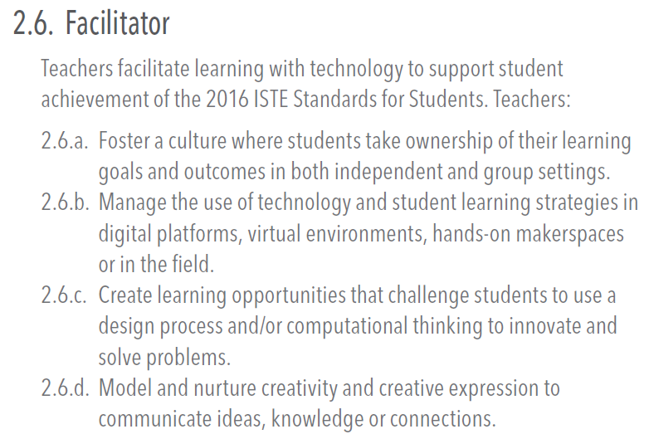
Standards for Educators by International Society for Technology in Education (ISTE) (2017)
24 sub-standards under 7 roles of teachers/educators

Slide 6
SMART Education in South Korea (Heo et al., 2013)
SMART Education: An intelligent customized teaching-learning support system, i.e., new educational methods, curriculum, assessment, and teachers required in a knowledge-based society. This system integrates human-centered collaborative learning and adaptive learning within the context of an information and communication technology (ICT) environment.
Teacher competency for SMART education
Understanding future education, content knowledge, rapport with learners, assessment and reflection, etc.
  4. Operate classes using advanced technology and infrastructure (e.g., smart devices, electronic blackboards, cloud environments, etc.) appropriately.
  5. To implement smart education, apply a learner-centered teaching-learning model and develop materials.
  6. Understand the characteristics of digital teaching materials and materials (e.g. e-textbooks, digital textbooks, video materials, etc.), produce and utilize them.

Slide 7
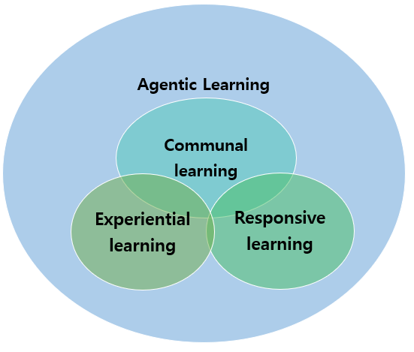
Teaching and Learning Model for Preservice Teachers: Competency for Digital Age
How to achieve competency for digital age?
CERA Model
Learning theories:
Role of agency in learning
Learning community
Learning by doing (experiential learning)
Responsive pedagogy and learning

Slide 8
Design Experiment
9 courses from elementary and secondary teacher education programs will apply CERA model in Fall 2023
3 year project: Improve and elaborate the model over 3 years
Measure of effect
  Digital-based teaching competency
  Teacher competency for the future

Slide 9
Changing goal of Education
OECD Future of Education and skills 2030
Learning Compass 2030
https://www.oecd.org/education/2030-project/teaching-and-learning/learning/core-foundations/

Slide 10
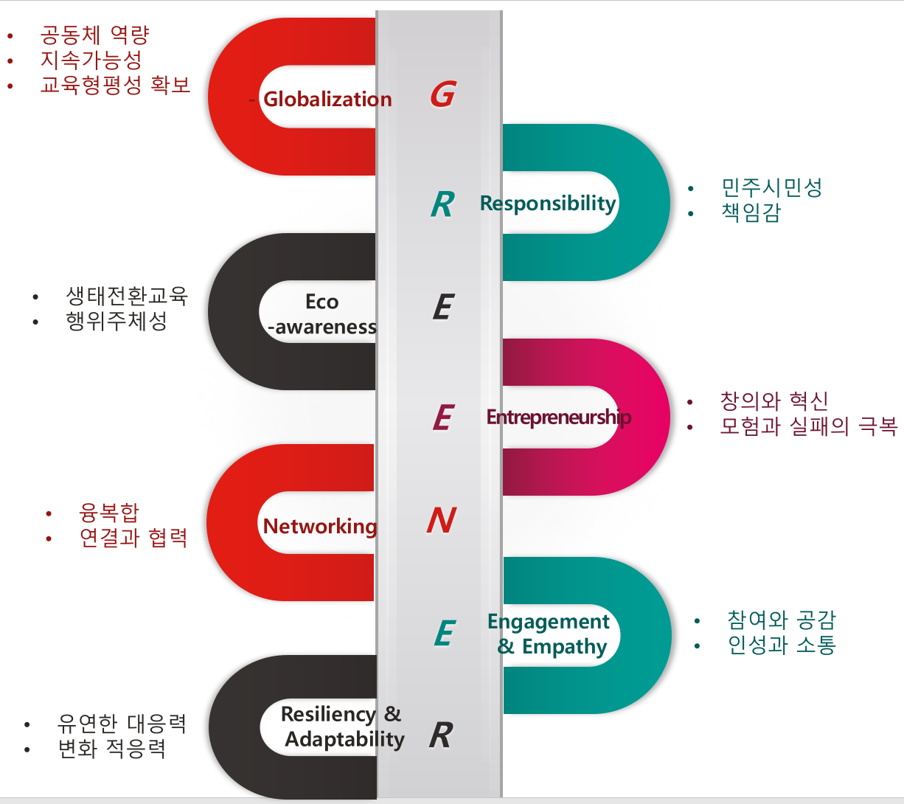
Alignment with the 2022 Revised National Curriculum
Global competency
Responsibility
Eco-awareness
Entrepreneurship
Networking competency
Engagement & Empathy
Resiliency and Adaptability

Slide 11

감사합니다

