Slide 1

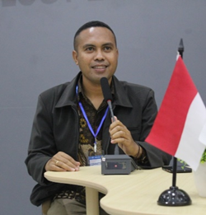
PROMOTING SCIENCE TEACHERS’ TPACK USING A
“PARTNERSHIP-TECHNOLOGY-ETHNOSCIENCE-BASED” PROGRAM
Yohanes Freadyanus Kasi Ari Widodo
Universitas Pendidikan Indonesia
Notes:
Background kurang menggambarkan mengapa mesti PAten

Slide 2
Background
Many science teachers need to uprade competencies
Science teachers’ TPACK of East Nusa Tenggara Province are low
Widodo, 2017
(Innaha, 2017; Suyamto dkk., 2020)
Ethnoscience provide context for learning science
Technology inluences classroom teaching
TPD that integrate Partnership, Technology, Ethnoscience
Teachers need a learning community
Notes:
Background kurang menggambarkan mengapa mesti PAten

Slide 3

Research Questions
How effective is the “Partnership-Technologi-Ethnosience-Based” Program to improve science teachers’ TPACK?
How useful is the the “Partnership-Technologi-Ethnosience-Based” Program in supporting teacher teaching practice?
How useful is the the “Partnership-Technologi-Ethnosience-Based” Program in promoting students’ motivation?
Notes:
Nan

Slide 4
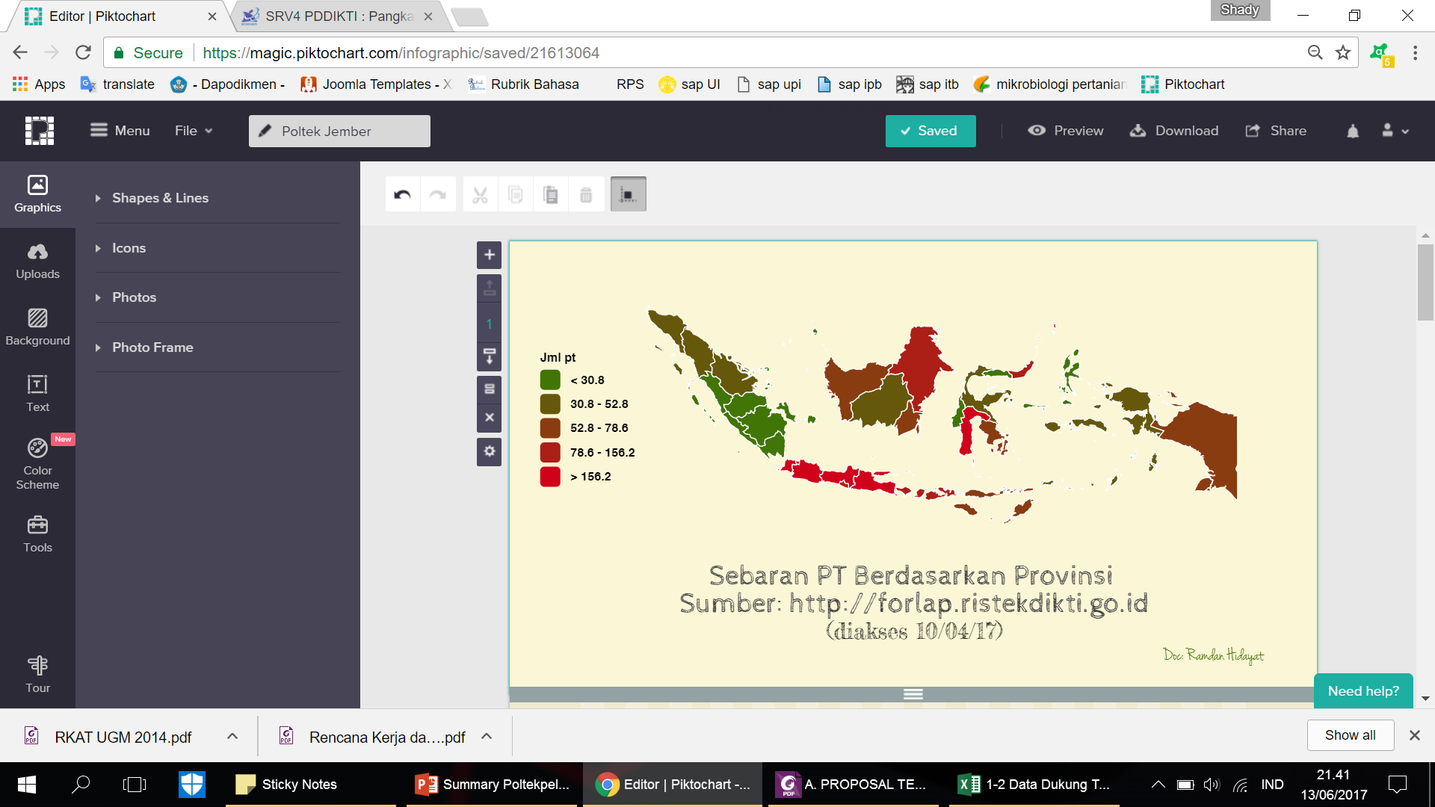
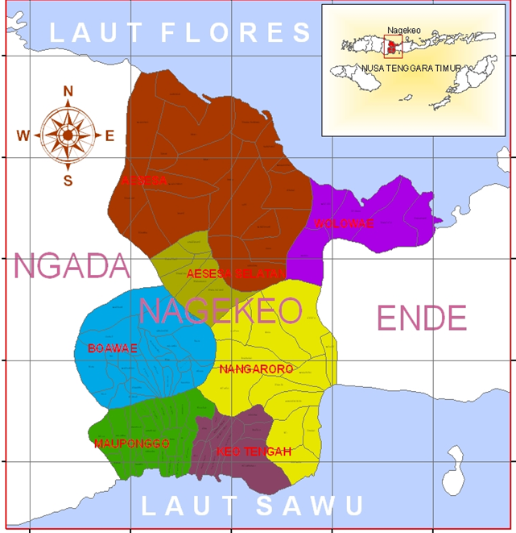
Methods
Research location
Participant : 28 science teachers and 101 students.

Slide 5
Methods
Profile of the participants | Number
Educational background:
Bachelor of Physics Education | 14
Bachelor of Biology Education | 10
Bachelor of Chemistry Education | 4
Teaching experience:
3 - 6 years | 5
7 - 10 years | 20
11-18 years | 3
Gender:
Man | 9
Woman | 19
School | Teacher | Number of students
SMPS Kotagoa | G10 | 28 orang
SMPN 3 Boawae | G2 | 28 orang
SMPN 1 Aesesa | G22 | 22 orang
SMPN 1 Nangaroro | G27 | 23 orang

Slide 6
Research Procedure
Motivation
Analysis of Science Contents in the Local Culture
Planning lessons
Teaching
Ethnoscience
Pedagogy
Technology

Slide 7
Research RESULTS
Partnership-Technologi-Ethnosience-Based” Program promote science teachers’ TPACK

Slide 8
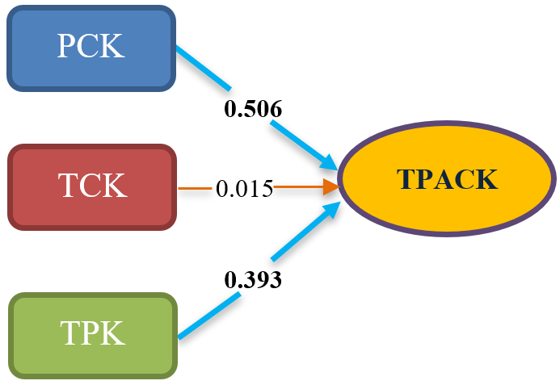
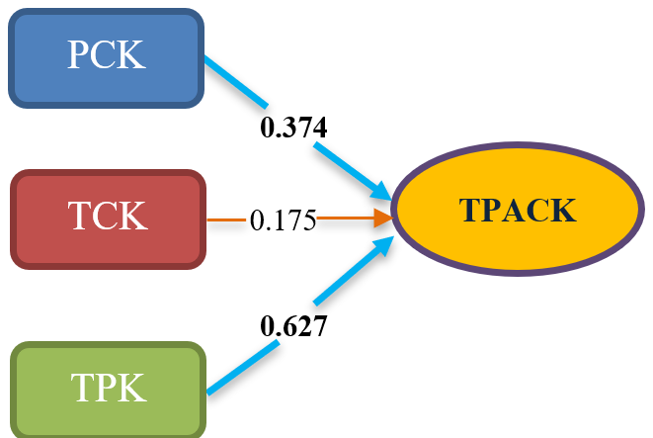
Research RESULTS
Pretest
Postest
PCK and TPK give a significant impact on teachers’ TPACK.
TCK does not give a significant impact on teachers’ TPACK

Slide 9
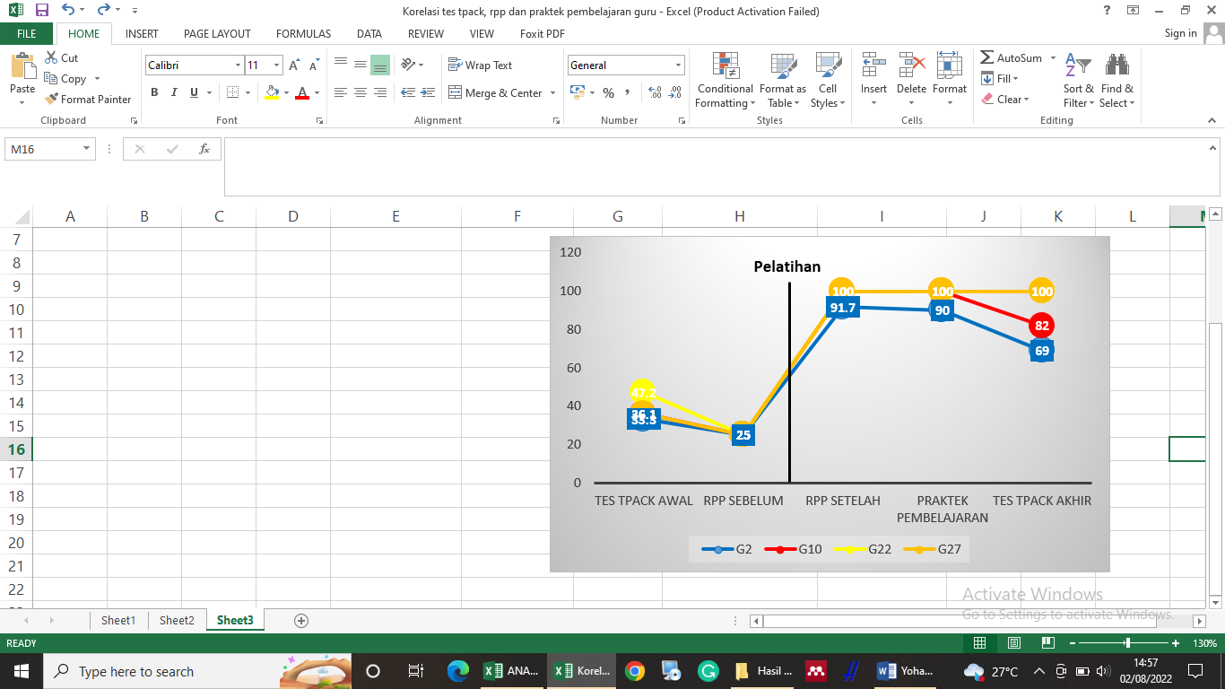
Research RESULTS
There are variations amongst teachers
Some teachers could maintain their TPACK but some others could not

Slide 10
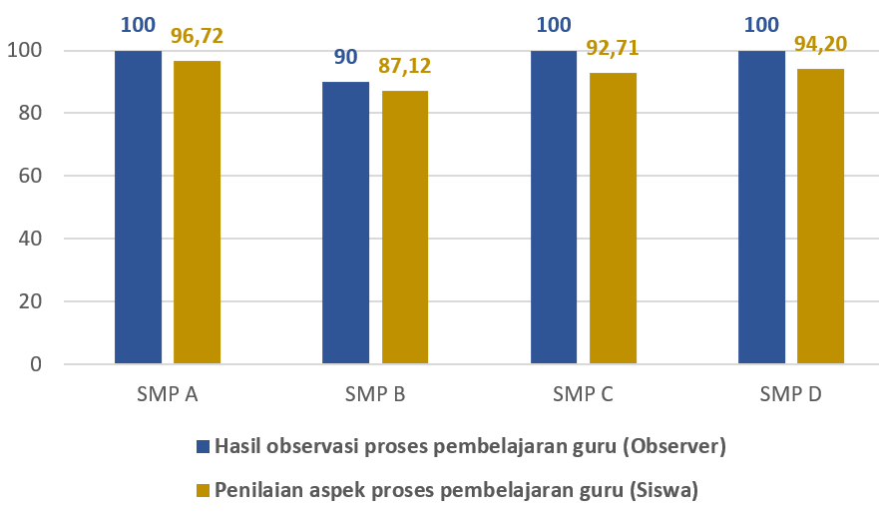
Research RESULTS
Teacher's TPACK proportionally relate to student learning motivation.

Slide 11

Conclusion
The “Partnership-Technologi-Ethnosience-Based” Program shows some effectiveness to improve science teachers’ TPACK
01
The “Partnership-Technologi-Ethnosience-Based” Program is useful to support teachers’ teaching practice.
02
03
The “Partnership-Technologi-Ethnosience-Based” Program contributes to the improvement of students’ motivation

Slide 12
Thanks for your kind attention

