Slide 1
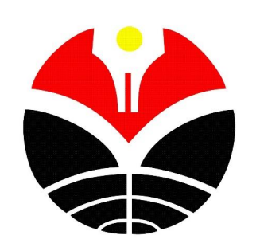

EDUCATION FOR SUSTAINABILITIES: IMPROVING THE CONCIOUSNESS THROUGH STEM EDUCATION
Ida Kaniawati
(Science Education UPI-Indonesia)
kaniawati@upi.edu

Slide 2
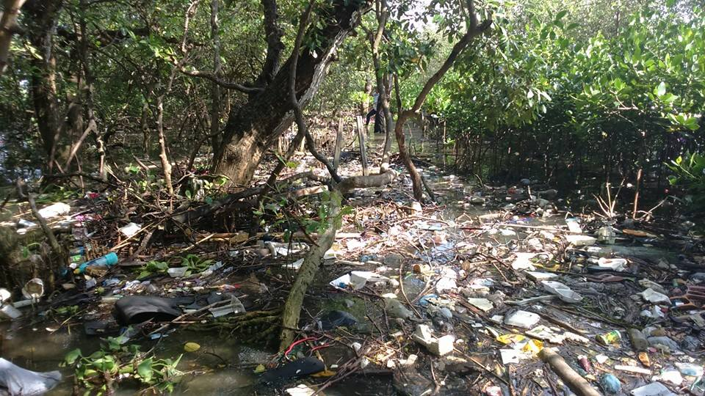
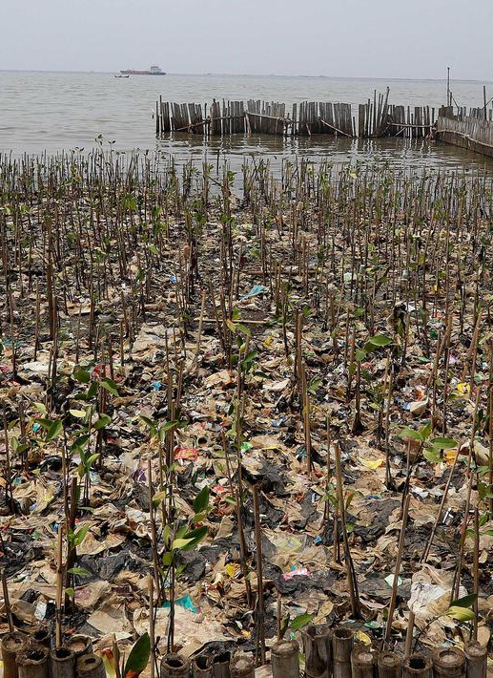

Introduction
Learning using the ESD context leads students to ask questions, learn to clarify one's values, learn to think sustainably, and learn to think (Tilbury, 2011). Sustainability issues are wicked problems that must be addressed, ESD needs to empower students to be able to understand the problems holistically and take actions at individual and collective levels (Brundiers & Wiek, 2013). The focus of ESD should be on developing students' understanding of sustainability issues and change students' attitudes and behavior regarding environmental, social, and economic sustainability (Kalsoom & Khanam, 2017)

Slide 3
primary goals:
The research aims to determine the improvement of students’ sustainability consciousness after attending STEM learning in sustainability issues. The goal of STEM in sustainability issues is raising student’s awareness of sustainability. The results of this study are expected to be used as a reference for other researchers to explore more deeply about learning strategies that can provide more opportunities for students to learn about sustainability issues and also develop attitudes and behaviors that are pro-sustainability.

Slide 4
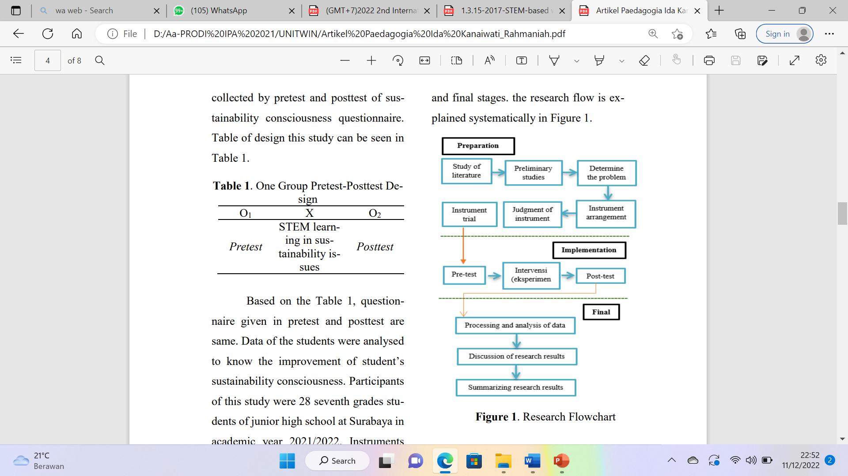
RESEARCH METHOD
This study used pre-experimental method with one group pretest-posttest design. The sample of this study consisted of 28 seventh grades students of junior high school in Surabaya. The sustainability consciousness profile is measured using a questionnaire containing 20 item using three categories consisting of sustainable knowledge, sustainable attitudes, sustainable behavior regarding environmental, social, and economic. The instrument was declared as valid based on expert’s judgment and showed Alpha Cronbach score 0,85.

Slide 5
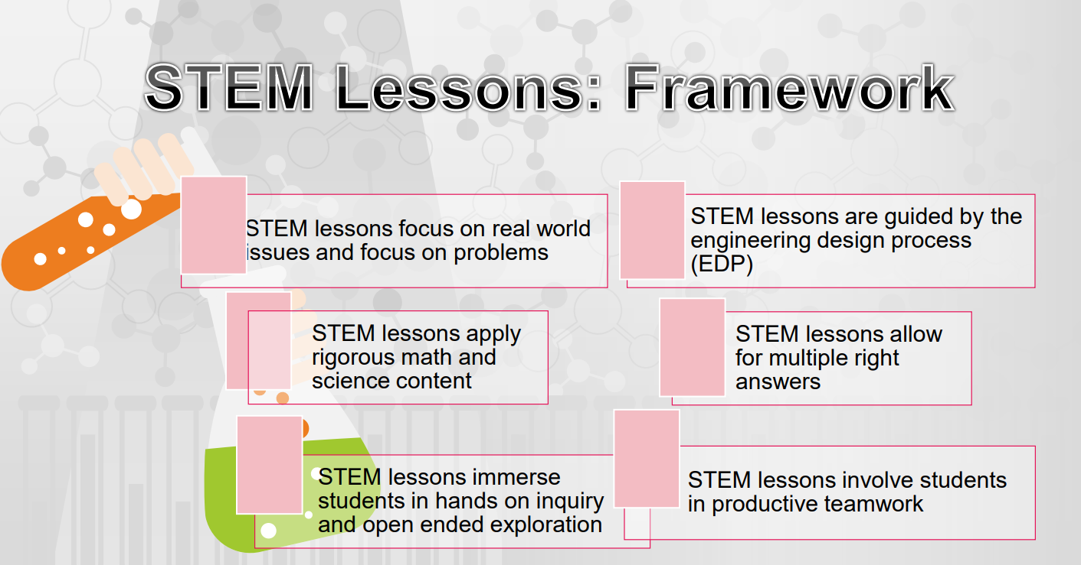

Slide 6
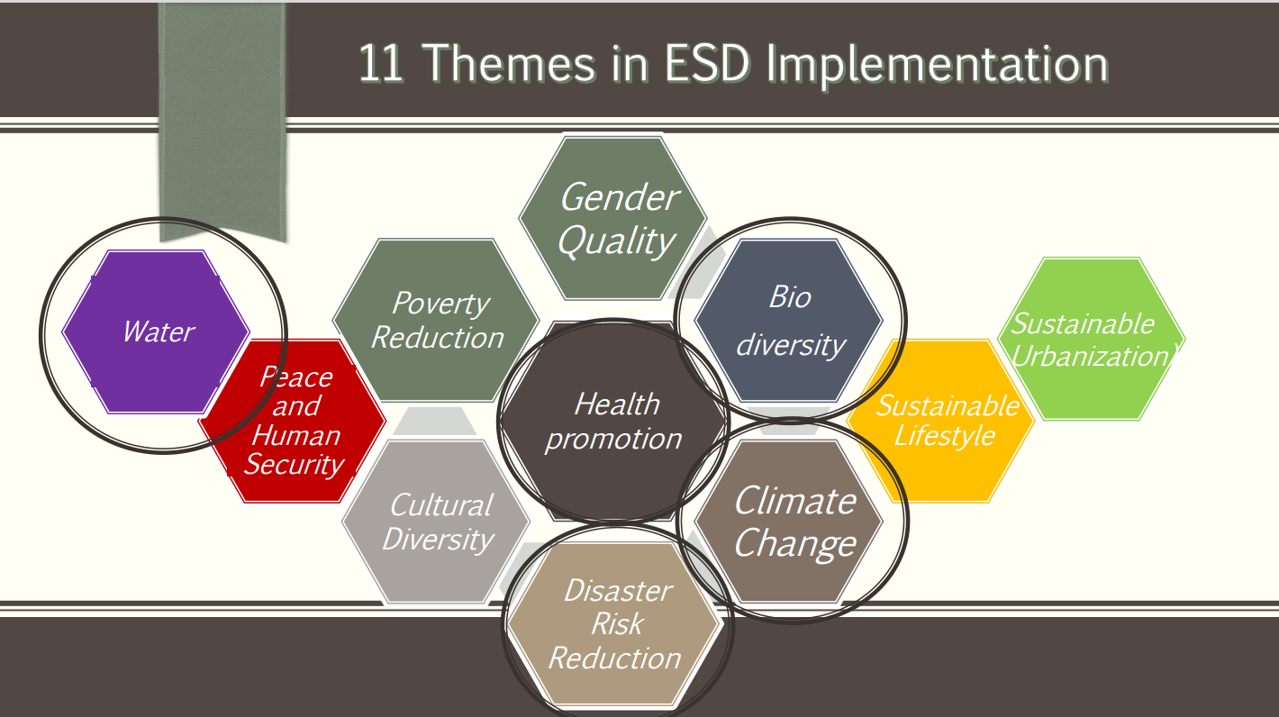

Slide 7
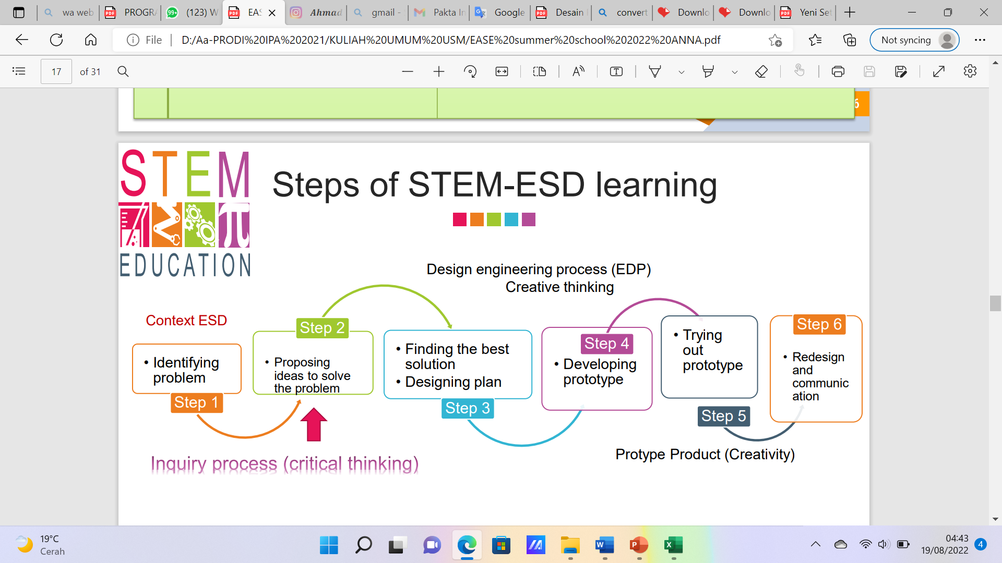

Slide 8
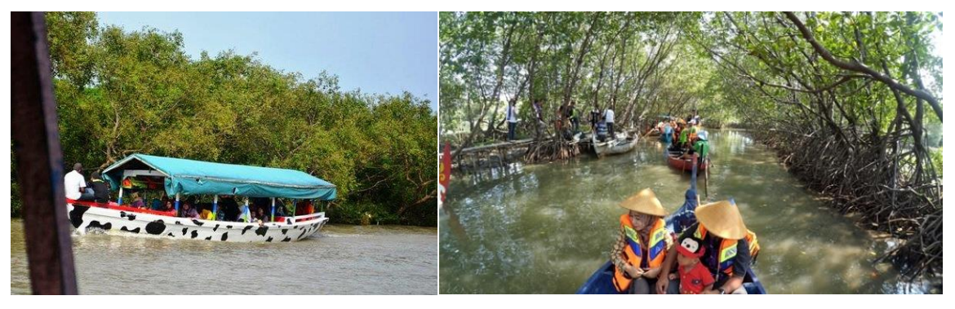
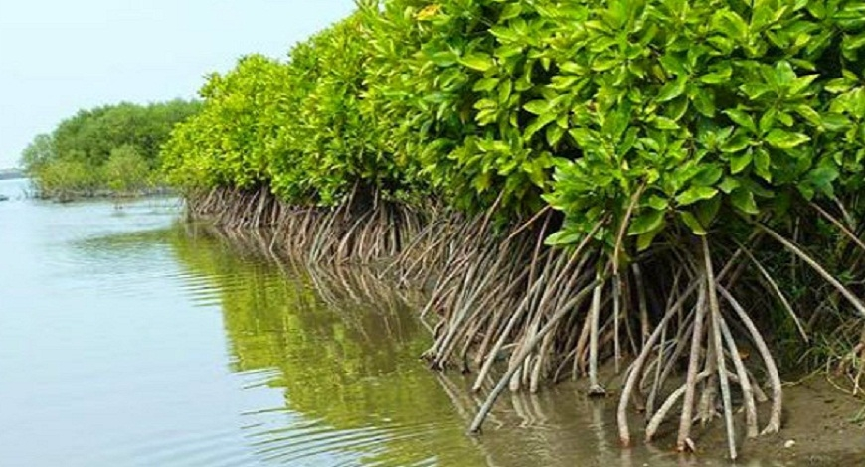
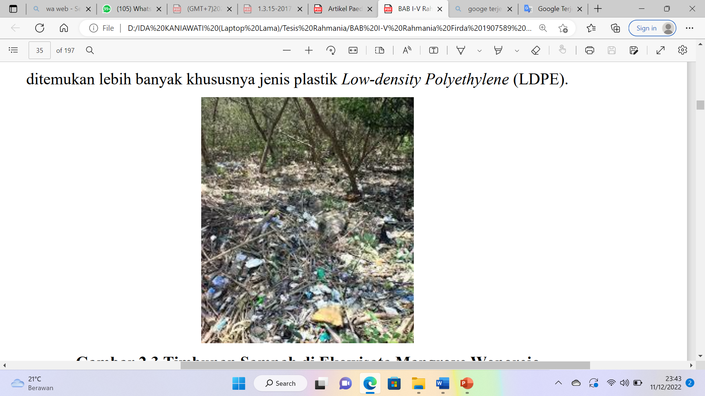
The sustainability issue raised in this study is the pollution that occurs in mangrove forests.
The material on environmental pollution consists of pollutant substances that can damage ecosystems, especially the water, air, and soil environments that surround human life.
Students need to understand the theory of pollution and introduce pollution problems that occur in the surrounding environment.
One of the rare ecosystems in the world with an area of only 2% of the earth's surface is the mangrove ecosystem.
This ecosystem has decreased by 30-50% in the last half century due to pollution due to coastal development, expansion of pond development, and excessive logging (Cifor, 2012).
According to Setyawan and Winarno (2016), mangrove forests are ecosystems that have ecological, socioeconomic, and socio-cultural roles in accordance with the context of Education for Sustainable Development (ESD).
With the introduction of environmental pollution material that occurs in the Mangrove Forest, it is hoped that students can use their knowledge to provide solutions to environmental pollution problems and have sustainable thinking so that the environment remains sustainable

Slide 9
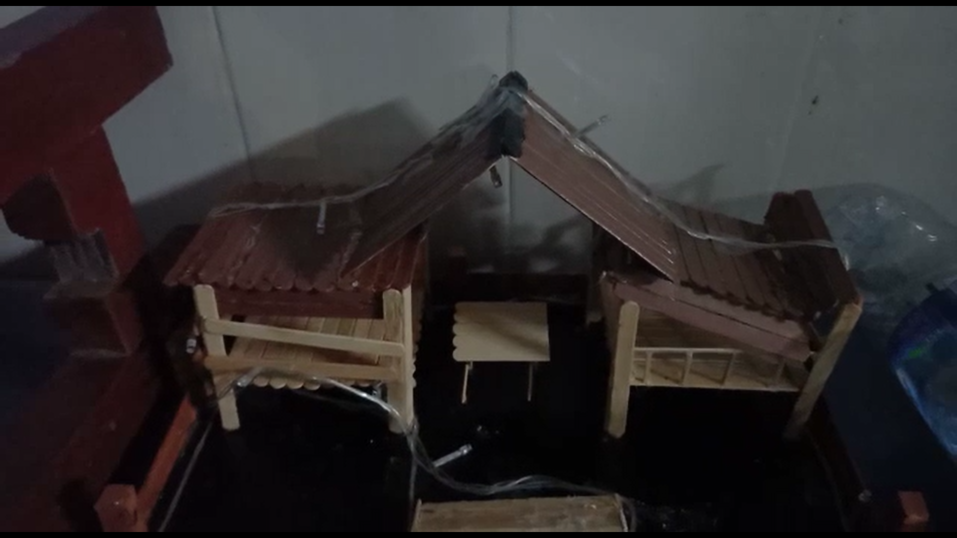
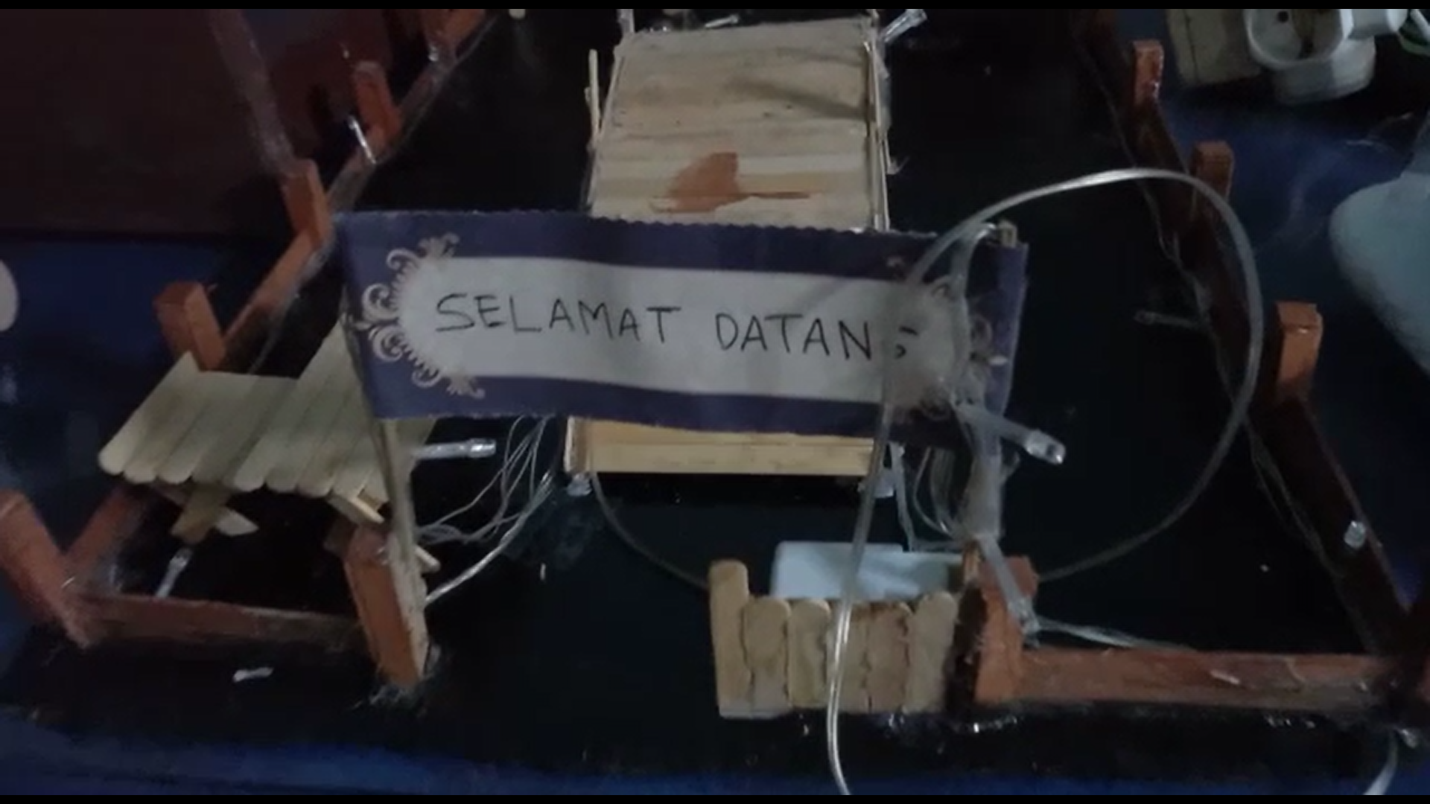
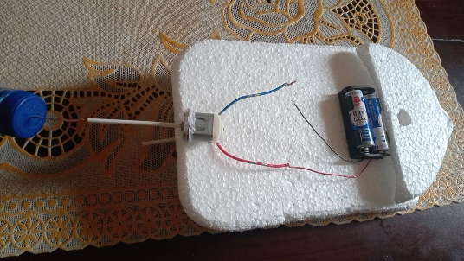
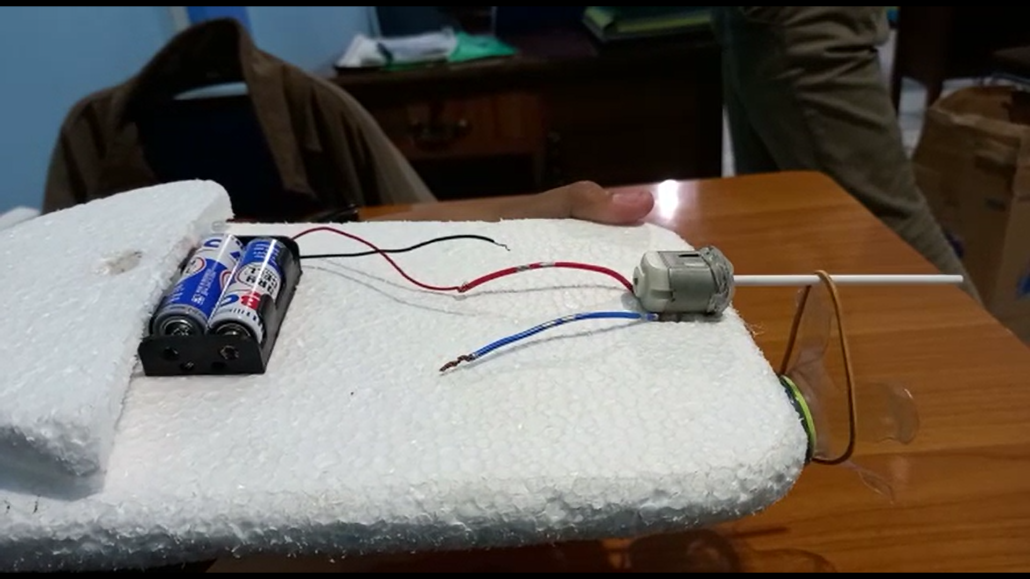
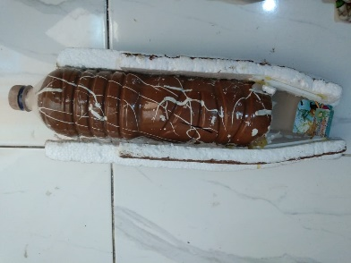
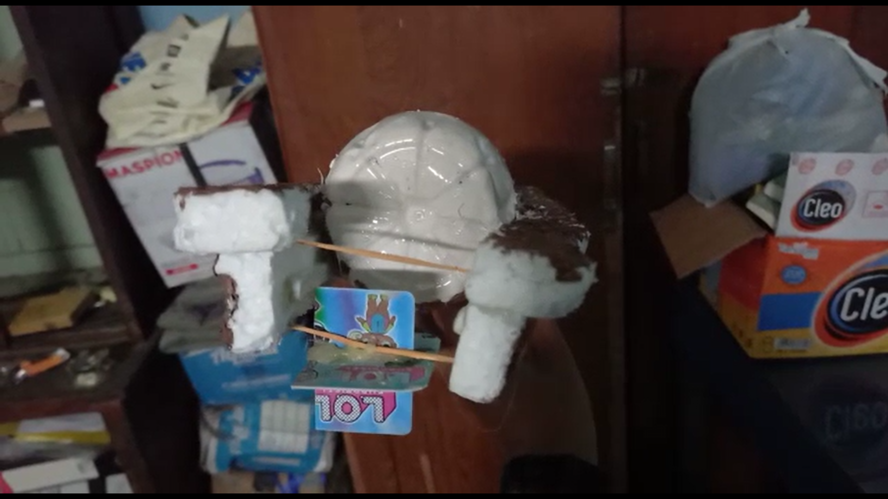
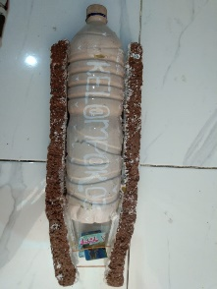
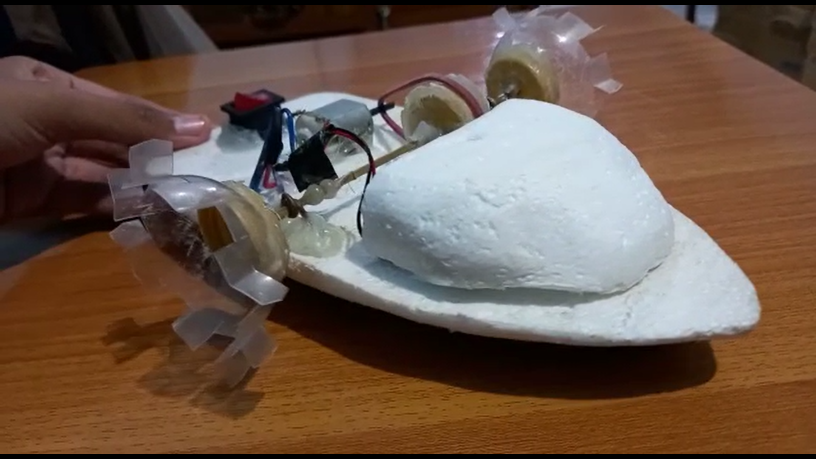
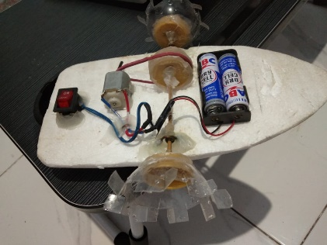
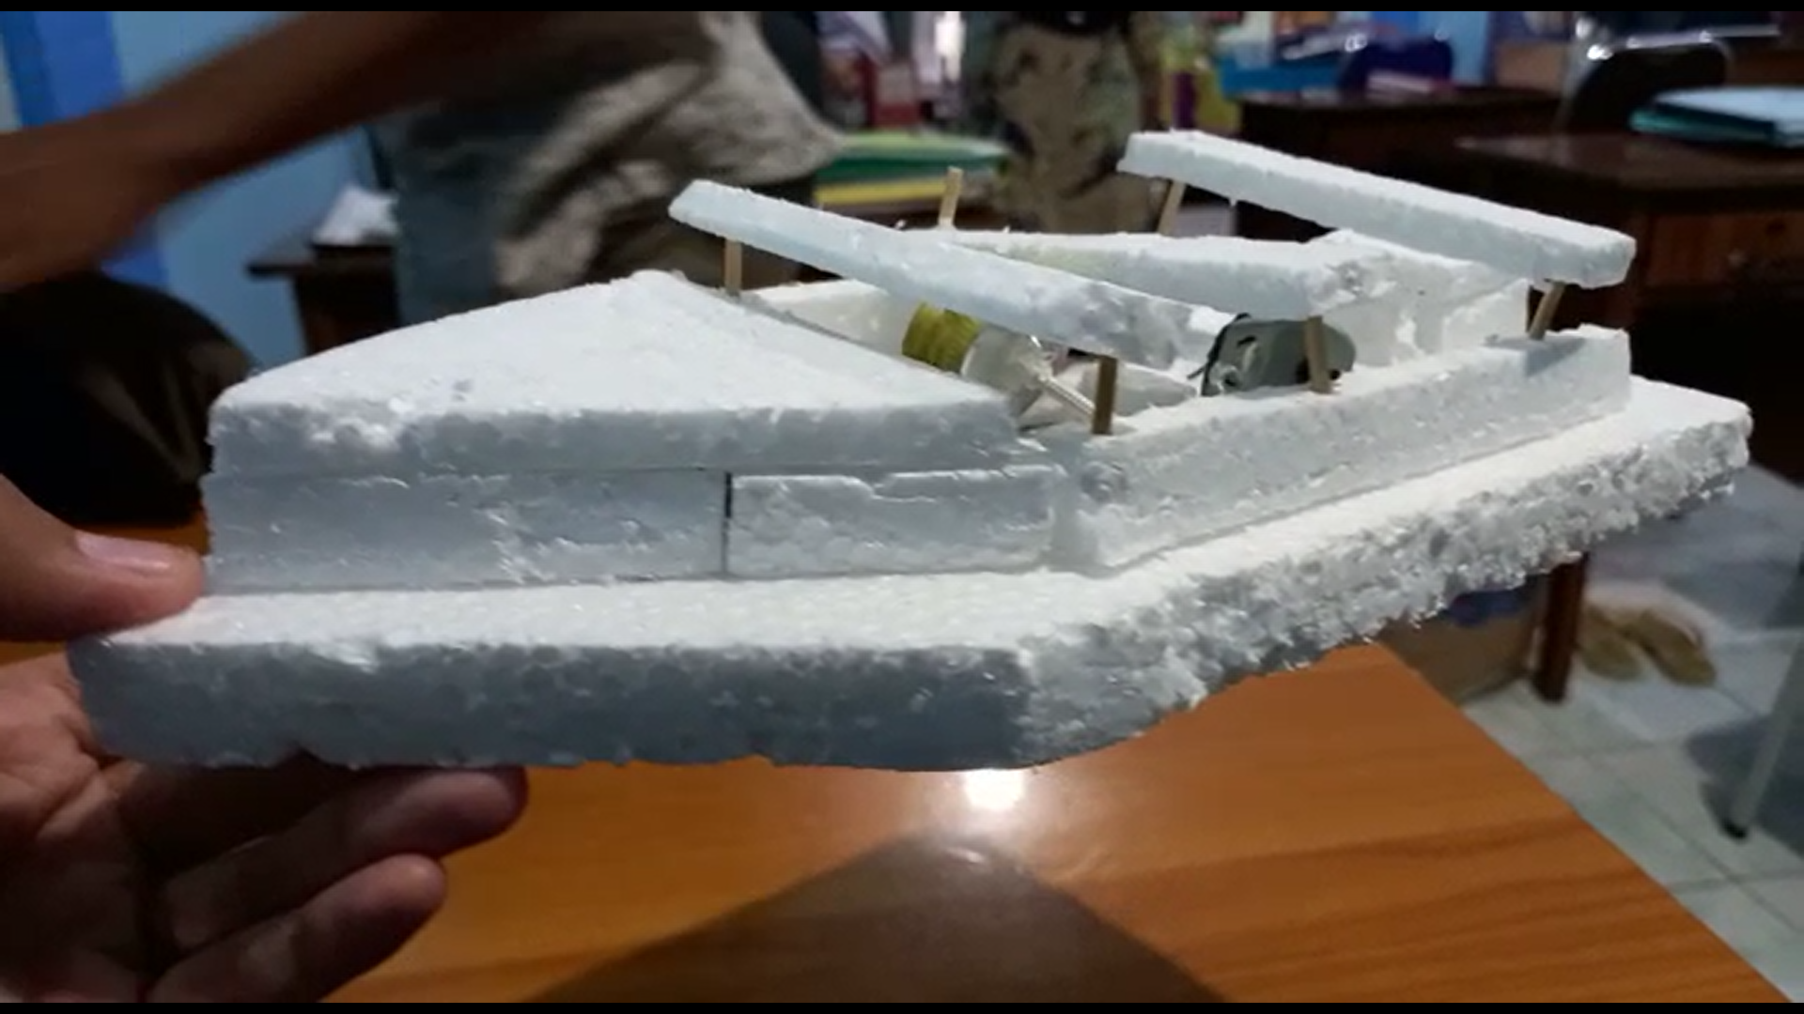
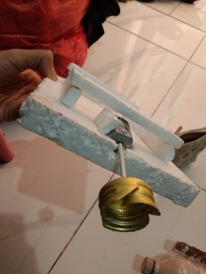
Bridges and gazebo products from group 1
The electric boat is a product of group 2
The getek boat is a product of group 3
The electric boat is a product of group 4
The electric boat is a product of group 5

Slide 10
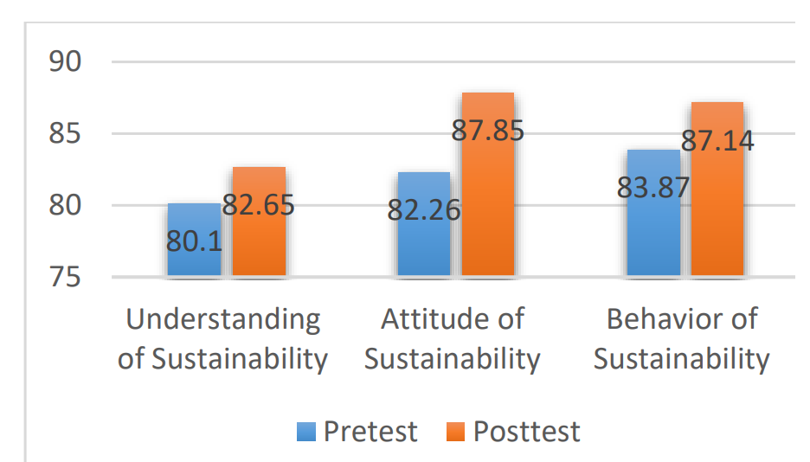
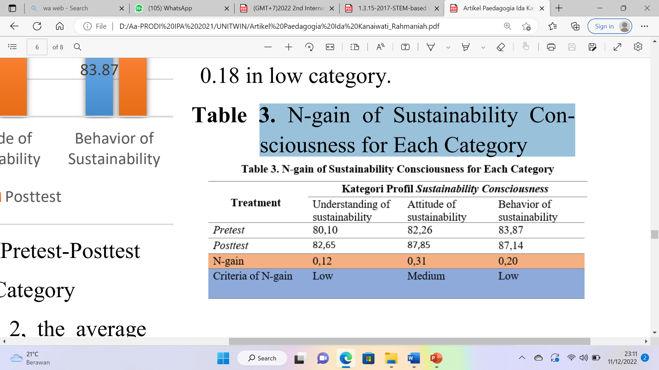
The improvement of students' understanding of sustainability issues and change students' attitudes and behavior regarding environmental, social, and economic sustainability after STEM learning in sustainability issues was implemented.
N-gain of Sustainability Consciousness for Each Category

Slide 11
RESULTS AND DISCUSSION
Students are directed to recognize several sustainability issues that lead them to change attitudes and behavior towards sustainability regarding environmental, social, and economic sustainability on STEM learning in sustainability issues.
ESD is a transformative education that aims to develop students' understanding of sustainability issues and change students' attitudes and behavior regarding environmental, social, and economic sustainability. (Kalsoom & Khanam, 2017).
SC is the expected result with the presence of ESD where SC is a complex construction and various factors can contribute to its development. According to Kalsoom et al. (2017) states that the development of SC is not due to the ESD profile, but the education culture as a whole (including environmental care, social justice, democracy, economic equity).
The hope with STEM learning in the context of ESD is to make students more aware of sustainability.

Slide 12
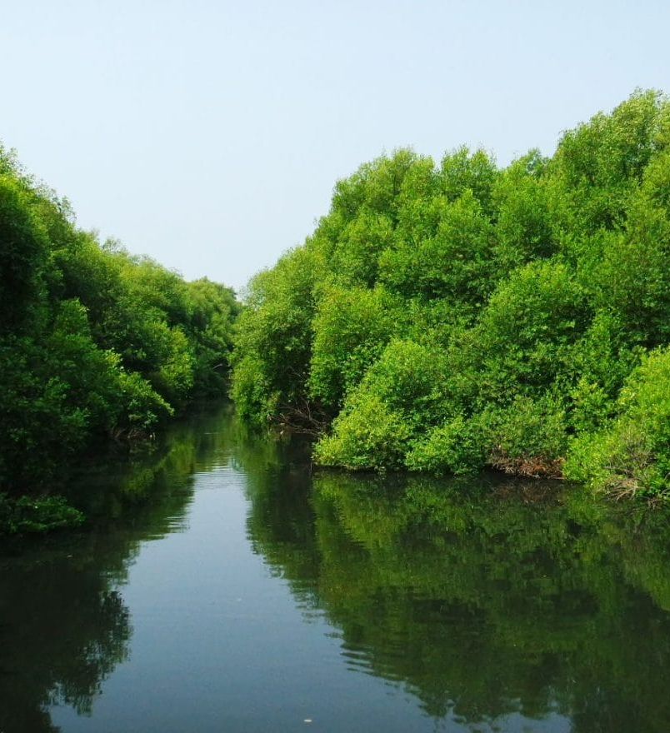
CONCLUSION
The conclusion of this study is enhancement of students' sustainability consciousness in Surabaya shows 0.18 in low category. While the enhancement of students' sustainability consciousness for each categories as follows: N-gain for student’s understanding of sustainability issues got the lowest result from other categories; 0,12 in low criteria, N-gain for Behavior of sustainability got the result: 0,20 in low criteria, and N-gain for attitudes of sustainability got the highest results from other categories 0.3 in medium category. Continuous awareness raising is in the low category because the pre-test score has a high score. this shows that students already have continuous awareness before applying this learning.

Slide 13
thank you

