Slide 1


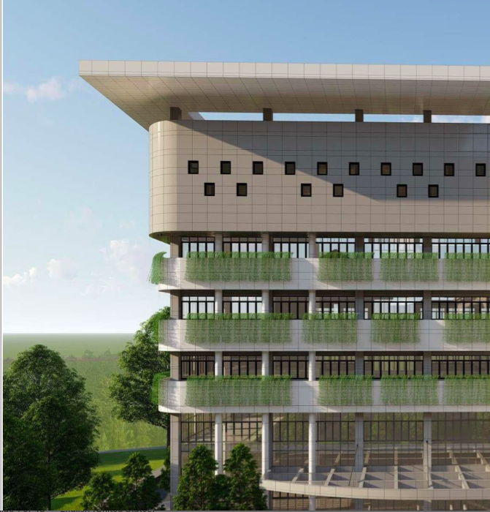

TEACHER PROFESSIONAL CERTIFICATION
IN INDONESIA
UPI
2022 KNUE-UNITWIN INTERNATIONAL CONFERENCE
Diana Rochintaniawati
UNIVERSITAS PENDIDIKAN INDONESIA

Slide 2

Teacher Professional Certification (TPC)
Government law Number 14 year 2005 about teachers & lectures:
teachers & lecturers must improve their competencies
and the law determine position that teachers & lecturers as professionals
Teachers competencies:
Personal competency, pedagogical competency, social competency, and professional competency
TPC begins in 2007 after the launched of Ministry of Education regulation number 18 in 2007 about certification for in-service teachers

Slide 3
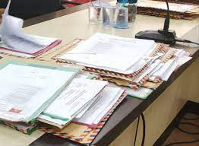
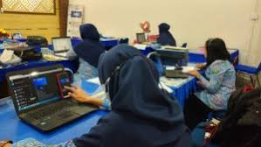
The Development of Teacher Professional Certification in Indonesia
2007 – 2017 Teacher Professional Education and Training provided for Teacher who has experience in teaching for more than 5 years
Portfolio
Documents representing teachers’ attainments in a certain period of time
Nine (9) days workshop for 90 hours meeting (30 hours theory and 60 hours teaching practice)

Slide 4
TPC scheme
Development of Teacher’s Professional Certification In Indonesia
Since 2018 the program changed into : “Teacher Professional Education (TPE)”
TPE in 2018 – 2019 - Offline
TPE in 2019 – 2021 – Online (pandemic of Covid 19)
2022 Online for Inservice, Blended for Pre service (Post Pandemic)
Year 2022
TPC
In Service
First Category
TPC
Second Category
Pre service/
Fresh Graduate

Slide 5
TPE Scheme in 2022
Aspects | Fresh Graduate/ Pre Service | Inservice 1st Category | Inservice 2nd Category
Input | Fresh graduate from bachelor degree (education or non education background) | Teacher (government employee or private teachers) with 5 or mor e teaching experience | Teacher (government employee or private teachers) with 3 to less than 5 teaching experience
Period of Education | One year (2 semester education) | 3 months Training | 6 months training
Credits | 39 Credits | 36 Credits | 36 Credits
Government Recognition to the teaching experience | No teaching recognition | 24 credits teaching recognition | 18 credits teaching recognition
Credits taken after recognition | 39 Credits education | 12 credits education | 18 credits education
Type of Program | Blended learning: Offline Corse & LMS | Online | Online
7

Slide 6
Procedure of Teacher Professional Education
Registration
(Online)
Selection test
online – In service
Online test & interview – Pre service
Learning Process
Final Assessement
(Online)
Certificate & incentive
Retaker
Comprehensive assessment

Slide 7
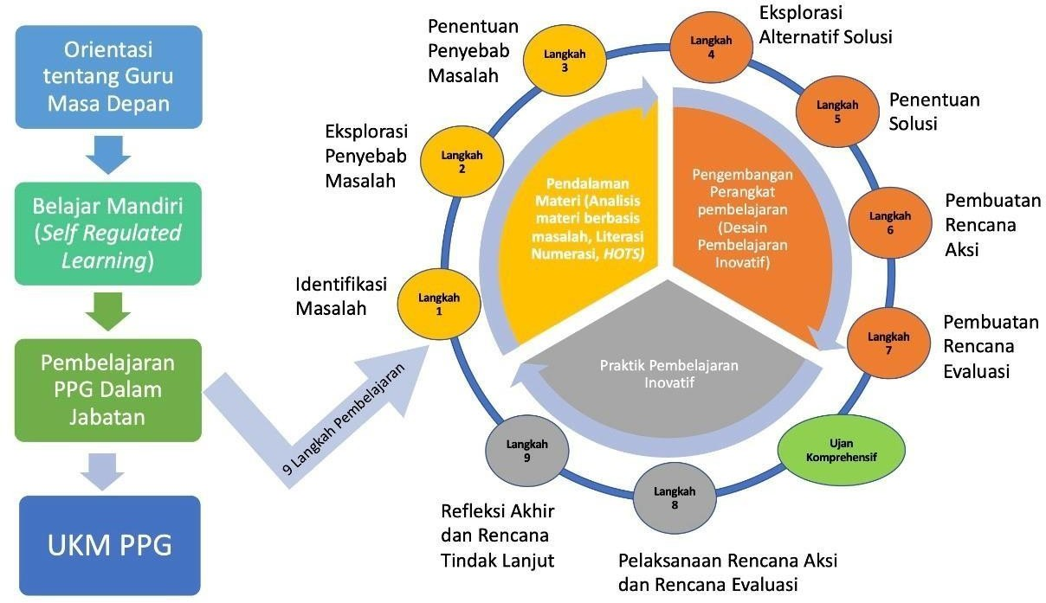
Learning Process in TPE program for In-Service (2022)
Exploring the alternative solution
Determination to the cause of problem
Step 4
Teacher orientation
Step 3
Step 5
Determine the solution
Exploration to the cause of problem
Step 2
Content analysis
Innovative teaching design
Step 6
Action
Self Regulated Learning (Pedagogy & Content module)
Problem identification
Step 1
Step 7
Plan the Assessment
Teaching & Learning in TPC
Innovative teaching practice
9 learning steps
Step 9
Comprehensive assessment
Step 8
Professional competencies assessment
Reflection & follow up
Implementation of the action and Assessment

Slide 8
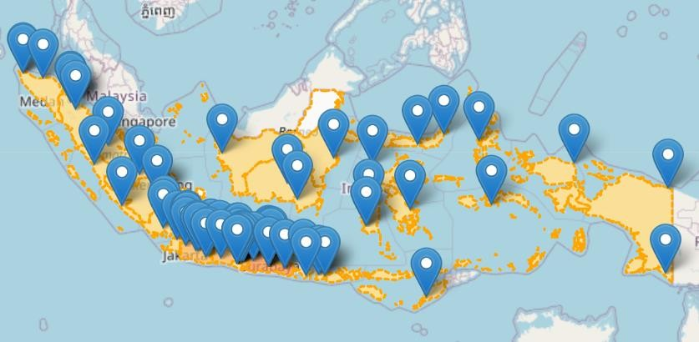
TPE in Education Institutions
UPI

Slide 9
Notes:
Apa beda kedua grafik? Kalau sama saja pilih salah satu aja

Slide 10
NATIONAL RESULT OF TPE
2018
2019
2020
2021
2022

Slide 11
Obstacles of TPE Examination
From 23.876 students, 1.119 having problem in online examination

Slide 12
Discussion & Recommendation
Facts:
Approximately 65,000 professionally certified teachers are needed every year to replace retired teachers.
1,200,000 teachers who are on their duty as teachers, yet without professional certificate
The current number of education institution administering the TPE is still limited and has not fulfilled the need for the number of teachers to be certified
The online program for in service will be continued in the next few years as it can accommodate more teacher to be involved in TPE & Less budget
Recommendation:
Improve number the facility of online learning, mostly the internet capacity.
Support more Educational Institutions to run the TPE

Slide 13
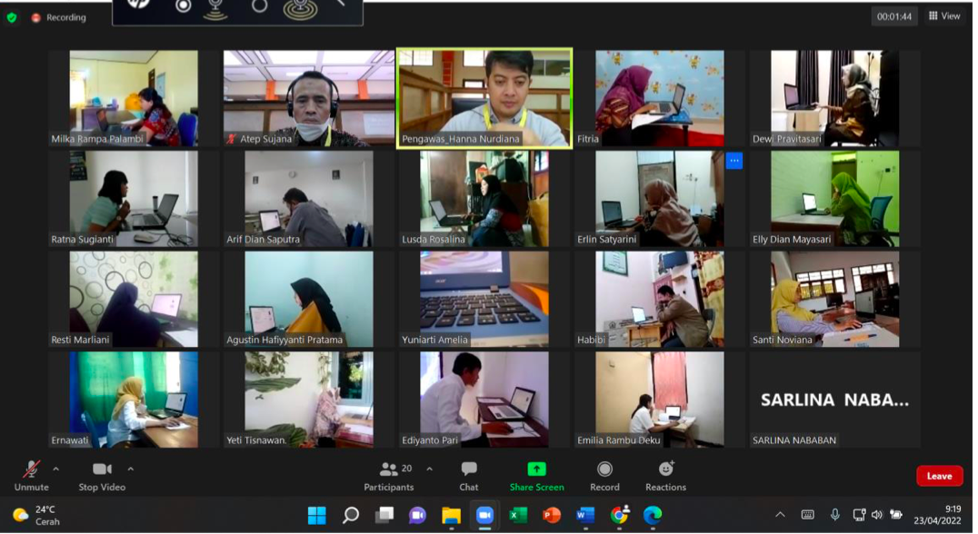
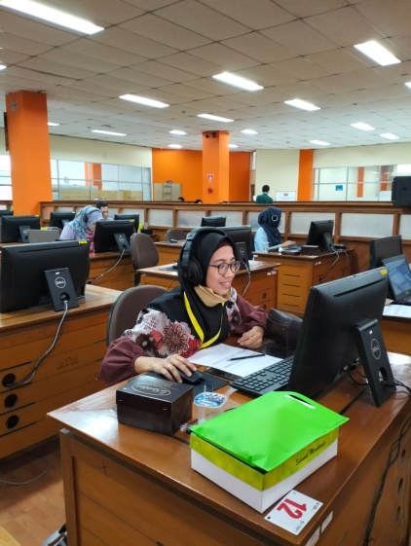
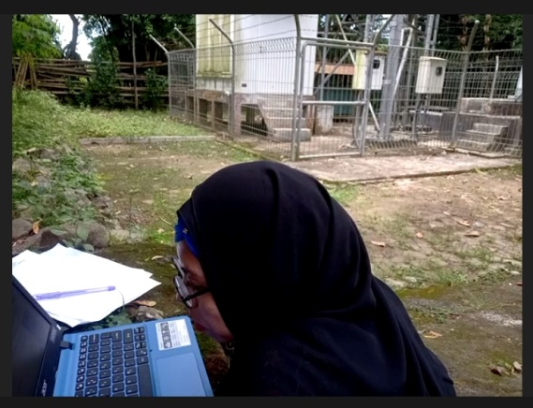

Slide 14
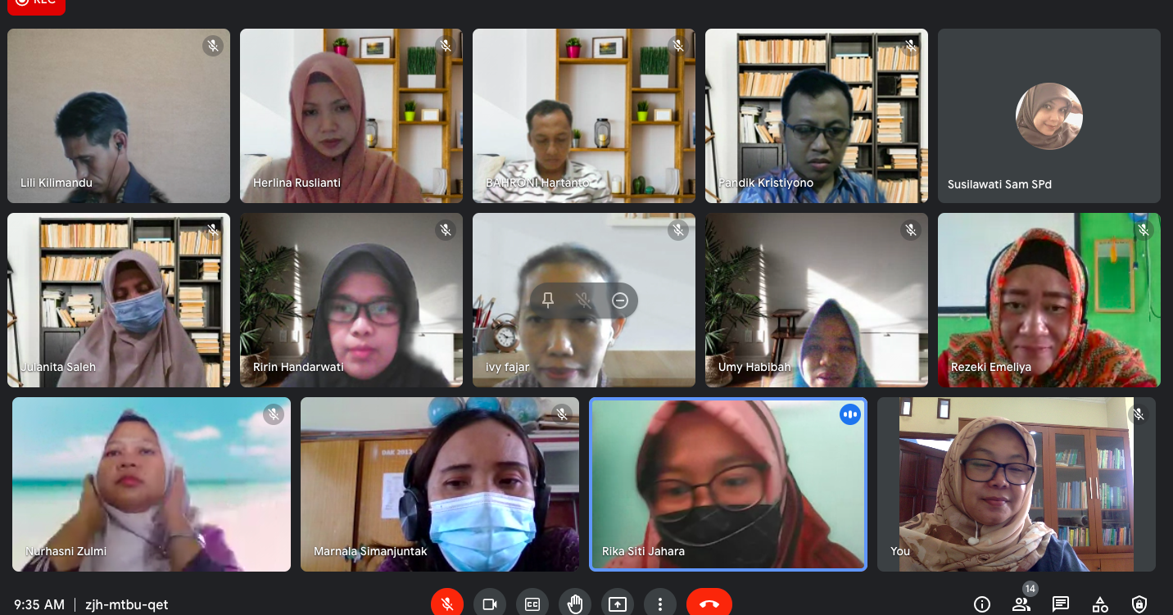

Slide 15
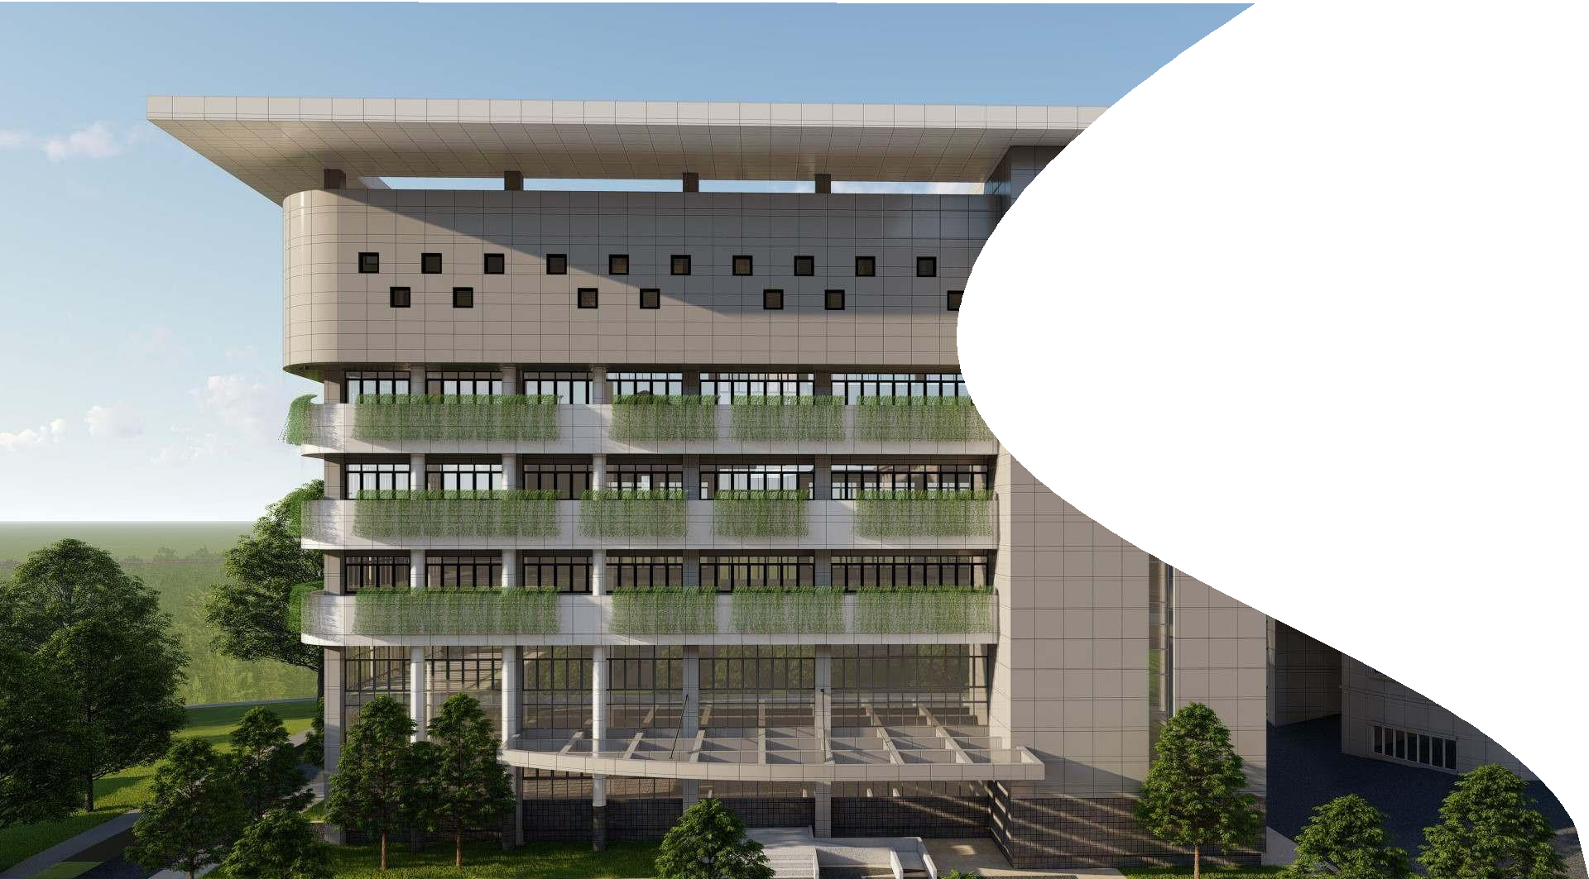

Thank you
Prof. Younghoon Kim – KNUE
Prof. Ari Widodo – UPI
Participant of UNITWIN

