Slide 1

Vietnam National University – University of Education
A SYSTEMATIC REVIEW ABOUT RESEARCH IN TEACHING AND LEARNING MATHEMATICAL MODELING AT SCHOOL IN VIETNAM
Assoc. Prof. Dr. Nguyen Chi Thanh, BSc. Nguyen Thi Thao Linh

Slide 2








INTRODUCTION
We will explain the reason for choosing topic
LITERATURE REVIEW
AND RESEARCH METHOD
Table of contents
Mathematical modeling (MM), Mathematical modeling competence (MMC), Mathematical modelling process (MMP)
RESULT AND DISCUSSION
Reveal result and discussion on the direction of further research

Slide 3

INTRODUCTION
We will explain the reason for choosing topic

Slide 4

IN THE WORLD
IN VIETNAM
Leong (2014) pointing out the importance of modeling in the mathematics curriculum at the high school level in Malaysia, Li (2020) reseaches about Covid-19 in China Albarracín (2021) comparing the vehicle of a city and a town according to population estimates for second grade students in Germany, etc.
Le Thi Hoai Chau (2014) researches on teaching Probability, Nguyen Duong Hoang (2019) reasearches on topic Quadratic functions, Nguyen Chi Thanh, Nguyen Thao Linh (2022) on modeling according to Didactic approachapproach. The studies about the university level are Mai Van Thi (2018), Do Thi Thanh (2020), Nguyen Chi Thanh, Nguyen Thao Linh (2022)
current research is very diverse, with different theoretical frameworks, so it will be difficult for math teachers to approach teaching mathematical modeling and difficult to implement the general education program 2018

Slide 5


INITIAL QUESTIONS
1. How many papers are there in Google Scholar, Scopus, and math education journals in Vietnam from 2015 to 2022?
2. What are the main research topics?
3. What modelling perspectives are often chosen in studies?
4. What research methods are used?

Slide 6

LITERATURE REVIEW
Mathematical modeling (MM), Mathematical modeling competence (MMC), Mathematical modelling process (MMP)

Slide 7




1 Thinking ability and mathematical reasoning
2. Mathematical modeling competence
3. Math problem solving ability
4. Mathematical communication skills
5. Ability to use tools and means of learning mathematics
Mathematical competence
According to the General Education Program in Mathematics 2018

Slide 8


Mathematical modeling competence is the synthesis of knowledge, skills, and personal attributes to solve problems related to mathematical modeling
Ministry of Education and Training, 2018
Mathematical modeling competence
Definition

Slide 9
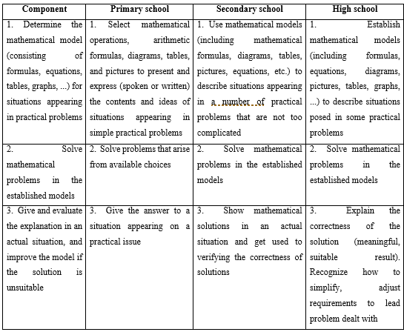
Mathematical modeling competence
Requirements

Slide 10
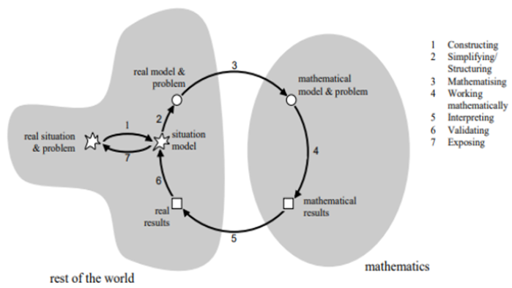
Mathematical modelling process
Blum (2007)

Slide 11
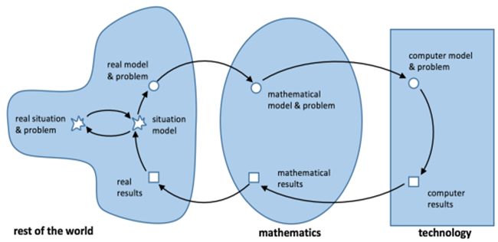
Mathematical modelling process
Expanded MMP with IT support (Greefrath, 2018)

Slide 12
Step 1 and 2: Needs and Review Question
Step 3: Scope
- Journals in the field of education, scientific journals of the ISI/Scopus system from Q1 to Q3:
+ Vietnam Journal of Education (VJE),
+ International Journal of Learning, Teaching and Educational Research (IJLTER),
+ Thai Nguyen University-Journal of Science and Technology (TNUJE),
+ Can Tho University - Journal of Science (CTUJE)
+ HCM City University of Education - Journal of Science (HCMUEJE). T
- Research on the MMP, MMC, IT application in the MMP at Vietnamese school
- Published in the year 2015-2022.
Research
method
Joklitschke et al. (2021)

Slide 13
Step 4: Search
We use keywords “Mathematical modelling process”, “Mathematical modelling competency”, “IT” and “Vietnamese school” in English and Vietnamese to search for articles and journal articles. From the Google Scholar mathematical education journals in Vietnam, we found 180 results in English and 25 results in Vietnamese related to the above terms (total is 205 results) and sifted through the articles
Step 5: Screening
-After the first screening by filtering for articles published in 2015-2022, we excluded 96 articles out of 205 articles (remaining 109 articles). Next, we read the titles, abstracts, and keywords of all the articles. In the end, we only found 24 articles that met the criteria in step 3
Research
method
Joklitschke et al. (2021)

Slide 14
Step 6: Code
We will analyze the articles after screening
Step 7 and 8: Map and appraise
Statistics and representation as tables, charts summarize the research
Step 9 and 10. Synthesize and communicate
We will present the synthesis and communication in the results and discussion
Research
method
Joklitschke et al. (2021)

Slide 15

RESULT
AND DISCUSSION
Reveal result and discussion on the direction of further research

Slide 16
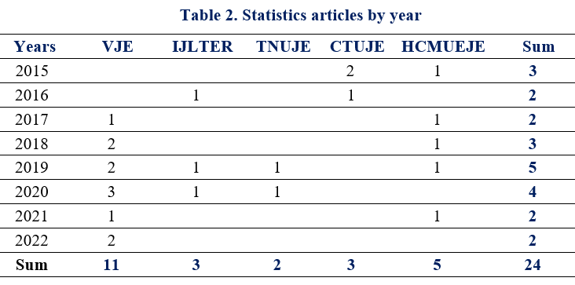
Vietnam Journal of Education (VJE), International Journal of Learning, Teaching and Educational Research (IJLTER), Thai Nguyen University-Journal of Science and Technology (TNUJE), Can Tho University - Journal of Science (CTUJE) and HCM City University of Education - Journal of Science (HCMUEJE)

Slide 17
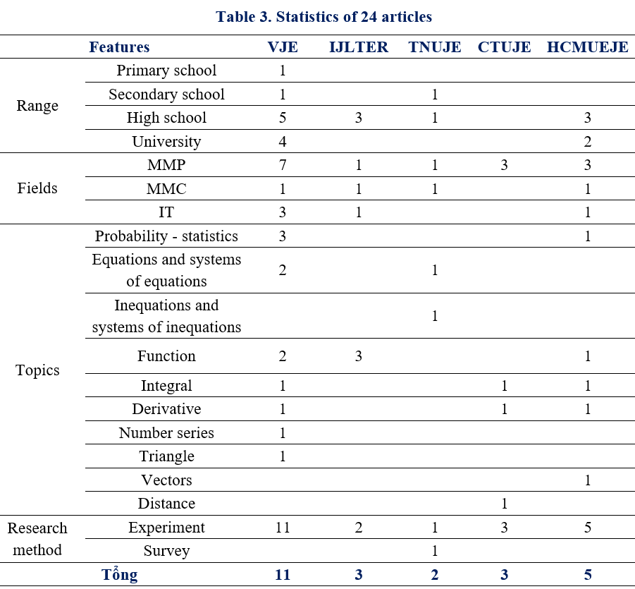

Slide 18

CONCLUSION
In this study, we have systematized a part of the research overview on mathematical modeling in Vietnamese schools. Research results are an important evidence for the selection of research topics and scopes. From there, as a basis for studying pedagogical measures to improve mathematical modeling capacity for learners.
We believe that teaching mathematical modeling in schools in Vietnam in the coming period has many prospects, especially research on primary students.

Slide 19
Thank you for listening!

