Slide 1
Issues and Recommendations for Professional Development of Philippine Public School Teachers
Prof. Lizamarie Campoamor-Olegario, Ph.D. University of the Philippines
College of Education
Notes:
Good day everyone! I will talk about Issues and Recommendations for Professional Development of Philippine Public School Teachers

Slide 2

https://mb.com.ph/wp-content/uploads/2021/07/15892.jpeg
Notes:
The Philippine Education System is in Crisis. In this 2021 infographic by an advocate group, the Philippine Business for Education, I will only state some of the issues. 1 out of 3 children under 5 years old are stunted. 1 out of 4 kinder-aged children are not in school 1 out of 5 children under 5 years old are underweight 1.1 million students did not go to school in 2021 The overall average passing rate in the Board Licensure Examination for Professional Teachers (BLEPT) from 2009-2019 was 28% in the elementary level and 37% in the secondary level. The K-3 teachers who were surveyed scored 44 mean percent correct out of 100% in the Mother tongue- based multilingual education (MTB MLE) instructional knowledge. 1 out of 4 parents say that their children are not learning

Slide 3
https://mb.com.ph/wp-content/uploads/2021/07/15892.jpeg
Notes:
72% of 15 year old Filipinos are low achievers in Reading, Math, and Science based from PISA 2018. The learning-adjusted years of school (LAYS) is only 6.9 to 6.5 out of 12 years. Junior high school students move up despite having low proficiency in Math, English, Science, Filipino, and Social Studies. Grade 5 students do not meet the proficiencies of their level, with very low scores ranging from 2 to 17 over 100 in Reading, Writing, and Arithmetic.

Slide 4
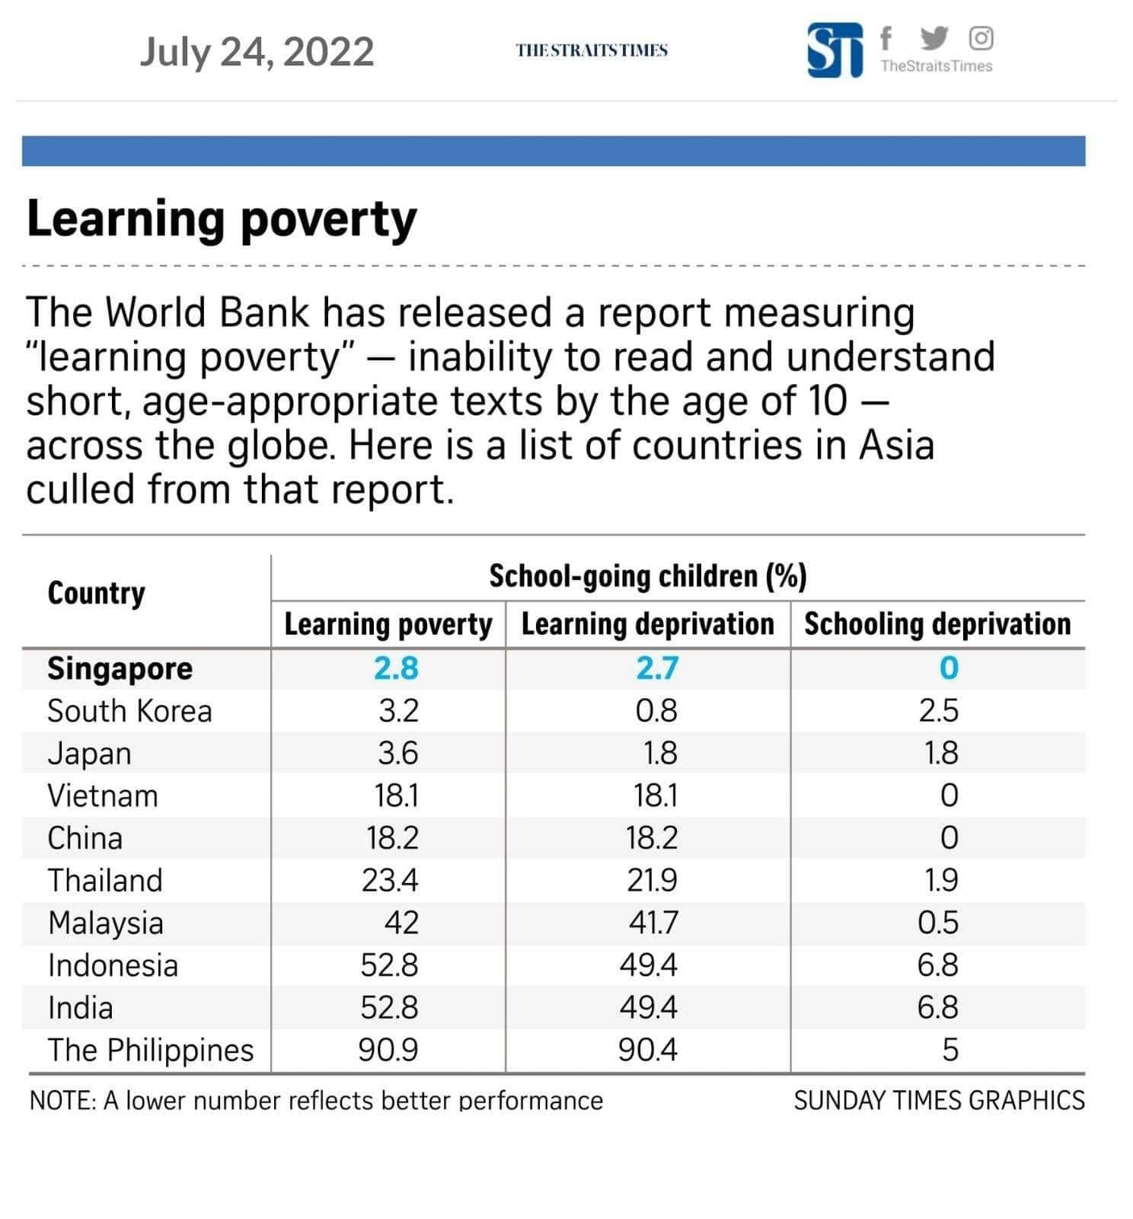
https://www.straitstimes.com/asia/se-asia/years-of-remote-schooling-exacerbate-learning-poverty-among-filipino-children
Notes:
Recently, the World Bank has released a report measuring “learning poverty”, which means inability to read and understand short, age-appropriate texts by the age of 10. The Philippines is one of the countries with the highest rates of learning poverty in the East Asia and Pacific region and among lower-middle income economies. Nine out of 10 Filipino children are still struggling to read simple texts by age 10. Some experts attribute the low performance in exams to the language used in the examinations, some experts say that it is more than the language issue.

Slide 5
“The quality of an education system cannot exceed the quality of its teachers and principals, since student learning is ultimately the product of what goes on in classrooms”
PISA 2009: What Makes a School Successful?
Notes:
According to PISA 2009, “The quality of an education system cannot exceed the quality of its teachers and principals, since student learning is ultimately the product of what goes on in classrooms.” While some students may be more intelligent than some teachers, the quality that the teacher brings in developing thinking skills is crucial.

Slide 6
Basic Education Development Plan 2030
Phase 1 – 2022–2026 will primarily cover the following major areas:
post-COVID-19 recovery and transition:
addressing the remaining access gaps, in particular for groups in situations of disadvantage;
focus on quality with three focus areas:
strengthen programs on reading, numeracy, socioemotional learning, 21st century skills, and reskilling teachers;
sharpen skill sets of teachers in contextualization to address the concerns of diverse learners; and
strengthen instructional leadership and supervision to improve teaching quality; and
system-wide capacity development.
Notes:
That’s why in the first phase of the Philippine Basic Education Development Plan of 2030,
one of the priorities is to improve teacher quality through reskilling them, sharpening their skill sets, and their capacity in order to strengthen programs on reading numeracy, socioemotional learning, and 21st century skills.

Slide 7
Philippine K to 12 curriculum
The implementation began in 2012 from a previous 10-year basic education program
Two key issues have been highlighted in the implementation that directly affect the quality of student learning outcomes:
High cognitive demand for learners
Weak pedagogical skills of teachers for addressing 21st century skills.
BEDP 2030
Notes:
The reason for prioritizing teacher quality in the Basic Education Development Plan 2030 is the weak pedagogical skills of teachers in addressing the 21st century skills, which was identified as one of the key issues in the implementation of the Philippine K to 12 curriculum that directly affect the quality of student learning outcomes. However, there are other factors that contribute to the low quality of student outcomes.

Slide 8

Other Factors that Affect the Quality of Student Learning Outcomes:
https://www.change.org/p/department-of-health-child-malnutrition-rampant-in-philippines
Notes:
The other factors that affect the quality of student learning outcomes include 1) High incidence of malnutrition in the country. Lack of education causes malnutrition symptoms to go unnoticed And malnourished children tend to have lower IQs.

Slide 9

Other Factors that Affect the Quality of Student Learning Outcomes:
Notes:
Another factor that contribute to poor quality of student learning is Large class size. Although there was an effort to reduce class sizes, there are still classes that are congested. We need to have more classrooms and more teachers. The World Bank assessment of the Basic Education Service Delivery in the Philippines in 2021 report that The availability of key facilities has improved but classroom deficits still remain. Public infrastructure improvement systems suffer from many problems which result in poor quality and incomplete classrooms and water and sanitation facilities. Local government funding to basic education is relatively low, declining and unequal.

Slide 10
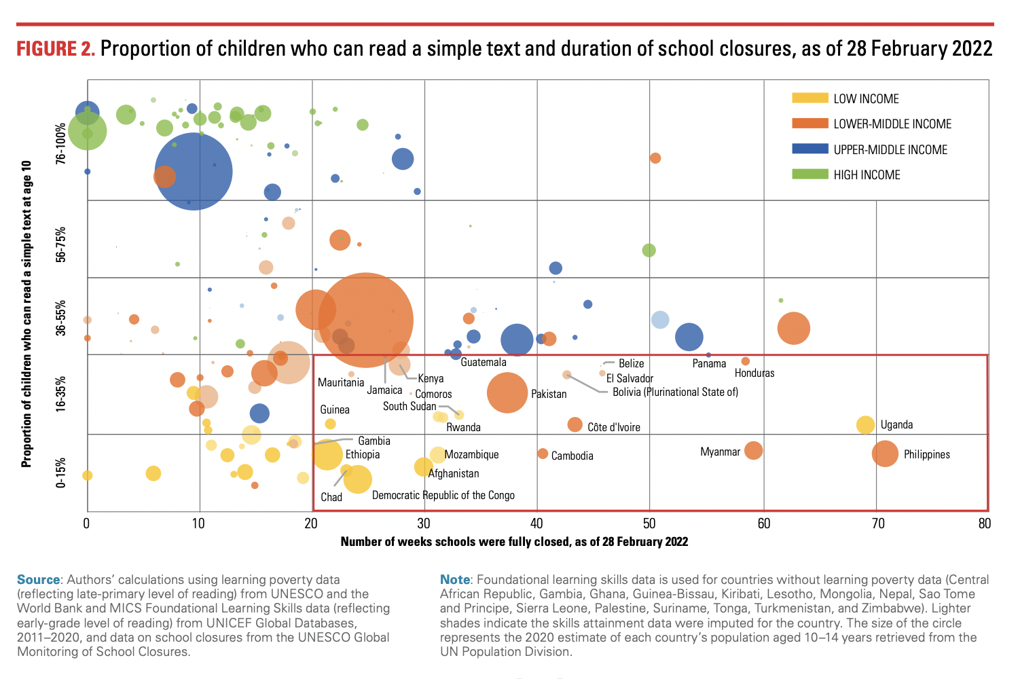
Other Factors that Affect the Quality of Student Learning Outcomes:
Notes:
3) We also need to address learning loss. Among about 214 countries, we belong to the top 25 countries with the longest duration of school closure. You can see in this graph that there can be a relationship between proportion of children who can read a simple text at age 10 and the number of weeks schools were fully closed

Slide 11
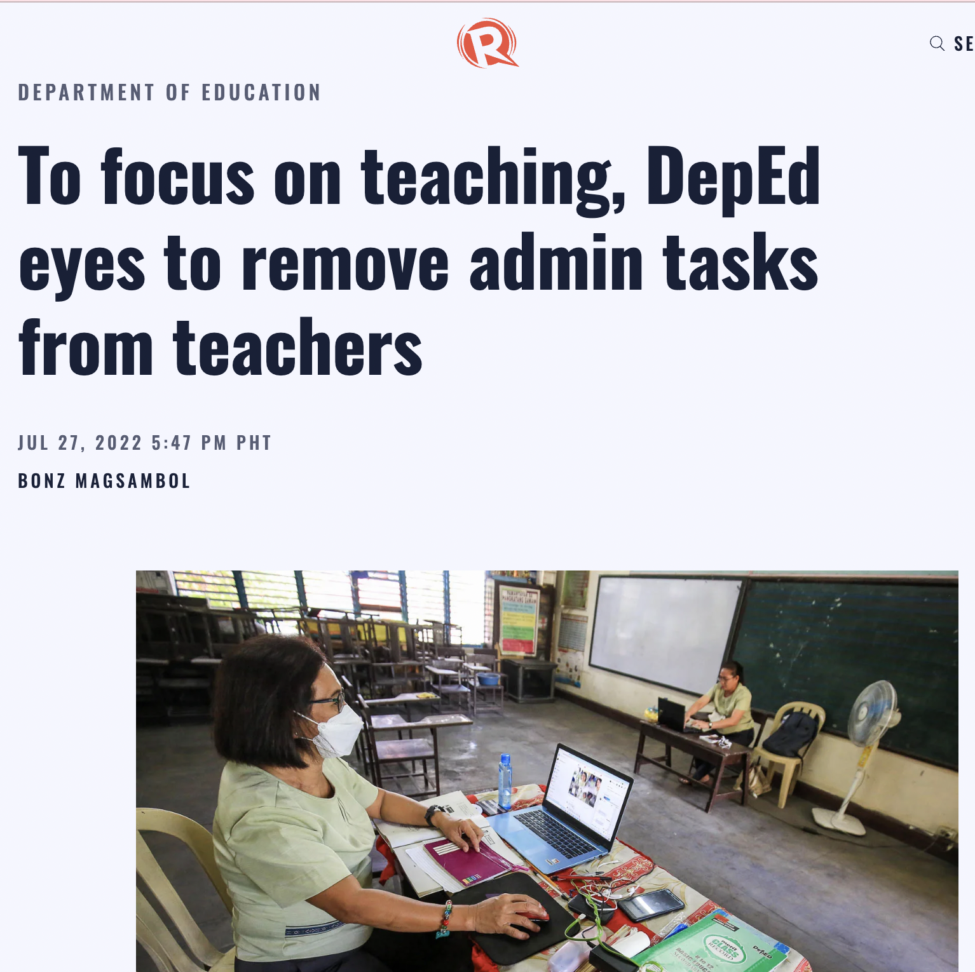
Other Factors that Affect the Quality of Student Learning Outcomes
Duties of a public school teacher (David et al., 2019)
Maximum of six hours of actual classroom instruction a day
Paperwork/ Portfolio making for submission to Performance Based Bonus and reports for the following other tasks
Additional designations in line with student guidance, budget, disaster response, and health.
Participate in the implementation of various government programs, such as mass immunizations, community mapping, conditional cash transfer, deworming, feeding, population census, anti-drug, election, among others.
Provision of psychosocial support to students
Mapping process
https://www.rappler.com/nation/deped-eyes-remove-administrative-tasks-teachers-can-focus-teaching/
Notes:
The fourth factor that affect the quality of student learning outcomes is the overloaded duties of the teachers. 4) Teachers have many tasks other than teaching, leaving them to have no time for improving teaching, research, and professional development.
Aside from the six hours of actual classroom instruction a day, a public school teacher has
paperworks/ portfolio making for submission to performance-based bonus and reports for the following other tasks,
additional designations in line with student guidance, budget, disaster response, and health,
task to participate in the implementation of various government programs, such as mass immunizations, community mapping, conditional cash transfer, deworming, feeding, population census, anti-drug, election,
provision of psychosocial support to students, and
the mapping process, which involves teachers going house-to-house to count and document target learners. This process is tedious and is an additional responsibility imposed on teachers.
Recently, the Department of Education stated that the removal of admin tasks from teachers is being reviewed.

Slide 12
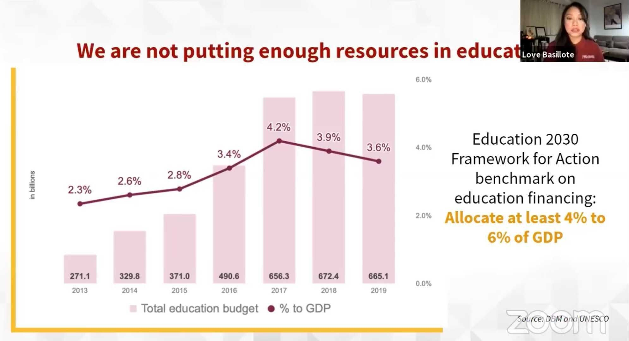
Other Factors that Affect the Quality of Student Learning Outcomes:
https://media.philstar.com/photos/2021/01/14/image-ios_2021-01-14_18-48-46_gallery.jpg
Notes:
5) Spending on education has not been enough and does not meet the UNESCO's Education 2030 Framework for Action benchmark on education financing, where 4% to 6% of the country's gross domestic product should be allocated to the sector.

Slide 13
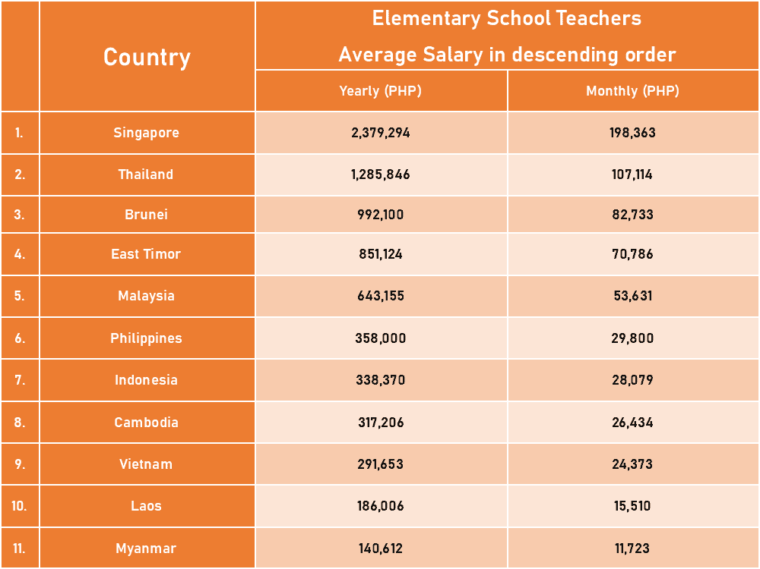
https://teachertayo.com/wp-content/uploads/2021/05/Elementary-School-Teachers-Average-Salary-in-descending-order-1.png
Notes:
The budget for education is related to the average salary given to the teachers. The teachers in our country have been requesting for higher pay.

Slide 14
Other Factors that Affect the Quality of Student Learning Outcomes:
6) Professional development opportunities offered to teachers frequently fail to meet even minimum levels of quality and fall short of what teachers want and need (World Bank, 2014)
Notes:
As mentioned earlier, due to the need to the accomplish reports and other tasks, the teachers lack time for professional learning such as attending graduate studies. Thus the sixth factor that affect the quality of student learning outcomes is that the 6) Professional development opportunities offered to teachers frequently fail to meet even minimum levels of quality and fall short of what teachers want and need (World Bank, 2014)
When the public school teachers are interviewed, they say that short-time seminars are not enough aside from the fact that it’s difficult for them to attend seminars because of lack of time and financial resources.

Slide 15
“Teachers are not only one of the ‘variables’ that need to be changed in order to improve their education systems, but they are also the most significant change agents in these reforms.” (Villegas-Reimer, 2003)
Notes:
According to Villegas-Reimer (2003) in her UNESCO booklet on teacher professional development, teachers are not only one of the ‘variables’ that need to be changed in order to improve their education systems, but they are also the most significant change agents in these reforms. This emphasis has been welcome by teachers and educators in general as it represents a much needed appreciation of teachers’ work, and also promotes the concept of teaching as a profession.”

Slide 16
Addressing Weak Pedagogical Skills of Teachers
Continuing Professional Development (CPD) programs (BEDP 2030)
Content knowledge
Pedagogy/ instruction of 21st century and socio-emotional skills / Learning approaches and learning modalities
Formative/ authentic assessment
Management of learners at risk/ Handling students experiencing mental and psychosocial health issues
Implementation of remediation programs
Notes:
One of the development plans for basic education to address the weak pedagogical skills of teachers is to provide continuing professional development programs focusing on the following topics: Content knowledge
Pedagogy/ instruction of 21st century and socio-emotional skills / Learning approaches and learning modalities
Formative/ authentic assessment
Management of learners at risk/ Handling students experiencing mental and psychosocial health issues
Implementation of remediation programs
These indeed should be the focus of the teacher professional development, but I would like to emphasize the word continuing.

Slide 17
Characteristics of the “New” Perspective of Professional Development (Villegas-Reimer, 2003)
Constructivism rather than on a ‘transmission-oriented model’.
Acknowledges the fact that teachers learn over time
Relates training to actual classroom experiences
Notes:
I’d like to cite the summary of Villegas-Reimer of the characteristics of the new perspective of professional development. For our country, this may still be new even though the UNESCO booklet was written in 2003, 20 years ago. 1) It is based on constructivism rather than on a ‘transmission-oriented model’.
There’s a need for our K-to-12 system to shift the teachers’ paradigm from the transmission-oriented model to constructivism, thus, the teacher professional development need to have that paradigm shift too. Teachers are consequently treated as active learners who are engaged in the concrete tasks of teaching, assessment, observation and reflection as I earlier mentioned. Professional development needs to be positioned not as an intervention which seeks to ‘fix’ teachers’ weaknesses in knowledge and practices, but as a development approach which values teachers’ existing knowledge and skills and
uses these as the basis for further learning.
2) It is perceived as a long-term process as it acknowledges the fact that teachers learn over time. A series of related experiences (rather than one-off presentations) is seen to be the most effective as it allows teachers to relate prior knowledge to new experiences. This is the reason that I have been asserting that a system of mentoring should be in place. MENTORING
3) It is perceived as a process that relates training to actual classroom experiences
Contrary to the traditional professional development opportunities that did not relate ‘training’ to actual classroom experiences (that’s why they fall short of what the teachers need), the most effective form of professional development, according to Villegas-Reimer, is that which is based in schools and is related to the daily activities of teachers and learners. Successful professional development needs to be relevant to and integrated into the daily professional life of the teacher, and should be situated in ‘schools and classrooms and not in training rooms. Schools are transformed into communities of learners, communities of inquiry, and professional communities The most successful teacher development opportunities are ‘on-the-job learning’ activities such as study groups, action research and portfolios.

Slide 18

https://www.strivedevelopment.co.uk/wp-content/uploads/2016/02/Mentoring.jpg
Notes:
The teaching mentoring program that I recommend is a yearlong, one-to-one guidance to less experienced teachers, with mentors and mentees typically meeting at least once a week. The veteran teacher gives impromptu classroom visits and converses with the new teachers for them to gain professional knowledge, skills to reflect on the status quo, and a vision for the future.
The mentor-mentee relationship is dynamic and fluid, depending on the current topic and each teacher’s needs. The mentor and the mentee learn from one another. The mentor and mentee, which should not be strictly one-to-one can also do action research together to solve teaching and learning problems in their content area. This process may entail reduced teaching load for both the mentor and the mentee.

Slide 19
Traditional vs. Clinical Supervision (Villegas-Reimer, 2003)
Traditional ‘inspectional’ model (Bourke, 2001)
Typically completed by an administrator who comes into a classroom, either takes notes or checks according to a list of criteria whether the teacher is achieving all the necessary requirements, and then leaves the classroom, giving no feedback (immediate or otherwise) to the teacher.
Based on this brief evaluation, the teacher may receive or be denied promotion, tenure, or even a renewed contract for the following year.
Clinical Supervision (Harvard Newton Summer School)
Fosters teacher development through discussion, observation and analysis of teaching ‘in the clinic of the classroom’
Observations are conducted in a ‘gentle’ way, and feedback is given in a respectful manner.
Teachers were able to regard observations and assessment of their work as an opportunity to grow and develop in their career, rather than as something to be fearful about.
Notes:
Villegas-Reimer gives a contrast between the traditional inspectional model and clinical supervision. The teacher professional development in the Philippines tends to follow the traditional ‘inspectional model’. In the traditional ‘inspectional model’, which is typically completed by an administrator who comes into a classroom, either takes notes or checks according to a list of criteria whether the teacher is achieving all the necessary requirements, and then leaves the classroom, giving no feedback (immediate or otherwise) to the teacher.” Based on this brief evaluation, the teacher may receive or be denied promotion, tenure, or even a renewed contract for the following year.
In the clinical supervision model, which was originally conceived at the Harvard-Newton summer school as a means of fostering teacher development through discussion, observation and analysis of teaching ‘in the clinic of the classroom’”(Grimmett and Crehan, 1992, p. 68), observations are conducted in a ‘gentle’ way, and feedback is given in a respectful manner. Teachers were able to regard observations and assessment of their work as an opportunity to grow and develop in their career, rather than as something to be fearful about.

Slide 20
Characteristics of the “New” Perspective of Professional Development (Villegas-Reimer, 2003)
4) Culture building and not of mere skill training
5) A teacher is conceived of as a reflective practitioner
6) Collaborative process
7) Schools and educators must evaluate their needs, cultural beliefs and practices
Notes:
To continue the summary of Villegas-Reimer of the characteristics of the new perspective of professional development.. 4) The professional development is a process of culture building and not of mere skill training, which is affected by the coherence of the school programme.
The teacher professional development programme should be supported by the school or curricular reform.
5) A teacher is conceived of as a reflective practitioner, someone who enters the profession with a certain knowledge base, and who will acquire new knowledge and experiences based on that prior knowledge. In so doing, the role of professional development is to aid teachers in building new pedagogical theories and practices and to help them develop their expertise in the field.
6) Professional development is conceived of as a collaborative process. The most effective professional development occurs when there are meaningful interactions, not only among teachers themselves, but also between teachers, administrators, parents, other community members, and across schools.
7) Schools and educators must evaluate their needs, cultural beliefs and practices in order to decide which professional development model would be most beneficial to their particular situation. Guskey (1995b) argues strongly the importance of paying attention to context so that the “optimal mix” (p. 3) of professional development processes can be identified and planned.

Slide 21
Addressing Weak Pedagogical Skills of Teachers
Teacher mentoring program conducted by key school-based mentors or by division officers
Curriculum guides including the appropriate learning approaches and assessment are developed, disseminated, and implemented
Corresponding change in the pre-service teacher training curriculum
Professional development programs for instructional leaders (MTs, SHs, PSDS, EPS) to support teacher PD in various priority areas.
Additional support to teachers in schools is the provision of non-teaching personnel who can assist with administrative tasks and provide ancillary services so that teachers can focus on their core role of teaching (BEDP 2030)
Notes:
Aside from the continuing development plan and teaching mentoring program conducted by key school-based mentors or by division officers, the Basic Education Development Plan 2030 also cites
And indeed, curriculum guides including the appropriate learning approaches and assessment are developed, disseminated, and implemented, but I do hope that the curriculum guide is collaboratively developed, instead of a top down approach wherein the teachers are least included in the development
The BEPD 2030 also recommends Corresponding change in the pre-service teacher training curriculum
Professional development programs for instructional leaders (MTs, SHs, PSDS, EPS) to support teacher PD in various priority areas.
Additional support to teachers in schools is the provision of non-teaching personnel who can assist with administrative tasks and provide ancillary services so that teachers can focus on their core role of teaching (BEDP 2030)

Slide 22
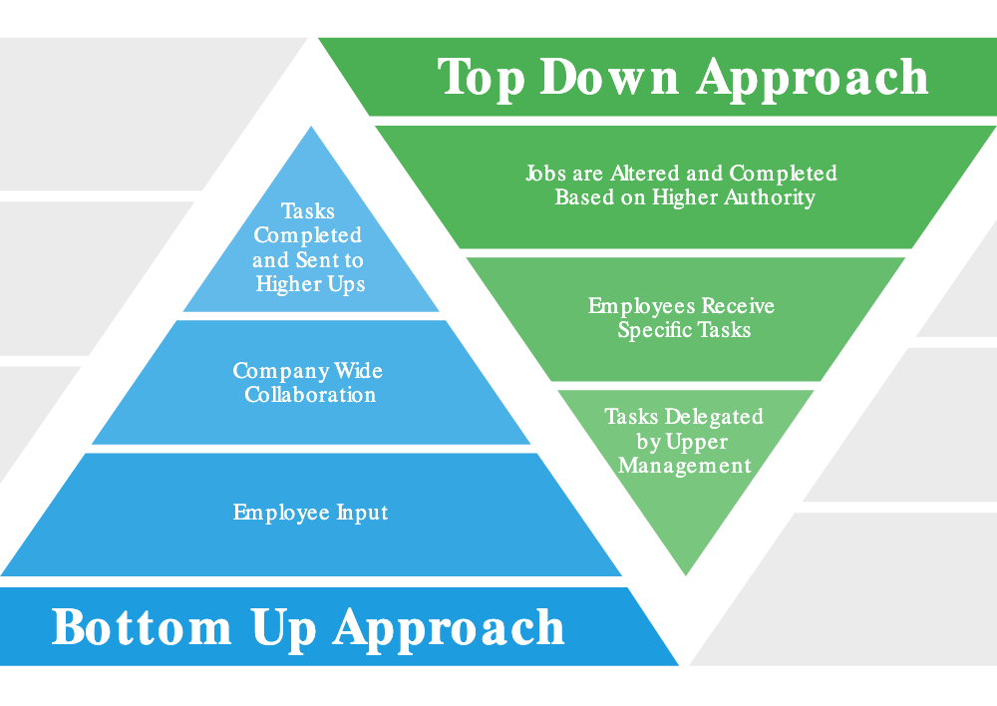
https://www.smartsheet.com/sites/default/files/IC-Top-Down-vs-Bottom-Up-Approach.svg
Notes:
Research indicates that teachers who have limited choice as typically less satisfied with their professional development than teachers who do have some choice and a didactic model in which facilitators simply tell teachers what to do has limited impact. When the teachers who are in the front lines of the institutions have not been consulted, they do not have any real commitment beyond simply complying. This type of professional development has often been called top-down professional development because it comes from above by the administrator, and its opposite if bottom-up professional development. Bottom-up professional development comes from below in that teachers are consulted and many times decide how and what they want to develop (Richards and Farrell, 2005). This bottom-up approach sees teachers are voluntary attendees and engage in professional development because they want to reflect on their practice in order to better serve their students.

Slide 23
Thank you for listening!
Notes:
Thank you so much for listening! Have a good day!!!

