Slide 1

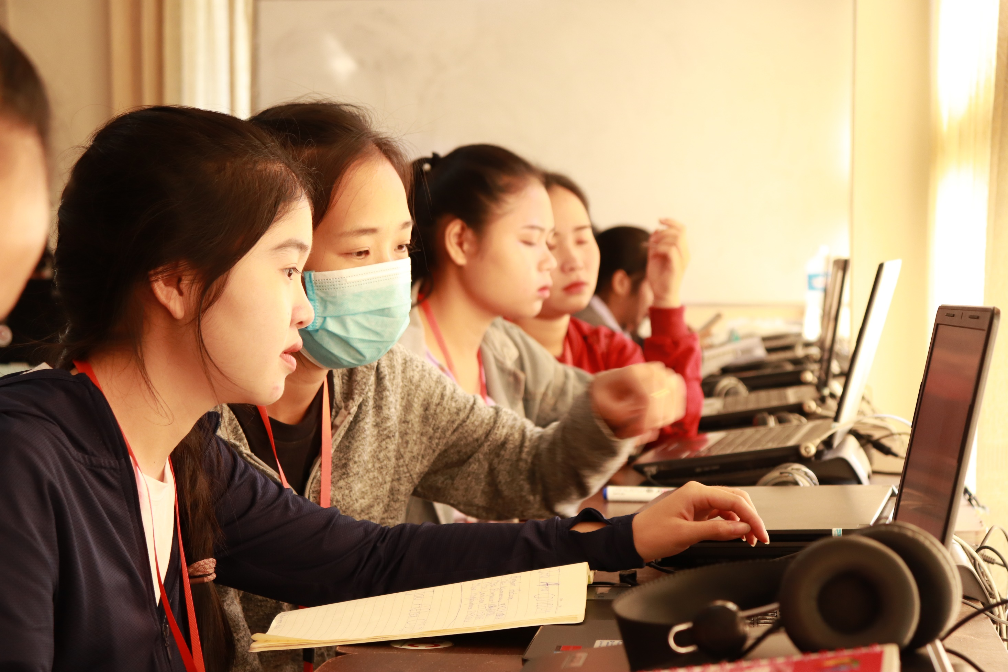
The Student’s Participation in Online Instruction
During the Pandemic of Covid-19
Faculty of Education, Souphanouvong University; Lao PDR
By: Saiphone KHOTSAIGNOH

Slide 2

Background
“In the present day, technology had a huge development and connect the haft of the people from all over the world together on a network named “Internet” (internetworldstats, 2020).

Slide 3
Background
The Faculty of Education is one of six faculties in Souphanouvong University Laos; which it instruct the bachelor curriculum that aims to produce technicians with all the requirements of a teacher professionally such as the Code of Ethics, Morals, Diligence of Teaching Profession, with the vision for the year 2030 "to become a center of excellence for education professional development and production for sustainable development"

Slide 4
Background
As an education institute who running to improve it self with technology by encouraged lecturers to apply technology with teaching, Many lecturers are using online platform to teach their students and make it as a discussion board about the lesson; Some lectures are using videos to assist the instruction; In the same way other multimedia platform are also integrated effectively.

Slide 5
Background
According to the current lockdown situation due to the pandemic of COVID-19; most country are effort their people to stay home and keeping social distance as a new normal; Every works or businesses was impacted and change their life styles; in this situation the face to face instruction in classroom are also disrupted; meanwhile the online instruction was an answer.

Slide 6
Background
The faculty of education are also conducting a large scale of online instruction for student, Many lecturers used their individual resources to launching an online activities

Slide 7
Background
Anyhow, this is our first time to conducting a large scale of online instruction; Meanwhile some of lecturer and students are not experience with the platform; but due to situation of the pandemic that we could not conducting onsite class room then the online method are the only solution we had

Slide 8
Background
By this situation, we faced many problem during the implementation. We have a various students who come from different resident background. And as we know Laos is a country that the infrastructure are not developed in enough way; most of rural area are not able to access the internet service, and this is a very important concern due to almost half of our students comes from the rural area and facing the barrier to access the internet; this research will show us more clearly about the inside of student’s participation in online instruction that we can use it to improve our process in the future

Slide 9
II. Research Objective
❶ To investigate the student’s participation in online instruction during the pandemic of COVID-19
❷ To investigate the difference of participation level between two group of Urban resident and Rural resident students

Slide 10
III. Research Hypothesis
❶ The student`s participation in Online instruction are in a high level
❷ The student from urban and rural resident has different participation level with the statistical significant of .05

Slide 11
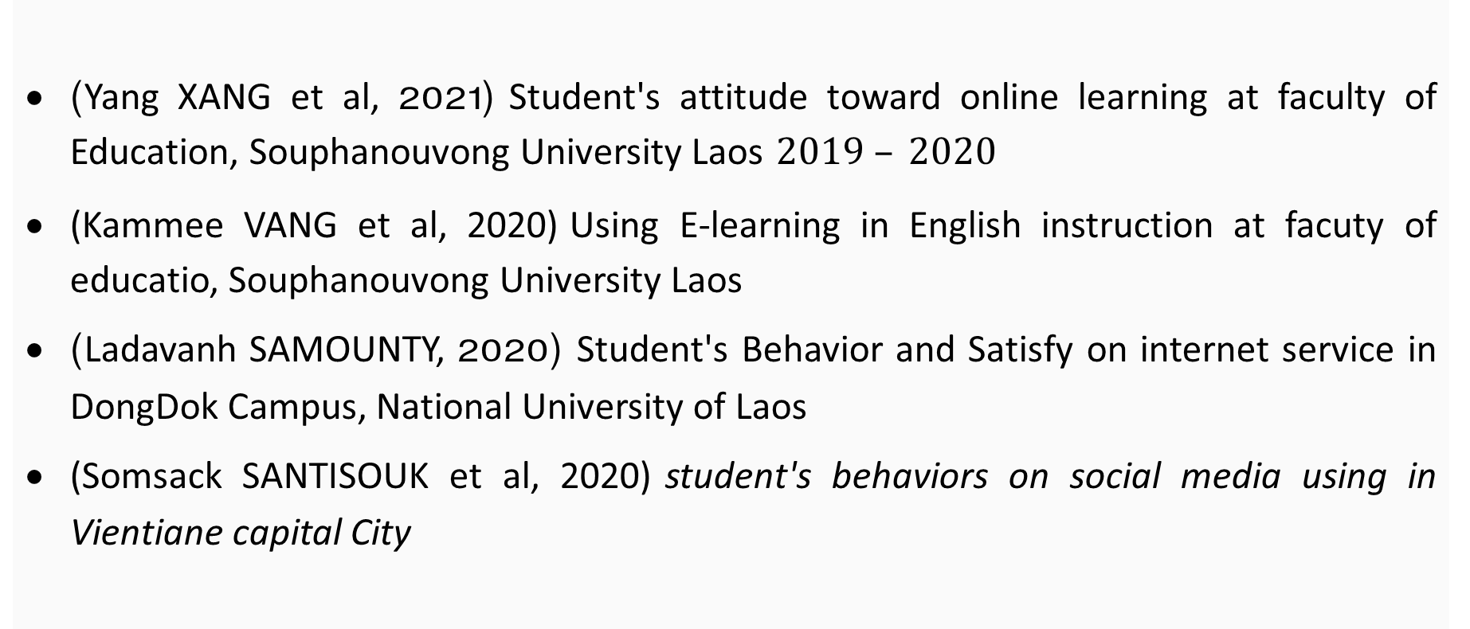
IV. Literature Review
(Yang XANG et al, 2021) Student's attitude toward online learning at faculty of Education, Souphanouvong University Laos $2019 – 2020$
(Kammee VANG et al, 2020) Using E-learning in English instruction at facuty of educatio, Souphanouvong University Laos
(Ladavanh SAMOUNTY, 2020) Student's Behavior and Satisfy on internet service in DongDok Campus, National University of Laos
(Somsack SANTISOUK et al, 2020) student's behaviors on social media using in Vientiane capital City

Slide 12

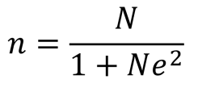
V. Methodology
Population and sample
(Yamane, 1970: 580-581)
This research has conducted with 165 sampling students which has selected from the total of 283 students who are currently study during the academic year 2020-2022;
(Yamane, 1970: 580-581)

Slide 13
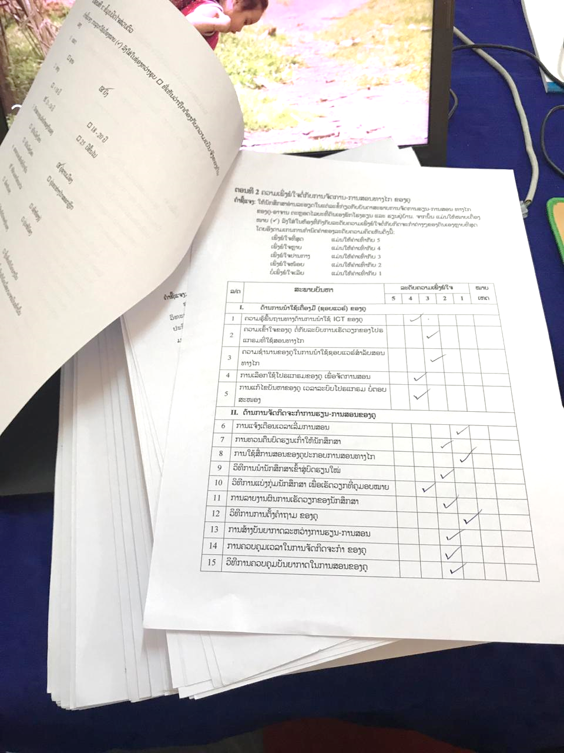
V. Methodology
Research instrument
The instrument of this research is a rating scale of questionnaire for investigate the student’s participation with 4 processes of online instruction in respond to 25 items of with IOC = 1 and the reliability was of .964

Slide 14
VI. Analyze
the research was conduct throughout the analyzing of Mean, Standard Deviation and Compare Mean
❶ Analyze to finding Mean and Standard Deviation to indicate the level of student’s participation
❷ Analyze to compare mean of the student’s participation between the Urban and Rural resident by Independent sample T-test

Slide 15
VII. Outcome
Student’s Residential

Slide 16
VII. Outcome
Participation on Platform planning

Slide 17
VII. Outcome
Participation on Instruction activities

Slide 18
VII. Outcome
Participation on Discussions

Slide 19
VII. Outcome
Participation on Evaluations

Slide 20
VII. Outcome
Over all of Student’s participations

Slide 21
VII. Outcome
Compare mean of Urban and Rural Residential

Slide 22
VIII. Keys finding
❶ The students’ participation in online instruction during the pandemic was found at moderate level by the mean of 3.35 and Standard Deviation = 1.05
❷ Student from Urban and Rural residence has different participation level with the statistical significant of .05

Slide 23
IX. Conclusions
In conclusions, it was found that the student’s participation in online instruction in faculty of education during the pandemic of Covid-19 Academic year of 2020-2022 was in Moderate level
Meanwhile the finding showed that all processes of instruction has difference participation level such as
The Student’s participation with platform planning was in Low level
The Student’s participation with Instruction activities was in Moderate level
The Student’s participation with Discussion was in Moderate level
The Student’s participation with Evaluation was in Moderate level

Slide 24
IX. Conclusions
In addition the compare mean of student’s participation who comes from difference resident, Urban and Rural area was found in significant difference due to the condition of internet access in both area where the student live and learn from home during the pandemic.
Laos is a country with inconvenience infrastructure; particular the telecommunication network are not available in most remote area; So the student has a difficulty to participate the online learning from their area

Slide 25
IX. Conclusions
An other reasons of the participation from the student who take part with online classroom were not in high level we found that the following factor:
The preparation for the platform
The preparation for Hardware
The preparation for the contents
The preparation for the methodology

Slide 26
IX. Conclusions
Anyhow, not only the participation that showing the statistic in the moderate level; we also found some research which it study in the same location and same period of pandemic such as (Yang XANG et al, 2021) found that the students from difference resident has difference attitude about online learning; and (Kammee VANG et al, 2020) found that English student at the faculty of education has satisfy on learning English via E-learning in moderate level;

Slide 27
IX. Conclusions
As for the difference of student’s participation between Urban and Rural resident are significant differenced due to the internet access status in both area’ as we know the urban area is quite easier; so that the level of online engagement of the student in the city or urban area is in high level (Somsack SANTISOUK et al, 2020); and in other way the student in the town are also satisfy with the high speed of network (Ladavanh SAMOUNTY, 2020).
Those above factors are not available in the Rural area

Slide 28
XI. Reference
Faculty of Education. (2009). Educational Technology. LouangPrabang: Souphanouvong University.
internetworldstats. (2020). Internet User Intribution in the world. Retrieved from https://www.internetworldstats.com/stats.htm
J. Michael Spector. (2020). Design for Educational Technology. Texas: University of North Texas.
Junfeng Yang. (2020). User perspective of educational education. Hangzhou, Zhejiang, China: Hangzhou Normal University.
kansiri Chanchalearn. (2015, 11 26). Identifying population and sample. Retrieved from uxlabth.com.
Ministry of Education and Sport. (2016). Strategy 2015 and Vision 2030 . Vientiane: Ministry of Education and Sport.

Slide 29
XI. Reference
Kammee VANG et al. (2020). Using E-learning in English instruction at facuty of educatio, Souphanouvong University Laos. Souphanouvong Journal: Multi-disciplinary Research of Souphanouvong University, 6(1), 119-129.
Ladavanh SAMOUNTY. (2020). Student's Behavoir and Satastify on internet service in DongDok Campus, National University of Laos. Vientiane: National University of Laos.
Somsack SANTISOUK et al. (2020). student's behavoirs on social media using in Vientiane capital City . Humanities & Social Sciences, 37(2 May - August 2020), 120-142.
Yang XANG et al. (2021). Student's attitude toward online learning at faculty of Education, Souphanouvong University Laos. Souphanouvong University Journal of Multidisciplinary Research and Development, 7(2), 351-359.

Slide 30

THANK YOU

