Slide 1
Adaptive Expertise and STEM education
Jihyun Hwang
Korea National University of Education
UNESCO UNITWIN

Slide 2
COVID-19
Hope everyone and your families are doing well
Today’s topic
Adaptive Expertise (What is needed to teach STEM)
Based on my previous studies and an NSF project in progress

Slide 3
Learning is...
Learning is done by the individual –
but needs to be done within social context
We don’t control what goes on within an individual’s head in terms of learning
We need to negotiate with students
  Hwang et al. (2022)

Slide 4
Knowledge generation environment
Knowledge Generation Environments
Teacher
[Fluid]
Learner [Freedom]
Big Ideas
[Fixed]
The need to be adaptive
Underlying Principles
Benefit to cost ratio
Everyday → Academic
Deliberative not disputative
Independent but interdependent
Epistemic Orientation Frames
Learning
Language
Argument
Dialogue
Development of tool [Knowledge, Practices, Pedagogy]
Development of resources
Adaptiveness [Fluidity]
Notes:
Learners need to have the freedom to explore ideas
– using their own language, their own framing
However, there is a need to addressed the fixed ideas that are part of the curriculum
Needs for teachers to be flexible in their thinking and actions
Underlying principles → negotiation

Slide 5
Teaching is...
Teaching is a complex process
Requires the need to engage in a different range of activities
  Negotiating
  Writing
  Understanding Conceptual Knowledge
Need to move between providing student freedom and the fixed ideas of the curriculum

Slide 6
Complexity related to Adaptive expertise
Classrooms are complex learning environments
  Teachers’ orientation to learning affects how they approach this complex environment and the epistemic tools they engage with students—epistemic orientation (Suh et al., 2022)
  Previous work has decontextualized the environment, teachers’ orientations, and the epistemic tools teachers use with students
Adaptive Expertise
the ability of teachers to maximize learning outcomes by drawing on varied epistemic tools to respond to and manage complex environments

Slide 7
To be Adaptive
All people in the environment need to be adaptive
Learning pathways are dependent on the individual classroom
  No one fixed linear path to the Big Idea
Utilizing of all available intellectual resources (Bailin, 2002)
  Language, argument, negotiation
Learning is both cognitively demanding and enjoyable

Slide 8

Framework
Baseline
Inputs
Changes
Changes
Teaching Experiences
Adaptive Expertise
Professional Development
Knowledge of Epistemic Tools
Content Knowledge
Knowledge Generating Environments
Academic Year Support
Epistemic Orientation
Practices
Knowledge of Pedagogy

Slide 9
Science Writing Heuristic (SWH)
Hand and Keys (1999)
  The development of the underpinning epistemic framework phase
  the argument phase
  the summary writing phase

Slide 10
Based on this framework
Connections between reasoning in mathematics and science
  Baseline Studies
(2) The effects of SWH on science and mathematics achievement
  After SWH Professional developments
(3) Longitudinal analysis
  (2) and (3): Because of development of adaptive expertise

Slide 11
Choi et al. (2020)

Slide 12
Hwang et al. (2020)

Slide 13
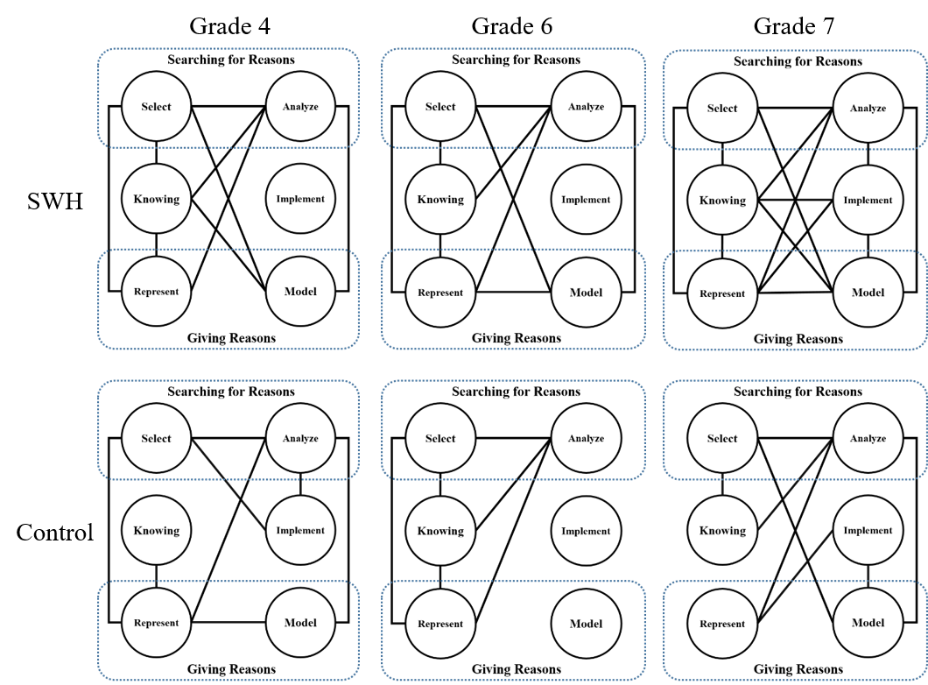
Effects of SWH on Science and Mathematics

Slide 14
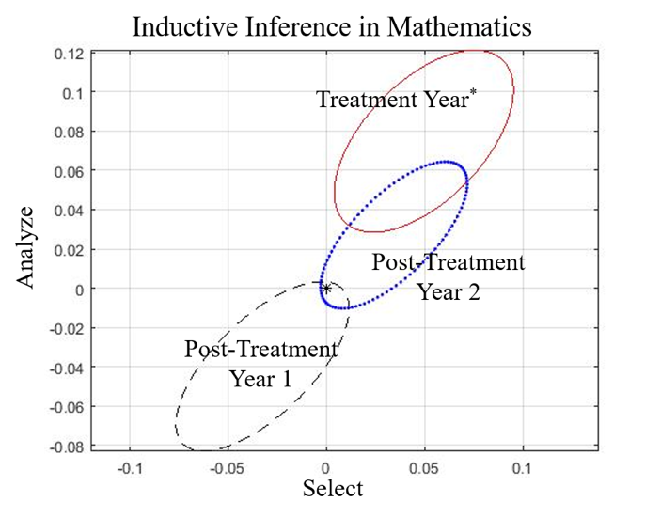
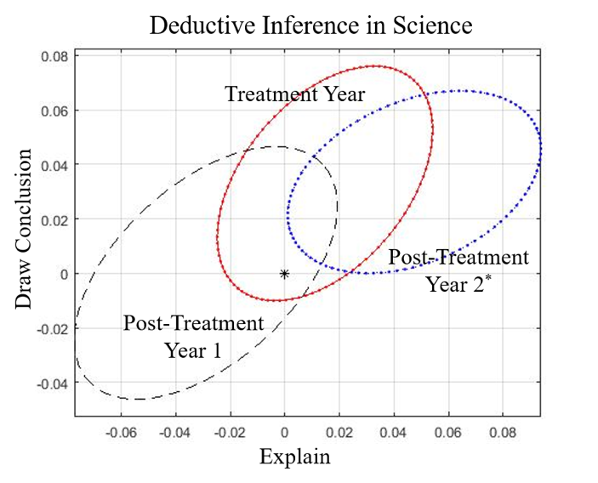
Hand et al. (2022)
95% confidence regions for group differences in growth of inductive inferences in mathematics and deductive inferences in science.

Slide 15
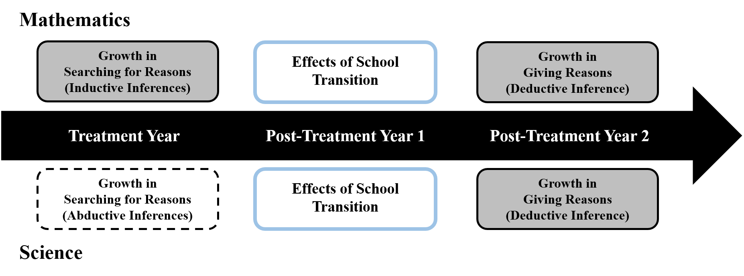
Hand et al. (2022)

Slide 16
Conclusion
Connections between inferences in mathematics and science
To be adaptive
Epistemic orientation and Epistemic tools
Next
Examine what happens in classrooms
Influence from mathematics to science (instead of SWH)

Slide 17
References
  Bailin, S. (2002). Critical thinking and science education. Science & Education, 11, 361–375.
  Choi, K., Seo, K., Hand, B., & Hwang, J. (2020). A theoretical model for the utilization of intellectual resources between science and mathematics: An empirical study. Journal of the Korean Society of Mathematical Education Series A: The Mathematics Education, 59(4), 405–420. https://doi.org/10.7468/mathedu.2020.59.4.405
  Fulmer, G. W., Hwang, J., Ding, C., Hand, B., Suh, J., & Hansen, W. (2021). Development of a questionnaire on teachers’ knowledge of language as an epistemic tool. Journal of Research in Science Teaching, 58(4), 459–490. https://doi.org/10.1002/tea.21666
  Hand, B., & Keys, C. W. (1999). Inquiry investigation. Science Teacher, 66(4), 27–29.
  Hand, B., Choi, K., & Hwang, J. (2022). A longitudinal study of the development and utilization of reasoning resources as an outcome of argument-based inquiry. Manuscript in preparation.
  Hwang, J., Choi, K., & Hand, B. (2022). Epistemic actions and mathematics achievement. International Journal of Science and Mathematics Education. https://doi.org/10.1007/s10763-022-10278-2
  Hwang, J., Choi, K., & Hand, B. (2020). Examining domain general use of reasoning across science and mathematics through performance on standardized assessments. Canadian Journal of Science, Mathematics and Technology Education, 20(3), 521–537. https://doi.org/10.1007/s42330-020-00108-4
  Suh, J., Hwang, J., Park, S., & Hand, B. (2022). Epistemic orientation toward teaching for knowledge generation: Conceptualization and validation of the construct. Journal of Research in Science Teaching. https://doi.org/10.1002/tea.21769

Slide 18
Thank you!
Q/A jihyun-hwang@knue.ac.kr jihyunhwang.com

