Slide 1

Design a curriculum to develop teaching STEM competence for teacher students in primary education
PHAM QUANG TIEP, DANG MINH TUAN*
FACULTY OF PEDAGOGY
UNIVERSITY OF EDUCATION, VNU, HANOI

Slide 2

STEM Concept
Integration of 4 fields such as Science; Technology; Engineering; Mathematic.
STEM → STEAM, STREAM…

Slide 3
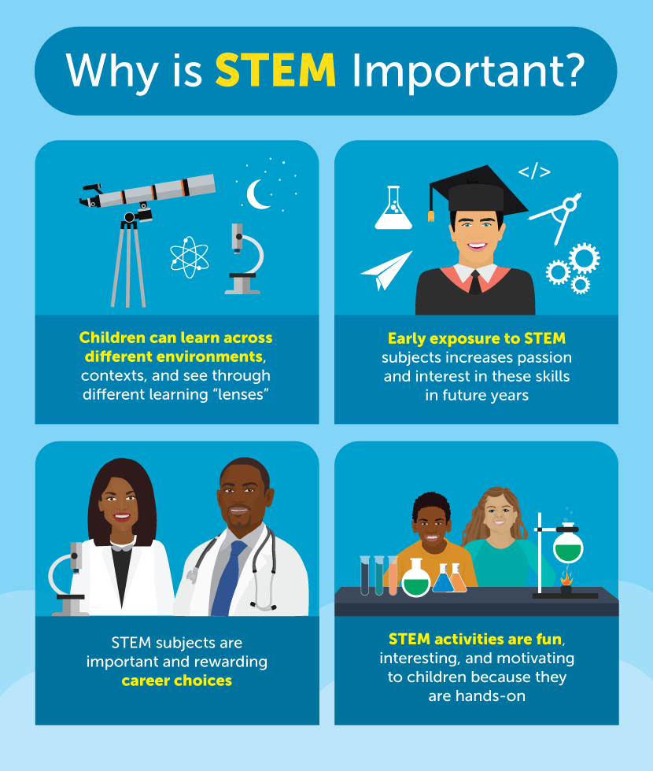
THE ROLES OF STEM
Engaging learners
Developing judgment and creativity
Developing problem solving capacity, cooperation
Make learning easier
Improve the quality of education

Slide 4
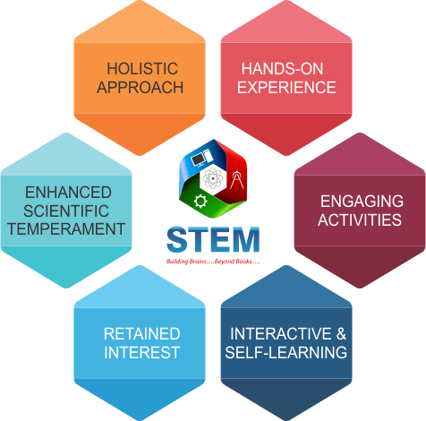
MULTI-STRATEGY APPROACH TO STEM EDUCATION
3 MAIN APPROACHMENTS
  STEM is a way of organizing teaching content
  STEM is a teaching method
  STEM is a Teaching Model

Slide 5
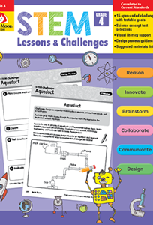
  STEM IS A WAY OF ORGANIZING TEACHING CONTENT
STEM is built into a new subject
The content of the teaching lesson is a deep integration of 4 areas of S-T-E-M
Teaching content is associated with real-world contexts, evoking students' interest in learning
Learning becomes more engaging and easier for students
STEM raises the level of education quality but not in the direction of intensive differentiation

Slide 6
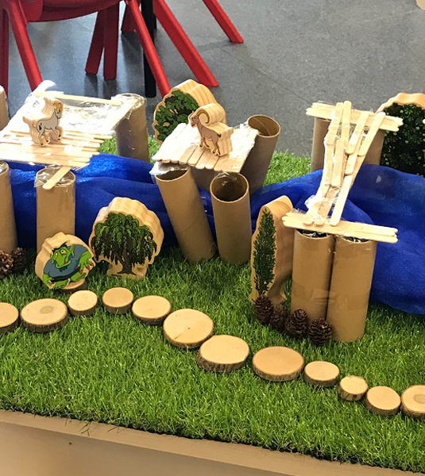
  STEM IS A TEACHING METHOD
  (Any subject can be taught)
Students are put in challenging situations, associated with real-world contexts
Students are encouraged to judge and be creative
Using STEM knowledge and skills to solve the root of learning problems
Enhance opportunities for group learning, develop Team work skills
Focus on competencies rather than specific knowledge

Slide 7
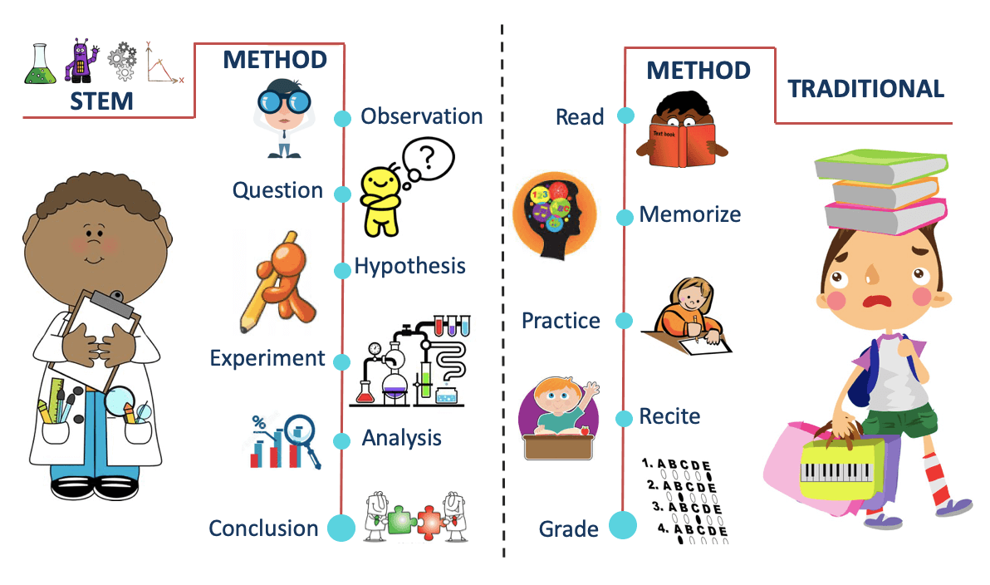
STEM IS A TEACHING MODEL
Comprehensive integration of scientific fields in 4 central elements S-T-E-M
The curriculum is only STEM topics/projects
Teaching methods focus on developing practical capacity
Open and diverse teaching methods: Inside and outside of the classroom, time is not constrained, Product-oriented
Comprehensive assessment according to capacity
Construction of modern Learning equipment and learning space

Slide 8

STEM IN
NEW NATIONAL CURRICULUM 2018
The 2018 National Education Program (NEP) focuses on the goal of forming and developing the qualities and competencies of students.
Some effects:
  Integration (tích hợp)
  Decomposition (phân hoá)
  Experience (trải nghiệm)
  STEM
    Mastery in the entire NEP
    Across all levels
    Emphasis in related subjects: Social Study, Natural Science, Informatics and Technology, Maths

Slide 9
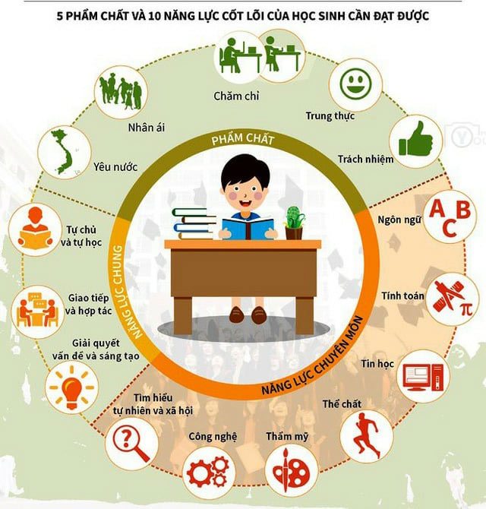
4 STEM SECTORS IN THE COURSE PRIMARY EDUCATION PROGRAM
S – Social Study, Natural Science: People, Plants, Animals, Other Creatures, Earth, Sky, Matter, Energy
T – Informatics and technology: Computers and some simple software, Using technology in some areas of life
E – Informatics and technology: Some simple and close technical design and practice: planting trees, assembling, making school supplies, toys...
M – Math: Numbers and Calculus, Geometry and Calculus, Probability and Statistics

Slide 10

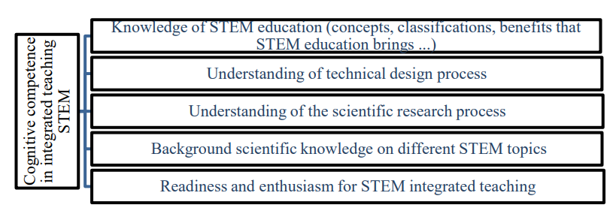
TEACHER’S COMPETENCE TO IMPLEMENTATE STEM EDUCATION
(Source: Nguyen B. et al. 2019)

Slide 11
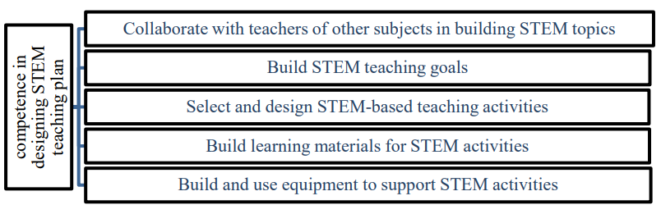
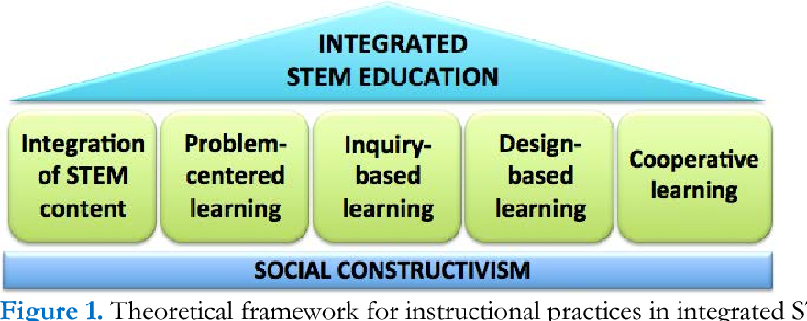
TEACHER’S COMPETENCE TO IMPLEMENTATE STEM EDUCATION

Slide 12
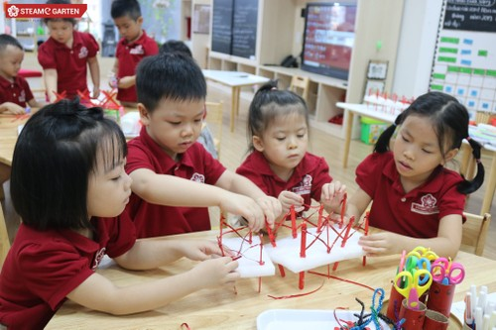
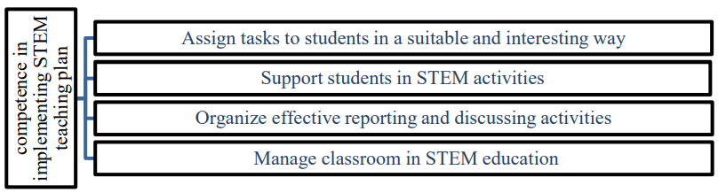
TEACHER’S COMPETENCE TO IMPLEMENTATE STEM EDUCATION

Slide 13
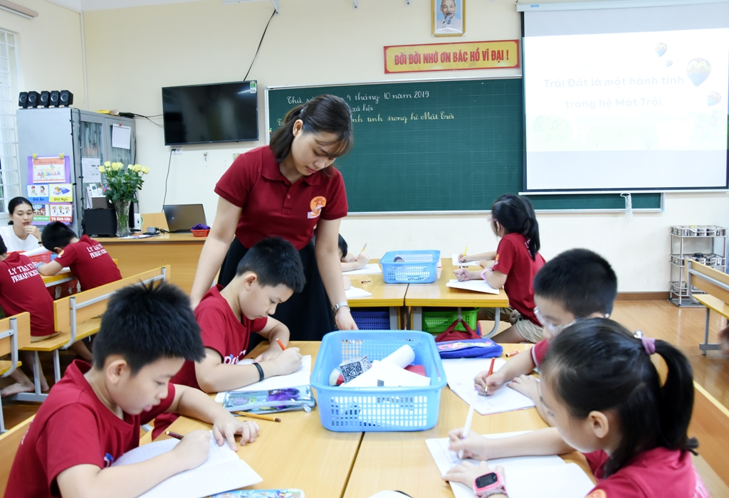
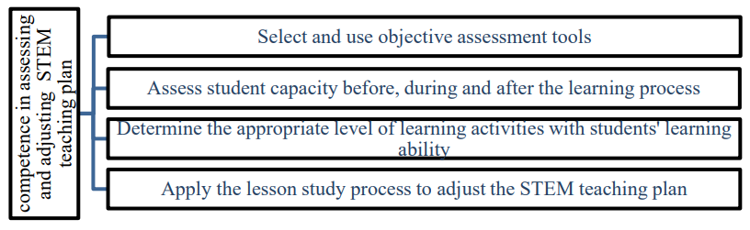
TEACHER’S COMPETENCE TO IMPLEMENTATE STEM EDUCATION

Slide 14
PROPOSED STEM EDUCATION TRAINING PROGRAM FOR STUDENTS IN PRIMARY LEVEL
In line with the implementation of the new national curriculum program 2018.
Training students to become primary school teachers; Competence in STEM education
Focus on 4 groups of competencies as analyzed above.
The program is structured into modules for ease of deployment.

Slide 15
PROPOSED STEM EDUCATION TRAINING PROGRAM FOR STUDENTS IN PRIMARY LEVEL
Program structure:
Module 1: Current status and solutions of STEM education
Nature and characteristics of STEM Education
STEM education in the world
Current status of STEM education in Vietnam
Orientation of STEM education for primary school students in Vietnam

Slide 16
PROPOSED STEM EDUCATION TRAINING PROGRAM FOR STUDENTS IN PRIMARY LEVEL
Program structure:
Module 2: Design STEM topics/lessons
Analysis of the elementary education program
Select science content to integrate into STEM topics/lessons
Identify real-world problems to build into STEM topics/lessons
Practice designing STEM topics/lessons

Slide 17
PROPOSED STEM EDUCATION TRAINING PROGRAM FOR STUDENTS IN PRIMARY LEVEL
Program structure:
Module 3 : Organizing STEM education for elementary students
Some learning characteristics of primary school students
Some popular methods in organizing STEM topics/lessons
The process of organizing STEM topics/lessons for elementary students

Slide 18
PROPOSED STEM EDUCATION TRAINING PROGRAM FOR STUDENTS IN PRIMARY LEVEL
Program structure:
Module 3 : Evaluation in STEM education for elementary students
Some general issues about capacity assessment and assessment
Developing criteria and assessment tools for STEM topics/lessons
Conduct regular and periodic reviews
Learners’ feedback

Slide 19
SOME FEEDBACKS ON STEM EDUCATIONAL COMPETENCE TRAINING PROGRAM FOR PRIMARY EDUCATION STUDENTS
We have consulted 20 experts from 7 key pedagogical universities on the Competency Framework and the STEM education competency training program for students majoring in primary education.
Some specific comments:
The majority (89%) agreed with the competency framework and modules we proposed to train students.
Some other comments:
The training program needs to focus more on equipping students with STEM knowledge and STEM education methods.
Students need to be equipped with knowledge and skills to build and organize STEM club activities for students.
Vietnam needs to do research to include an independent STEM subject in the general education curriculum.

Slide 20


