Slide 1

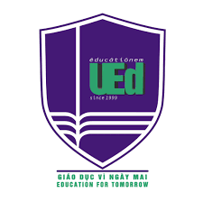
The reality of STEM education in Vietnam: a case study on STEM education in Vietnam's 2018 general education curriculum
VNU – University of Education
Assoc. Prof. Dr Pham Kim Chung
Dr. Le Thi Phuong

Slide 2
Overview of STEM Education in Vietnam
From 2018, Vietnam reformed the education program in the direction of developing the capacity of students; Create a learning environment help students to know how to apply different methods of learning to complete foundational knowledge and skills, consciously choosing a career and lifelong learning.
The general education program is divided into two stages: the basic education stage (from grade 1 to 9) and the stage of general education. career-oriented education (grades 10 to 12).
The system of subjects and educational activities of the general education program includes educational subjects and activities compulsory, career-oriented electives, and electives.
The program only stipulates general principles and orientations on educational methods, not too detailed regulations, to create favorable conditions for students. encourage teachers to promote initiative and creativity in program implementation

Slide 3
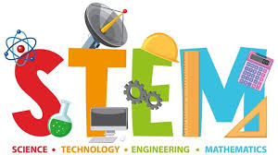
Overview of STEM Education in Vietnam
STEM education is an interdisciplinary approach to learning where rigorous academic concepts are coupled with real-world lessons as students apply science, technology, engineering, and mathematics in contexts that make connections between school, community, work, and the global enterprise enabling the development of STEM literacy and with it the ability to compete in the new economy. (Tsupros, 2009)

Slide 4
How did implement STEM education in Vietnam?
The project “Adapting STEM Education in England into Vietnam context” in 2016 – 2017: The British Council in Vietnam and MOET. 15 schools in 5 cities in the North of Vietnam
At that time, while the public schools only cautiously deployed STEM education, gifted schools, private schools and private educational centers had plenty of STEM activities such as science shows, robotics mini contests, science camps, STEM clubs, etc
Based on this directive, the Ministry of Education and Training has assigned to promote STEM education as well as pilot implement STEM education in some schools (The Prime Minister, 2017).

Slide 5
STEM education in the 2018 general education curriculum
STEM education is integrated approach (sciences, technology, engineering, mathematics) in teaching with following aims:
Increasing interesse of students in STEM subjects;
Appling integrated knowledge to solve realistic problems;
Connecting school and community;
Learning by doing, learning through experience;
Developing characters and competencies of student;

Slide 6
The general education curriculum
In the general education curriculum, STEM education has been focused through the following manifestations:
2018 general education curriculum is full of STEM subjects: Mathematics; Natural Sciences; Technology; Informatics, Physics, Chemistry, Biology.
The position and role of Informatics and Technology subjects in the general education curriculum has been significantly enhanced.

Slide 7
Forms of organization of STEM education
In order to support high schools to effectively implement STEM education, the Ministry of Education and Training guides a implementation STEM education activities in high schools (3089/BGDĐT-GDTrH).
Teaching science subjects according to STEM lessons
Organize STEM experiential activities
Organizing scientific and technical research activities

Slide 8
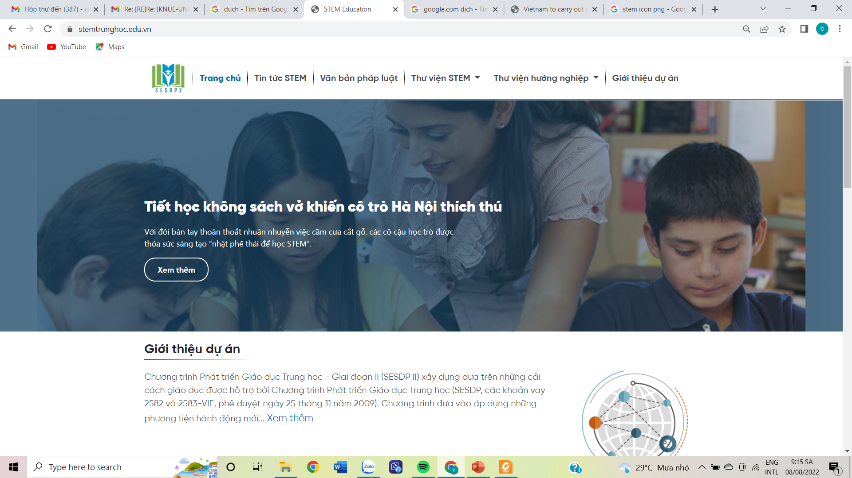
Ebook STEM
STEM topic
Video STEM
https://stemtrunghoc.edu.vn/

Slide 9
Some topics/contents of STEM education in the general education curriculum
In the Primary school:
Preparation of toothpaste | Pet kennels
Automatic fire alarm system | Wind generator
Respiratory system | Crystal candy
Movements of the Earth | Solar house
Cool house | Clean water filter
Soundproof house | I control and participate in traffic

Slide 10
Some topics/contents of STEM education in the general education curriculum
In the Secondary school
Natural colorants | Agricultural drying oven using solar energy | Smart night light
Precise weighing | Smart greenhouse | Detergents
Diversity of the living world under the microscope | Mini heat engine | Color changing lights
Smart electric fan | Biological ripening process | Wind generator
Clean water production | The journey of dissolution and crystallization | Sanitize chemical
Soundproof house | Smart lighting system | Color race
Light and green lungs | Natural indicator

Slide 11
Some topics/contents of STEM education in the general education curriculum
In the high school
Boyle's Law | Euro Sense listens to you | Acid or Base?
Melting point | Electromagnetic induction | Sound speed
Melting, solidifying | Capacitor | Sound wave
Thermostat | Anti-theft system | Oscillation fades out
Effect of concentration on the rate of reaction | Respiration of germinated seeds | Automatic lighting system
Chemical balance | Fermentation
Measure heartbeat | Car lift system

Slide 12
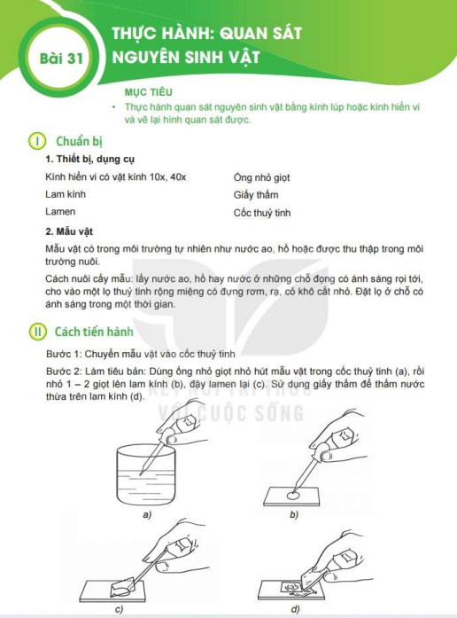
Example: Diversity of the living world under the microscope (Science 6)

Slide 13
Activities of the STEM education topic
Activity 1: Practical problems
Activity 2: Product design
Activity 3: Make products
Activity 4: Product testing and evaluation
Activity 5: Finishing the product
Activity 6: Activity report and evaluation
Activity 7: Putting the product into practice Assign students to apply it at home or at school
Activity 8: Become a technologist

Slide 14
In-school STEM education can be done through the following forms:
- STEM education in STEM subjects
- Teaching STEM integrated topics
- Teaching STEM projects
- STEM Club
- Lab STEM
- Science and technology competitions
- Creative experience activities
- Career-oriented education

Slide 15
Conclusions
STEM education is a new future approach to education and human resource training. It emphasizes the connection and connection between the four fields of Science, Technology, Engineering, and Mathematics.
STEM education has been and is being paid attention to in many countries and included in the curricula and extracurriculars in the schools.
STEM education responds very well to competencies development-oriented learning, which is also the goal of the 2018 general education curriculum.

Slide 16
Thanks for joining us

