Slide 1

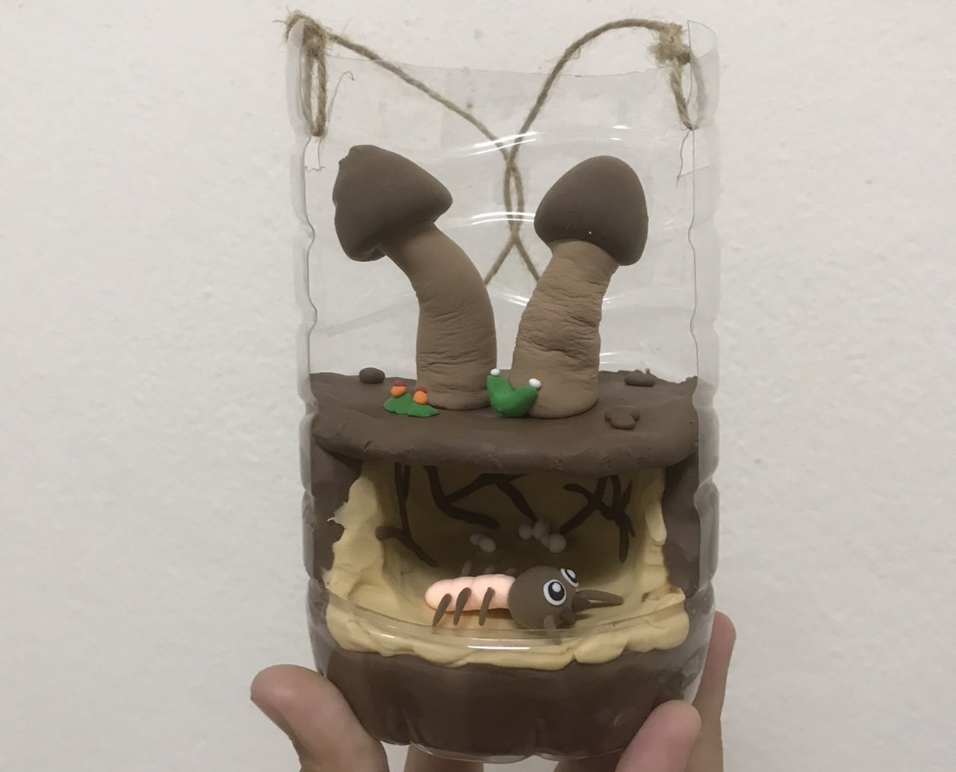
Termite Mushroom Lesson for Learning Local Natural Resources through STEAM Education
Chutamas Sukhontapatipak, Nitima Sutapin, Wimonmas Boonyungyuen,
Nongnuch Sungayuth, Suriya Butrapun, Pimsiri Subsombut, Nipha Boonsao
and Nutcha Trakarnphat
Mahidol University, Kanchanaburi Campus

Slide 2
Contents
Background & objectives
Teacher training
Lesson learned

Slide 3


Termite mushroom of Kanchanaburi
Seasonal harvested non-timber forest product, April to October
Recommended menu of Kanchanaburi
300-600 Baht per kg

Slide 4
Termite mushroom (Termitomyces spp.)
(Forest Research and Development Office, 2009)

Slide 5
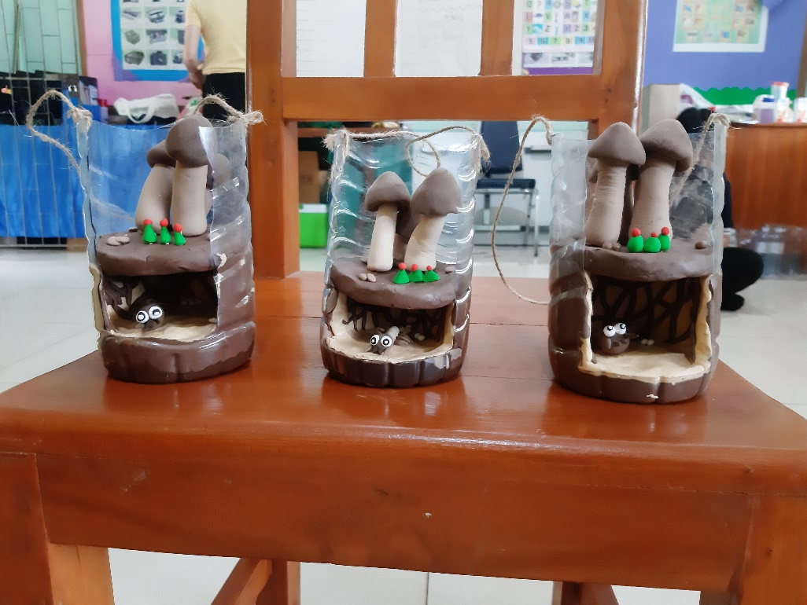
Objectives
STEAM lesson
Student’s life and profession skills
Local natural resources

Slide 6
Target group: Primary school teachers
Wat Triratanaram Charity School
15 teachers
Ban Wang Sing School
20 teachers

Slide 7
Teacher training

Slide 8
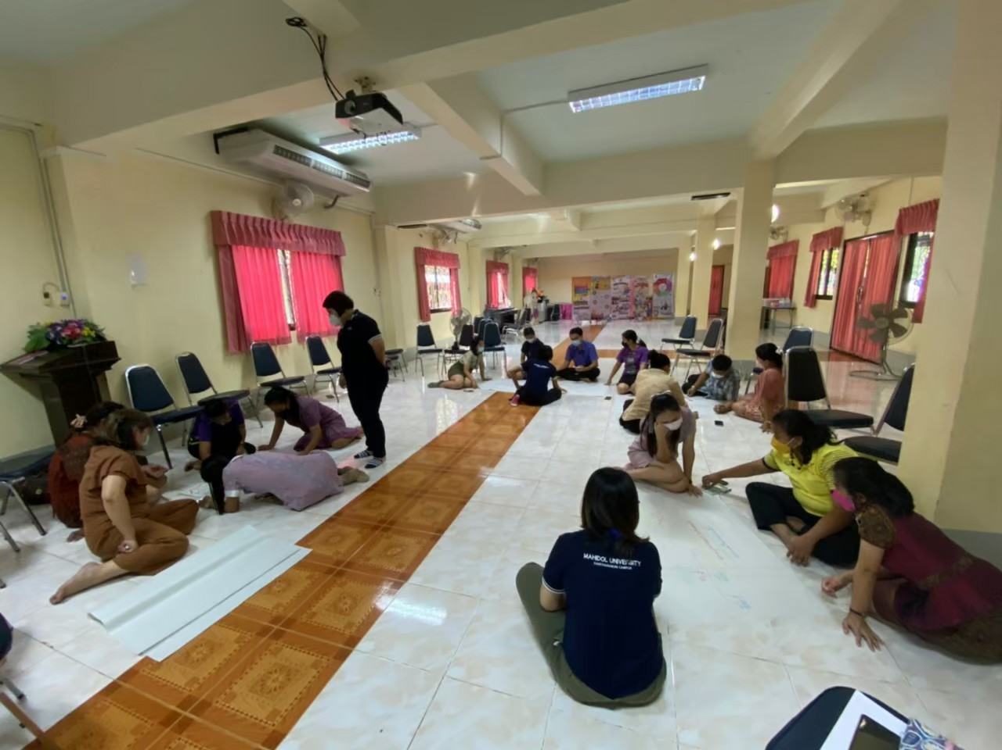
How to teach students about termite mushroom?
S – Science
T – Technology
E – Engineering
A – Arts
M - Mathematics

Slide 9
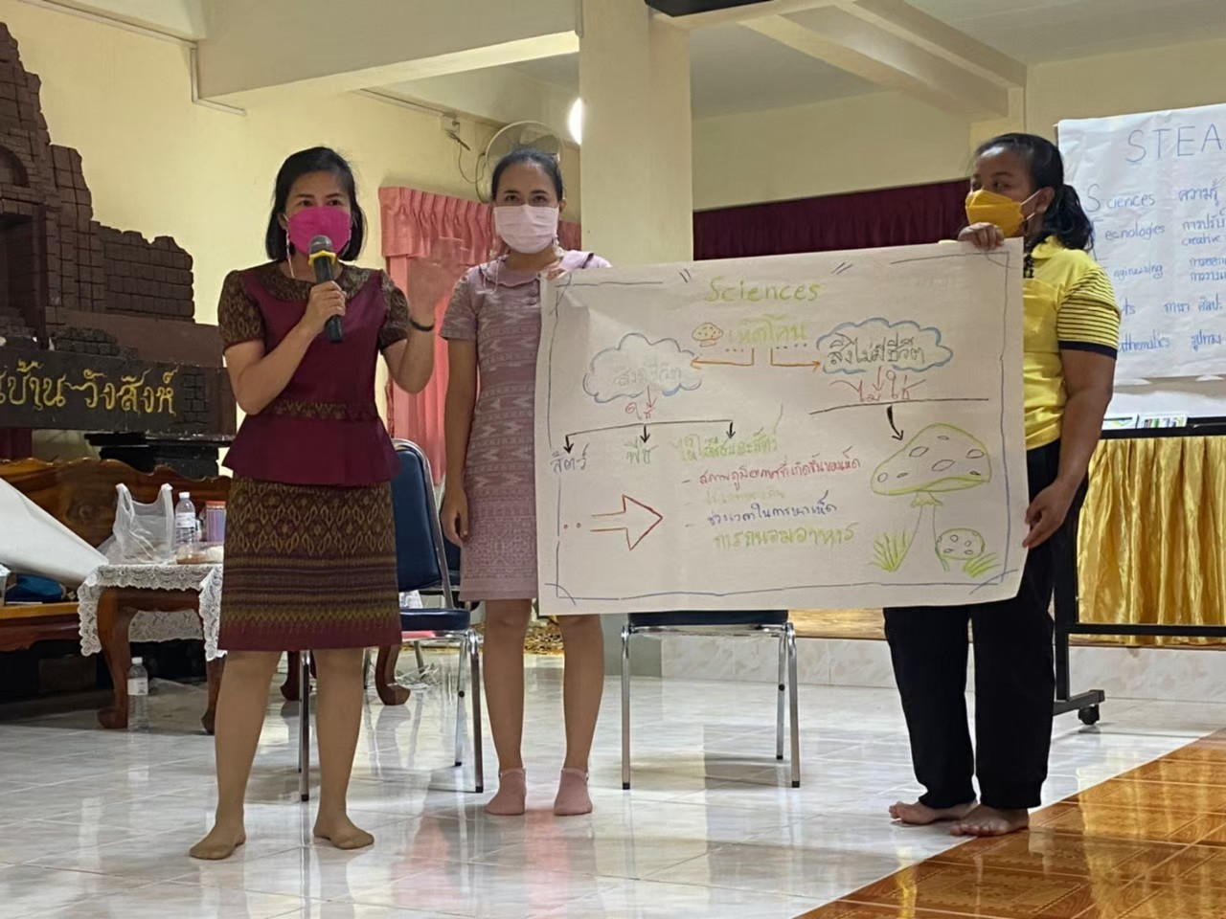
Termite mushroom in Science
Living vs. non-living things
Organism classification
Habitats
Environmental factors
Life cycle & harvest season

Slide 10
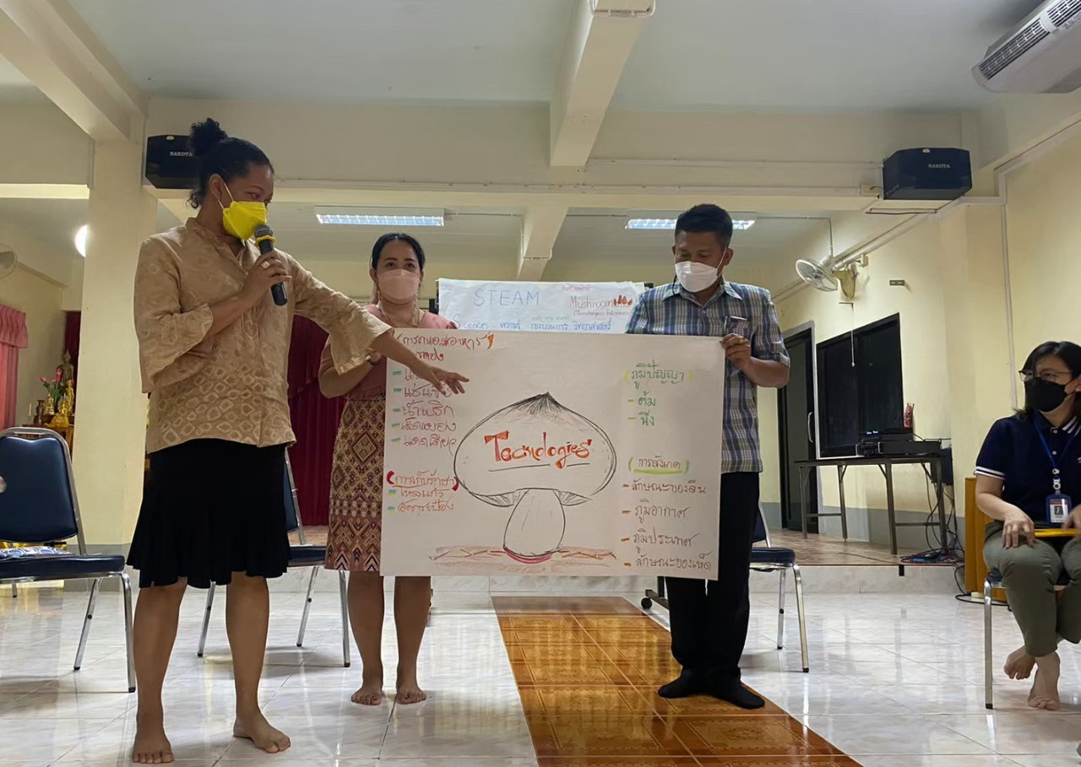
Termite mushroom in Technology
Local wisdom
Harvesting
Cooking
Food preservation & processing
Brined
Sour
Frozen
Canned

Slide 11
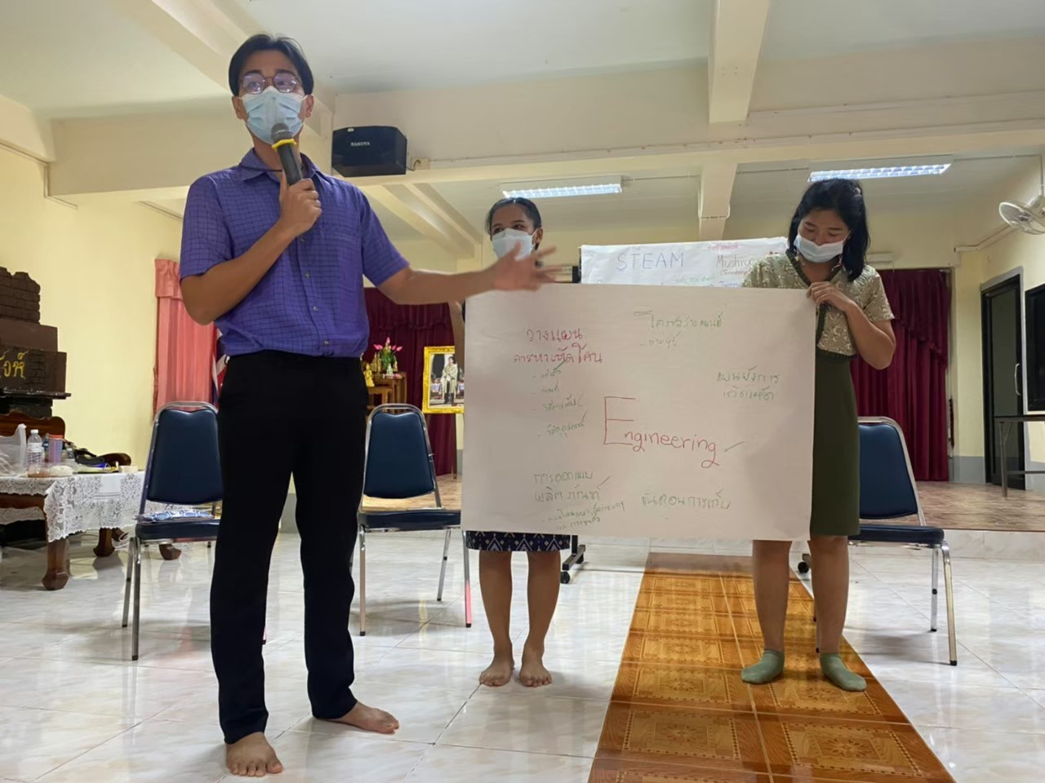
Termite mushroom in Engineering
Harvest planning
Suitable dress
Location mapping
Harvesting methods
Harvesting materials
Product design
Logistics

Slide 12
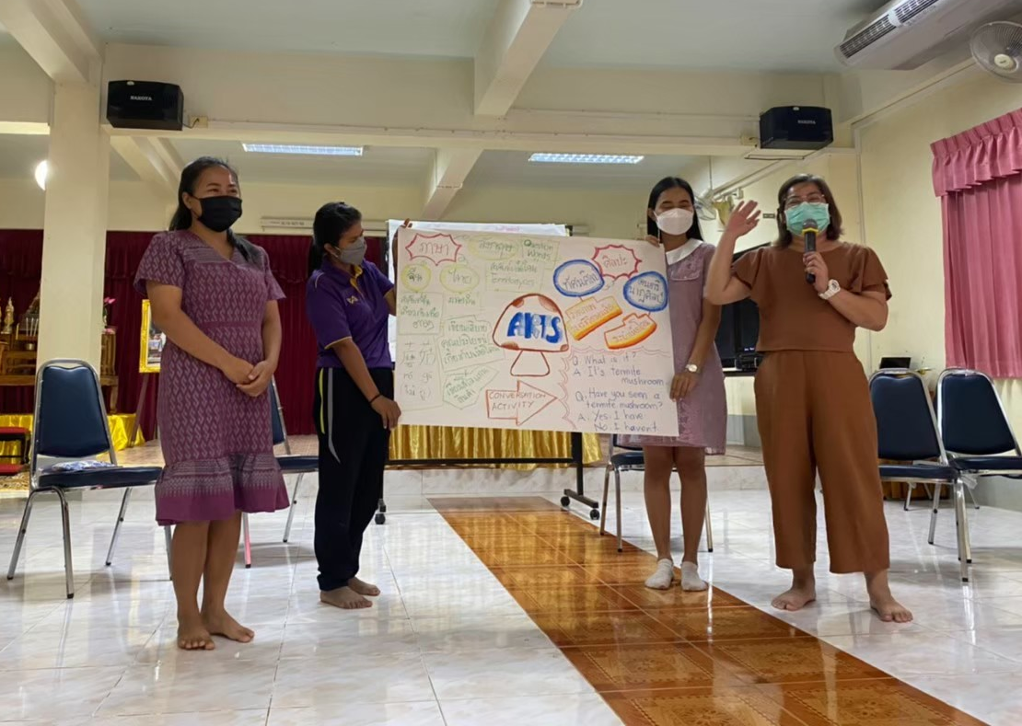
Termite mushroom in Arts
Languages
Dialects
English
Chinese
Visual arts
Drawing & painting
Life cycle
Music and dance
Termite Mushroom Harvesting Dance

Slide 13
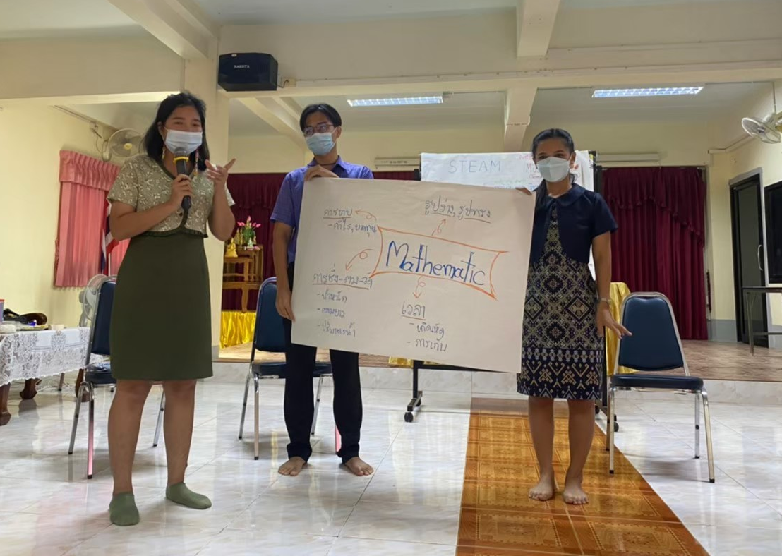
Termite mushroom in Mathematics
Shape
Measurements
Weight, Length, Volume
Money
Buying and selling
Cost, Prices, Profit
Time
Life cycle
Harvesting season

Slide 14
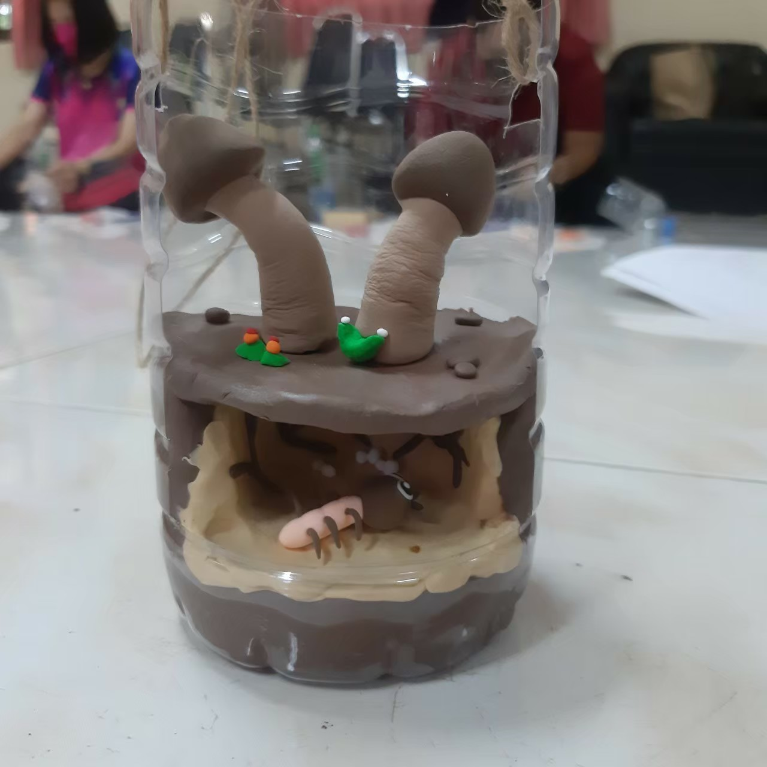





Lesson demonstration: Termite Mushroom Model
Pre-test
Active reading
Sculpting
Appreciation
Sharing

Slide 15
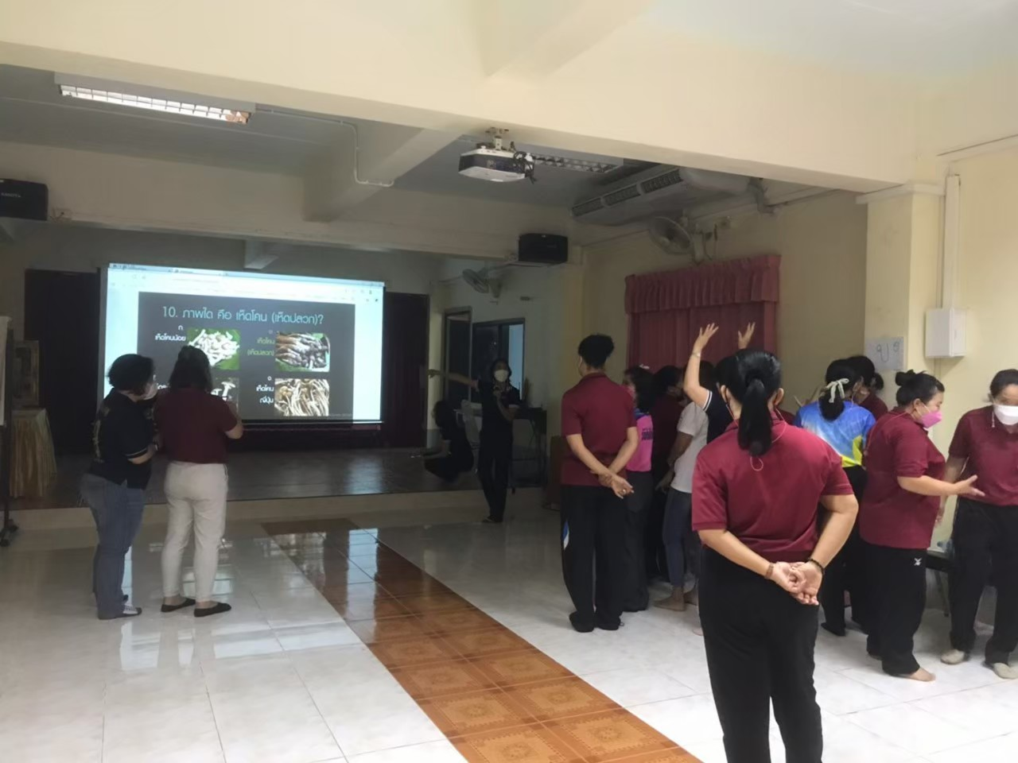
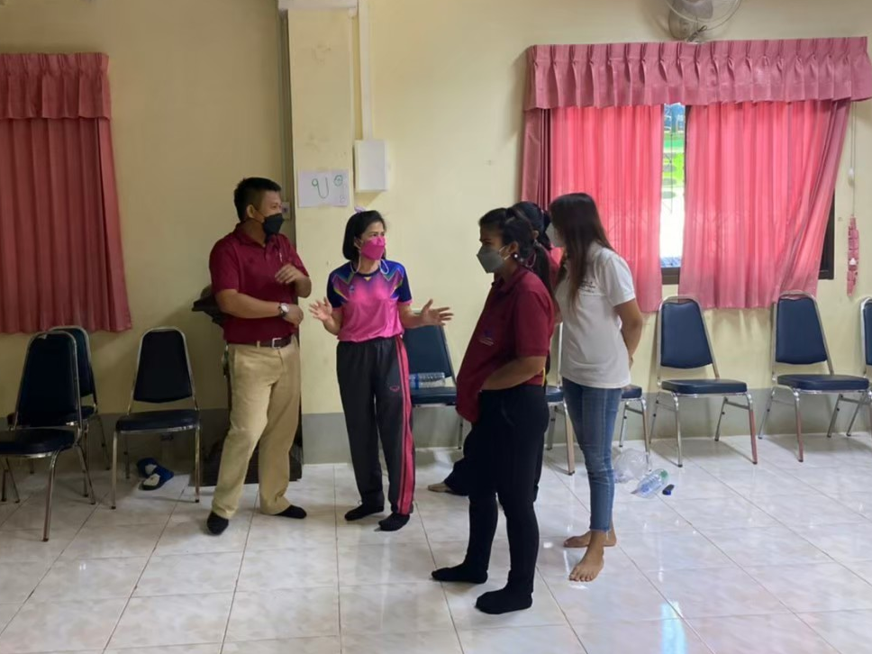
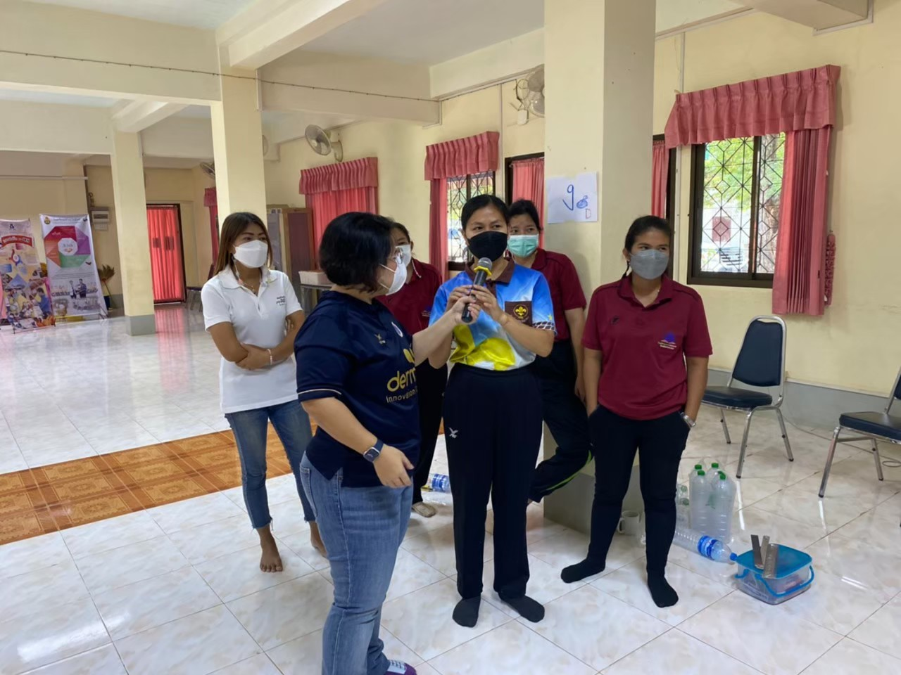
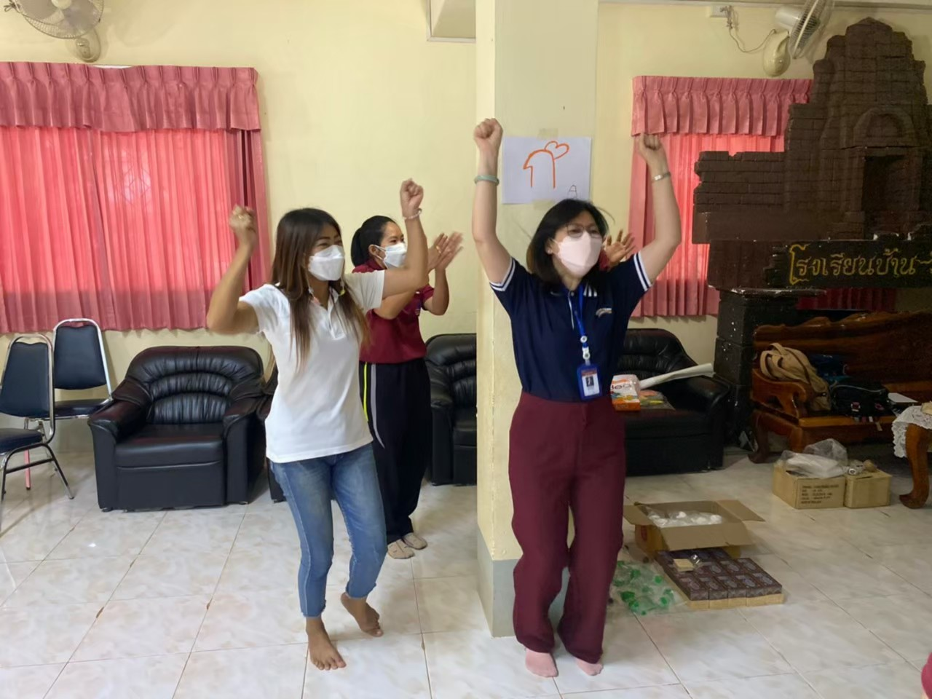
Pre-test: Termite Mushroom Quiz

Slide 16
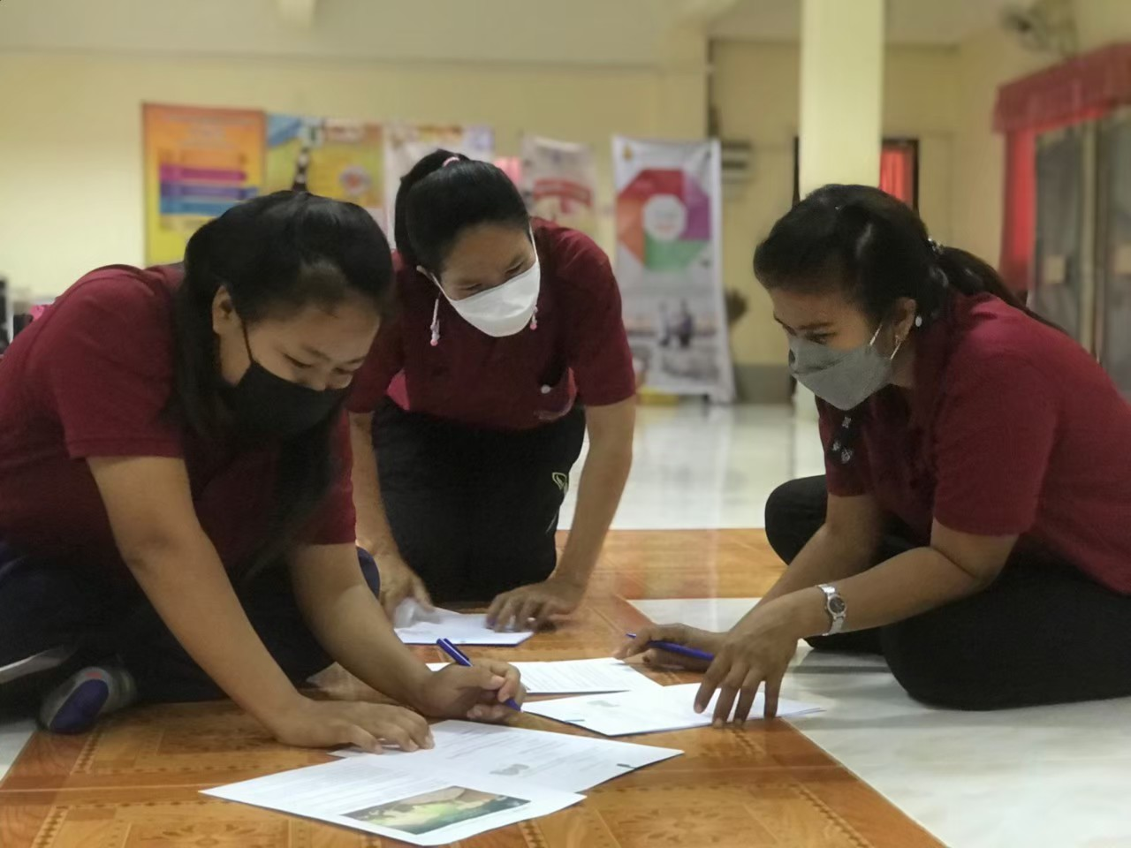
Active reading: Why the termite mushrooms were found on the termite mound?
Worksheet
Why is this mushroom named termite mushroom?
What do termites eat?
Why do mushrooms grow in termite nests?
What benefits do mushrooms and termites get from each other?
What is the interaction between mushrooms and termites called?

Slide 17
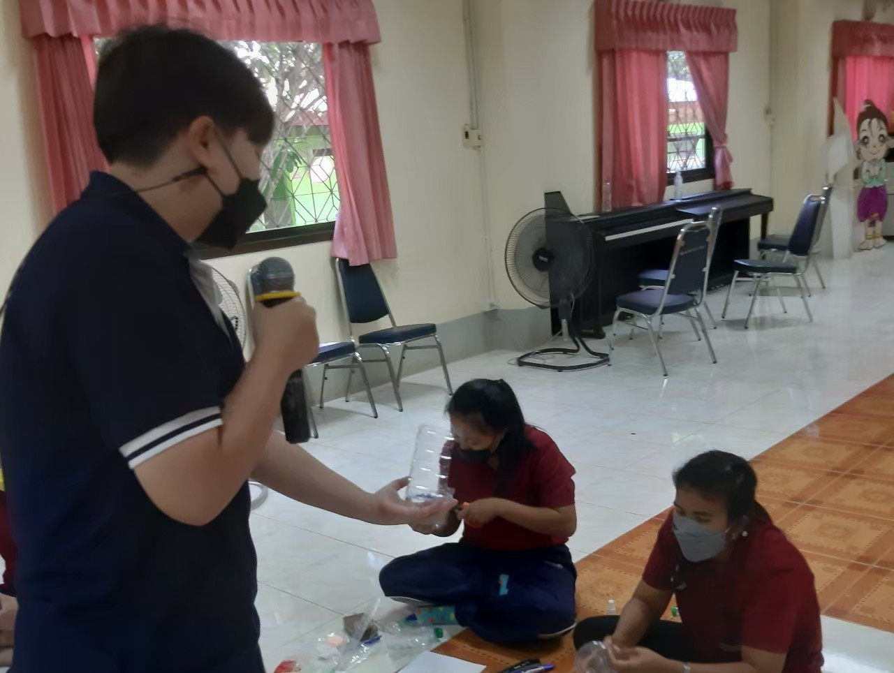
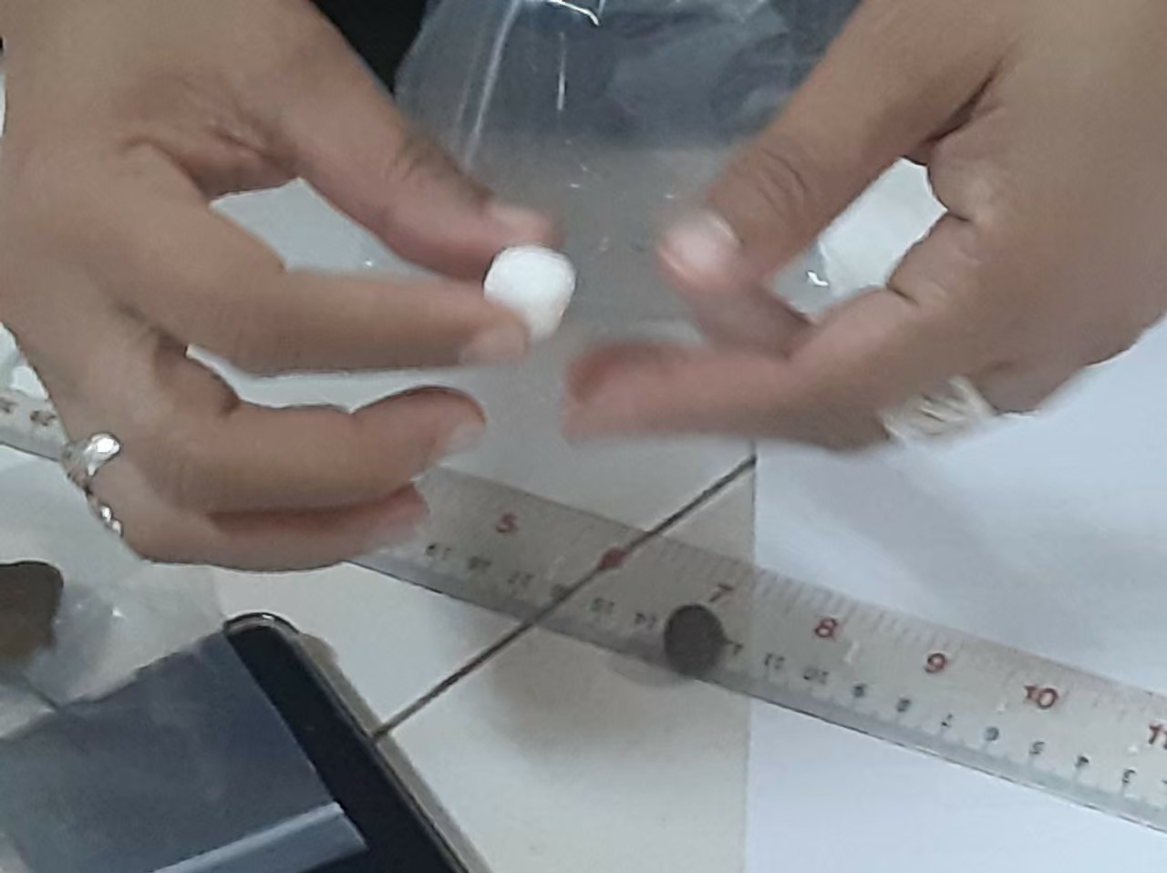
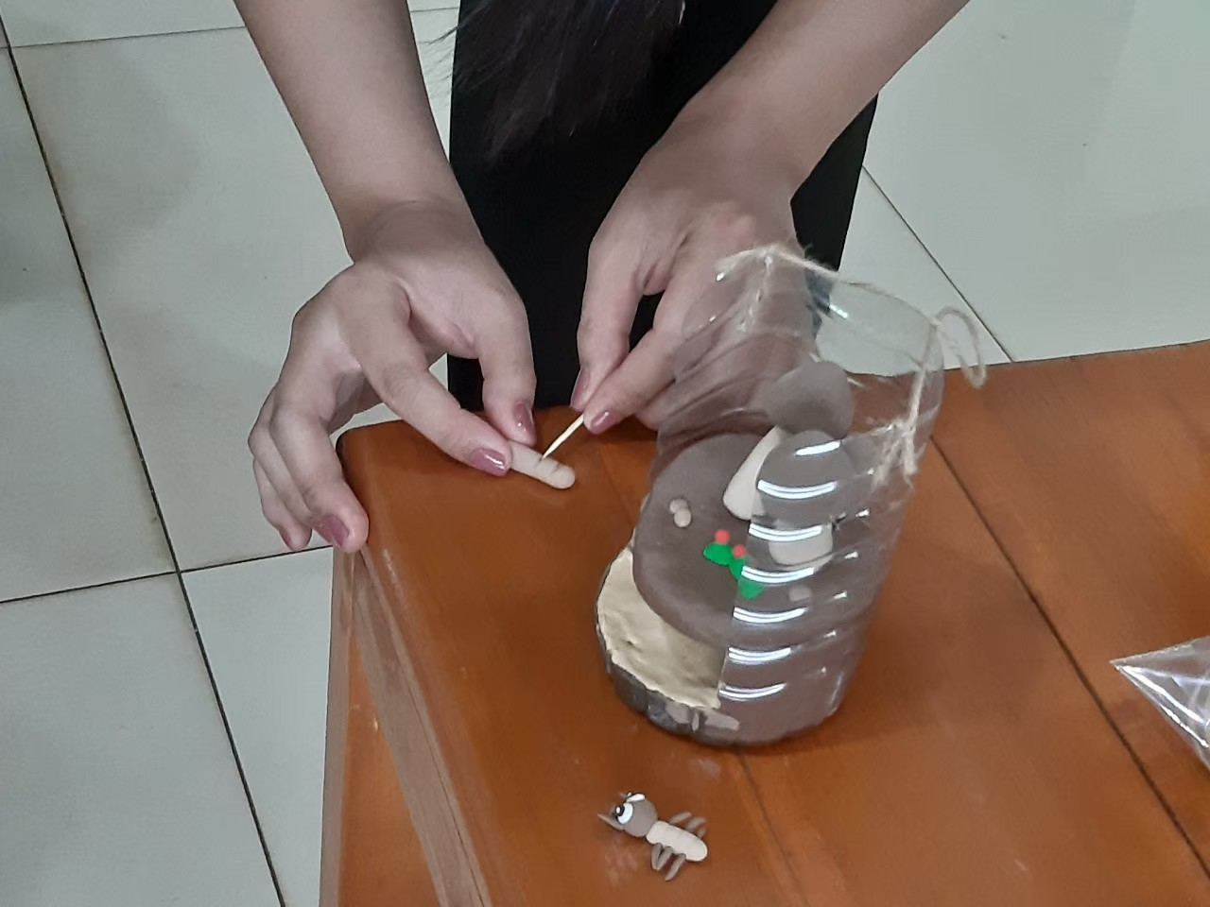
Sculpting

Slide 18
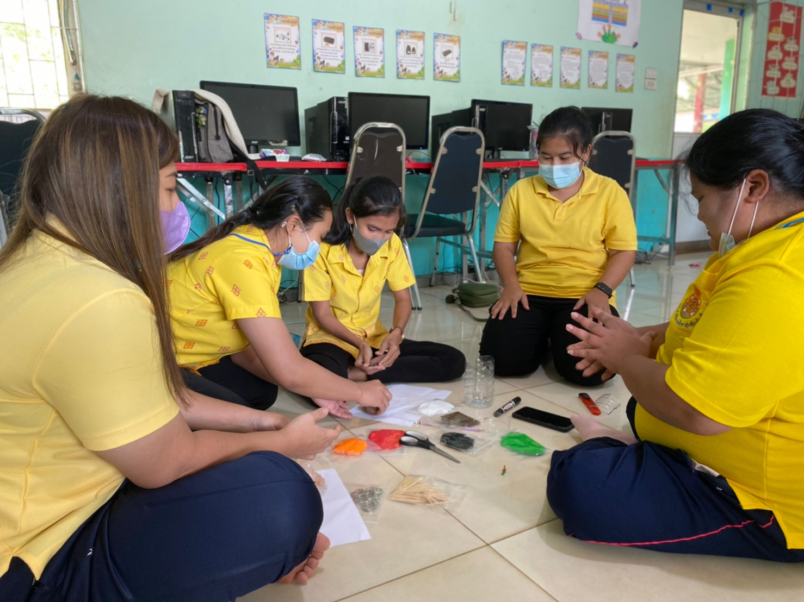

Sculpting: Flipped classroom
Prototype

Slide 19
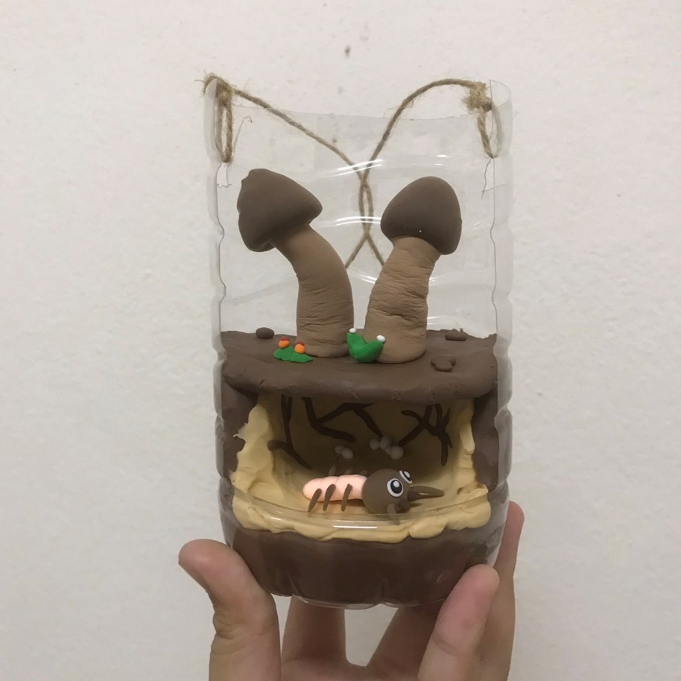
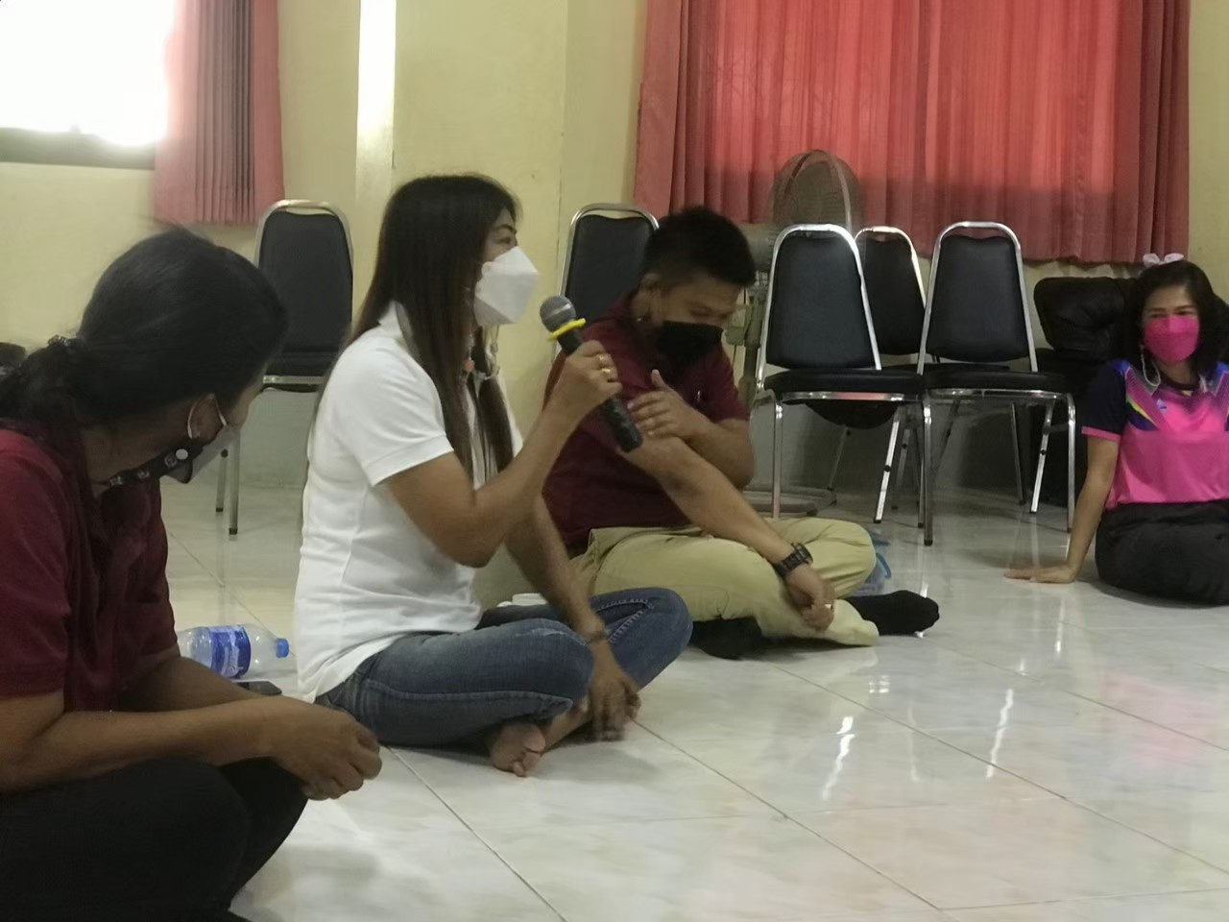
Sharing
Using the termite mushroom model to tell the story of this mushroom to your classmates based on your own knowledge and understanding

Slide 20
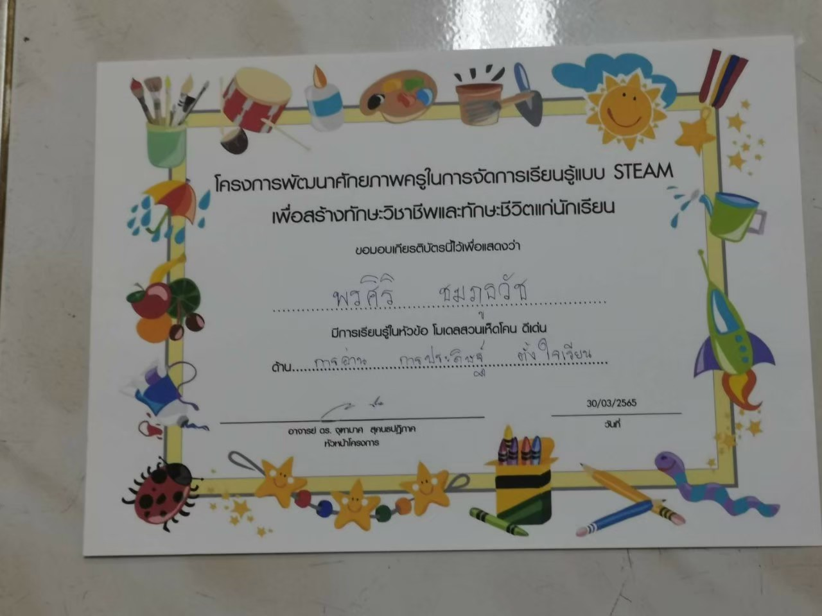
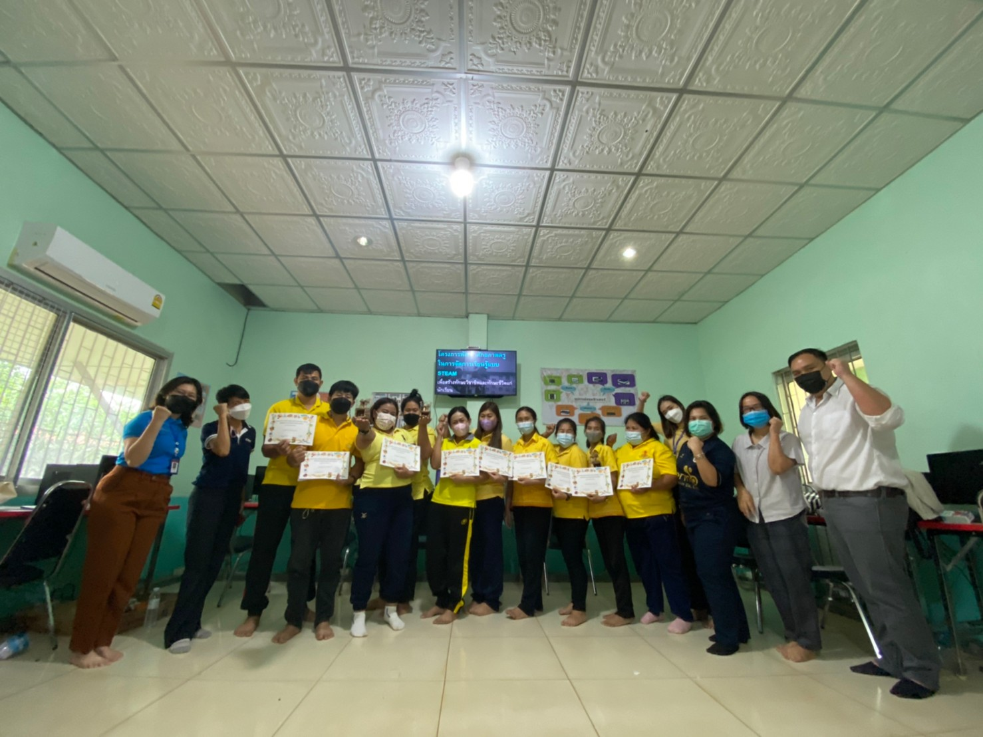
Appreciation

Slide 21
Lesson learned

Slide 22
STEAM & Termite mushroom
Expanded perspectives on STEAM education
Integrating community-based learning with STEAM education
Team teaching is important to do STEAM education based on Parallel, Multidisciplinary, or Transdisciplinary Instruction.

Slide 23
Pre-test
Most teachers recognized termite mushrooms, but not able to describe the interaction between the termite mushrooms and the termites
Some misconceptions about forest types, and species interactions (mutualism vs. commensalism)
Informal pre-test, like playing a game,
Learners were enthusiastic, fun ,and not afraid to make wrong answers.
Encouraged critical thinking, knowledge sharing, and learnings among learners.
Explaining answers helps learners gaining more knowledge and correcting misconceptions.

Slide 24
Making termite mushroom model
Science
Engineering
Technology
Methods used for modeling
Termite mush-room biology
Arts
Mathematics
How to create the model like a prototype
Sculpting and mixing colors
Shapes and measure-ments
Infusion instruction
Sharing the termite mushroom story helps to recap knowledge they have learned
Awarding self certificate promotes self-esteem of learners.

Slide 25



Thank you
U-School Mentoring Program, Ministry of Higher Education, Science, Research and Innovation
Mahidol University, Kanchanaburi Campus
Wat Triratanaram Charity School
Ban Wang Sing School
Chutamas Sukhontapatipak
(66)87-495-0560
chutamas.suk@mahidol.ac.th

