Slide 1
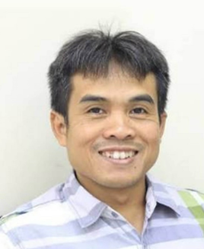

CONTENT AND PEDAGOGY: How much content is needed by biology teachers?
Ari Widodo
Universitas Pendidikan Indonesia
Susanti Wulandari
Institut Agama Islam Cipasung

Slide 2
Tentative Models of Teachers’ PCK
C
Good content knowledge but limited
pedagogical knowedge
boring lesson
P
P
C
Balanced content knowledge and
pedagogical knowedge
ideal
P
Good pedagogical knowledge but
limited content knowedge
misconception
C

Slide 3
Research Question
How deep and how broad is content knowledge needed by biology teachers?
depth of content is the hierarchy of concepts from general concepts to more specific concepts.
Breadth of content is the scope of concepts in a field.

Slide 4
Methods
Explorative study
Interviews
Respondents
9 teachers (3 elementary schools, 3 junior high schools and 3 senior high schools)
18 educators
18 scientists

Slide 5
Characteristics of the respondents
Gender | Male Female | 22 23
Education | Bachelor Master Doctor Professor | 4 6 24 11
Teaching Level | Elementary School Junior High School (JHS) Senior High School (SHS) University | 3 3 3 36
Teaching experience | < 5 years 5-10 years > 10 years | 2 13 30

Slide 6
Major Biology Contents
Evolution
Ecology
Genetics
Physiology
Cell biology
Biodiversity and Taxonomy

Slide 7
Results
There are agreements and disagreements amongst scientists, educators and teachers concerning the depth and bread of content for every school level
Primary school teachers are expected to undertand contents at macroscopic level and can be observed through our senses.
Junior high school teachers are expected to understand contents at cellular level
Senior high school teachers are expected to understand contents at mollecular level

Slide 8
Unanimous agreement on the breadth of the Content
No | Content | Primary school | Junior Secondary school | Senior High School
1 | Evolution |  | √ | √
2 | Ecology | √ | √ | √
3 | Genetics | √ | √ | √
4 | Physiology | √ | √ | √
5 | Cell biology |  | √ | √
6 | Biodiversity & Taxonomy |  | √ | √
The higher the level of the schools, the broader the concepts

Slide 9
The Depth of the Content
School Level | The depth of the content
Primary School | Basic concepts (protoconcepts)
Junior High School | Cellular
Senior High School | Mollecular
The higher the level of the schools, the deeper the concepts

Slide 10
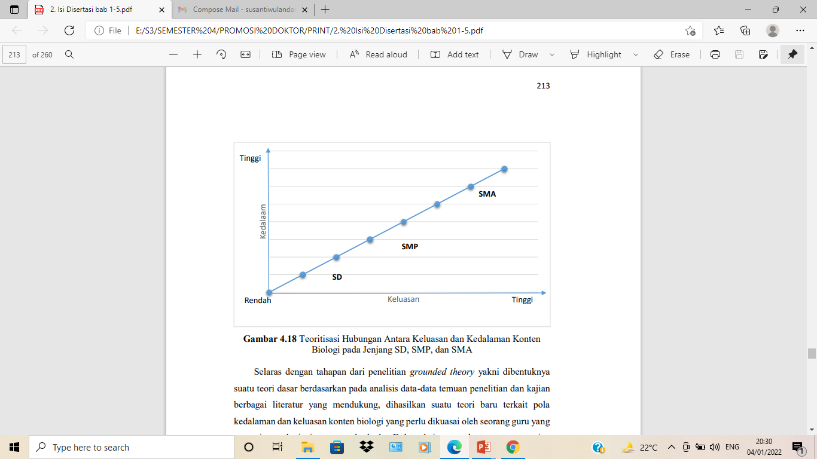
Pattern of Breadth and Depth
High
Senior High School
The depth of content
Junior High School
Primary School
Low
The breadth of content
High

Slide 11
Detailed of Depth and Breadth
No | Content | Primary school | Junior Secondary school | Senior High School
1 | Evolution | Basic ideas of evolution | Theory of evolution | Mechanism of evolution Evidence of evolution Factors that influence evolution
2 | Ecology | Food chain and water cycle | Interaction in the ecosystem | Ecosystem Environmental issues
3 | Genetics | Genetic inheritance in the family | Chromosome Mendel’s law Genetically inherited deseases | DNA Synthesis of protein

Slide 12
Detailed of Depth and Breadth
No | Content | Primary school | Junior Secondary school | Senior High School
4 | Physiology | Structure and function of organs at macroscopic level | Cellular bases of organs | Metabolism
5 | Cell biology | Microscope as a tool to observe cell | Structure of cell Cell division | Bioprocesses in a cell
6 | Biodiversity & Taxonomy | Artificial classification | Traditional classification (morphology and anatomy) | Modern classification (mollecullar)

Slide 13
Thanks for your attention

