Slide 1

Using assessment results to improve classroom activity
Asst.Prof. Dr.Phongthanat Saejoo

Slide 2

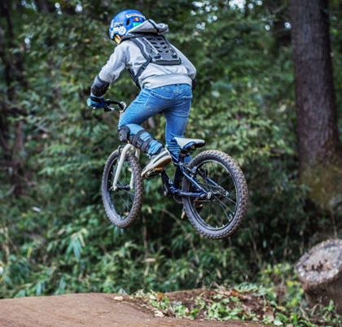
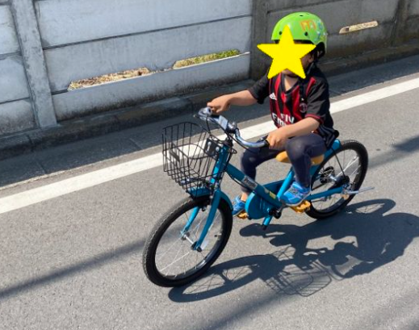
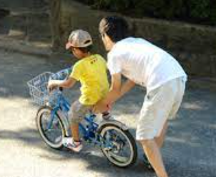
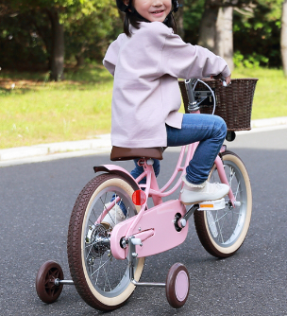
Rubric
Bike riding SKILL
Achievement

Slide 3
Competency Assessment Performance
CO-PLAN
How to create Competency Assessment rubric
CO-DO
How to use Competency Assessment rubric and what for
CO-SEE
How to improve student from the result

Slide 4
CO-PLAN
Team working to create Competency Assessment rubric so that all member can understand the objectives and goal of learning
Example: Competency Assessment rubric
Grand design
(school)
Lesson Plan for Class
Lesson Plan for Subject
Lesson Plan for Chapter
Lesson Plan for
-To analyze student performance
- To set up competency for improving
- To set up leanring goal etc.
School director use Grand design to work with teacher
School director work with teacher to setup the goal of learning
School director work with teacher to set up rubric

Slide 5
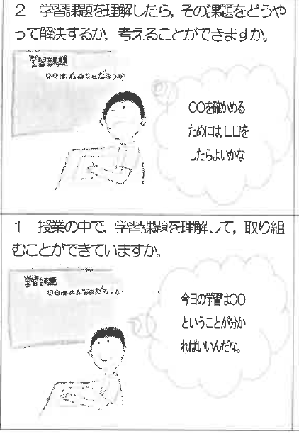
CO-DO
Teacher can explain student how to assess competency so that they can plan self development
example : competencey rubric “self problem finding” level 1 and 2
Ref: Ishiki junior secondary school (Japan)
Levle 2 Student understand problem in classroom and know how to solve
Students know which level they are and know how to improve themself
Teacher know student’s level to enhance their lerning
Student understand what and how competency they can do
from the problem we need to explore first
Level 1 Student understand problem in classroom what to do
Today we learn this topic and the problem is.

Slide 6
CO-SEE
Teacher use assesment result to improve classroom
Science subject
Topic electric circuit
Objective : Student can compare electric circuit
Item
well done
done
need improving
student can compare electric circuit and solve the problem
Student can compare the difference and explain the reason
Student can compare the difference
Student can not compare the difference
Case 1
Case 2
Few students need improving so teacher have to adjust the lesson such as grouping, presenting problem, supporting problem solving process
None need improving but most of them can perform well so teacher can adjust timing for problem solving process and experiment or choose some student to present their idea etc.

Slide 7
how to set rubric ....
Understand objective and competency to develop
Set up goal of learning
CO-PLAN
CO-DO
CO-SEE

Slide 8
difficulty of rubric
changing number to meaningful wording
Team worker set up learning goal and predict the problem in lesson to create detail in each level
CO-PLAN
CO-DO
CO-SEE

Slide 9
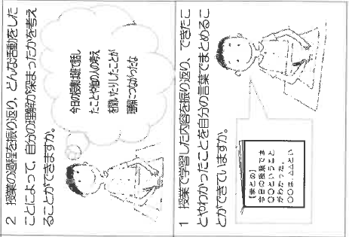
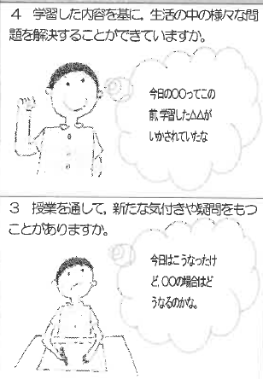
example competency rubric from Ishiki secondary school in Kagoshima province Japan
Metacognitive competency
Student can reflect learning process. They can understand very well from learning activity
From this lesson we have learned we can apply to solve problem in daily life
Today i understand more when i discuss to my group member
The previous lesson can enhance today problem solving
Student can reflect learning process. They can summarize their understanding with their word
From this lesson, student suspect and construct new knowledge
From the lesson today i learn OO to be [][][]
we learn from the result today and how about the result from OOOO case

Slide 10
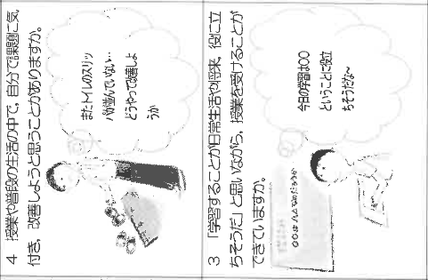
example competency rubric from Ishiki secondary school in Kagoshima province Japan
Problem identifying
Level 2 Student understand problem in classroom and know how to solve
Level 4 Student understand the problem in classroom and daily life by themself and try to solve the problem
from the problem we need to explore first
Shoes in font of toilet not tidy what should we do?
Level 3 Student realize what they have learned and apply in daily life or how we can apply in the future
Level 1 Student understand problem in classroom what to do
this topic we can apply when we.....
Today we learn this topic and the problem is

Slide 11
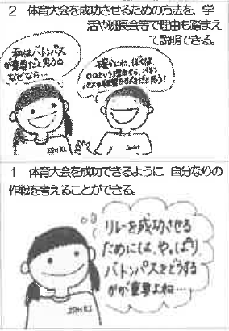
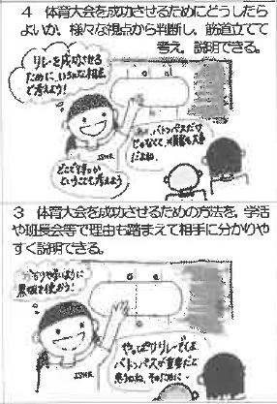
example competency rubric from Ishiki secondary school in Kagoshima province Japan
Logical thinking skill
Student can propose how to achieve and give reason for discussion
Student can make decision from various logic reason and explain how to achieve the competition
I think the most important is sending lumber because ........
let’s think how we can win
runner order is the most important
but i think the last lumber because.......
so just pratice and adjust order as the best practice
Student can propose how to achieve and give reason for discussion and understand easily
To achieve the competition they can plan by themself
I think to send lumber is important you see? why we need to practice more
we have to join relay race if we want to win we have to practice how to send lumber

