Slide 1


2022
KNUE-UNTWIN
INTERNATIONAL CONFERENCE
EXPLORING THE LIVED EXPERIENCES OF AFRICAN INTERNATIONAL STUDENTS IN GRADUATE EDUCATION IN KOREA
KINGSLEY K. BOACHIE (KOICA-KNUE GLOBAL EDUCATION LEADERSHIP)
1

Slide 2

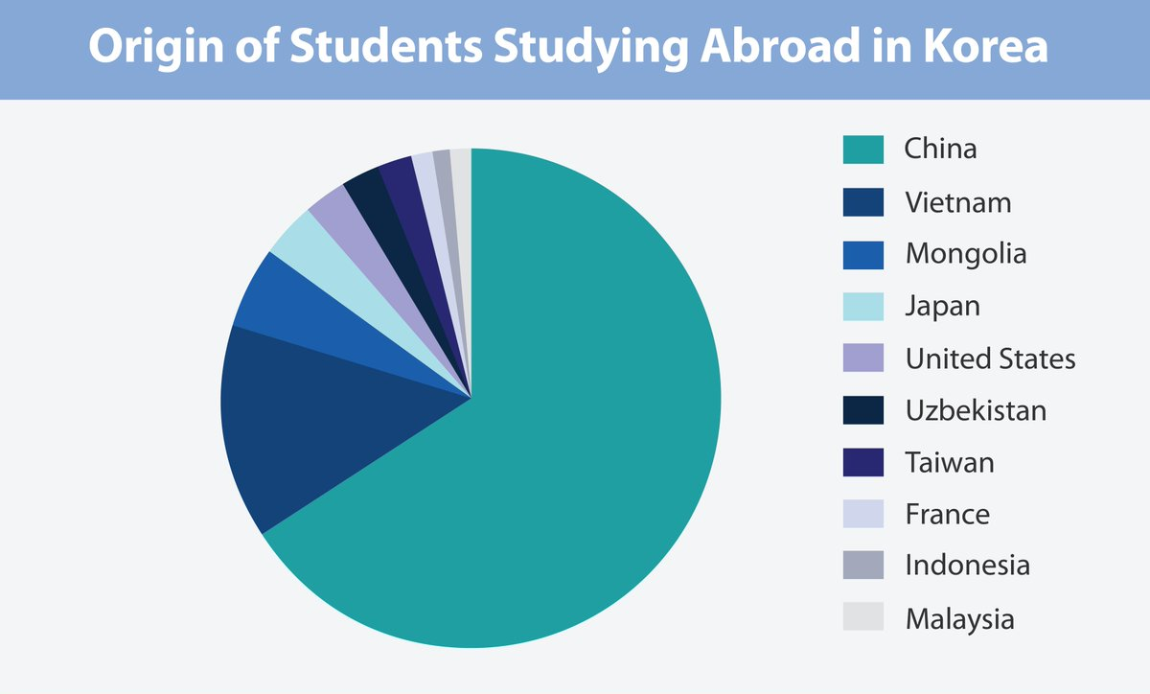
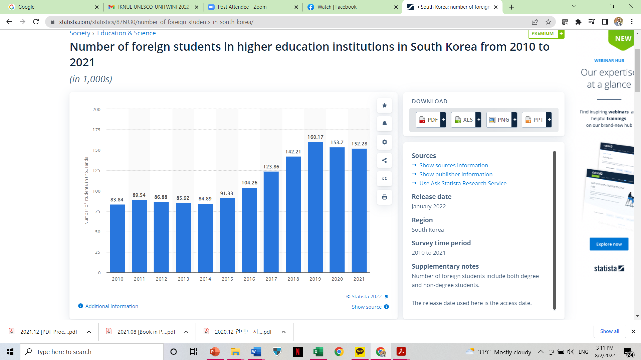
Background
The general globalization agenda has been compelling higher institutions of education (HIE) to transform themselves.
The internationalization of education has become a heightened issue within higher education literature
Students from different parts of the world travel to other countries to pursue various programs at the graduate level.
Many universities in South Korea are on the forefront of admitting international students to the sciences, education, engineering and technology.
Source: MoE-NIIE (2020)
Source: Yoon (2022)
2

Slide 3









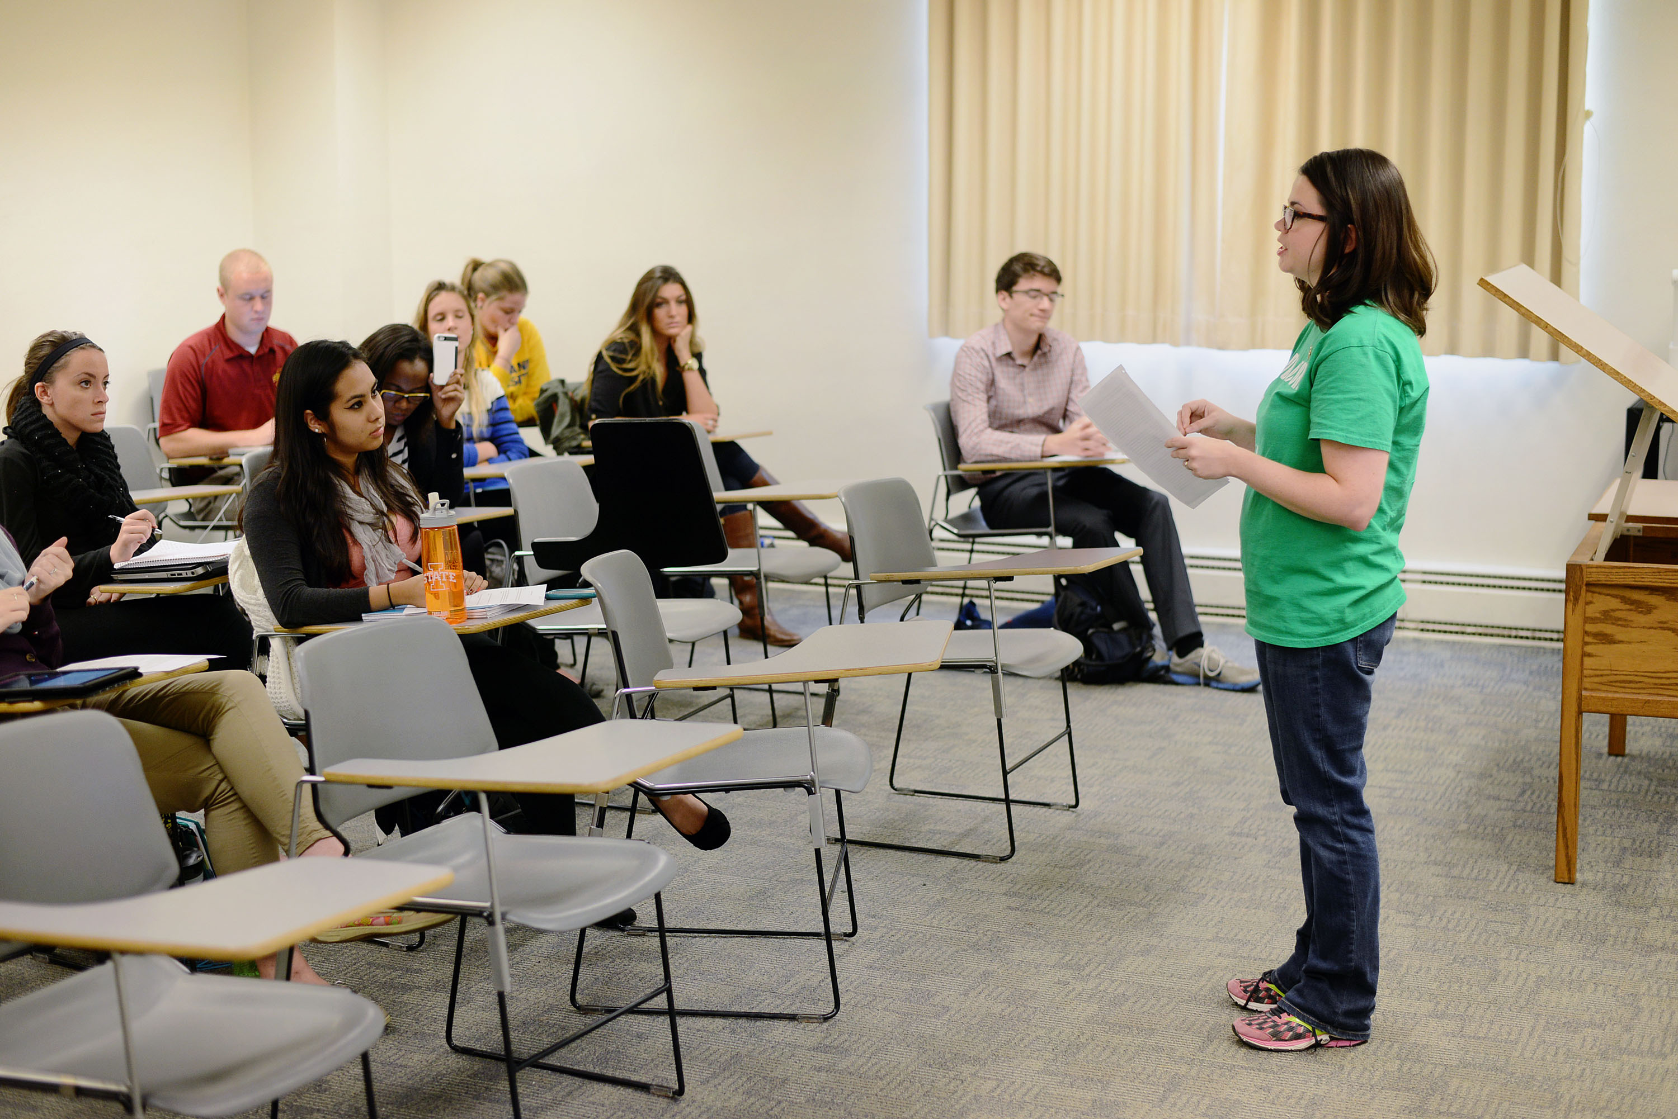
Research Problem
Many international students have been exposed to experiences that are related to living conditions, different food, learning styles, studying appointments, academic writing/research, work-life balance, language, interpersonal relationship, financial, sociocultural, racism and personal issues.
Koreans place much premium on education… “education syndrome” or “교육열 gyoyug-yeol- education fever”
However, there seem to be limited studies that explored the experiences of international students in Korea, especially among students from Africa.
3

Slide 4
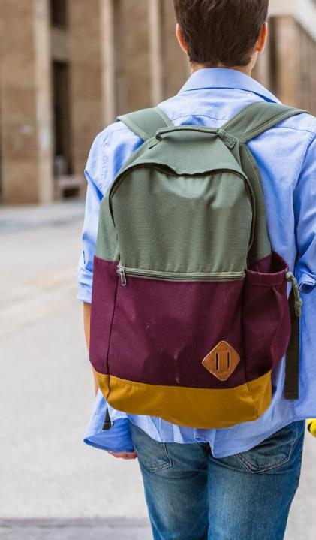

Research Questions
To fill this gap in literature, this study used the phenomenological methodology to explore the experiences of African international students in South Korea universities. Thus, following questions will guide this study:
How do international students experience the space and time of studying at the graduate level?
What is the corporeality of studying as an international student from Africa?
How do students experience the relationality of self and others in the context of being a graduate student?
How do students experience things and technology as graduate students from Africa?
4

Slide 5
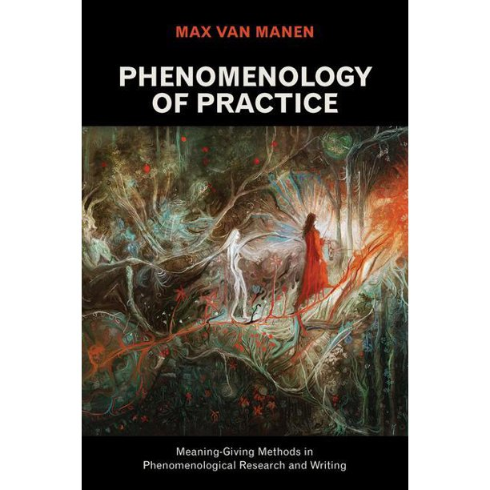
Why Phenomenology?
Designed to understand the subjective, lived experiences and perspective of participants.
Focus on various individuals and their experiences
Interviews (conversations) are the primary method of data collection.
Leads to in-depth reflective description of experiences
Information obtained cannot be used to make generalizations.
Universal themes of lifeword: lived space (spatiality), lived time (temporality), lived self-other (relationality), lived body (corporeality), lived things (materiality).
5

Slide 6
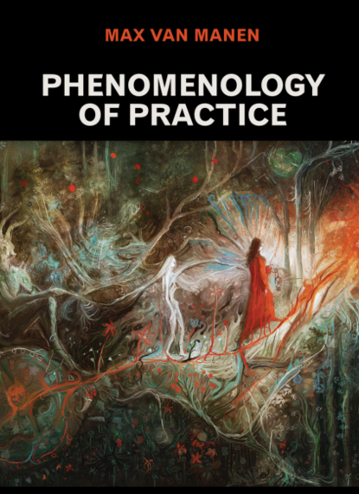





Methodology
Purposive Snowball Sampling
12 participants (Different African countries, different universities, varied levels of GE, fair gender representation, mini. of 1 year stay in Korea)
Pilot testing of Interview Guide/Questions
Individual Semi-structured Interview
(IRB, informed consent, voluntary participation, confidentiality and secrecy)
Analytical Procedures (van Manen 2014;2015)
(Phenomenological attitude, investigating lived experiences, thematic reflection and Describing through writing)
6

Slide 7
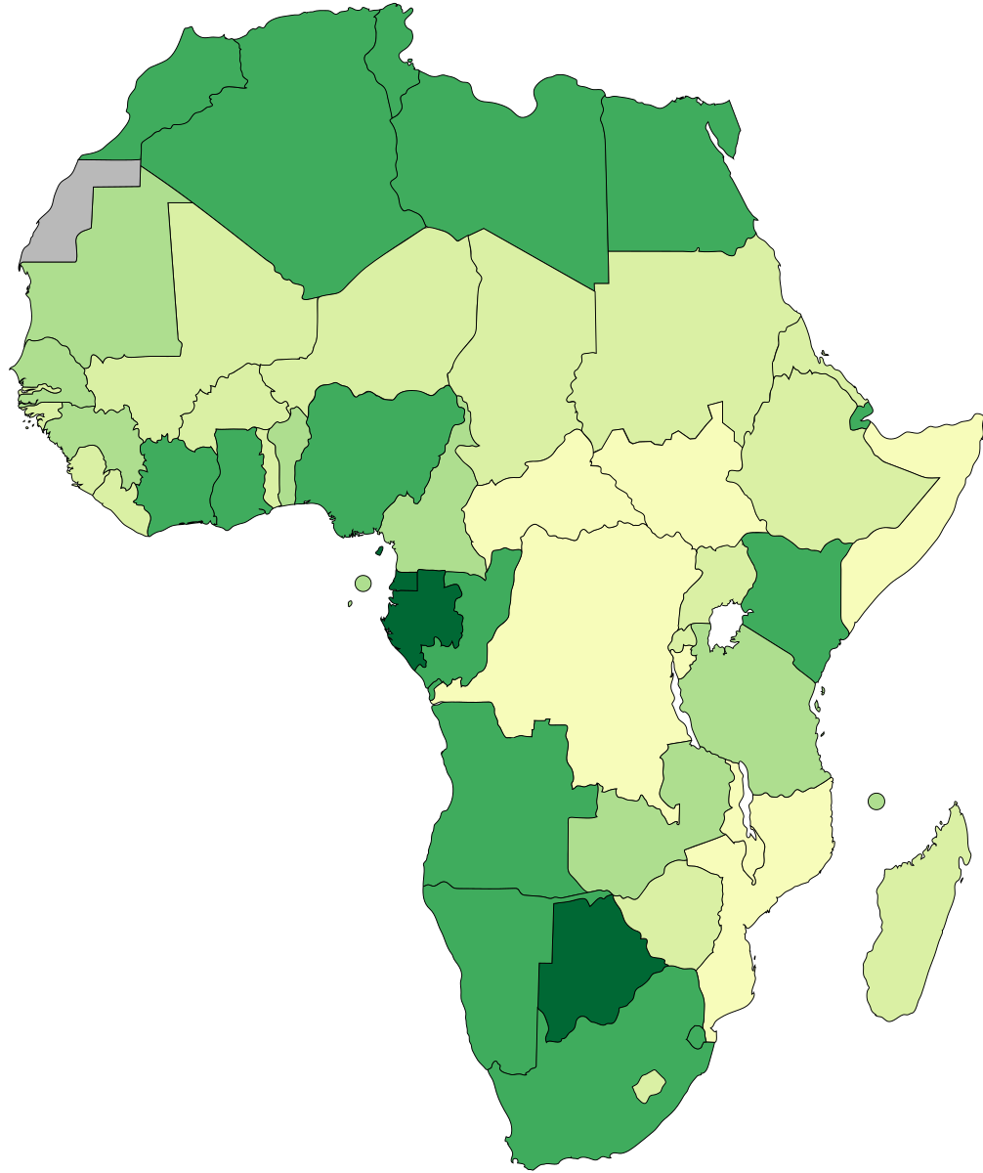
Demographics of Participants (Country)
EGYPT
ALGERIA
SUDAN
ETHIOPIA
SIERRA LEONE
UGANDA
GHANA
KENYA
NIGERIA
TANZANIA
CAMEROON
ZIMBABWE
7

Slide 8
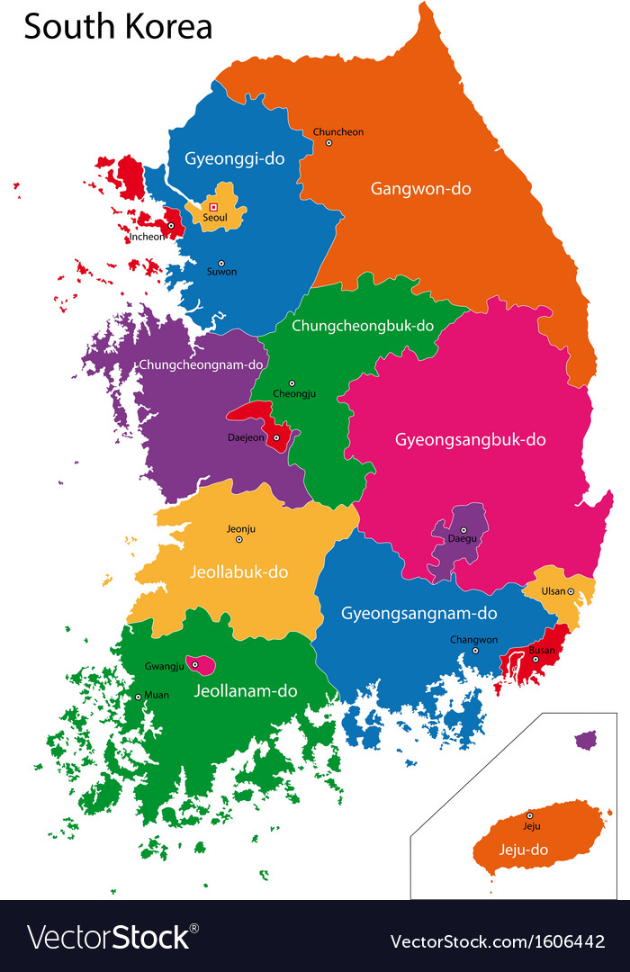

Demographics of Participants (University & Years in KR)
SEOUL NATIONAL UNIVERSITY
YONSEI UNIVERSITY
INHA UNIVERSITY
AJOU UNIVERSITY
SUNGKYUNKWAN UNIVERSITY
KDI SCHOOL OF PUBLIC POLICY AND MANAGEMENT
KOREA NATIONAL UNIVERSITY OF EDUCATION (KNUE)
KYUNGPOOK NATIONAL UNIVERSITY
YEUNGNAM UNIVERSITY
KOREA ADVANCED INSTITUTE OF SCIENCE & TECHNOLOGY (KAIST)
8

Slide 9
Preliminary Reflection
Destination for advance studies (stuff, systems, facilities and environment )
Handwork and dedication to academic work
Academic writing and research (referencing source)
Technology use in education (online education)
Learning during COVID-19
Respect for age, rank and personal space
Communication/language barrier
Dietary difficulties
Subtle discriminatory behavior
Limited opportunity for career advancement after studies (Humanities)
Varied extra-curriculum activities (sporting, hiking, travelling, group dinner, walking)
9

Slide 10

Initial Concluding Remarks
Obtaining detailed information about the program of study (professors/advisors/supervisors, language for instruction/graduation, stipends, publication of papers, graduation requirements) is vital.
Self confidence, analytical and critical reflective skills are important.
Language assimilation improves experience.
Extensive reading about country, people and culture (YouTube) enhances students lived experiences.
10

Slide 11




Expected Outcomes
Contribution to literature on international students’ experience in Higher or Graduate Education
Influence policy reforms and programs for international students in universities
Provide information to guide the experiences of prospective students aiming to study in Korea
11

Slide 12


Slide 13

REFERENCES
De Wit, H. (2011). Trends, issues and challenges in internationalisation of higher education. Centre for Applied Research on Economics and Management, Hogeschool van Amsterdam.
Kilinç, A. Ç., Arslan, K., & Polat, M. (2020). Studying abroad: A phenomenological study of lived experiences of international students in Turkey. Journal of International Students, 10(4), 853-871.
Kim-Renaud, Y. K., Grinker, R. R., & Larsen, K. W. (2005). The Sigur Center Asia Papers: Korean Education. (Eds.), The George Washington University Press. Retrieved from http://www.gwu.edu/~sigur/pubs/SCAP24-pdf
Marshall, J. (2014). Introduction to comparative and international education. SAGE.
Morosini, M., Corte, M., & Guilherme, A. (2017). Internationalization of higher education: A perspective from the great south. Creative Education, 8(1), 95–113
Ozturgut, O. & Murphy, C. (2009). Literature vs. practice: challenges for international students in the U.S. International Journal of Teaching and Learning in Higher Education, 22(3), 374–385.
Dos santos, L. M. (2020). The challenging experiences of international students in South Korea: The neo-racism perspective. Universal Journal of Educational Research, 8(12B), 8102-8109.
Schlossberg, N. (1983). Counseling adults in transition. Springer.
Seth, M. J. (2002). Education fever: Society, politics, and the pursuit of schooling in South Korea. University of Hawaiʻi Press and Center for Korean Studies.
van Manen, M. (2014). Phenomenology of practice: Meaning-giving methods in phenomenological research and writing. Left Coast Press Inc.
van Manen, M. (2015). Researching lived experience: Human science for an action sensitive pedagogy (2nd ed.). Left Coast Press.
13

