Slide 1



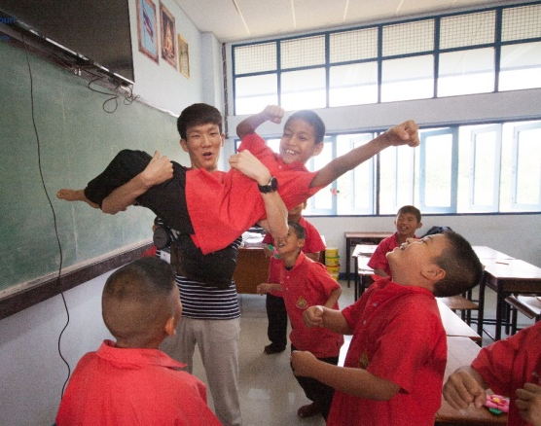
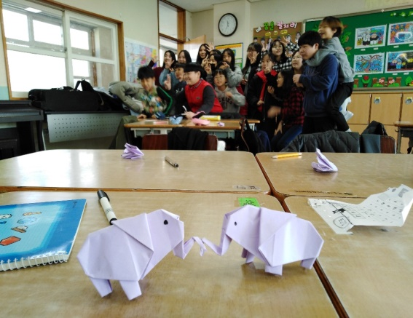

Who Bring Innovation into School?
2020 05 29
Jungjoo Sohn

Slide 2
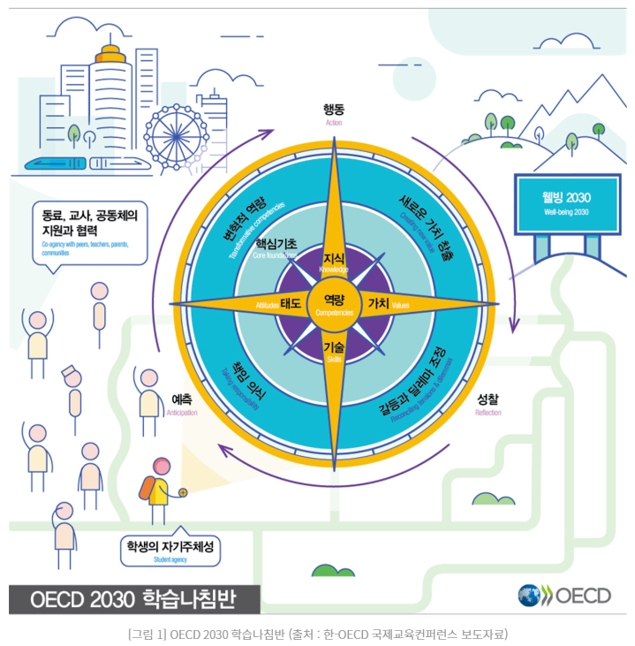
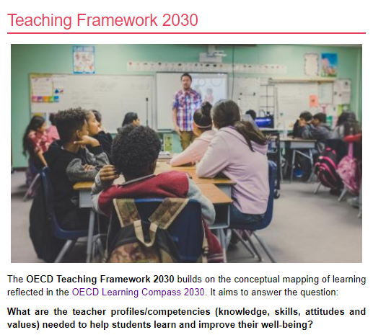

Slide 3







A traditional teaching Approach emerged in such classroom culture
transmit
Contents
demonstrating, questioning, describing, lecturing, etc.,
Z..Z..Z
memorizing
A teacher
Students
Inprasitha, 2011

Slide 4

New classroom conditions
Every student
How?
Think
Think
Think
Think
Think
A teacher
Think
Think
Think

Slide 5
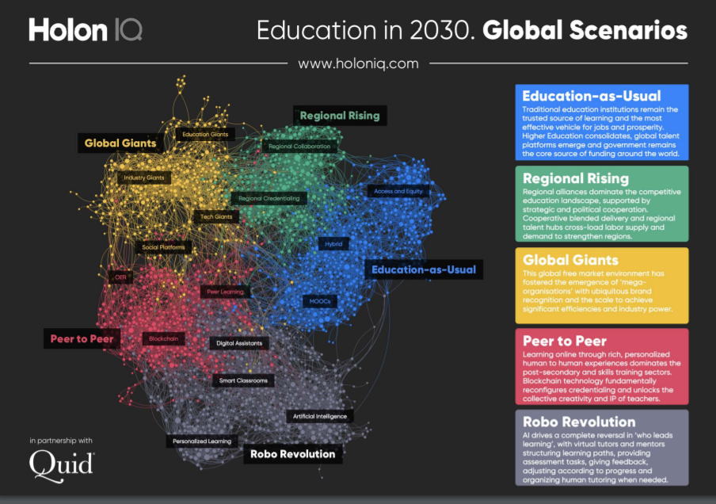
Notes:
Holon IQ는 OECD, World Bank UNESCO 전문가들의 통찰과 머시러닝 기술을 활용해 5,000여개의 뉴스아티클로부터 시사점을 도출해 교육의 미래에 대해서 보고서를 발간하고 있다. HolonIQ Education in 2030 보고서에서는 위의 데이터 소스를 기반으로 5가지 주요 키워드를 뽑고, K-12, Post-Secondary(대학), Teachers, Skills Training, Work and Jobs 영역의 전망을 언급했는데, 꽤 예측이 재미있는 지점이 있어서 소개한다.

Slide 6
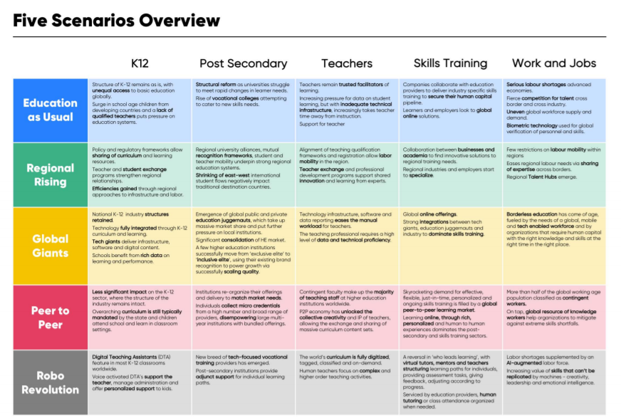

Slide 7
1. Education as Usual
[초중등]세계적으로 교육의 불평등 구조는 여전할 것이며 개발도상국의 학령 인구의 급증에도 불구하고 검증된 교사 부족이 교육 시스템을 압박할 것이다.
[교사]교사는 학습에서 여전히 신뢰받는 퍼실리테이터로서의 역할을 할 것이고, 학습 데이터 활용에 대한 압력이 증가하지만 부족한 기술 인프라가 허들이 될 것이고 전달식강의는 점진적으로 교사의 업무에서 낮아질 것이다.

Slide 8
2. Regional Rising
[초중등]커리큘럼과 리소스의 공유가 가능하도록 정책과 규제 프레임워크가 만들어질 것이고, 교사와 학습자의 교환 프로그램은 지역 국가 간 전략적 연대를 강화할 것이다. 인프라와 노동 인력의 지역별 연대 기반의 접근을 통해 효율성을 강화할 것이다.
[교사]교사 자격체계와 교원 자격증의 국가간 인정을 통해 국가 간 노동의 이동성이 보장되고, 교사 교환과 역량강화 프로그램은 전문가를 통한 혁신과 역량을 공유하는데 기여하게 될 것이다.

Slide 9
3. Global Giants
[초중등]국가 초중등 교육 산업 구조는 유지될 것이며, 기술은 초중등 교육과정과 학습에 대부분 통합 될 것이다. 구글, 마이크로소프트 등 기술 자이언트 기업들은 인프라와 소프트웨어 그리고 디지털 콘텐츠를 유통할 것이며, 학교는 학습과 성과 관리에 있어서 풍부한 데이터를 통해 지원을 받게 될 것이다.(구글클래스룸과 마이크로소프트 팀즈에 향후 콘텐츠, 교육과정과도 결합하게 될 것임.)
[교사]기술 인프라와 소프트웨어 그리고 데이터 기반의 리포트는 교사의 수작업 업무를 경감 시켜 줄 것이고, 교사에게는 데이터 운영과 높은 기술적 역량이 요구될 것이다.

Slide 10
4. Peer to Peer
[초중등] 초중등 산업구조는 그대로 유지되어 충격은 거의 없을 것이다.(코로나19이후는 어떻게 될까?)
[교사]임시직이 전세계 고등교육 기관 교직원의 대부분을 차지하고, P2P경제가 확산됨에 따라 집단 창의와 교사의 지적 재산의 공개가 확대되어 대규모의 교육과정과 콘텐츠 세트가 공유될 것이다.(Amazon Inspire, TES, Teacher Pay Teacher와 같은 마켓플레이스들의 확대강화)

Slide 11
5. Robo Revolution
[초중등] 전세계적으로 초중등 교육에서 디지털 교수지원 서비스(Digital Teaching Assistants)가 특징이다. 음성 인식을 기반으로 한 DTA는 교사와 학습관리, 개인화된 학습을 지원하게 된다.
[교사] 세계의 교육과정은 완전한 디지털화, 태그, 분류 그리고 주문형 체계가 만들어질 것이고, 선생님은 보다 복잡하고 높은 차원의 교수활동에 집중할 것이다.(PBL World, Work bench Education 등의 교육과정과 콘텐츠는 엄청난 부를 가져다 줄 것인가?)

Slide 12
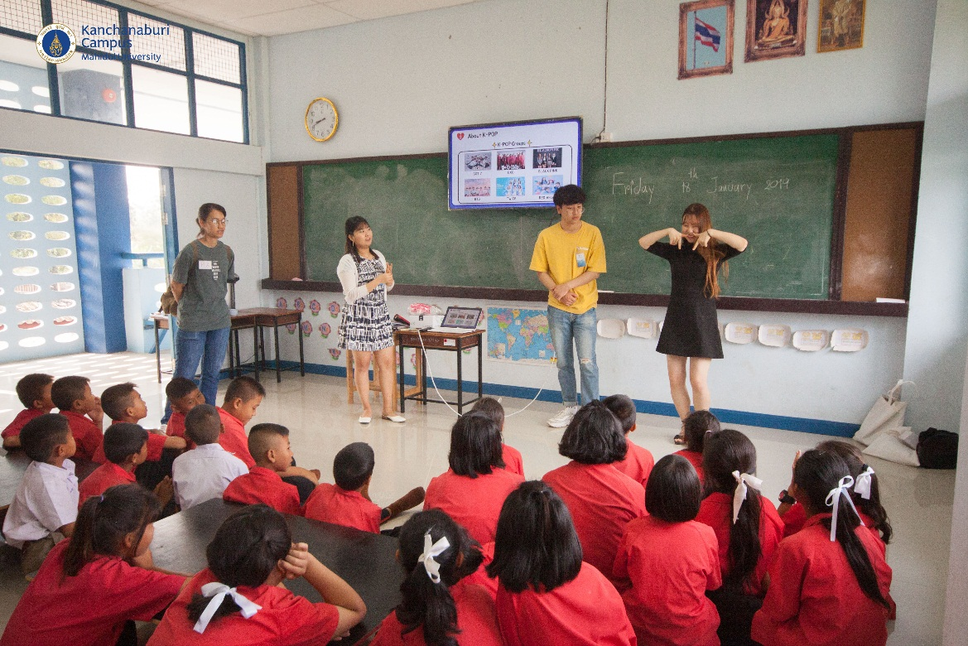
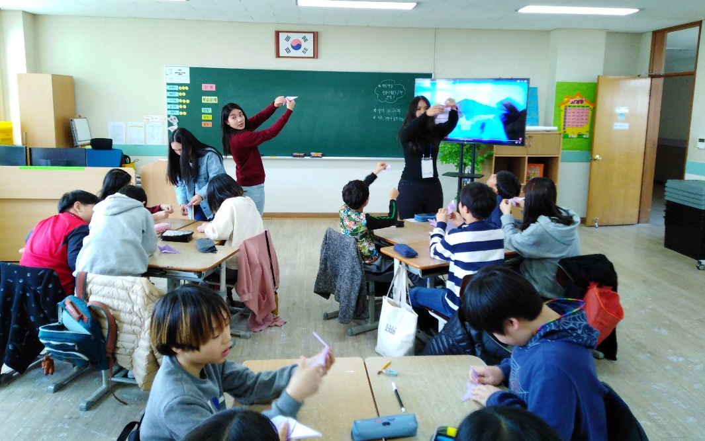

Slide 13

The 30-year Thailand project (2000 - 2030)
Expand Innovations
across the country and region
Strengthen Network (among teacher education Institutes) in using Innovations
Invested in HRD (PhD) and R&D on Innovations
2000-2010
2011-2020
2021-2030

Slide 14

The 30-year Thailand project (2000 - 2030)
started on how to change the way of teaching focusing on changing the problem we use in mathematical activity
2030
2006
2008
2017
2001
2013
started 4 project schools using "whole school approach" to implement "lesson study" and "Open Approach"
Plane 30 years project (2000 - 2030)
2002
2013 - present expanded to 120 schools across the countries.
first group of student teachers started implementing "open-ended problems" in 7 schools nearby Khon Kaen City
1999
2006 - present started APEC Lesson Study Community in APEC and Non-APEC members economies
Expand across the country and region
Strengthen Network (among TIEs)
Invested in HRD (PhD) and R&D in Innovations
2000-2010
2011-2020
2021-2030
started small community of Lesson Study with a group of student teachers (15 students)
tried the idea of using "open-ended problems" to create mathematical activities with 800 teachers in Khon Kaen Province
expanded to 22 schools in the northeast and northern parts of Thailand
2003
2005
2009
2012
2000

Slide 15
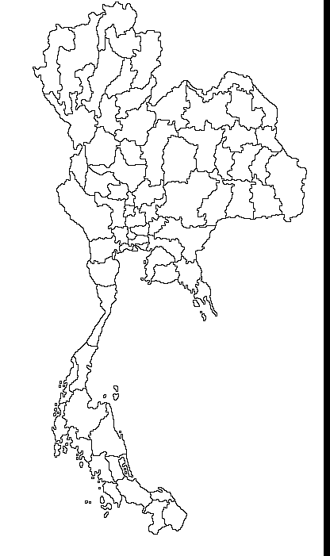



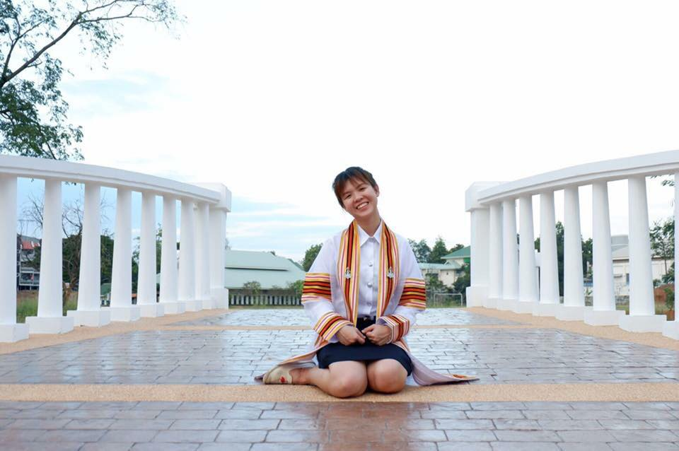

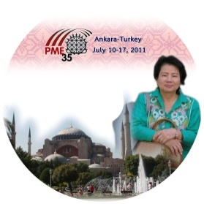








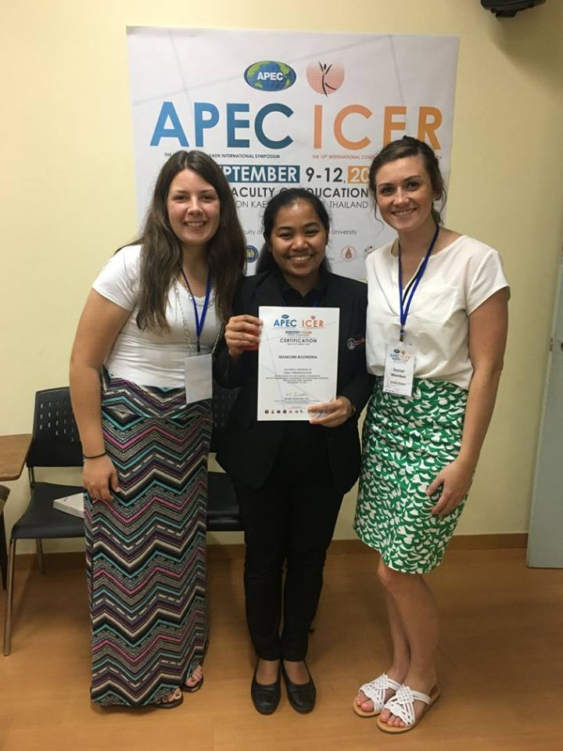

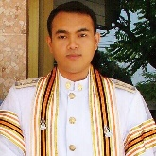

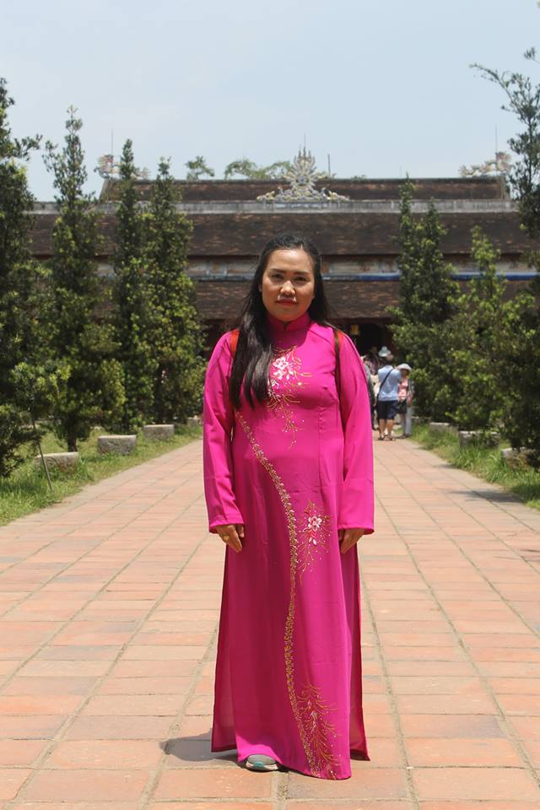
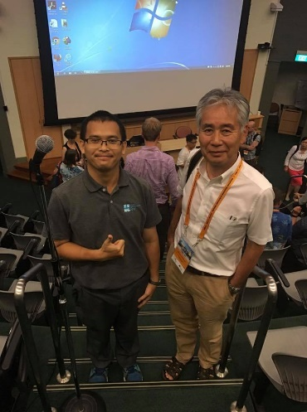

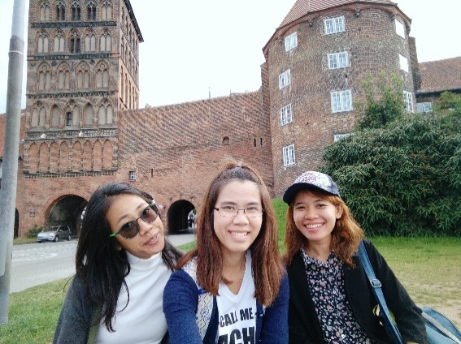
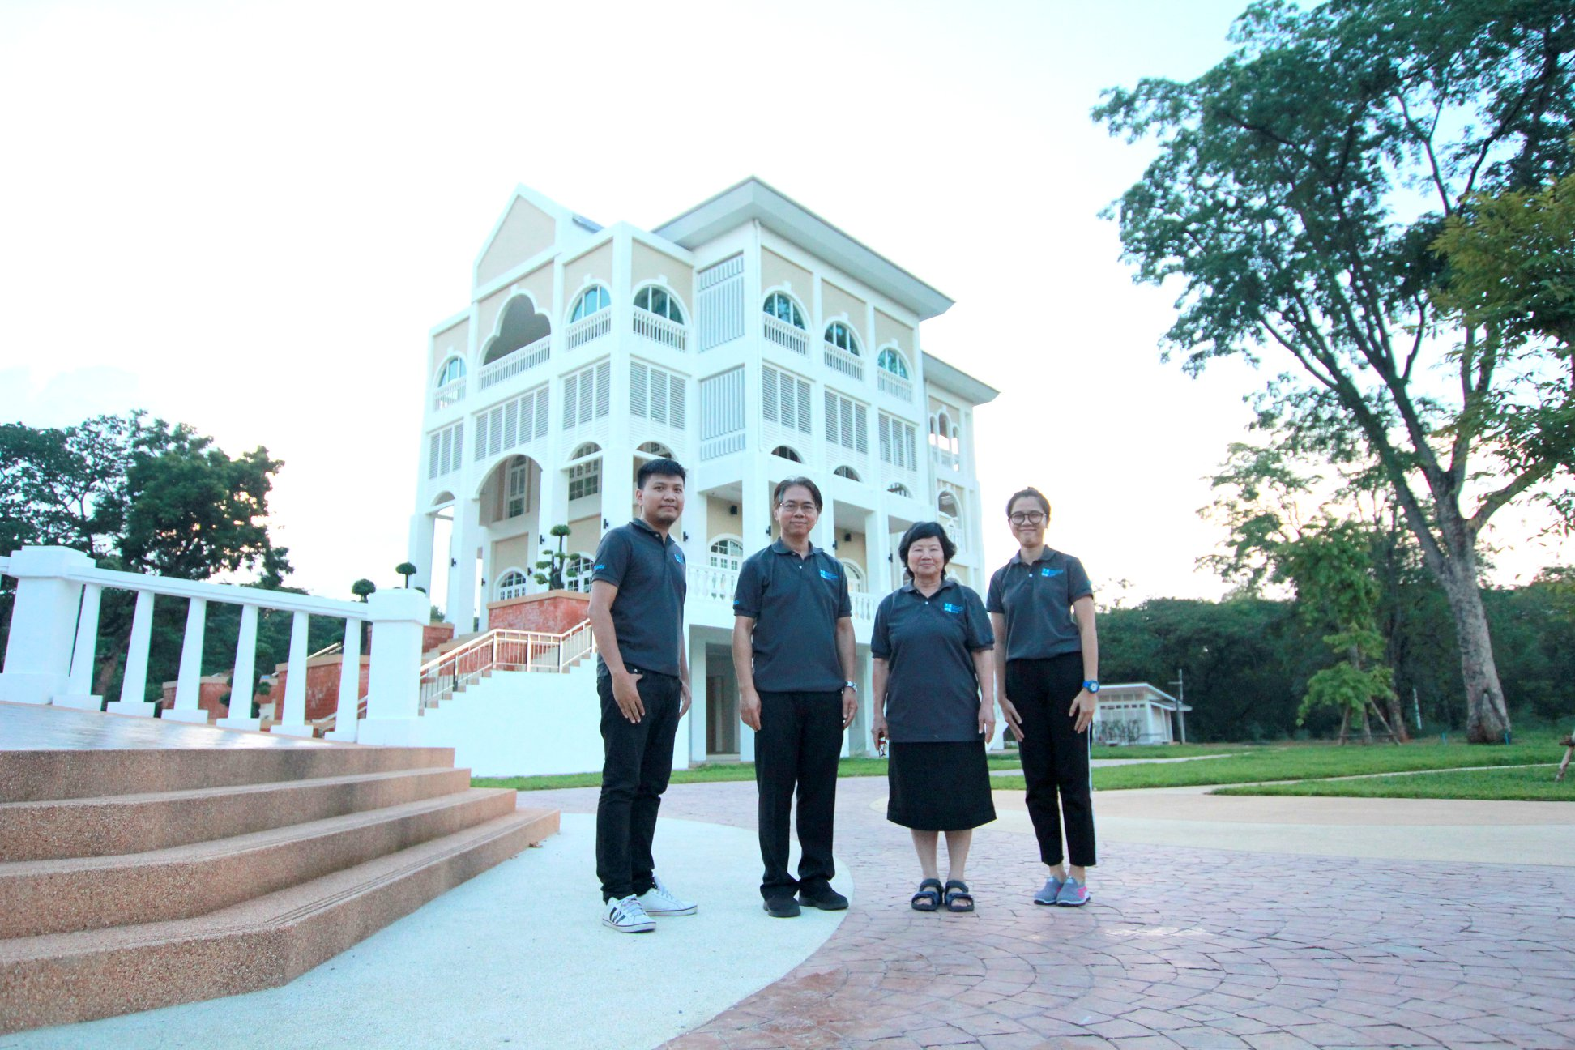





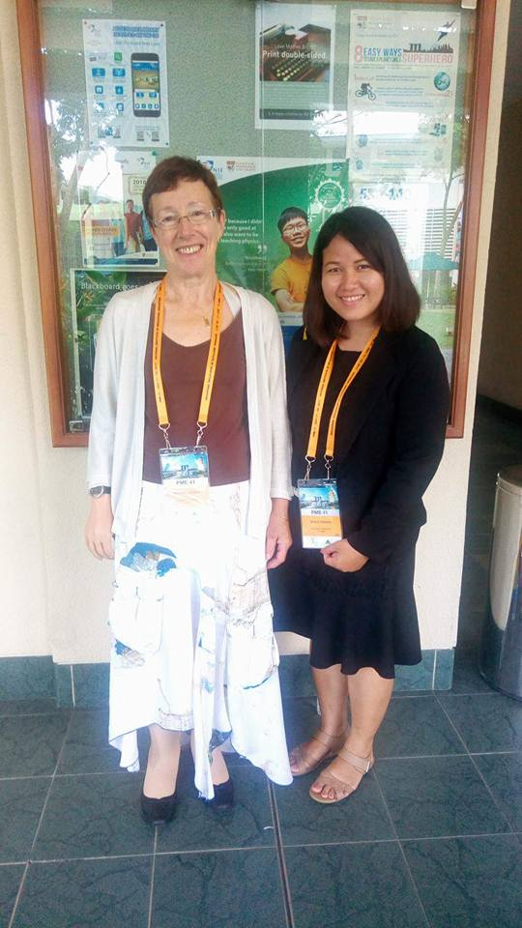












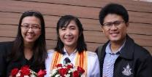


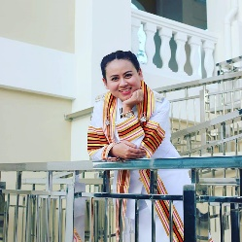



Universities Network in 30-years Thailand Project
อ.ดร.อาริยา, อ.ภัทรพงศ์ และ อ.ชมพู่ // ม.นครพนม
อ.ดร.ศิวารักข์ // มรภ.เลย
อ.ชนิกาและอ.พิมพ์ผกา // มรภ.ลำปาง
อ.ดร.เจนสมุทร // ม.เชียงใหม่
อ.ดร. รุ่งทิวา // มรภ.เชียงใหม่
อ.เบญจวรรณ //มรภ.กำแพงเพชร
อ.ณัฐวัตร อ.พิมพ์ลักษณ์ และ อ.กาญจนา // มรภ.วลัยอลงกรณ์
อ.ศิริรัตน์, อ.สุพินดา // มรภ.พระนครศรีอยุธยา
รศ.ดร.ไมตรี, รศ.เอื้อจิตร, อ.ดร.สัมพันธ์, ผศ.ดร.นฤมล, อ.ดร. สมควร อ.นิศากร อ.ณัฐธิดา // ม.ขอนแก่น
อ.กิตติปกรณ์ // โรงเรียนบ้านไผ่
อ.ศิริขวัญ, อ.ประภาวดี, อ.ศาสตรา อ.ชนินทร, // รร.สาธิต มข. อ.อลิษา // รร.สาธิตแผนกนานาชาติ
จิตรลดา จตุพร สันติ เข็มทอง// นักวิจัย ศูนย์วิจัยฯ
อ.ดร.ขวัญตา
อ.ดร.วาสุกรี // มทร. สุวรรณภูมิ
อ.ดร.ญานิน // มศว.
อ.ดร.ณิศรา // มทร. พระนคร
อ.กิตติพศ // รร.แก้งคร้อวิทยา อ.กนกนภา // ม.มหาสารคาม อ.ทองอุ่น //มรภ.ศรีสะเกษ อ.วีระศักดิ์ // มรภ.อุบลราชธานี
อ.ดร.กตัญญุตา และอ.ดร.กิตติศักดิ์ // มรภ.นครศรีธรรมราช
อ.ดร.ธัญญา อ.ดร.สุทธารัตน์ และอ.ดร.อเนก //มรภ.สุราษฎร์ธานี
อ.ดร.เกษมและ อ.ดร.สุวรรณี // ม.ทักษิณ
อ.ดร.สุดาทิพย์, อ.ดร.จุฬาลักษณ์และ อ.ดร.วิภาพร // มรภ.ภูเก็ต
อ.ดร.รัชดา // ม.สงขลานครินทร์ วิทยาเขตปัตตานี

Slide 16
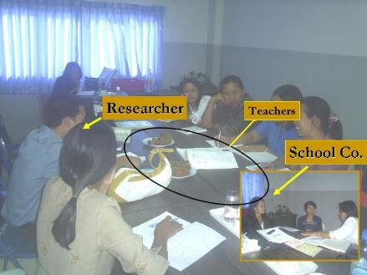
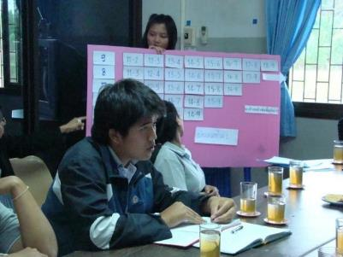
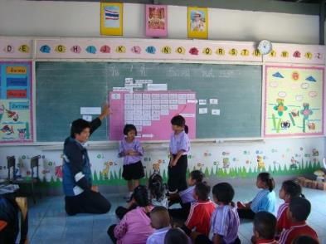

Scenario at 1st year project school
UNESCO UNITWIN
Seminar Program
Kookhampittayasan school
Plan
Plan Lesson on Tuesday
School principal and teachers set schools’ timetable/ schedule for plan, do, see process.
Textbook
See
Student intern
Student intern
DO
Reflect on Thursday
All rights reserved by Center for Research in Mathematics Education, Khon Kaen University

Slide 17
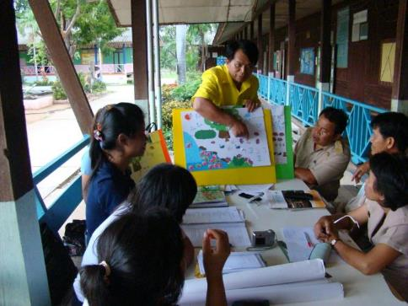
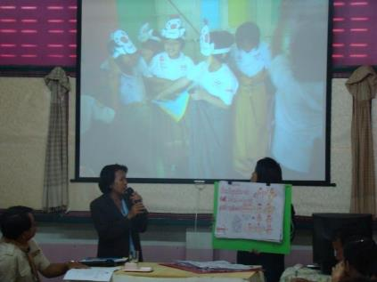
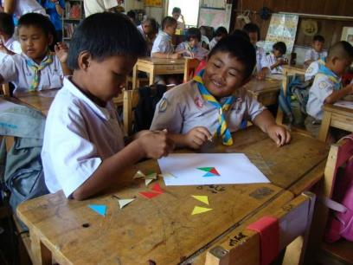
Scenario at 1st year project school
UNESCO UNITWIN
Seminar Program
Chumchonban chonnabot school
Plan
Plan Lesson on Monday
Do
See
Reflect on Wednesday
All rights reserved by Center for Research in Mathematics Education, Khon Kaen University

Slide 18
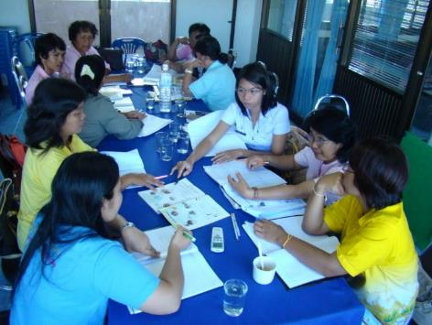
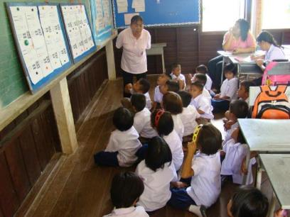
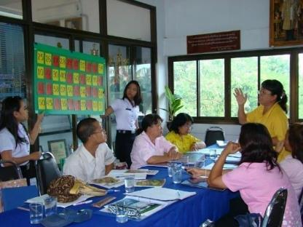
UNESCO UNITWIN
Seminar Program
Scenario at 2nd year project school
Banbuengniumbuengkrainoon school
Plan
Plan Lesson on Tuesday
See
Do
Reflect on Thursday
All rights reserved by Center for Research in Mathematics Education, Khon Kaen University

Slide 19
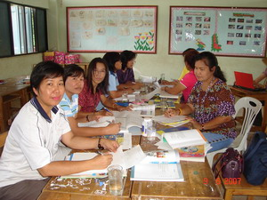
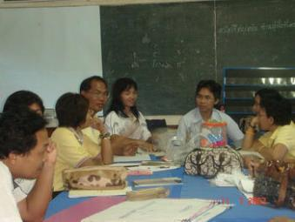
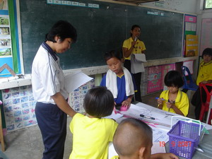
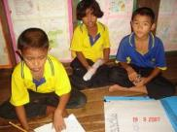
UNESCO UNITWIN
Seminar Program
Scenario at 2nd year project school
Nongtoom Nongngooluem school
Plan
Plan Lesson on Monday
See
Do
See
Do
Reflect on Wednesday
All rights reserved by Center for Research in Mathematics Education, Khon Kaen University

Slide 20
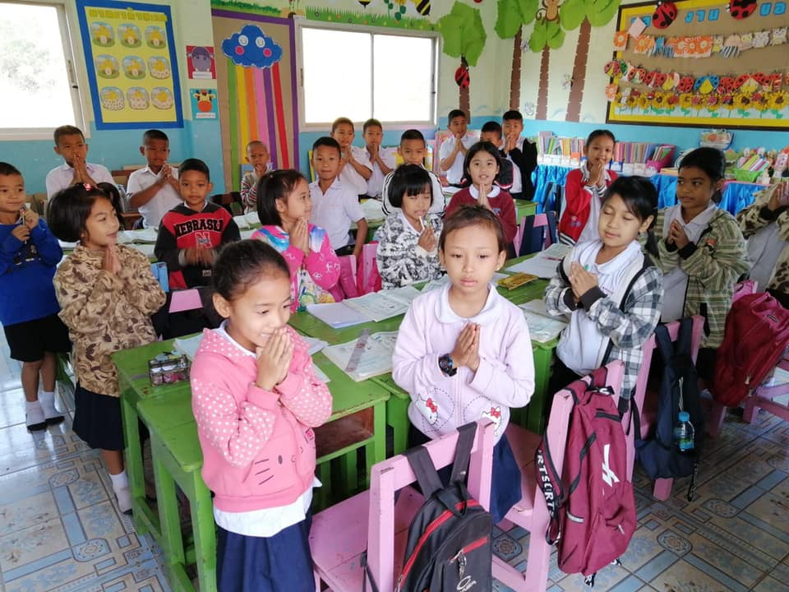
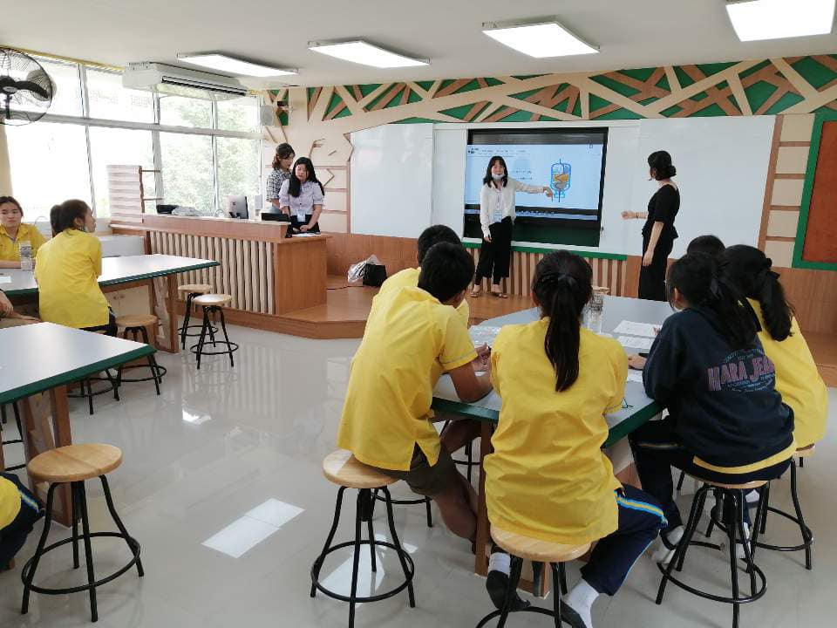
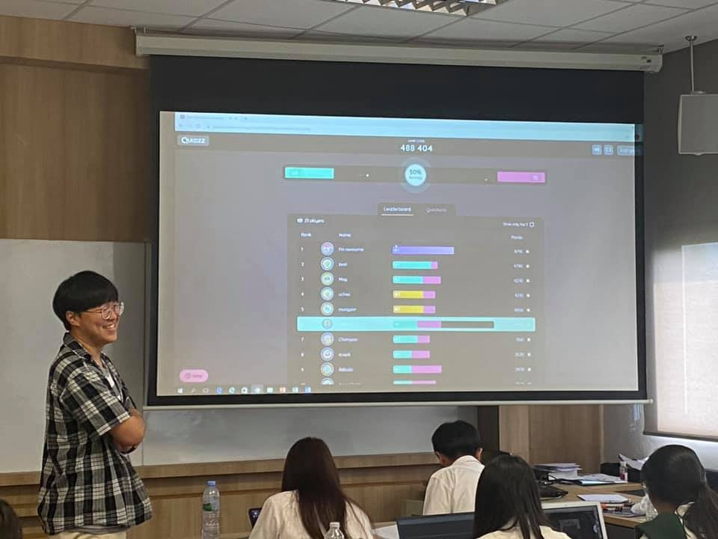
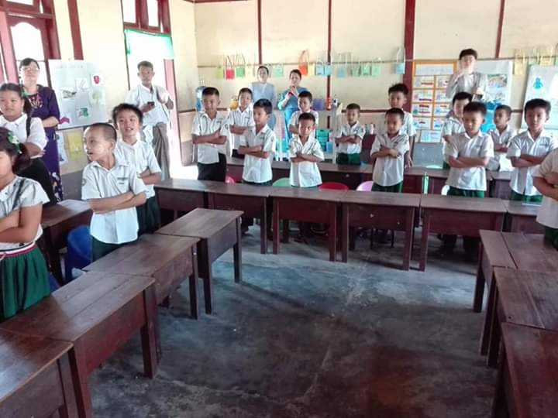
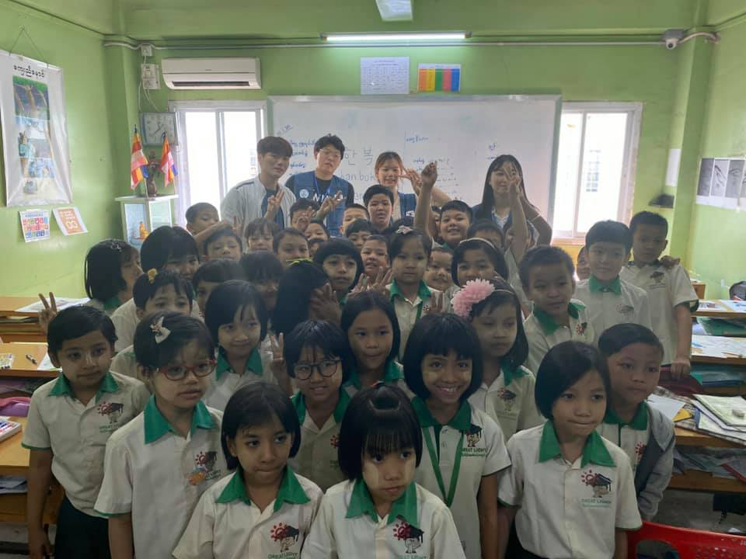
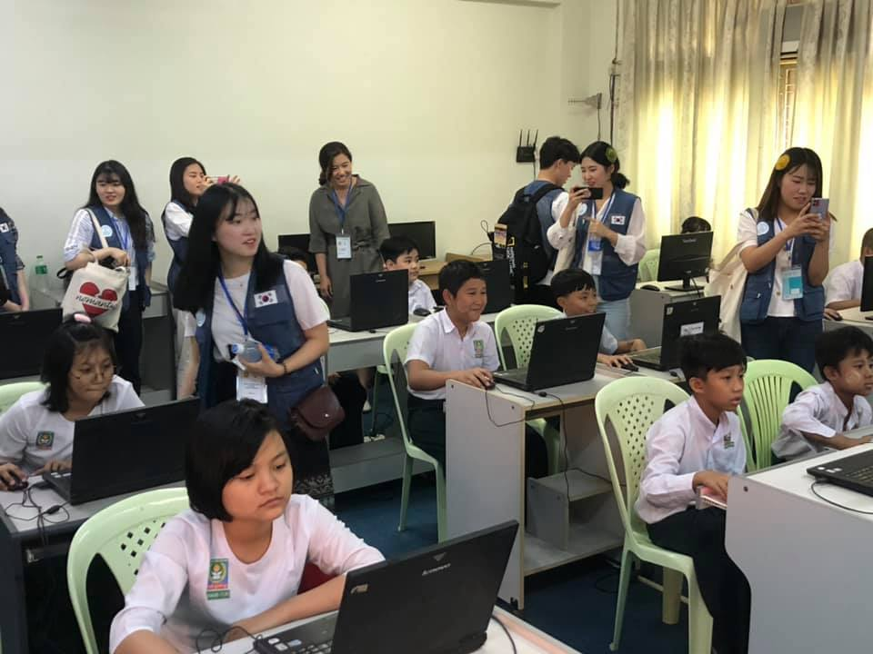

Slide 21
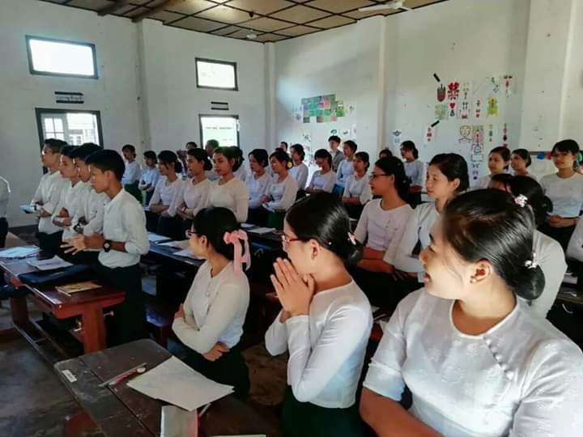
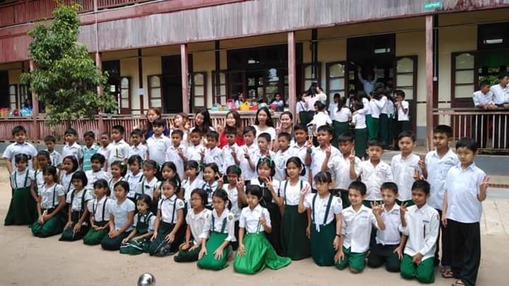
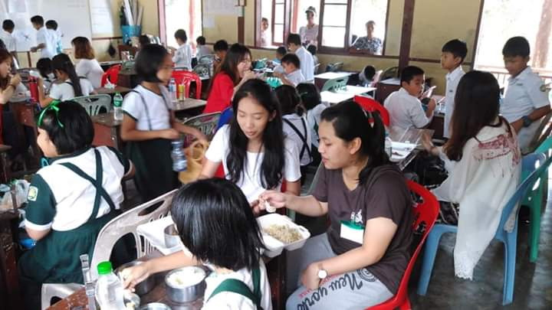

Slide 22
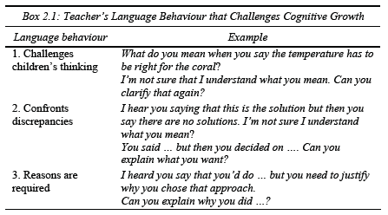
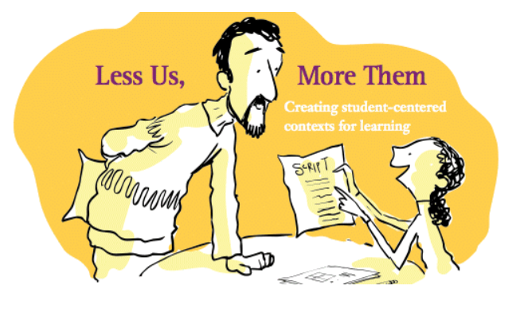
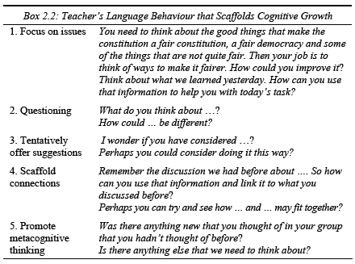

Slide 23
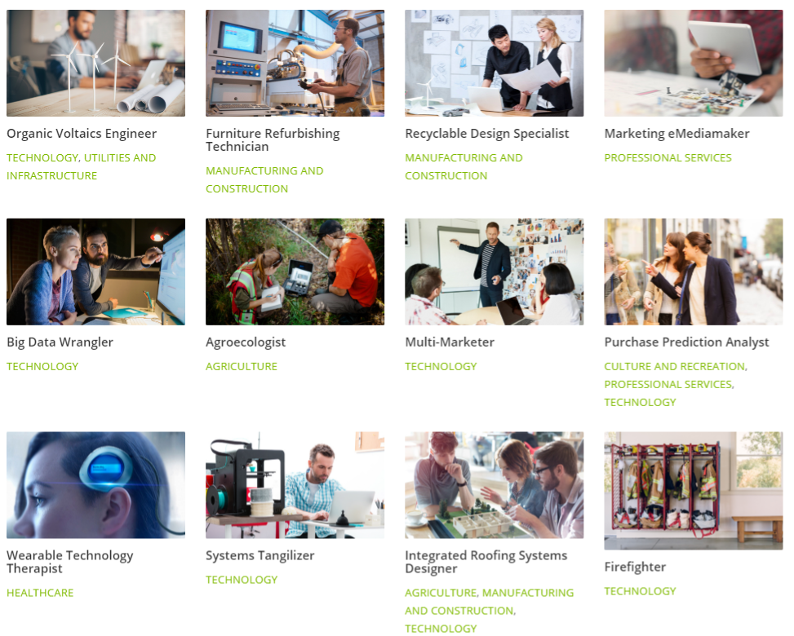
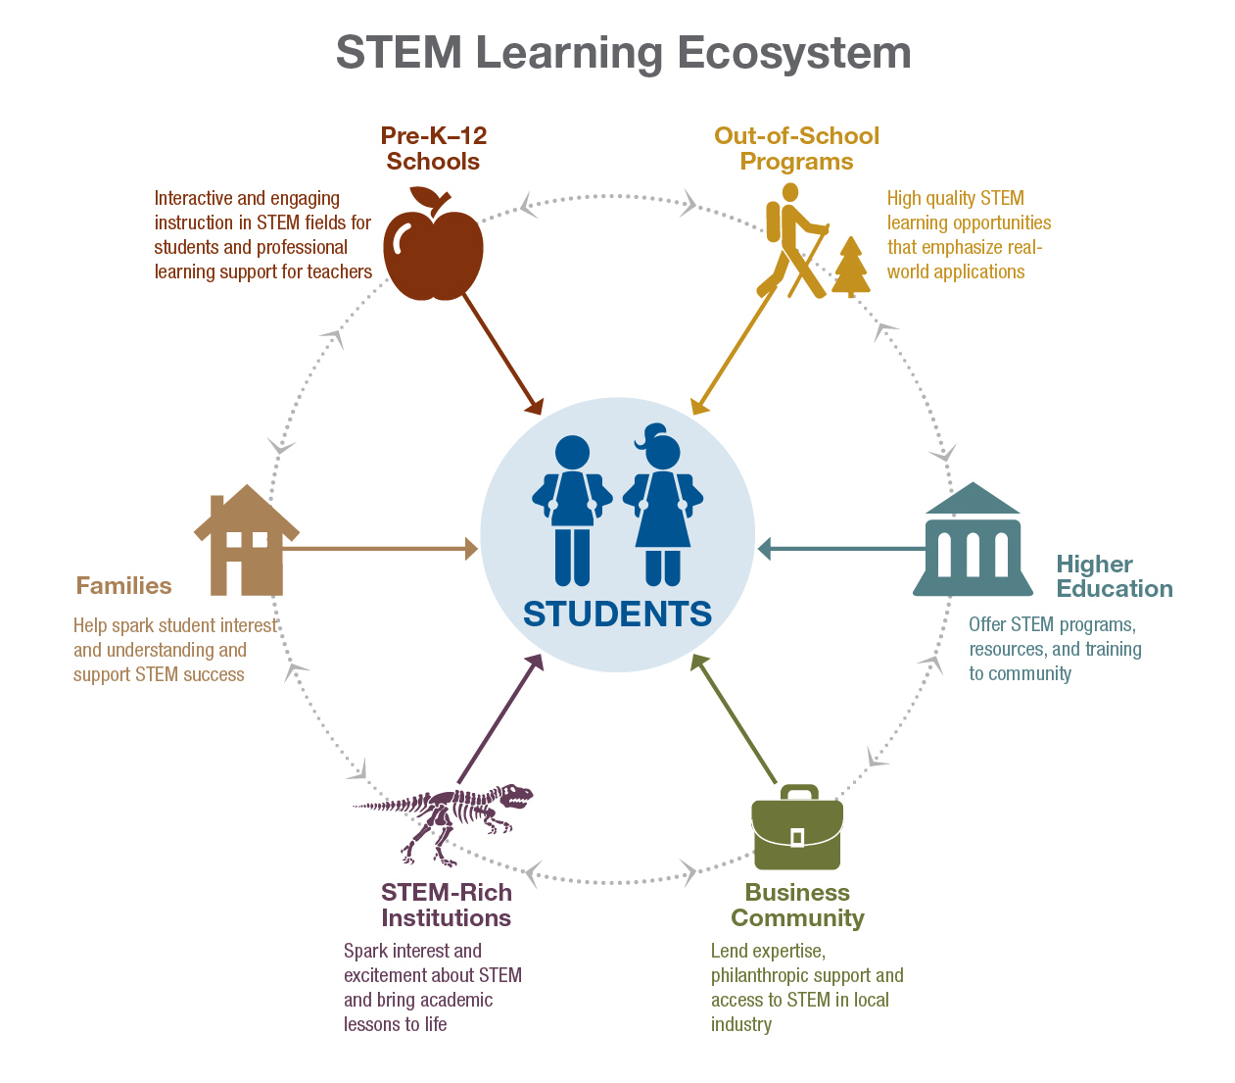

The Office of Innovation and Improvement (OII), US
Notes:
Careers2030.cst.org/jobs
Welcome to the Office of Innovation and Improvement (OII), where our mission is to accelerate the pace at which the U.S. identifies, develops, and scales solutions to education’s most important or persistent challenges. OII makes strategic investments in innovative educational programs and practices, and administers 25 discretionary grant programs managed by four program offices: Charter Schools Program, Parental Options and Improvement, Teacher Quality Programs, and Education Innovation Programs. In addition, OII also serves as the Department’s liaison and resource to the nonpublic education and military communities through the Office of Non-Public Education and Military Affairs. Lastly, OII is home to ED’s Science, Technology, Engineering and Math (STEM) initiatives team.

Slide 24
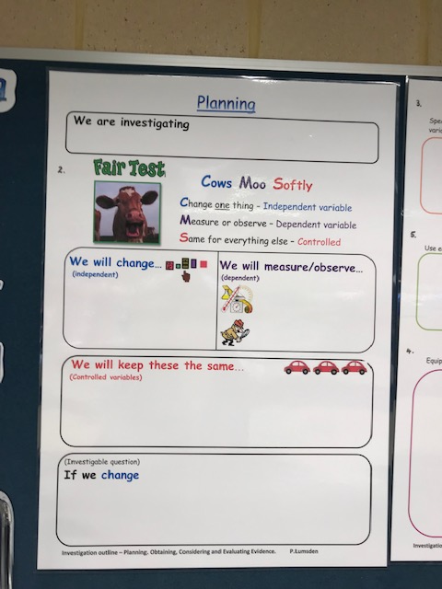
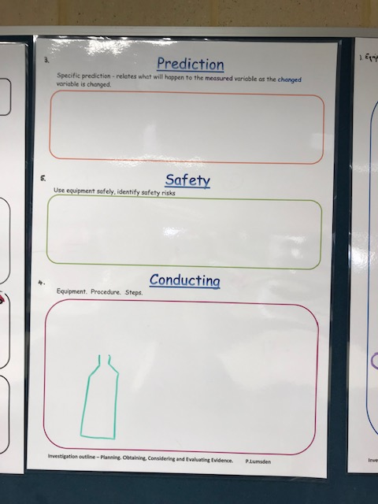
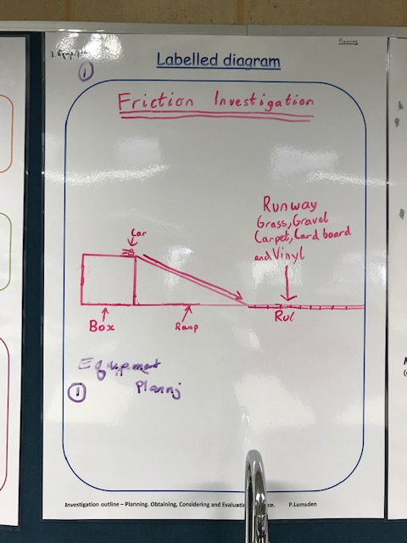




Slide 25




Slide 26

감사합니다.

