Slide 1
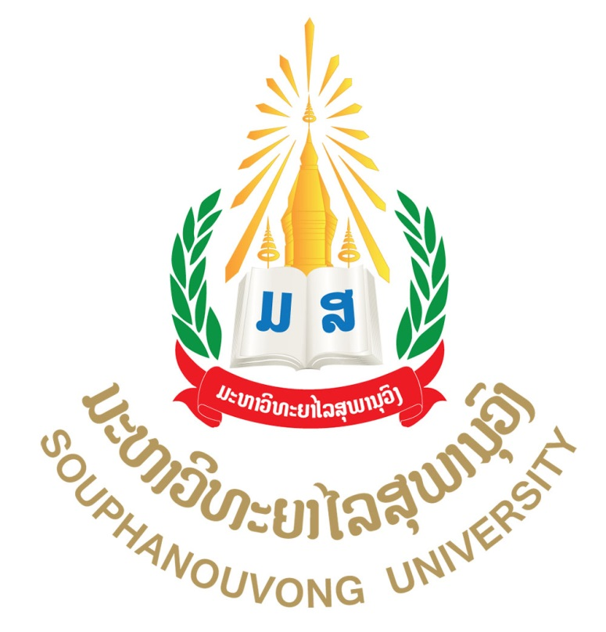
Pedagogical Education System in Lao PDR: A Case of Souphanouvong University
By:
Mr. Si Anouvong SAVATHVONG
Vice President, In Charge of Academic Affairs
Souphanouvong University, Lao PDR
June 2019

Slide 2
Presentation Outline
Overview of education policy and directions of the Lao government
Professional Education System Structure
Current situation of pedagogical education in Lao PDR
Future prospectrum

Slide 3
I. Education Development policy
Education is a core of human resource development to serve the country’s socio-economic development
To enhance human resource development is one of the government’s priorities
HRD is carried out through the three programs as follows:
1. Increase equitable access to education
2. Improve education quality and education framework
3. Strengthen education management

Slide 4
I. Education Development policy (cont’)
Requirements for education development
Consistency with national socio-economic development plan and human resource development plan
Need to ensure three characteristics: national, modern and scientific, and interpersonal characteristics
Learners should be developed in five pillars such as morale, intellectual, labor, physical strength and arts
Learners should gain a good balance between theories and practices
Learners should be encouraged to learn both in the classroom and real life situation
Ensure high quality and constancy with the regional and global contexts

Slide 5
Education System Structure
25 yrs
24
23
22
21
20
19
18
17 yrs
16
15
14
13
12
11
10
9
8
7
6
5
4
3 ¯ó
Medical Sciences &Postgraduate programs
University
(4-6 yrs)
Higher
Diploma ( 3 yrs )
USE ( 3 yrs)
TVET
( 2 - 3 yrs)





Non Formal
Education
LSE (4 yrs)
UPE( 5 yrs )
Kindergarten( 3- 5 yrs)
Creche( 3 m - 3 yrs )

Slide 6
Professional education
Professional education starts from upper secondary education consisting of technical and vocational education and training (TVET), pedagogy training and main stream higher education through upper secondary education.

Slide 7
TVET - Requirements
TVET should be conducted according to three features, five education principles and ensuring meeting labor quality standards.
TVET should ensure good balance between theories and practice, consistency, continuity, connectivity and life-long learning.
TVET should ensure that learners can be self-employed, balancing between domestic and foreign labor supply.
TVET should not discriminate learners regardless of their physical, mental, economical and social statuses.
Formal and non-formal TVET
  Formal TVET
    Technical degree (9+3 or 12+2)
    Diploma degree (12+2 or 12+3)
    Bachelor degree (12+4)
  Non-formal TVET
    Short term trainings conducted either by training institution or by the employers

Slide 8
Pedagogy - Requirements
“Training is essential as it activates lifelong learning for teacher educator in the higher learning institution because it is the knowledge and skills improvement and to learn the newtheory and new sciences”.

Slide 9
Main stream professional education
also called higher education, or post-secondary education or post-technical degree education.
starts from diploma degree through doctorate degree, for promoting life-long learning, aiming to create experts, researchers and scientists
  Diploma degree (12+2 or 12+3)
  Bachelor degree (12+4)
  Master degree (12+4+2)
  Doctorate degree (12+4+2+3)

Slide 10
III. Current situation of pedagogical education in Souphanouvong University, Lao PDR
pedagogy education in Souphanouvong University has expanded rapidly in recent decade
But, such development is not consistent with the actual labor demand
  Too much main stream professional education compared to TVET
  In main stream professional education, there is also imbalance among disciplines

Slide 11
III. Current situation of pedagogical education in Souphanouvong University (SU), Lao PDR
SU is 1 of 5 public higher education institutions
The academic structure comprises: Faculty of Education (FOE), Faculty of Economics and Tourism (FET), Faculty of Engineering (FEN), Faculty of Agriculture and Forest Resource (FAF), Faculty of Architecture (FAR), and Faculty of Languages (FOL)
Faculty of Education (FOE) takes response for pedagogy training

Slide 12
III. Current situation of pedagogical education in Souphanouvong University (SU), Lao PDR
pedagogical education has expanded rapidly in recent decade
But, such development is not consistent with the actual labor demand
  Too much main stream professional education for secondary school
  Government asks SU for only producing university and specialist teacher

Slide 13
IV. Future prospectrum
Pedagogical Training in SU will be focussing on university teacher training and on science and technology sector
“Training is essential as it activates lifelong learning for teacher educator in SU because it is the knowledge and skills improvement and to learn the new theory and new sciences”.
New facilities has to improve for suitable change.

Slide 14
IV. Future prospectrum (cont’)
to improve pedagogical skills of young professionals of SU, the goals of the pedagogical trainings are that participants learn to -
• plan a course as a coherent entity
• plan and apply teaching methods that activate and engage students
• apply teaching methods that promote students generic skills and working life competences
• develop teaching together with other teachers
• become more aware of own teaching practices and make plans for developing own teacher expertise.

