Slide 1



Development of a training program in School Counseling at VNU - University of Education
VIETNAM NATIONAL UNIVERSITY
UNIVERSITY OF EDUCATION
NAM TRAN

Slide 2


School violence is a big problem of Vietnam nowadays (Do, 2016, Hoang & Dang, 2016)
BACKGROUND
10% to 20% of students with mental health problems or other psychological difficulties (Tran.,2014)
60-80% of the students are in need of counseling about their emotional, learning problems, and career guidance (Bui, 2014).
Vietnam: Only 0.63 psychiatric beds per 10,000
0.8 psychiatrists and 0.06 psychologists
per 100,000 people
NEED 70K SCHOOL COUSELORS FOR PRIMARY AND SECONDARY SCHOOL UP TO 2020
Government's Decree No. 31/2017/BGDĐT to assign counselor’s position at school (part time teacher with training can provide services)

Slide 3

The Need for a School counseling Training Program in Vietnam
In contrast to the United States, where approximately 80.5% of school psychologists hold a specialist degree or higher (Fagan & Wise, 2007), a bachelor’s degree is the highest degree that an estimated 70% of Vietnamese school-based practitioners have earned and the degrees vary (Jimerson et al., 2008).
imerson and colleagues (2008) found that an estimated 50% of practitioners obtained degrees in psychology, while 30% earned degrees in education, and the remaining 20% studied diverse subjects.
Do (2006) (as cited in Le, 2009) found that most school counselors graduated in programs unrelated to psychology.
Only one bachelor training program in Psychology (School psychology oriented), offered by Hanoi National University of Education (start from 2010)

Slide 4
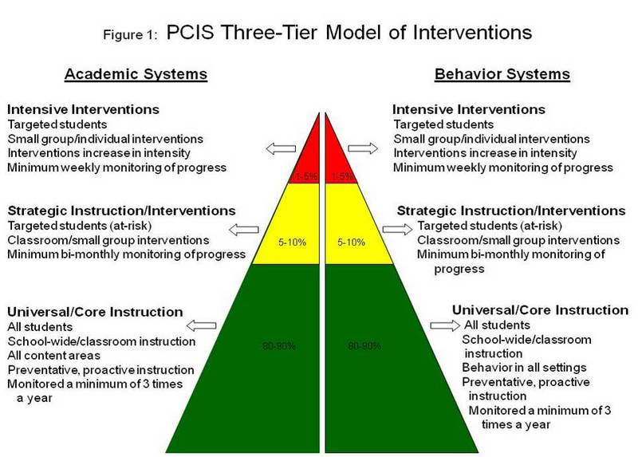
3-tier model of intervention
Notes:
Chỉ làm được tầng 1: Đội ngũ làm công tác tư vấn tâm lý trong nhà trường chủ yếu là giảng viên một số chuyên ngành như Luật, Tâm lý, Ngữ văn, Giáo dục công dân; một số là giáo viên dạy Lịch sử và Địa lí, các cán bộ chuyên trách các phòng ban như phòng Công tác HSSV, Đoàn Thanh niên, Hội Sinh viên,…
Tư vấn của cố vấn học tập, giáo viên chủ nhiệm, giáo viên, giảng viên bộ môn, báo cáo chuyên đề, hội thảo, thi tìm hiểu, sáng tác, giao lưu, tình nguyện, tư vấn trực tuyến,… đã bước đầu hình thành tổ chức tư vấn tâm lý trong nhà trường.
Đề xuất bồi dưỡng cho tầng 1 (từ đội ngũ Gv có sẵn)
ThS TVHĐ cho tầng 2 (các chương trình đào tạo thí điểm)
ThS và TS Tâm lý học lâm sàng cho tầng 3.
ĐHGD có cả.

Slide 5
VNU-UE develop the training program model
Tier 3: PhD Program in School Counseling (in the future)
Tier 2: MA in School Counseling Program
Tier 1: BA oriented in school counseling Program; Teacher certificated training program for school counseling (in-service teacher training courses)
Notes:
We now have a training program in Child & Adolescent Clinical Psychology

Slide 6
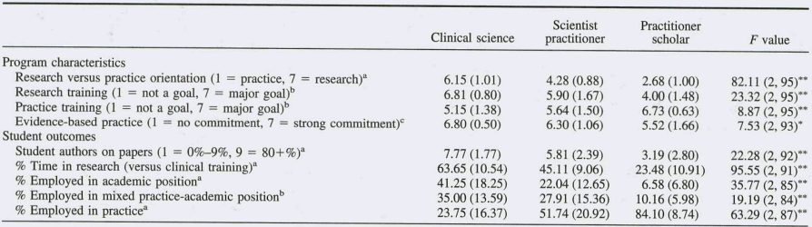
Benchmark Outcome of training models
Benchmark the outcome standards National Association of School Psychologists (NASP); American School Counseling Associations (ASCA) and Council on the Accreditation of Counseling and Related Educational Programs (CACREP)…
VNU-UE graduate training program have two track, one is research oriented; another is practice oriented

Slide 7
Benchmark foundational and functional competencies
Benchmark on 6 domains (including knowledge, skills and attitude)
assessment,
intervention,
consultation,
research,
supervision/teaching and
management/administration
Advocacy

Slide 8

Benchmark curriculum
(According to NASP) curriculum of the school counseling training programs are usually include: (i) general knowledge block, (ii) specialized subjects: scientific research; general introduction; psychological counseling; psychological tests, academic, behavioral & emotional interventions; school and community counseling; mental health; practice; graduation thesis, etc.

Slide 9
Benchmark curriculum
# | ID | Course name | credit | ISPA Standars (**) | CACREP Standars (**)
 | MSC 6001 | Introduction to School Counseling & Theories of Counseling | 3 | 1.2 Social and Emotional Development 2.2 Prevention, Mental Health Promotion and Crisis Intervention 5.2 Interviewing | Counseling and Helping Relationships
 | MSC 6002 | Human development & diversity in education | 3 | 3.2 Working with children and families from culturally diverse communities | Social and Cultural Diversity Human Development
 | MSC 6003 | Identification & assessment of students’ difficulties | 3 | 1.2 Social and Emotional Development 2.1 Evidence-Based Decision Making and Accountability 5.2 Interviewing | Assessment and Testing
 | MSC 6004 | Vocational guidance, counseling, & development | 3 | 1.3 Individual Differences 5.2 Interviewing | Career Development
 | MSC 6005 | Professional, Ethic, & Legal Standards in student services. | 3 | 3.1 Role and functions of school psychologists nationally and internationally 2.3 School and Systems Organization, Policy Development and Implementation 4.1 Legislation that impacts on education policy and practice 4.2 Ethical issues in professional practice 5.2 Interviewing | Professional Counseling Orientation and Ethical Practice
 | MSC 6006 | Theories of cognition, learning, & motivation | 3* | 1.1 Cognition and Learning 1.3 Individual Differences 2.1 Evidence-Based Decision Making and Accountability | Assessment and Testing Career Development
Notes:
Ex., VNU- University of Education courses in program & Professional Standards (ISPA & CACREP)

Slide 10
Benchmark curriculum
# | ID | Course name | credit | ISPA Standars (**) | CACREP Standars (**)
 | PSE 6024 | Research methods in social sciences. | 3 | 6.1 Research design and implementation 6.2 Analysis and interpretation of research findings | Research and Program Evaluation
 | MSC 6007 | Interview techniques & case development | 3 | 1.2 Social and Emotional Development 2.2 Prevention, Mental Health Promotion and Crisis Intervention 5.2 Interviewing | Counseling and Helping Relationships
 | MSC 6008 | Group counseling & communication skills development | 3 | 2.2 Prevention, Mental Health Promotion and Crisis Intervention | Group Counseling and Group Work
 | MSC 6009 (*) | Cognitive & Academic assessment & intervention | 3 | 1.1 Cognition and Learning | Assessment and Testing
 | MSC 6010 | Treatments of externalizing, internalizing problems | 3 | 1.2 Social and Emotional Development 1.3 Individual Differences 2.2 Prevention, Mental Health Promotion and Crisis Intervention
 | MSC 6011 | Crisis prevention & intervention | 3 | 2.2 Prevention, Mental Health Promotion and Crisis Intervention 5.2 Interviewing | Counseling and Helping Relationships
 | MSC 6012 | Social work in schools: Home-school-community collaboration | 3 | 3.2 Working with children and families from culturally diverse communities 2.4 Home-School-Community Collaboration 5.2 Interviewing
 | MSC 6013 | Academic advisement in universities and colleges | 3 | 1.3 Individual Differences 5.2 Interviewing | Counseling and Helping Relationships
 | MSC 6014 (*) | Interventions for Pre-School & Elementary Students. | 3 | 1.2 Social and Emotional Development 1.3 Individual Differences 2.2 Prevention, Mental Health Promotion and Crisis Intervention 2.1 Evidence-Based Decision Making and Accountability 5.2 Interviewing | Human Development Counseling and Helping Relationships Assessment and Testing
Ex., VNU- University of Education courses in program & Professional Standards (ISPA & CACREP)

Slide 11
Benchmark curriculum
# | ID | Course name | credit | ISPA Standars (**) | CACREP Standars (**)
 | MSC 6015 (*) | Interventions for Secondary & High School Students | 3 | 1.2 Social and Emotional Development 1.3 Individual Differences 2.2 Prevention, Mental Health Promotion and Crisis Intervention 2.1 Evidence-Based Decision Making and Accountability 5.2 Interviewing | Human Development Counseling and Helping Relationships Assessment and Testing
 | EDM 6031 | Educational project/Curriculum Development & Evaluation | 3* | 2.3 School and Systems Organization, Policy Development and Implementation 2.1 Evidence-Based Decision Making and Accountability | Research and Program Evaluation
 | TMT 6012 | Theories & Technology in Teaching | 3
 | MSC 6016 (*) | 1A. Practicum I. Focus on diagnosis, assessment skills; Cognitive, Academic & Vocational guidance intervention practicum in in the Lab, Schools | 3 | 1.2 Social and Emotional Development 1.3 Individual Differences 2.1 Evidence-Based Decision Making and Accountability 4.2 Ethical issues in professional practice 5.2 Interviewing | Professional Counseling Orientation and Ethical Practice Counseling and Helping Relationships Career Development Assessment and Testing
 | MSC 6017 (*) | 1B. Practicum I. Focus on diagnosis, assessment skills; Mental health intervention practicum in the Lab, School, or Hospital, Psychological counseling services; | 3 | 1.2 Social and Emotional Development 1.3 Individual Differences 2.2 Prevention, Mental Health Promotion and Crisis Intervention 2.1 Evidence-Based Decision Making and Accountability 4.2 Ethical issues in professional practice 5.2 Interviewing | Professional Counseling Orientation and Ethical Practice Counseling and Helping Relationships Assessment and Testing
 | MSC 6018 | 2A.Practicum II. Focus on School counseling, Vocational guidance assessment & intervention (in School) | 3 | 11.2 Social and Emotional Development 1.3 Individual Differences 2.2 Prevention, Mental Health Promotion and Crisis Intervention 2.1 Evidence-Based Decision Making and Accountability 4.2 Ethical issues in professional practice 5.2 Interviewing 4.3 Report writing | Professional Counseling Orientation and Ethical Practice Counseling and Helping Relationships Career Development Assessment and Testing Report writing
Ex., VNU- University of Education courses in program & Professional Standards (ISPA & CACREP)

Slide 12
Benchmark curriculum
# | ID | Course name | credit | ISPA Standars (**) | CACREP Standars (**)
 | MSC 6019 | 2B. Practicum II. Focus on Mental health assessment & intervention (in School, Psychological counseling services) | 3 | 1.2 Social and Emotional Development 1.3 Individual Differences 2.2 .Prevention, Mental Health Promotion and Crisis Intervention 2.1 Evidence-Based Decision Making and Accountability 4.2 Ethical issues in professional practice 5.2 Interviewing 4.3 Report writing | Professional Counseling Orientation and Ethical Practice Counseling and Helping Relationships Assessment and Testing Report writing
 | MSC 6020 | 2C. Practicum II. Focus on School social work (in School, Social work services) | 3 | 11.2 Social and Emotional Development 1.3 Individual Differences 2.2 Prevention, Mental Health Promotion and Crisis Intervention 2.1 Evidence-Based Decision Making and Accountability 4.2 Ethical issues in professional practice 5.2 Interviewing | Professional Counseling Orientation and Ethical Practice Counseling and Helping Relationships Report writing
 | MSC 7021 | Master Thesis | 15 | 6.1 Research design and implementation 6.2 Analysis and interpretation of research findings 4.3 Report writing | Research and Program Evaluation Report writing
Ex., VNU- University of Education courses in program & Professional Standards (ISPA & CACREP)

Slide 13

Course comparison

Slide 14
Notes:
We compare courses of School counseling programs in different school

Slide 16
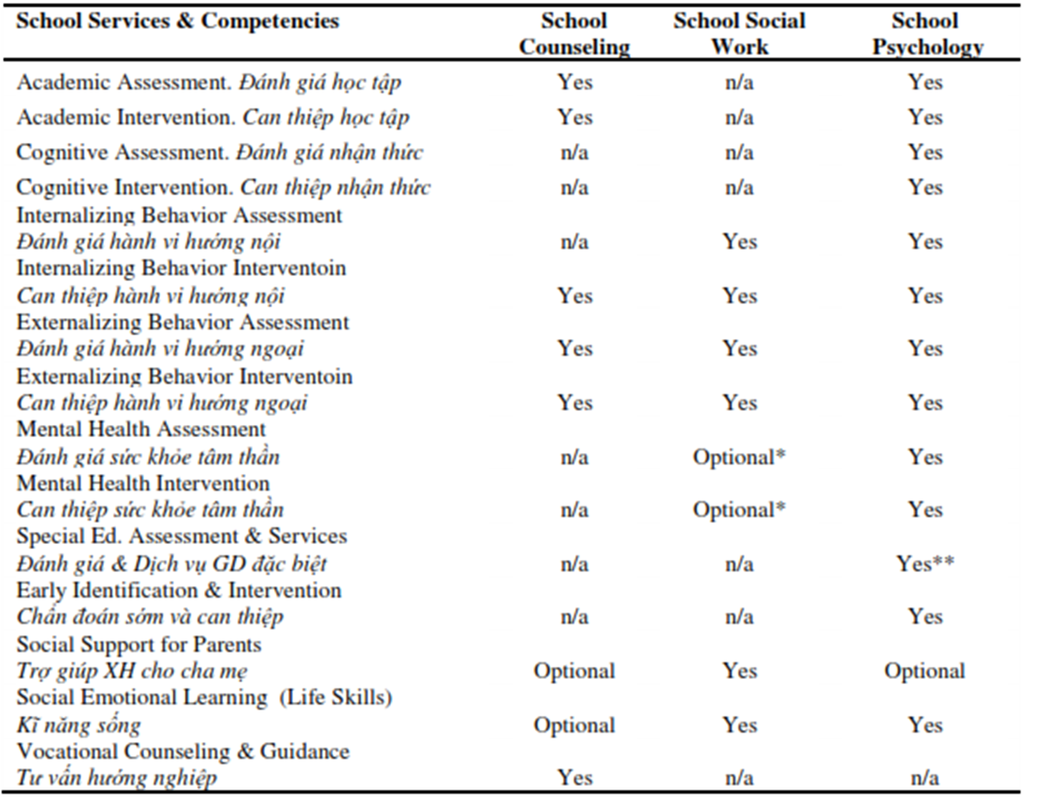
Notes:
We compare courses of different training program (School counseling, School social work and School Psychology)

Slide 17
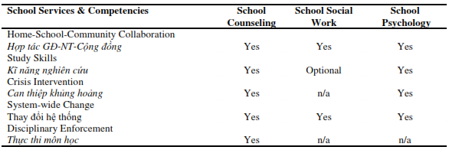

Slide 18
Benchmark teaching contents and methods

Slide 19
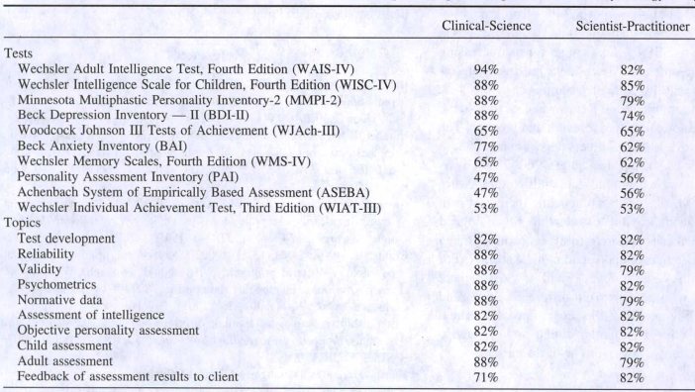
Notes:
For ex, The 10 Most Popular Psychological Tests and the 10 Most Popular Topics Taught in School Counseling Programs
The course need greater training in assessment that is relevant to Evidence Based Practice (EBP)

Slide 20
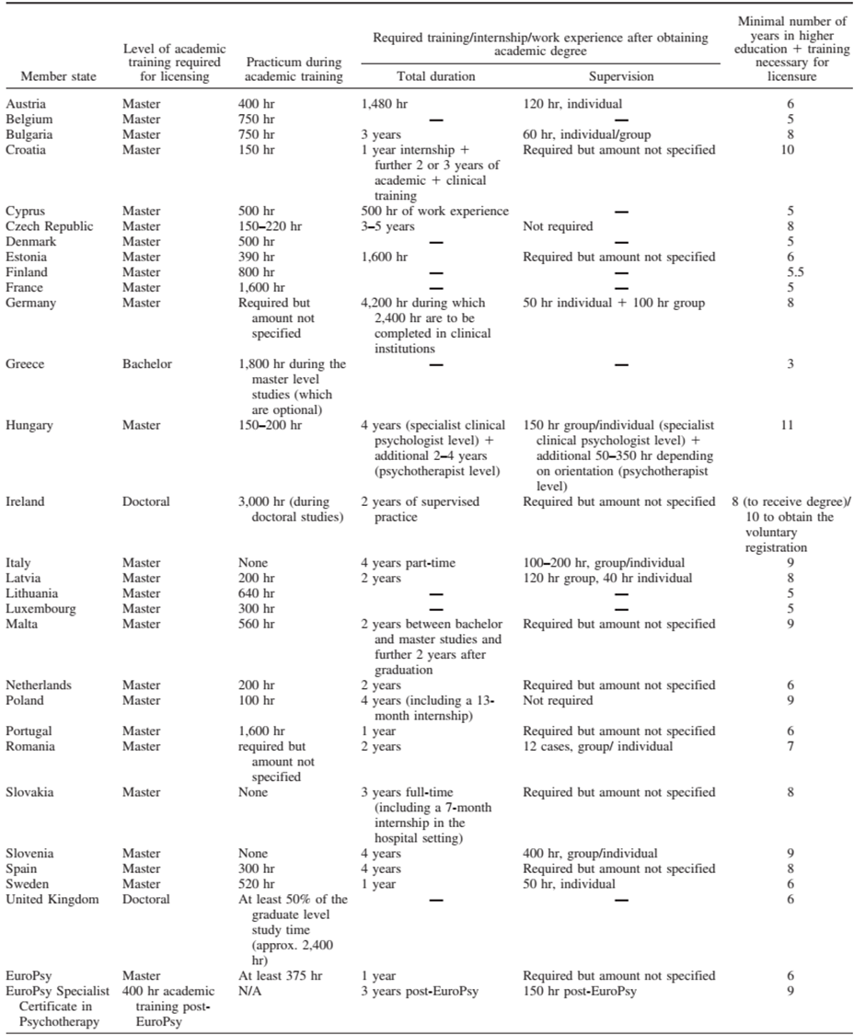
The VNU-UE School counseling master program required at least 600hr practicum during academic training

Slide 21
Teacher certificated training program

Slide 22

240 credit hours
8 modules
Introduction to School Counseling& Theories of Counseling
Assessment and case formulization
General counseling skills
Counseling for emotional and behavioral problems
Career counseling and career development
Gender and reproductive health counseling
Counseling for academic difficulties and academic strategies
Practicum

Slide 23
Teacher/Counselor support tools

Slide 24
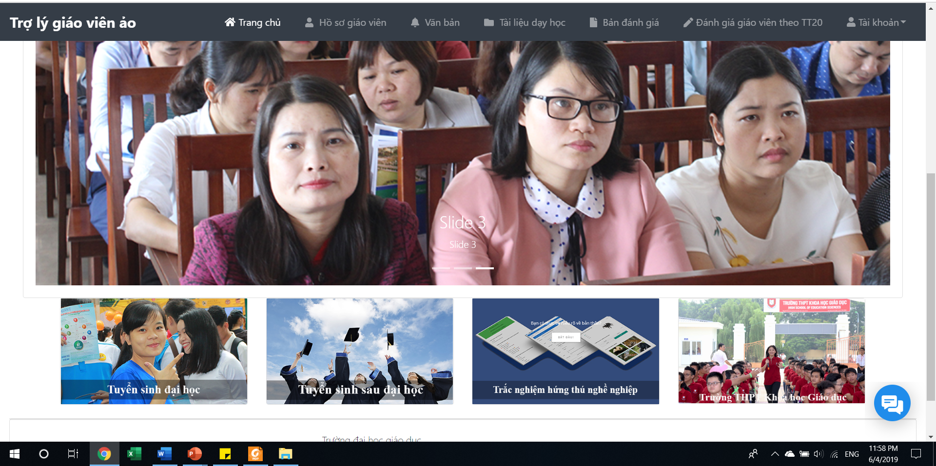
Teacher virtual assistant
Notes:
Computerized adaptive testing

Slide 25

Psychological assessment system

Slide 26

THANK YOU!

