Slide 1


Democracy and Political Education in Globalizing Korea
Sang-Young Park (PHD, Political Science)
Korea National University of Education

Slide 2
Democratic Transition
From Authoritarian regime To Democratic regime
South Korea
1987 direct presidential election (five-year single term)
Some authoritarian legacies continue
The resurrection of civil society

Slide 3
Democratic Consolidation
S. Huntington
“Two-turn test”
Linz & Stepan
“The only game in town”
A. Shedler
“Avoiding democratic erosion & breakdown”

Slide 4
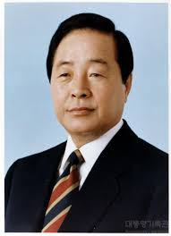
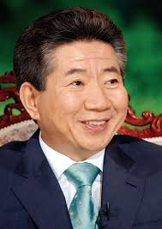
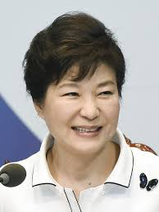
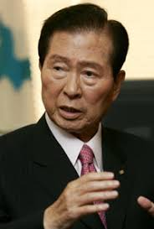
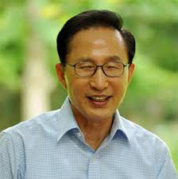
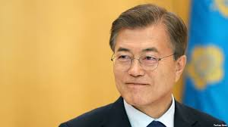
Korea’s Democratic Consolidation
1992–1997
Kim Young Sam
1998–2002
Kim Dae Jung
2003–2007
Roh Moo Hyun
2008–2012
Lee Myung Bak
2013–2017
Park Geun Hye
2017-Present
Moon Jae In

Slide 5
EIU Democracy Index
Full democracies: 8-10
01
Flawed democracies: 6-7.9
02
Hybrid regimes: 4-5.9
03
Authoritarian regimes: below 4
04

Slide 6
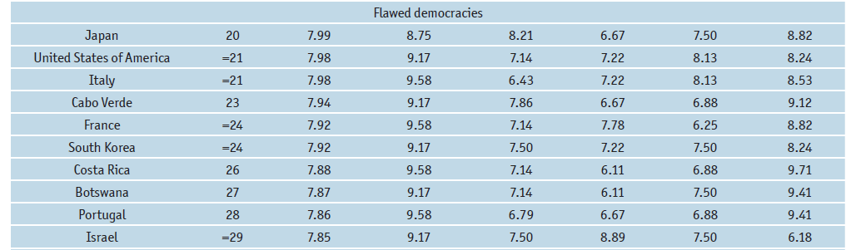
South Korea 2016: 24th, Flawed Democracy

Slide 7
South Korea 2006-2016: EIU Index

Slide 8
Freedom House Index 2008
STATUS: Free
FREEDOM RATING(1 = BEST, 7 = WORST): 1.5
CIVIL LIBERTIES(1 = BEST, 7 = WORST): 2
POLITICAL RIGHTS(1 = BEST, 7 = WORST): 1

Slide 9

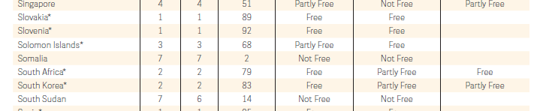
Freedom House Index 2016

Slide 10
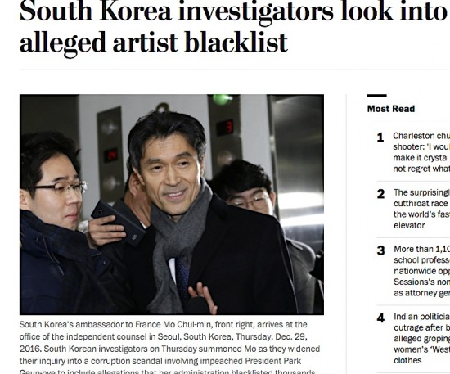
Blacklist

Slide 12
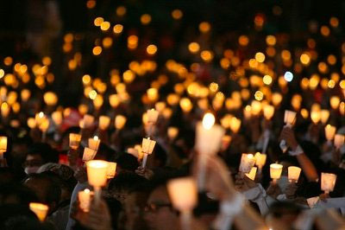
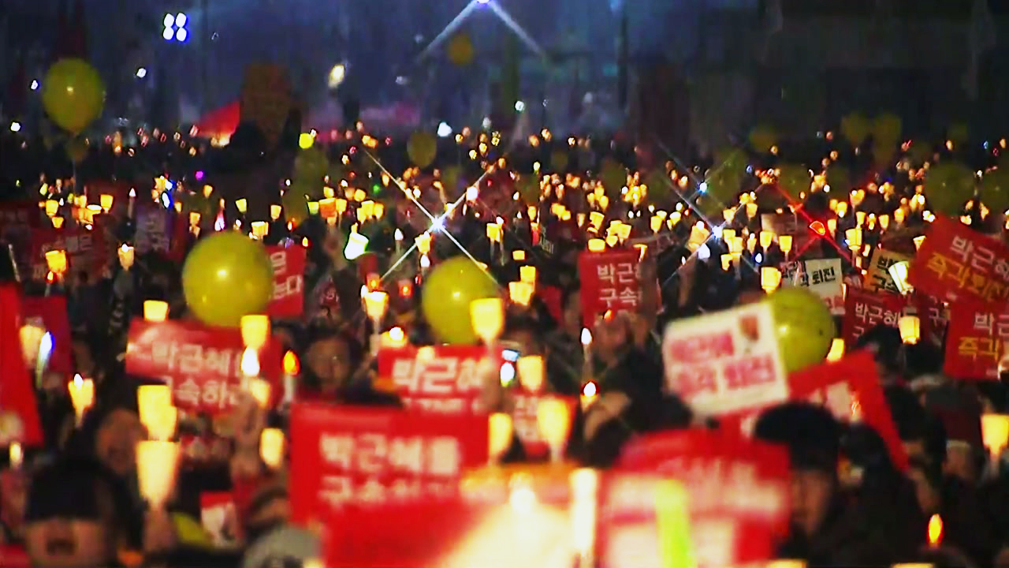
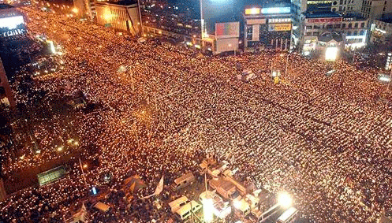
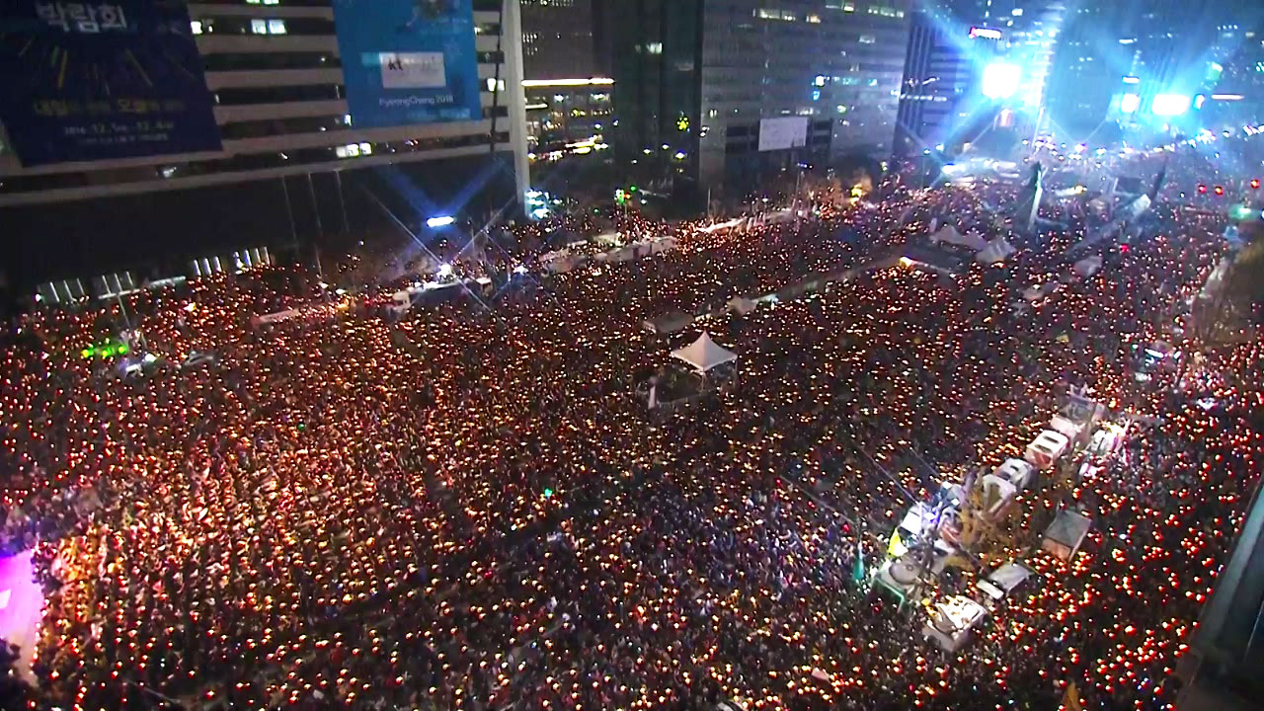

Slide 13

Schattschneider (1942)
A modern democratic system is unthinkable without political parties.

Slide 14

Political parties are regarded as being institutionalized … (Lee 2009)
When the number of parties are few,
When the same parties run in several consecutive elections,
When parties are rooted in society with systematic links to social organizations,
When party organization is developed to resolve the social choice problem and exercise party discipline

Slide 15
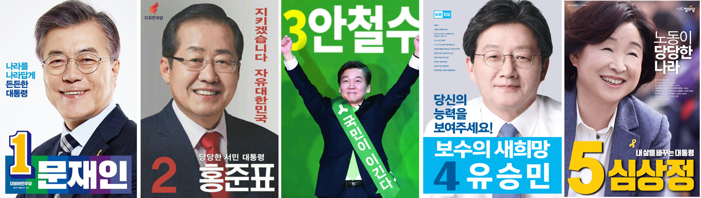
2017 Presidential election

Slide 16
party system institutionalization in six Asian countries, Croissant and Völkel (2010)

Slide 17
Korea’s political party system is…
“under-institutionalized”
“weak”
“fluid”
A “party-less” democracy

Slide 18
Why under-institutionalized?
Institutional factors: the electoral system (Cheng 2003)
Cultural factors: the Korean people’s strong penchant for charismatic leaders (Park and Shin 2006)
Historical/ Structural factors: Korea’s authoritarian legacies (Hermanns 2009; Lee 2009; Wong 2015)

Slide 19
lee (2009)
Korea’s over-mobilized social movements to the extent to substitute many functions of under-institutionalized political parties create distinctive predicaments for democratic representation and accountability.

Slide 21
The Fourth Industrial Revolution and Democracy
Optimists:
More direct democracy, more participation, more connected civil society
Pessimists:
Rise of populism, danger of mobocracy
Hidden implications of the Fourth Industrial Revolution on democracy
More deepened stage of capitalism
Higher level of work flexibilization
Declining and weakening deliberation
More wealth inequality

Slide 22
Hunger strike
Culture of Resistance

Slide 23
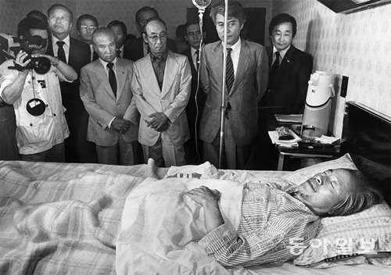
Kim young sam
May 1983
23 days
Demanding political reforms for democratization

Slide 24
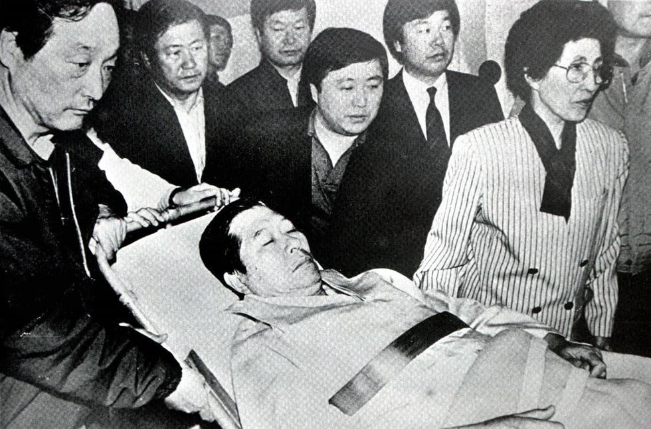
Kim dae jung
October 1990
13 days
Demanding the implementation of local self-rule
About 30 lawmakers of his party staged a protest fast of their own

Slide 25
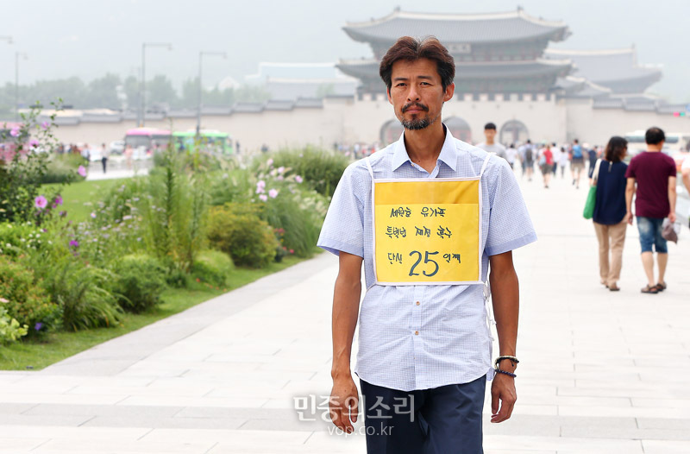
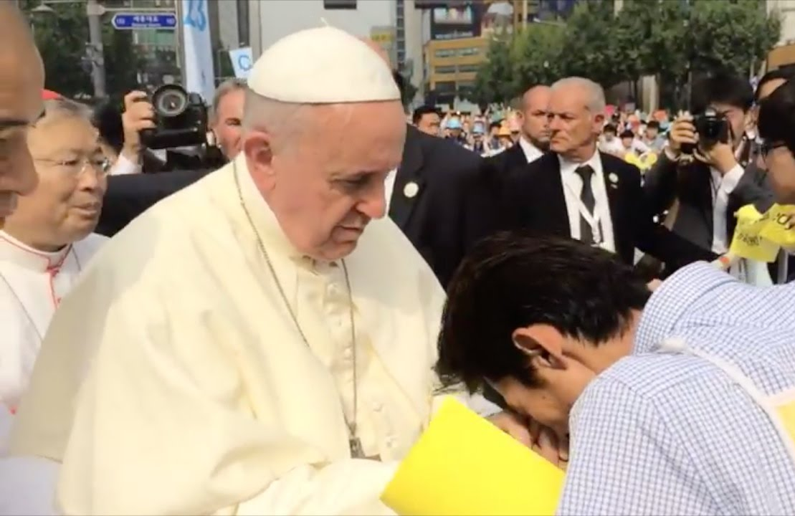
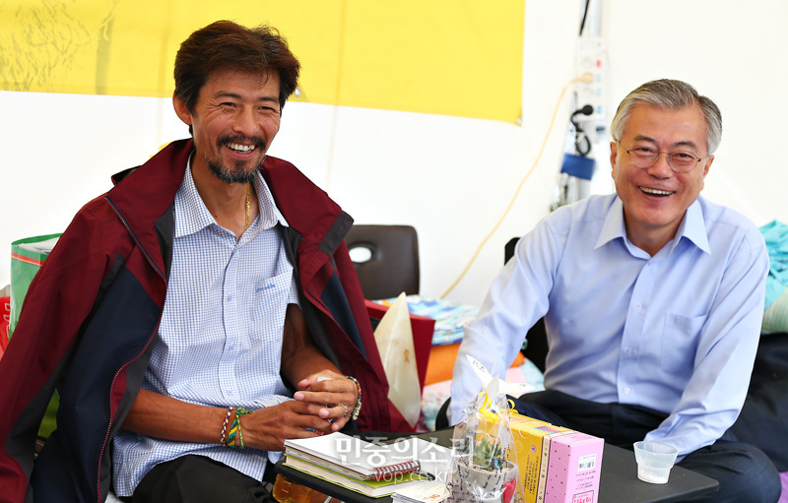
Kim young oh
August 2014
46 days
A father of Sewol Ferry Victim
Demanding for the legislation of Special Law of Sewol Ferry Victims

Slide 26
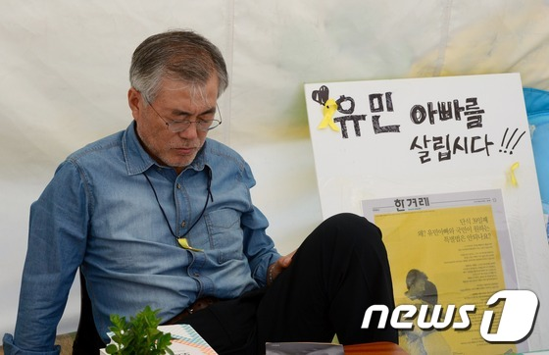
Mon jae in
August 2014
10 days
Supporting Mr. Kim Young Ho, and urging him to stop hunger strike

Slide 27
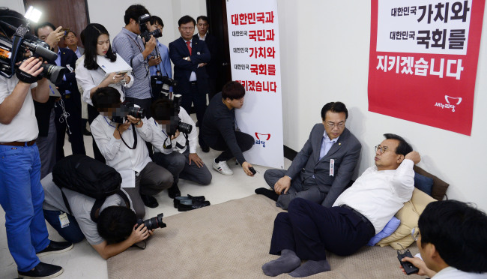
Lee jung hyun
September 2016
7 days
The leader of the ruling Sanuri Party
Demanding the Speaker’s resignation

Slide 28
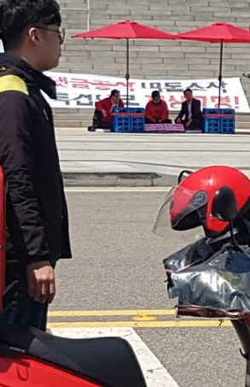
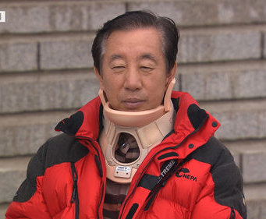
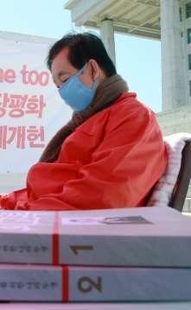
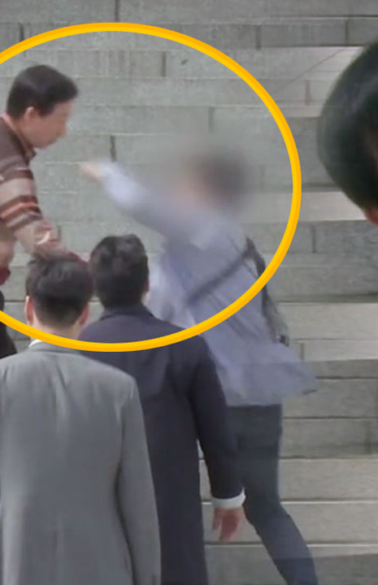
Kim sung tae
May 2018
9 days
Floor Leader of Liberty Korea Party
Demanding for an independent counsel probe into the scandal involving an influential blogger with alleged ties to a key ruling party lawmaker

Slide 29
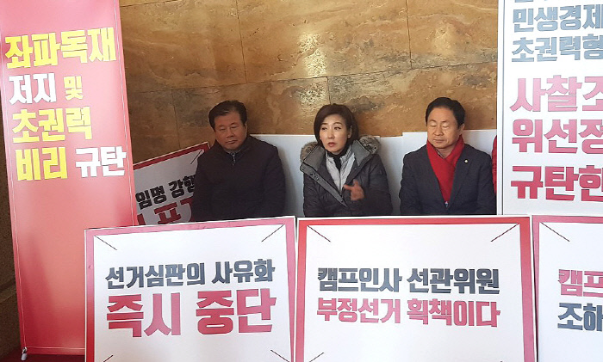
Liberty korea party
January 2019
5 Hours 30 min
Launched a relay hunger strike at the National Assembly in protest of President Moon Jae-in’s appointment of a former aide as vice chairman of the country’s election watchdog

Slide 30
Democracy in Korea
Strongly majoritarian political institutions vs. Strongly consensus-oriented civil society
Lack of mutual tolerance and institutional forbearance
Politics as a matter of life or death

Slide 31
w. Galston (2001)
“Compared with previous generations, scholars of today are more likely to agree that well-designed institutions are not enough, that a well-ordered polity requires citizens with appropriate knowledge, skills, and traits of character. And it is reasonably clear that good citizens are made, not born. The question is how, by whom, to what end?”

Slide 32
Osler & starkey (2006)
“… there is a recognition that democracy is essentially fragile and that it depends on the active engagement of citizens, not in in voting, but in developing and participating in sustainable and cohesive communities. This, in turn, implies education for democratic citizenship.”

Slide 33
Democracy education in korea
Very ‘minimalistic’ democracy
No social and political consensus about what kind of democracy education should be taught

