Slide 1


School-Based Lifelong Education
Policies In South Korea
Kim, Young Sek
Department of Education, KNUE
youngsek@knue.ac.kr

Slide 2
Lifelong Education By Laws
CONSTITUTION OF THE REPUBLIC OF KOREA
Article 31 (5)
The State shall promote lifelong education.
FRAMEWORK ACT ON EDUCATION
Article 9 (2)
Schools shall be public in nature and shall make efforts to maintain and develop sciences and cultural heritage and promote the lifelong education of residents as well as educating students.

Slide 3
A Broad Perspective of Lifelong Education
Older Adulthood
Level of Education
Middle Years
Region
Adolescence
Places
School
Home
Work
Place
Local
Community
Cyber
Space
Race
Ages
Childhood
Diversity
Lifetime

Slide 4
A Narrow Perspective of Lifelong Education
  All types of systematic educational activities other than regular school curriculums, including supplementary education for educational attainment, basic literacy education for adults, occupational ability enhancement education, humanities and liberal education, culture and art education, and citizen’s participation education
  <Lifelong Education Act, Article 2 (1)>

Slide 5
Meanings of School-Based Lifelong Education
Perspectives
Meanings
A Broad Perspective
Expanding concept of education by integrating regular curriculum of school education with other forms of education
Educating school students, their parents, and community members excluding regular curriculum
A Narrow Perspective

Slide 6
School-Based Lifelong Education Policies 1
: After-School Programs (Department of Education, 2017)
  Period : 2005 - Now
  Overview : A set of activities which are school-based operations but are not a part of regular curriculum
  Target : School Students
  Purposes
  ① Reducing expanses of tutoring outside school
  ② Providing diverse educational activities in rural areas
  ③ Interconnecting school and communities
  Participating Teachers : School Teachers 47.8%, Out-of-School Teachers 52.2%

Slide 7
Conceptual Framework of Korean Students' Learning Activity
(Bae & Jeon, 2011)
After School hours
School hours
Profit-seeking
private education
institutions
Regular
Curriculum
School-based
After School Programs

Slide 8
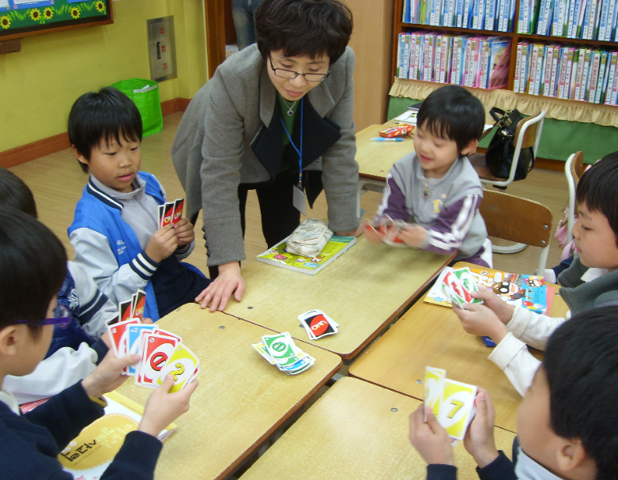
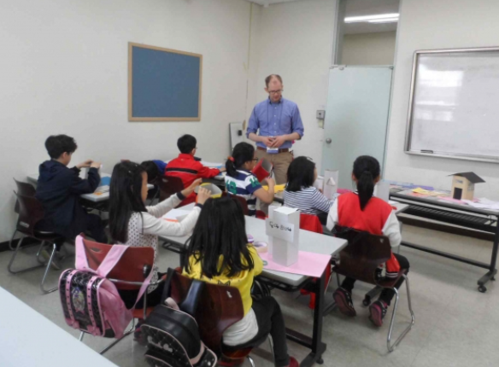
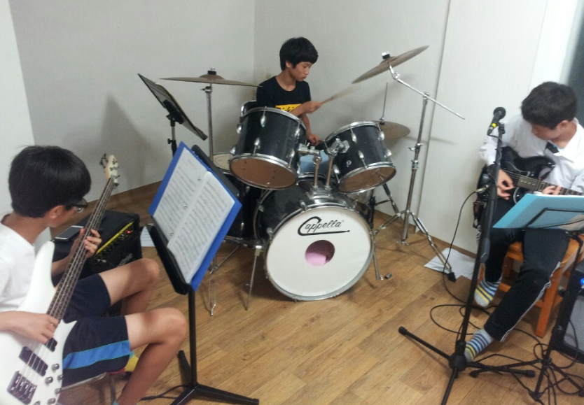
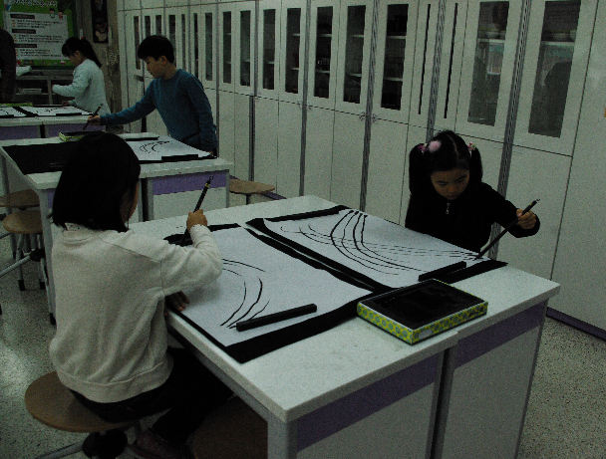
Math
English
Music
Arts

Slide 9
Participation Status : After-School Programs
(Department of Education, 2017)
 | Elementary Schools | Middle Schools | High Schools | Total
Number of Schools | 6,229 | 3,216 | 2,346 | 11,791
Percentage(%) | 99.8% | 99.2% | 99.4% | 99.6%
Number of Participating Students | 1,729,000 | 593,000 | 1,049,000 | 3,371,000
Percentage(%) | 64.7% | 42.9% | 62.9% | 58.9%

Slide 10
Types of After-School Programs
(Department of Education, 2017)
# of Programs | School Curriculum Related Programs |  |  |  |  |  | Specialty Programs |  |  |  |  |  | Total (%)
 | English | Math | Science | Korean Language | Social Studies | etc | Music | Arts | Physical Training | Computer | Reading & Writing | etc
Percentage (%) | 12.9 | 11.9 | 8.6 | 7.6 | 5.2 | 4.0 | 10.6 | 6.4 | 12.3 | 6.1 | 2.0 | 12.6 | 100
Total (%) | 50 |  |  |  |  |  | 50

Slide 11
Meaningful Results: After-School Programs
Lifelong Educational Significance
Features
Increasing teachers’ interest in local communities
Need to communicate with parents to find their needs
Interconnecting schools and communities
Able to invite professionals as teachers regardless of Teacher Certificate
Need to investigate the ability of out-of-school teachers continuously
Participating local residents as teachers
Teaching specialty programs, which were not included in school curriculum
Able to teach supplementary lessons for low-grade students
Expanding themes of Education

Slide 12
School-Based Lifelong Education Policies 2
: School Sharing with Local Community
  Period : 2007 - 2010
  Overview : Helping schools to function as community lifelong learning centers
  Target : Parents and Local residents
  Purposes : ① Providing various learning opportunities to parents and local residents by linking school and local resources
  ② Creating a school without fences to communicate with local
  communities
  Types of programs : Vocational Training Programs, English and Second Foreign Languages, Parent Education, Hobby Education, and etc

Slide 13
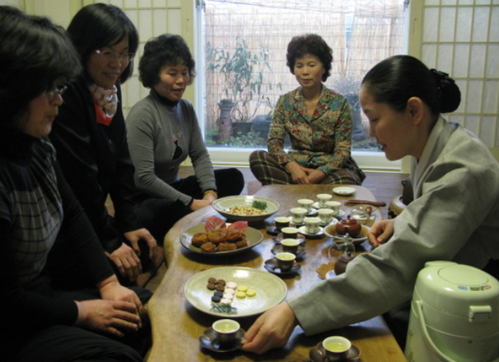
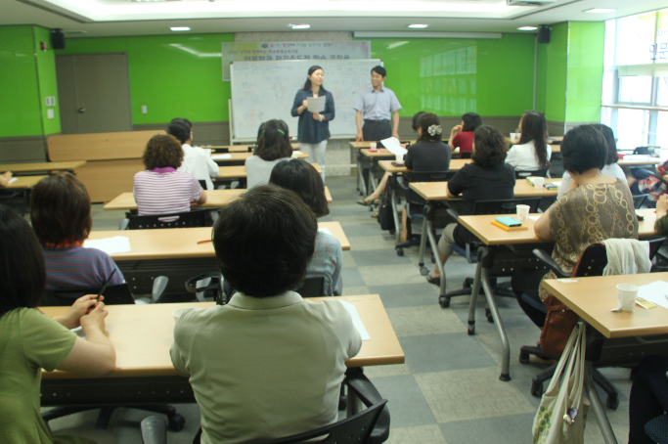
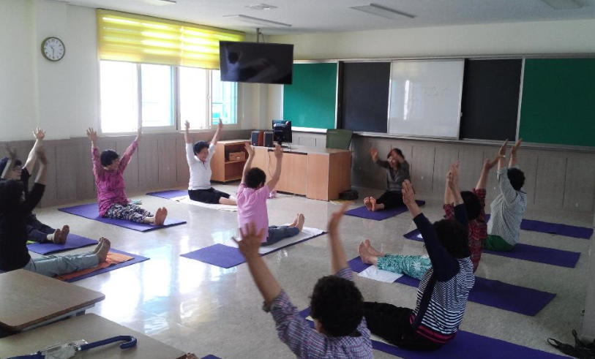
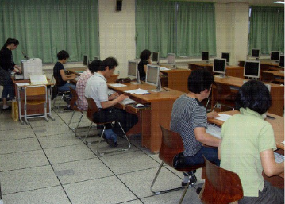
Tea Ceremony
Lectures
Yoga
Computer Classes

Slide 14
Participation Status
: School Sharing with Local Community
National Institute of Lifelong Education (2009)
Period | 2007-2008 | 2008-2009 | 2009-2010
Number of Regional Education Office | 34 | 34 | 38
Number of schools | 122 | 122 | 145

Slide 15
School-Based Lifelong Education Policies 2
: School Sharing with Local Community
Lifelong Educational Significance
Features
Expanding the subject of school education to local residents
Building networking between schools and local institutions: 14.3 local institutions per a regional education office, 4.7 local institutions per a school
Helping local residents to aware school as local public asset
Expansion of Educational Target
Collaboration with lifelong education managers
Lifelong Education Managers: Hiring by regional education office / Working at schools
Providing opportunities to work with lifelong education managers to school teachers

Slide 16
School-Based Lifelong Education Policies 3
: The Free Semester Programs
  Period : 2013 – Now
  Participating Rates of Schools : 100% of middle schools (From 2016)
  Target : Middle schools students
  Purposes : Providing opportunities for students to seek their dreams and potential during one semester of middle school
  Overview : ① Having students be released from the burden of examination, ② Making school curriculum be flexible and classes focus on participatory activities (debate, experiment, & etc), ③ Engaging in a variety of activities during regular school hours

Slide 17
School-Based Lifelong Education Policies 3
: The Free Semester Programs
Activities | Features
Elective Activities | Surveying students’ preferences and developing 5-17 week programs Example: Providing 2 hours of 3-D printer modeling program two-days a week for students who want make a lamp with recycle materials
Art and Sports Education Activities | Providing art and sports education in order to increase students' talents Using materials and professionals of local community as educational resources Example: Musical Production, Cheerleading, Crafts Activities, & etc
Club Activities | Joining clubs based on students' personal interests Improving problem-solving abilities by managing clubs without teachers' help Interconnecting club activities with festivals of local areas
Career Exploration Activities | Offering systemic career education Providing career counselling in order to find students' aptitude and talents Setting Career Education Places within local communities

Slide 18
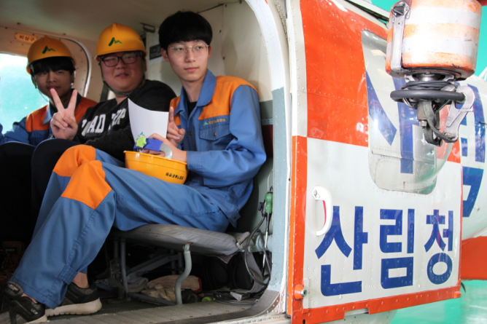
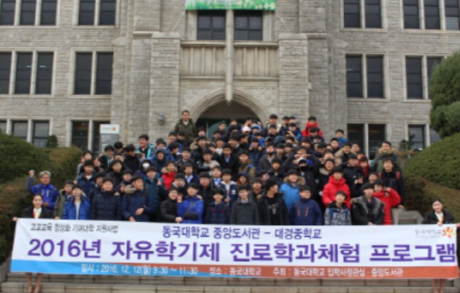
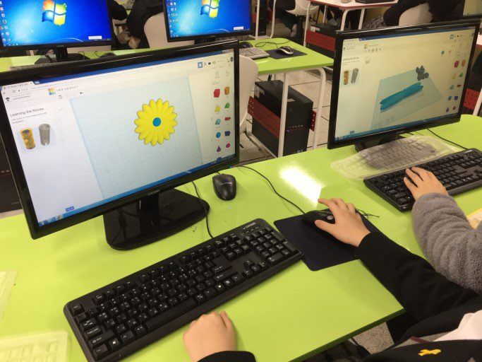
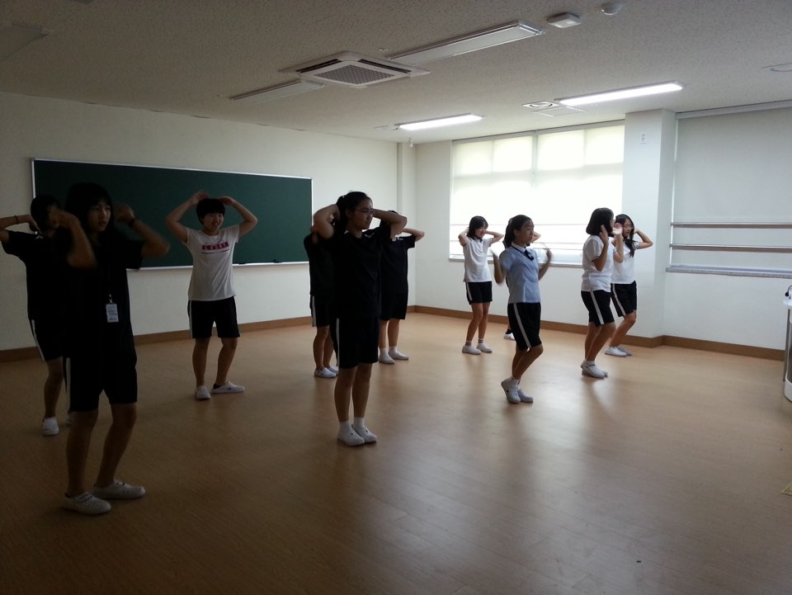
Experiencing Future Career
Visiting Universities
Club Activities: 3D Printing
Club Activities: Dance

Slide 19
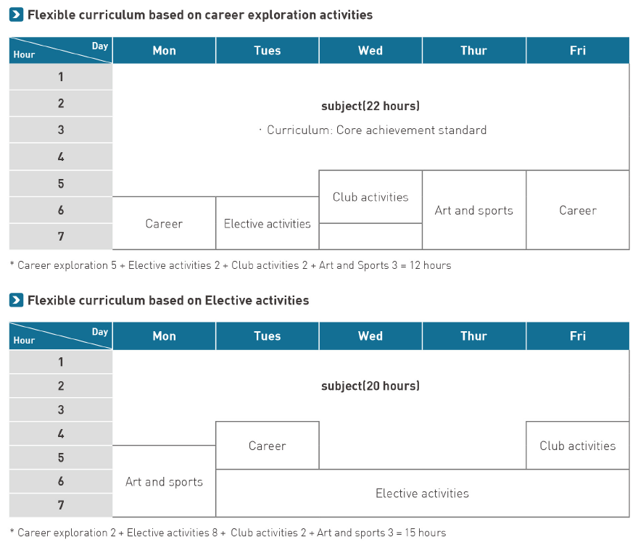
The Free Semester Programs
: Example of Curriculum Operation
Ministry of Education & Korean Educational Development Institute (2015)

Slide 20
School-Based Lifelong Education Policies 3
: The Free Semester Programs
Lifelong Educational Significance
Features
Connecting school with local communities(place and people) for career exploration, arts and sports education, and club activities.
Making school teachers cooperate with professionals and search for educational places and institutions outside of school
Expansion of Educational Places
Maximizing cooperative learning and team project for encouraging students’ participation and increasing self-expressiveness
Strengthening linkage between school and actual life to encourage learning motivation
Emphasizing Students’ Centered Lessons

Slide 21
Implications for School Teacher Training
Voluntary participation of teachers in school-based lifelong education
  Encouraging school teachers to think outside the box: “It Takes a Whole Village to Raise a Child” (African Saying)
  Training school teachers how to collaborate with out-of-school educational professionals
  Helping school teachers to have “time to learn about the village” in order to understand the lives of students and community residents

Slide 22
Implications for School Teacher Training
Efforts to reduce additional work for school teachers
  Placing lifelong education managers at each school by regional education office
  Working with lifelong education managers to reduce school teachers’ work duties
  Enabling lifelong education mangers to train school teachers about school-based lifelong education by taking into account regional situations

Slide 23
References
Bae S. H./Jeon, S. B. (2011). School-based afterschool programs: The key of quality and equality-Korea’s experience. In J. Ecarius, E. Klieme, L. Stecher, & J. Woods (Eds.), Extended education – an international perspective: Proceeding of the international conference on extracurricular and out-of-school time educational research. Opladen, Germany: Barbara Budrich Publishers, pp. 199–226.
Ministry of Education (2017). 2017 Current Status of Afterschool Programs (Written in Korean)http://www.moe.go.kr/boardCnts/view.do?boardID=317&boardSeq=74098&lev=0&searchType=S&statusYN=W&page=1&s=moe&m=030202&opType=
Ministry of Education & Korean Educational Development Institute (2015). The Free Semester Program: Happy Education: to nurture dreams and talents. (Written in English)
National Institute of Lifelong Education (2009). 2009 White Book of Lifelong Education. (Written in Korean)

Slide 24
THANK YOU
for your attention

