Slide 1



SERTIFICATION OF TEACHERS THROUGH TEACHER PROFESSIONAL EDUCATION PROGRAM
(CASE IN INDONESIA)
DINN WAHYUDIN - UPI
dinn_wahyudin@upi.edu
Presented in
UNESCO UNITWIN Seminar Program Cheongju-si ChungBuk
Republic of Korea , June17th and 19th, 2019.

Slide 2
AGENDA
1. TEACHER EDUCATION IN INDONESIA
2. TEACHER CERTIFICATION
CERTIFICATION OF TEACHER THROUGH TEACHER PROFESSIONAL EDUCATION PROGRAM

Slide 3


INDONESIA IN THE WORLD MAP

Slide 4

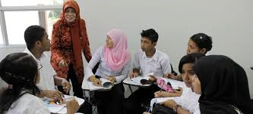
1.TEACHER EDUCATION IN INDONESIA

Slide 5
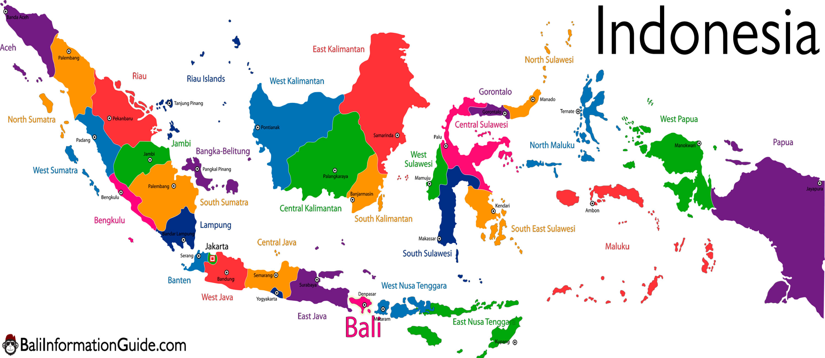
AGENDA
EDUCATION INDONESIA (2016) : Population: 261 million; Compulsory Education : 9 years; Type of Curriculum : Competency Based Curriculum (since 2004). Primary school : 150.400 schools, 25,5 milion students; 1,4 million teachers Junior Secondary school: 37.100 school, 10,1 million student ; 628.000 teachers Senior Secondary school: 13.200 school, 4,7 millions students; 307. 000 teachers Vocational school : 13.600 schools; 4,9 millions student; 292.212 teachers High Institution/Univ: 99 public, 3.100 private ; with 2,3 students

Slide 6
EDUCATION FACTS
The Indonesian education system is the fourth largest in the world with more than 50 million students, 3 million teachers, 300,000 schools.
Primary to Junior Secondary school level is compulsory.
In 2018, the net enrollment rate for primary education is t 96,82%, but the enrollment rate is decreasing for Junior Secondary school to 84,61% and Senior Secondary school to 66, 57 %.
Tertiary-education participation is even lower – 31,5 – this number is still quite high compared to other ASEAN member states.

Slide 7
TEACHER EDUCATION IN INDONESIA
Dutch Colonialism : Kweekschool (2 yrs)
Japan Colonialism : Syato Sihan Gakko (2 yrs)
INDEPENDENCE PERIOD:
- SGB (4yrs) for Primary School teachers, KGB
- SGA (6 yrs) for Secondary school Teachers, KGA
- SPG (3 yrs) for PSTs, B1 -B2, Diploma 2.
1954 : established Teacher Edu. in HE level (PTPG)
- BA (sarmud), Drs (sarjana)
2005 : All teachers should graduate frm Undergraduate Prog.( Bachelor -S1)
2017 : All teachers should graduate frm Undergraduate prog (S1/D-4) and plus 1 yrs PPG (Teacher Professional Education Program).

Slide 8
THE GOAL OF NATIONAL EDUCATION (Pasal 3 UU No 20 Sisdiknas Tahun 2003)
To develop students' potential to become faithful and pious man, noble, healthy, knowledgeable, skilled, creative, independent, and also to become democratic and responsible citizen.
Spiritual Attitude | Faithful and Pious
Social Attitude | healthy, independent, democratic and responsible
Knowledge | knowlegeable
Skill | skilled and creative, etc

Slide 9
CYCLE OF TEACHERS
(adopted from Kartadinata, 2010)
RECRUTMENT & TEACHER EDU
SERTIFICATION AND PLACEMENT
INSERVICE TEACHER EDUCATION
RETIRED TEACHERS
LIFE CYCLE OF PROFESI ONAL TEACHER
PRESERVICE TEACHER EDUCATION
PRESERVICE TEACHER EDUCATION

Slide 10
TEACHER AND EDUCATION
Teachers play an important role in teaching and learning process to improve student outcomes and their effects towards their competencies (Darling-Hammond, Wei, & Johnson, 2012).
Improving the competence of teachers has been at the heart of policies designed to raise the quality of education in Indonesia since 2005 when the major initiative to increase the minimum academic qualifications of teachers began.

Slide 11
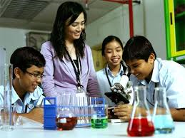
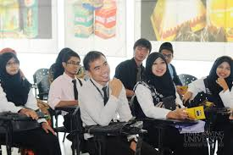
TEACHER EDUCATION IN HE LEVEL IN THE LAST 5 DECADES
INTEGRATED PROGRAM
MOSTLY USING CONCURRENT CURRICULUM MODEL RATHER THAN CONSEQUTIVE MODEL
PROVIDING AKTA 4 PROGRAM (TEACHING CERTIFICATE) FOR THOSE WHO HAVE NO BACKGROUND IN EDUCATION

Slide 12
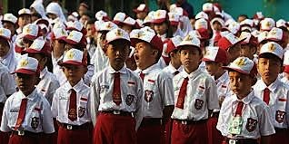
THE LAW ON TEACHERS AND LECTURERS (LAW NO. 14/ 2005)
It requires all teachers first to hold an academic bachelor’s degree, and second to successfully complete a certification process.
The law also set minimum competency standards and introduced two new sets of professional allowances, giving teachers incentives to complete certification and to work in remote areas.

Slide 13
3. NEW PRE SERVICE TEACHER EDUCATION (Permenristekdikti No 55/2017)

Slide 14
TEACHER EDUCATION INSTITUTIONS (OECD, 2015)
Indonesia has 374 teacher education institutes, (TIEs) 32 public and 342 private. They operate largely independently, with little co-ordination between them over materials and approaches.
The training providers determine the outcomes that they believe are most important.
In a large number of private TIEs, there is currently less systematic monitoring or evaluation to determine the effectiveness of teacher training on teacher quality.
Oversupply TIEs graduates.

Slide 15
TEACHER PROFESSIONAL EDUCATION PROGRAM
EMPHASIS ON MEANING OF PROFESSIONAL EDUCATION
Formulation and training on the continuous professional development, through training on the comprehensive professional competence required for teachers, based on context in the real practices in the authentic setting in schools.
ACADEMIC EDUCATION
(S-1 IN EDUCATION)
2 SEMESTERS
PROFESSIONAL
TEACHER
EDUCATION
PROGRAM
(PPG)
ACADEMIC EDUCATION
(S-1/D-IV NON-EDUCATION)
1. ENTRANCE TEST MANAGED AND REGISTERED DIRECTLY BY KEMRISTEK
2. ARISE PROBLEM AND LONG DISCUSSUON IN CONDUCTING PPG AMONG TIEs . THEY HAVE ALREADY CONDUCTED TEACHING PROFESSION AT EARLY SEMESTER

Slide 16
TEACHER PROFESSIONAL DEVELOPMENT PROGRAM
Professional development is a medium for teachers to develop their knowledge and skills in teaching
Professionals need to learn from experience, to update their competence, and ensure that their knowledge, skills, and understanding are also up to date.
Pedagogical transformation of the teacher can be facilitated through on going teacher professional development which enables them to reflect on their own practice and improve their professional practice through interaction with other practitioners

Slide 17
PROFESSIONAL TEACHER PROGRAM (PPG)
PPG program is implemented and run by selected Teacher education Institutions (TEIs) which is managed directly by the Minister of Research, Technology and Higher education.
Currently, there are 49 state and private Teacher education Institutions (TEIs) spread throughout the nation assigned to establish PPG program for pre-service teacher

Slide 18
THE LAW ON TEACHERS & LECTURERS (LAW NO. 14 2005)
The core principle that teaching is a “profession”.
The requirement that all teachers must meet a minimum standard of a four year degree before being certified and that all teachers should be formally certified after the four-year degree has being gained.
The reform of pre-service teacher education institutions.

Slide 19
SERTIFICATION FOR EXISTING TEACHERS
PLPG
PPG
It has already stoped in 2017
Peraturan Pemerintah 74 Tahun 2009
Pelaksanaan tahun 2007- 2017 (11 tahun)
Peraturan Pemerintah 19 Tahun 2017
Rintisan tahun 2017 untuk guru SMK Produktif

Slide 20
TEACHER PROFESSIONAL EDUCATION PROGRAM
(Permenristekdikti No 55/2017)
Professional Teacher Education Program (PPG) is educational program after academic graduate program (S1) or applied graduate (D-4) to hold teacher certificate for teaching in Kindergarten formal education, primary education and secondary education.

Slide 21
TEACHER PROFESSIONAL EDUCATION PROGRAM
(Permenristekdikti No 55/2017)
PPG PROGRAM
PPG for Novice
Teacher (Prajab)
36 – 40 SKS
PPG for Existing Teacher (Daljab)
24 SKS

Slide 22
PPG CURRICULUM
Pedagogic Deepening and Study Material.
Development workshop learning device, the application of the Techno-Pedagogical Content Knowledge principle (TPACK) Develop 21st Century Skills learning (21st Century Skills - critical thinking and doing, communication, collaboration, creativity, ICT literacy, cross-cultural understanding and character strengthening)
For prospective vocational teachers: field studies in the Business World/Industrial World
Field Experience Practices

Slide 23
STRUKTUR KURIKULUM PPG PRAJAB
Workshop subject-specific pedagogy/ SSP) & Workshop On authentic Assesment
Micro teaching in peer teaching
Practical Field Work
PROGRAM SYLLABUS

Slide 24
PEMBELAJARAN HYBRID PPG DALAM JABATAN
ONLINE AND OFFLINE
ON LINE
OFF LINE (DIRECT)
ONLINE SELF LEARNING
LOKAKARYA
PENGEMBANGAN PERANGKAT PEMBELAJARAN
OLINE SYSTEM
DOC 1:
PEDAGOGICAL COMPETENCIES
PRAKTEK
PENGALAMAN LAPANGAN
DOC 2:
PENDALAMAN BIDANG STUDI
PENYUSUNAN PROPOSAL PENELITIAN
TINDAKAN KELAS (PTK)

Slide 25
PPG PRE SERVICE
2 SEMESTERS
1
2
3
4
PPG PROGRAM
NEW SYSTEM
PROFESSIONAL TEACHERS
BACHELOR DEGREE (S1/D4)
Teacher Professional Program

Slide 26
FLOW OF CHART TEACHER PROFESSIONAL EDUCATION PROGRAM IN UPI
SELECTION ADM AND ACADEMIC
Managed and registerd by Ministry of RTHE
TEACHER CERTIFICATE
Pedagogy and subject content learning and Workshop in Class
Workshops & Peer teaching in TIEs
Field Teaching Practice in schools
PPG EXAM ----------------
Competencies exam and vocational expert
GRADUATED
EXPERTISE CERTIFICATE
For Teacher in Vocational schools
Implemented and managed by TIEs, TOTAL 2 Semesters
Managed and registered by Ministry of RTHE

Slide 27
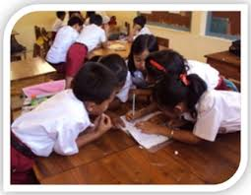

TRANSFORMING 21ST CENTURY TEACHER
Notes:
27

Slide 28
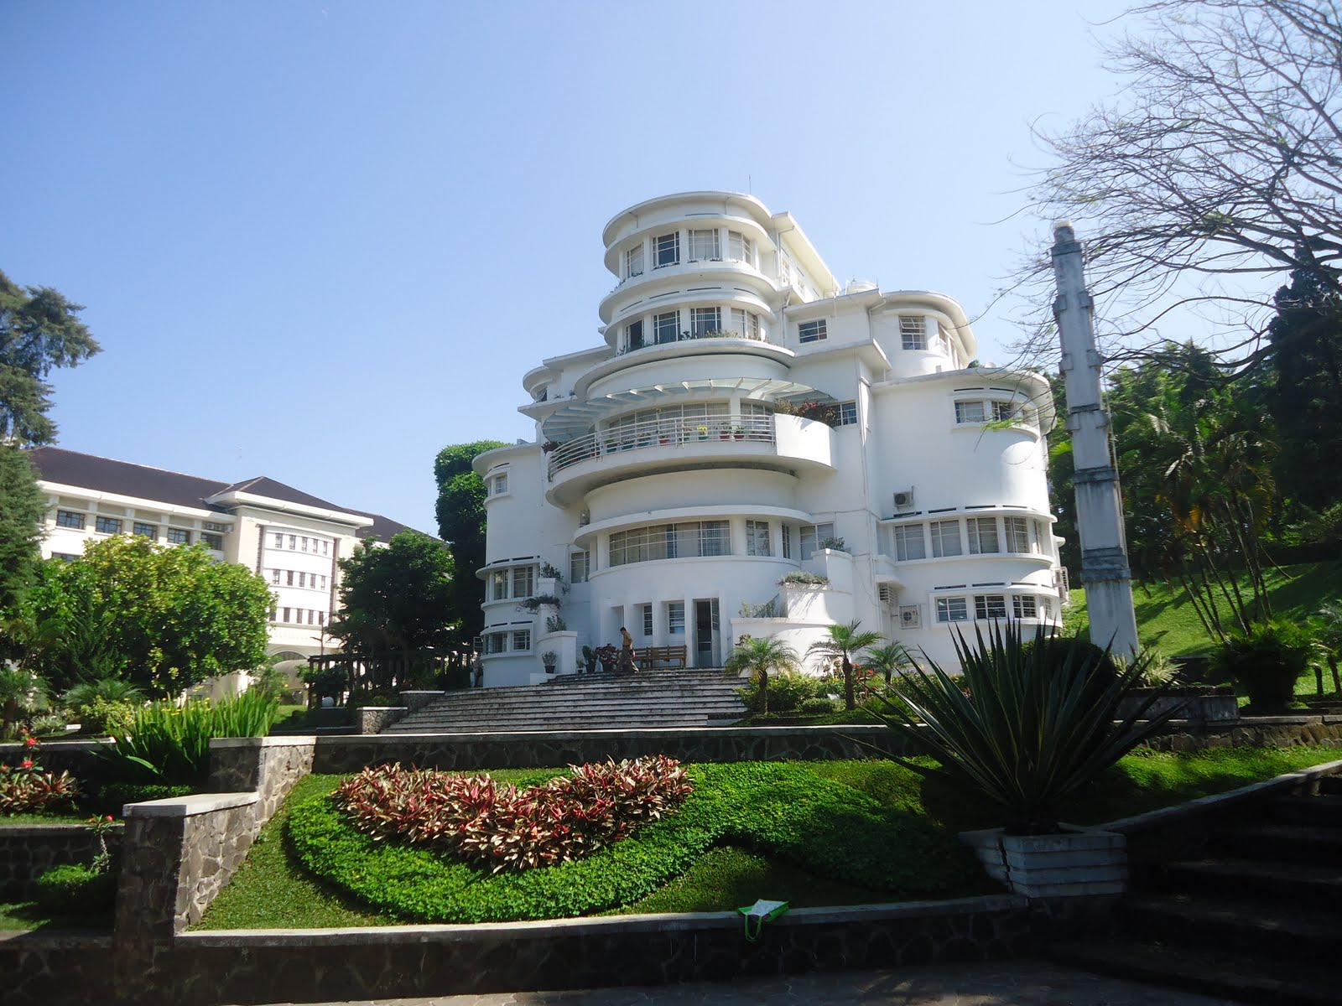
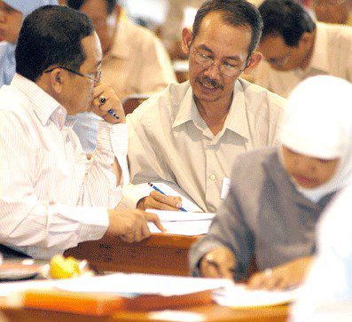
THANK YOU
ANNYEONG HASEYO
dinn_wahyudin@upi.edu

