Slide 1
Technology Integration in Teacher Education
Department of Education
Educational Technology Program
Youngju Lee

Slide 2
Outline
<In service teacher education>
Blended teacher professional development
Video based modeling for quality questioning
<Pre-service teacher education>
Formative evaluation with web-based reciprocal peer review system
Blogs to foster teachers’ reflective thinking

Slide 3
Issues with Technology Integration in Education
Loaded schools with technology hardware, with very little attention to pedagogical processes (Earle, 2005)
Teacher training occurred out of context, in a separate course on computer skills (Vrasida & McIssac, 2001)
Technology as ‘mind tools’ to support meaningful learning in teacher education

Slide 4
Challenges in Teacher Education Programs
Short-term
Static
Knowledge or technique-based
Disconnected from classroom practice
Fragmented & incoherent
(Ball & Cohen, 1999; Borko, 2004; Garet et al., 2001; Mashburn et al., 2008)

Slide 5

1. Blended professional development (Kinzie, Whittaker, Mcguire, Lee, Kilday, 2015)
Long-term, sustained, & practice-focused
Blended Professional Development
Online supports: flexible, scalable & on-going
Face-to-face supports: cohesions of community
<MyTeachingPartner>
Curricular development for Pre-K Math & Science : Design-based research
Classroom Assessment Scoring System(CLASS, Pianta et al., 2007)
Large scale randomized field tests

Slide 6
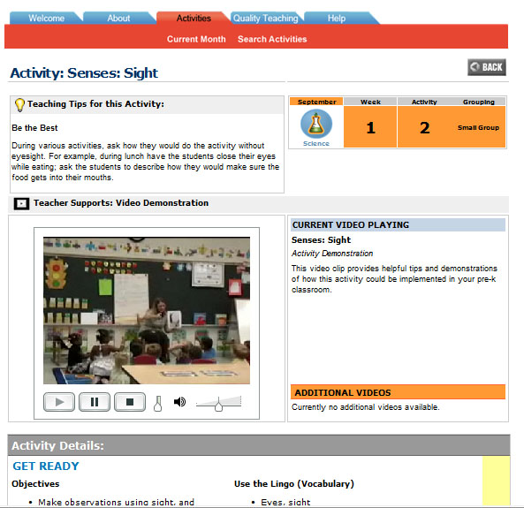
Online Teacher Supports
Web-based Demonstration Videos: High quality, high fidelity implementations of each activity
Teaching Tips
Teaching Challenges Videos
Quality Teaching Video Library (CLASS Library)

Slide 7
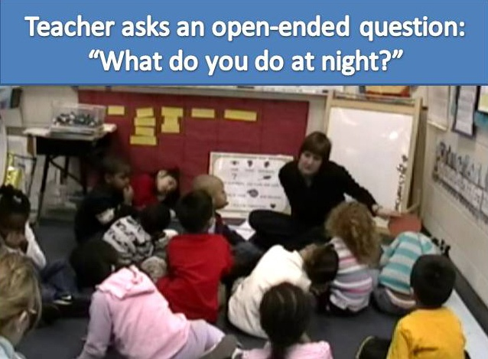
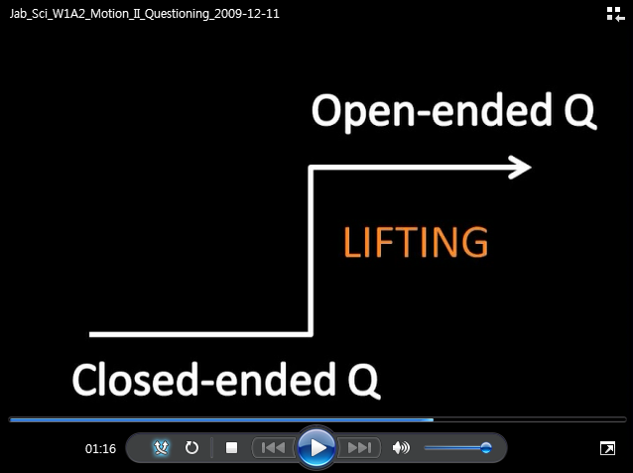
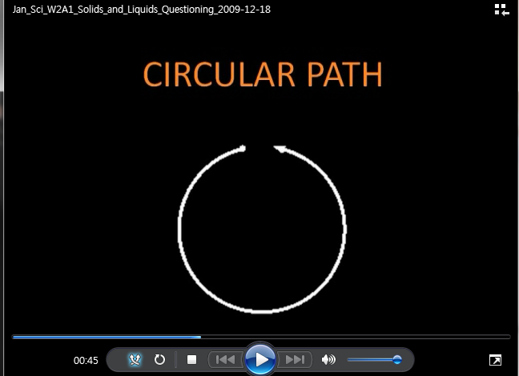
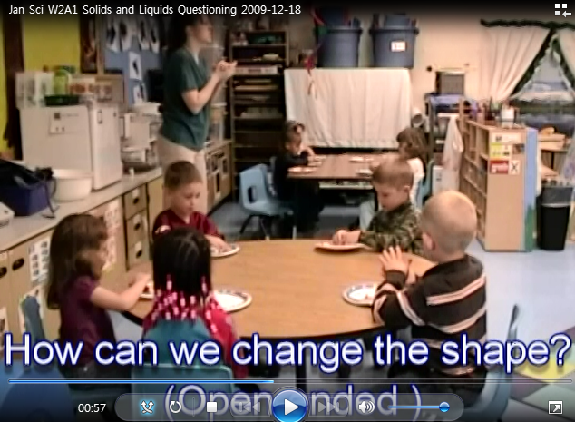
2. Video based modeling for promoting teachers’ quality questioning (Lee, 2012)
Questioning Demonstration Videos
Bandura’s social cognitive learning theory (Bandura, 1977; 1986)
Experiential learning theory (Kolb, 1975; 1984)

Slide 8
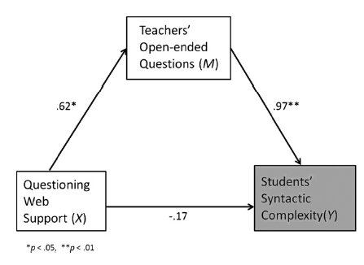
Findings: mediation effects of video based modeling for questioning
Significant indirect effect of web-based questioning-specific supports on students’ syntactic complexity(#of clauses) through teachers’ open-ended questions, 95% CI [.077, .893]

Slide 9
<Pre-service teacher education>
Formative evaluation with web-based reciprocal peer review system
Blogs to foster teachers’ reflective thinking

Slide 10
3. Formative evaluation with web-based reciprocal peer review system (Lee, 2012)
Problem with teachers’ formative evaluation
Evaluating written work is highly labor intensive
Positive effects of peer evaluation
Increase responsibility for students’ learning, improve writing skills (Howland, Jonassen & Marra, 2012)
Training students as formative evaluators
Enhance reliability & validity (Cho, Schunn, & Wilson, 2006)

Slide 11
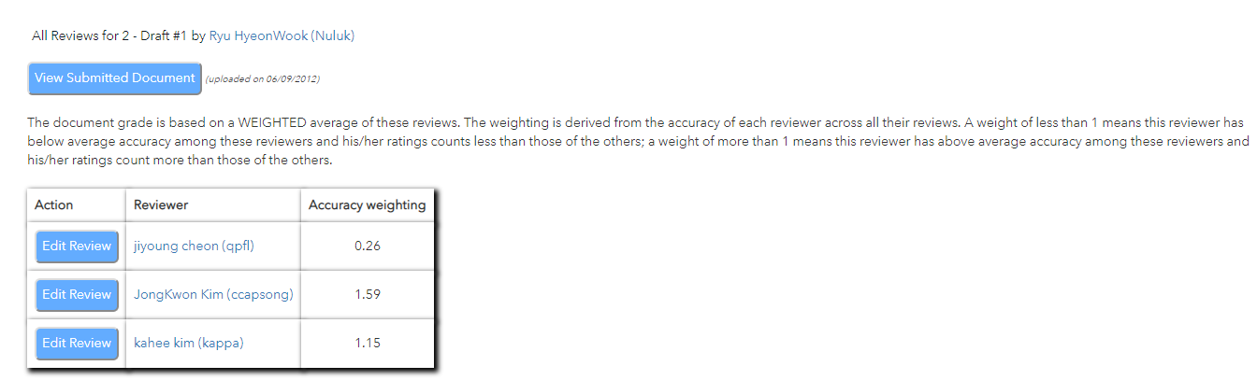
SWorRD(Scaffolded Writing and Rewriting in the Discipline) (Cho & Schunn, 2007)
Anonymous peer review
Scores adjusted for the consistency of the reviewers

Slide 12
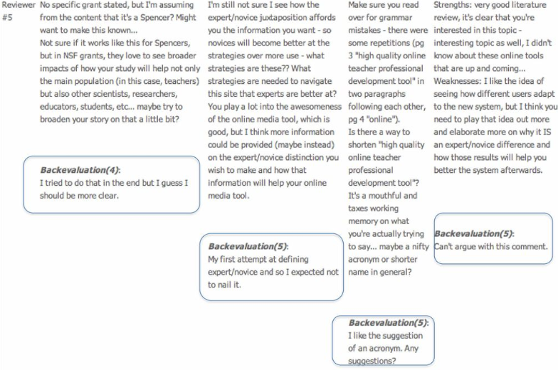

Back-evaluation to peers regarding review helpfulness

Slide 13
Findings: impacts of peer evaluation training
# of 130 pre-service teachers, 3 groups
①Peer Evaluation group with Training: PET
②Peer Evaluation group without training: PE
③Instructor Evaluation group: IE
Task: Lesson planning using ASSURE model
Results: PET group significantly higher in the increase of lesson planning skills compared to the other two groups(F(4, 248) =2.86, p<.05)

Slide 14
4. Blogs to foster teachers’ reflective thinking (Lee, 2018)
Blog writing benefit teachers’ reflections and critical analysis for of teaching behaviors (Ladayshewhky & Gardner, 2008: Tang, 2009)
Reconsidering usage of blogging in preservice teacher educational courses (Top, Yukselturk, & Inan, 2010)
Many teachers don’t actively interact with peers through blogs (few meaningful interactions occurred)
Teachers use blogs mainly for data collection and describes merely facts.
Use of blogs as a support for reflection requires more direction and guidance (Killeavy & Monlney, 2010)

Slide 15
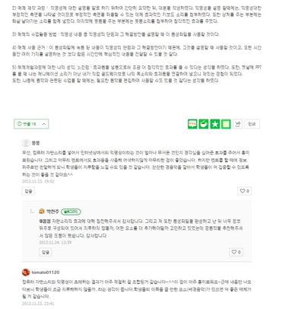
Media production course
-multimedia authoring software
(image, video, & audio software)
Data collection: 72 blog posts,
895 comments, 714 replies
Structured guidance
target students & objectives
methods of instructional media
rationale for using media
overall impressions of
instructional media production

Slide 16
Findings: patterns of type of statements
<Blog Posts>
A large number of ‘evaluative’ statements: describing rationale for the choice of instructional media
A great number of ‘reflective’ statements: overall impressions of instructional media production
<Comments & Replies>
Most of comments were ‘social’ and ‘affirmative’
Rarely used ‘critical’, suggestive, or ‘reflective’
Reflective statement frequently occurred in teachers’ replies

Slide 17
References
Lee, Y. (2018). The influence of structured guidance on pre-service teachers’ blog writing. Australasian Journal of Educational Technology, 34(3), 30-38.
Kinzie, M. B., Whittaker, J. V., McGuire, P., Lee, Y., & Kilday, C. (2015). Research on curricular development for pre-kindergarten mathematics & science. Teachers College Record, 117, 1-40.
Lee, Y., & Kinzie, M. B., Whittaker, J. (2012). Impact of online support for teachers’ open-ended questioning in pre-k science activities. Teaching and Teacher Education, 28, 568-577.
Lee, Y. (2012). Improving pre-service teachers’ instructional design skills through peer feedback: Writing lesson plans with ASSRE model. Korean Journal of Educational Technology, 28(4), 687-706.

Slide 18
Thank you!

