Slide 1


VIETNAM NATIONAL UNIVERSITY
UNIVERSITY OF EDUCATION
Preparing high-school teachers for new coming curriculum: Vietnam as a case study
Assoc. Prof. Dr. Nguyen Chi Thanh
Faculty of Teacher Education, VNU-UoE
Mail: thanhnc@vnu.edu.vn
KNUE, June 2019

Slide 2
Plan
Introduction
Teacher training in Vietnam
Teacher training at the VNU, UoE
New models
Conclusion and Discussion

Slide 3
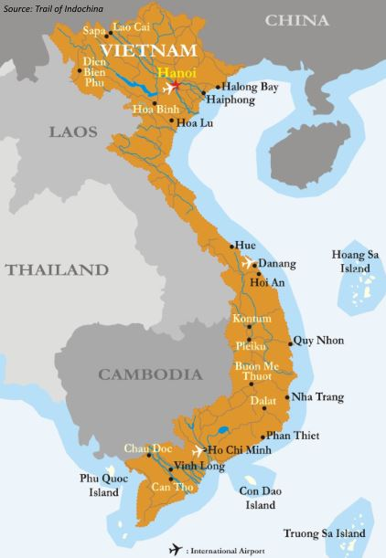
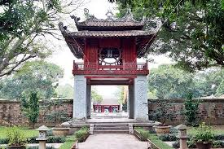

Introduction to Vietnam

Slide 4

INTRODUCTION
2 main models in teacher education training in the world
Consecutive model (CsM): after obtaining a Bachelor of Arts (BA) or Bachelor of Science (BSc) degree or equivalent, student study at a faculty of education for one-year program (or two-years depending on the university) to receive their Bachelor of Education (BE degree.
Concurrent / parallel model (CcM): students will study for a BA or BSc degree at a university simultaneously to complete the requirements for a BA which is usually over a four-year period.

Slide 5

Teacher education models in the world
Country | Duration | CcM | CsM | Combinasion | Post preparation
UK, France… | 3 – 5 | x | x |  | 1
Spain, Sweden | 3-5 | x |  |  | 1
Japan, Korea | 4 | x |  |  | 1
USA | 4 -5 | x | x | x | 1-3
Gremany | 5 | x |  |  | 2
Theo anh nên nhấn mạnh là 1. Tại châu ÂU thì đa phần GV đào tạo đến bậc Ths
2. Cách xét tuyển đầu vào tại các quốc gia: ví dụ tại Pháp thì có 2 cách: vào từ năm 1 (năm đầu ở bậc cử nhân); vào từ năm 4 (năm đầu ở bậc ThS).
Từ đó kết nối sang slide sau.
Notes:
Nên để tiêu đề: Tổng quan một số CT dào tạo GV trên thế giới;

Slide 6
Teacher education models in the world
Educational knowledge / educational sciences
Subject knowledge
Methodological knowledge
Practicum
General knowledge
Educational knowledge
Subject knowledge
Practicum
According UNESCO
EU and OECD

Slide 7
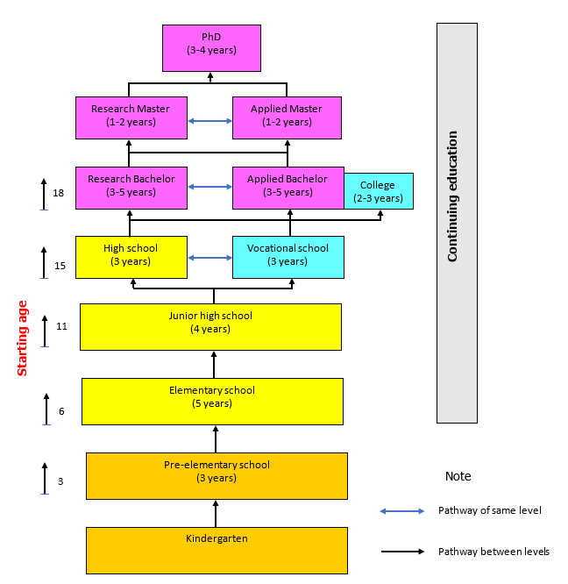
Education system in Vietnam

Slide 8
INTRODUCTION
New teacher professional standards (Decree No 20, dated on 22/08/2018)
Teacher values (2 criteria)
Pedagogical competency and professional development (6 criteria)
Language and ICT competencies (2 criteria)
Competency of building a democratic school environment (2 criteria)
Competency to build social relationship (3 criteria)
Notes:
. Phẩm chất là tư tưởng, đạo đức, lối sống trong thực hiện công việc, nhiệm vụ của giáo viên.
2. Năng lực là khả năng thực hiện công việc, nhiệm vụ của giáo viên.

Slide 9
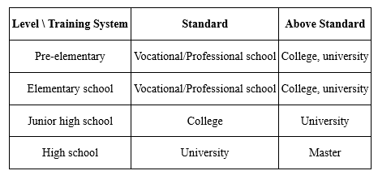

Teacher Training Systems by Level of Education
Student cycle in teacher training university in Vietnam

Slide 10
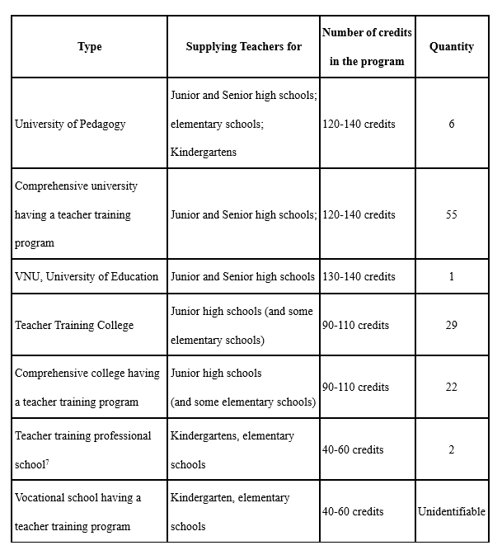
Number of teacher education institutions in 2017

Slide 11
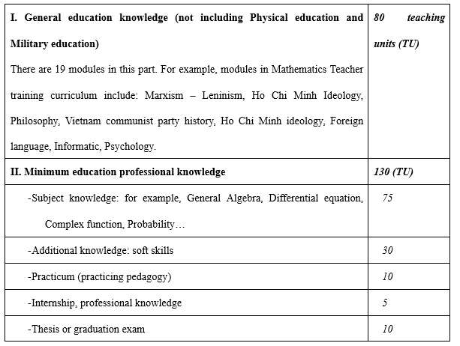
General content of teacher training curriculum

Slide 12

Comparison between Vietnam teacher education model and some countries
Như anh nói ở trên, ví dụ ở Pháp họ nhận SV từ cả năm thứ nhất.
 |  | Việt Nam
Admission | Countries with advanced education in the world such as Singapore, Germany, Finland, ... Student teachers are selected from students who have graduated from universities, masters with good results and have strict examination. | Selecting students in Vietnam with low input quality, regulations on recruiting students are not strict, have not attracted talents to participate in education.
Model | In general, in countries with advanced education, the next model of training at multi-disciplinary and multi-disciplinary universities is prevailing. | Concurrent training model in pedagogical schools are prevailing
Duration | The application of the next model helps Finland, Singapore, Germany, the US and Japan countries ... have enough time for training of general teachers, before becoming a real teacher, they have time to practice long enough and well-trained | Training programs in Vietnam's pedagogical schools are still heavy on theoretical training and partly due to short training periods. Only about 10 weeks of practical study - too short for good students in pedagogical universities to have enough experience to become a true teacher
Readiness | Newly graduated teachers can access the work immediately due to good training and good quality | Teachers who have just graduated from school when they go to school still face many difficulties and need a long time to get acquainted to be able to integrate well with the work.
Anh nghĩ nên nhấn mạnh vào mô hình ĐTGV tại trường đa ngành như ở ĐHQG.
Ở ĐHSP, ĐTGV Toán là đào tạo khép kín tại khoa Toán-Tin; Trong khi đó ở ĐHGD thì tại 2 trường thành viên.

Slide 13
Current issues in teacher training in Vietnam
- The quality of entrance examinations at pedagogical universities is not high (compared to the general level of other occupations), which has a great impact on the quality of training.
- The duration of training in the teacher training colleges is 4 years while the students have to study both the specialized knowledge and the science of education, practice and pedagogy.
- The short training time will be difficult to be able to train teachers meet the practical requirements. New graduates are also shocked and need a long time to get acquainted to work well at school.

Slide 14

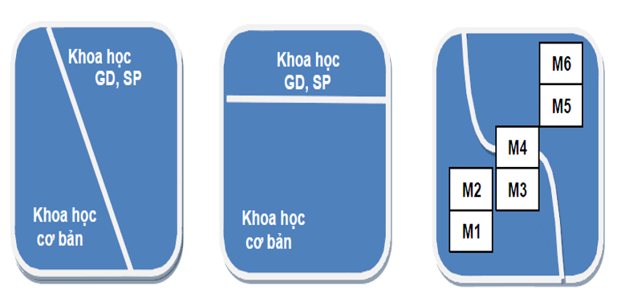
Teacher training at VNU-University of Education
At VNU-Ued we train for high school teacher in Maths, Physic, Chemistry, Bio, History, Literature
and Naturel Sciences teacher at Junior high school.
4th year
3rd year
2nd year
1st year
from 2000 to 2012
from 2012 up to now
Note: Khoa học GD, SP: Educational knowledge; Khoa học cơ bản: Subject knowledge

Slide 15
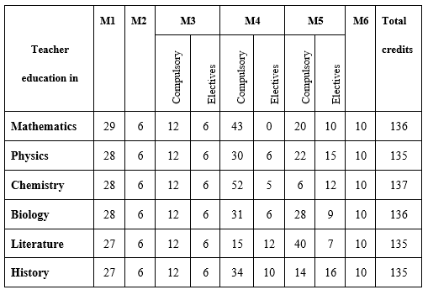
The distribution of number of credits for each major in teacher education in VNU-UEd

Slide 16
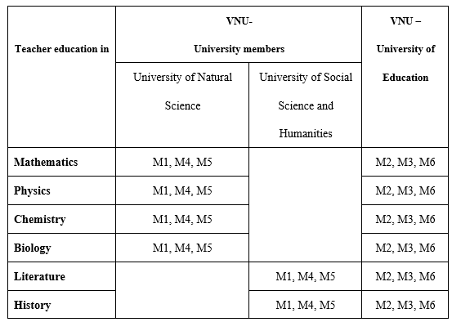
Responsibility for teaching in the model of teacher education in VNU-UEd

Slide 17

Characteristics of teacher education system in VNU-UoE
The specialized training in professional knowledge of each major and professional practice of teaching/ pedagogy though two training stages in two universities.
The flexibility of the model with various courses in combination of two educational institutions. Students can choose any course during their training process. It makes to minimize training time as much as possible.
The model saves training costs and resources. Student can use the facilities and resources of two institutions.
The combined training opens more chance for students to choose career. To be trained in the model, students have more knowledge and various skills in two training environments.

Slide 18

Toward a proposal of new models
3,5 years
1-1,5 years
1-1,5 years
BS
BP
Master
Double majors
Acadamic results

Slide 19
Toward a proposal of new models
Year | Knowledge blocks |  | Diploma
1rst | Finish knowledge for BS |  | BP (M1: 4-4,5 years) | Double majors (at the same times) (M2: 4,5-5,5 years) | BP and Master (M3: 5,5-6 years
 |  | Alternative subjects PK. SK.
2nd
3th
3.5th
4.5th | Finish PK and SEK
5th | Professional Integration (6 months)
6th | Finish master knowledge and thesis
Notes:
Cần có một slide nêu ưu điểm và thách thức của MH ; lí do tại sao xây dựng MH này?

Slide 20
Discussion
Discussion about increasing career experience time / practicum (6 months)?
Discussion about 3 models?
“Good” model?

