Slide 1










Who Bring Innovation
into School?
UNESCO UNITWIN Seminar Program
June 17-19, 2019 at Korea National University of Education
Maitree Inprasitha, Ph.D.
Director, Center for Research in Mathematics Education (CRME),
Director, Institute for Research and Development for Teaching Profession for ASEAN (IRDTP),
Khon Kaen University, Thailand
President, Thailand Society of Mathematics Education (TSMEd)
APEC HRD Lesson Study Project Overseers
Narumol Inprasitha, Ph.D.
Past Director, Center for Teaching Profession, Faculty of Education, Khon Kaen University
Head, Department of Language Education, Faculty of Education, Khon Kaen University

Slide 2
UNESCO UNITWIN
Seminar Program
In the 21st Century, Teachers NOT to teach subject as is, BUT need to teach "Thinking Skills".
In other words, teachers has to change their roles for "from delivering knowledge" to "prepare real world situation for students to solve by themselves"

Slide 3
UNESCO UNITWIN
Seminar Program
Paradigm Shift
about Demanding Skills
for the 21st Century
Behaviors
Thinking Skills

Slide 4
UNESCO UNITWIN
Seminar Program
New Demanding Skills for the 21st Century
14
12
Expert Thinking
10
8
6
Complex Communication
4
2
0
Routine Manual
-2
Routine Cognitive
-4
-6
Non-Routine Manual
-8
1969 1974 1979 1984 1989 1994 1999
Source: Levy and Murnane (2004). The new division of labor: 46. Princeton University Press

Slide 5

UNESCO UNITWIN
Seminar Program
Thinking Skills
Not thinking only for the answer
Not thinking for the same thing
Not the repeating
Not just thinking
5

Slide 6
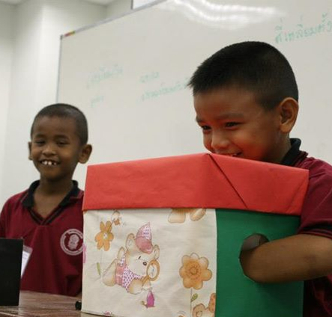
UNESCO UNITWIN
Seminar Program
For students, How to practice
“Thinking Skills” in the Classroom ?
Started with
“Thinking by yourself
through
Solving your own problem”
(Shimizu, 2007 )
6

Slide 7







A traditional teaching Approach emerged in such classroom culture
transmit
Contents
demonstrating, questioning, describing, lecturing, etc.,
Z..Z..Z
memorizing
A teacher
Students
Inprasitha, 2011

Slide 8

New classroom conditions
Every student
How?
Think
Think
Think
Think
Think
A teacher
Think
Think
Think

Slide 9
UNESCO UNITWIN
Seminar Program
As we all teacher educators are aware of that
the central issues of curriculum reform implementation are: Institutionalize, Organizationalize, and Pedagogical Innovations (Inprasitha, 2019).

Slide 10
UNESCO UNITWIN
Seminar Program
Less effectiveness of short-course teacher training is obvious and demand for innovation is apparent.

Slide 11
UNESCO UNITWIN
Seminar Program
Thus, how to bring innovations into school is the most challenging issue for most of the countries in the era of educational reform movement since at the beginning of the 21st century.

Slide 12
UNESCO UNITWIN
Seminar Program
In the case of Thailand, it had been planned since 2000, the 30 years Thailand project, in order to institutionalize and organizationalize two pedagogical innovations into schools.

Slide 13
UNESCO UNITWIN
Seminar Program
The two categories are not mutually exclusive, of course, and there are close relationships and dependencies between them .
The former relies on the permeation of knowledge of the reformed curriculum via the vehicle of teacher education programs.
The latter consists of professional development exemplars of various models capitalizing on the capacities of in-service teachers, institutional and organizational programs and supports (ICMI Study 24, 2019).

Slide 14
UNESCO UNITWIN
Seminar Program
APEC Lesson Study Project 2006: Get Started
“A collaborative Study on Innovations for Teaching and Learning Mathematics in Different Cultures among the APEC Member Economies Project” was proposed by Office of the Higher Education Commission, Ministry of Education, Thailand and Ministry of Education, Culture, Sports, Science and Technology, Japan in 2006. This project is an APEC Education Network (EDNET) project since 2006 until present that aims to improve the quality of education in mathematics through the use of Lesson Study.

Slide 15
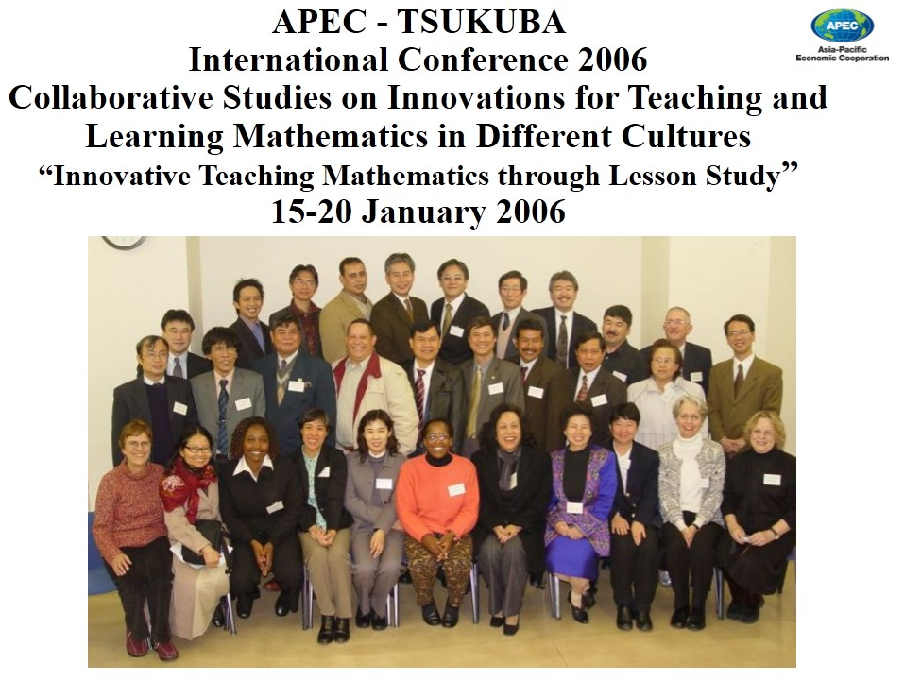
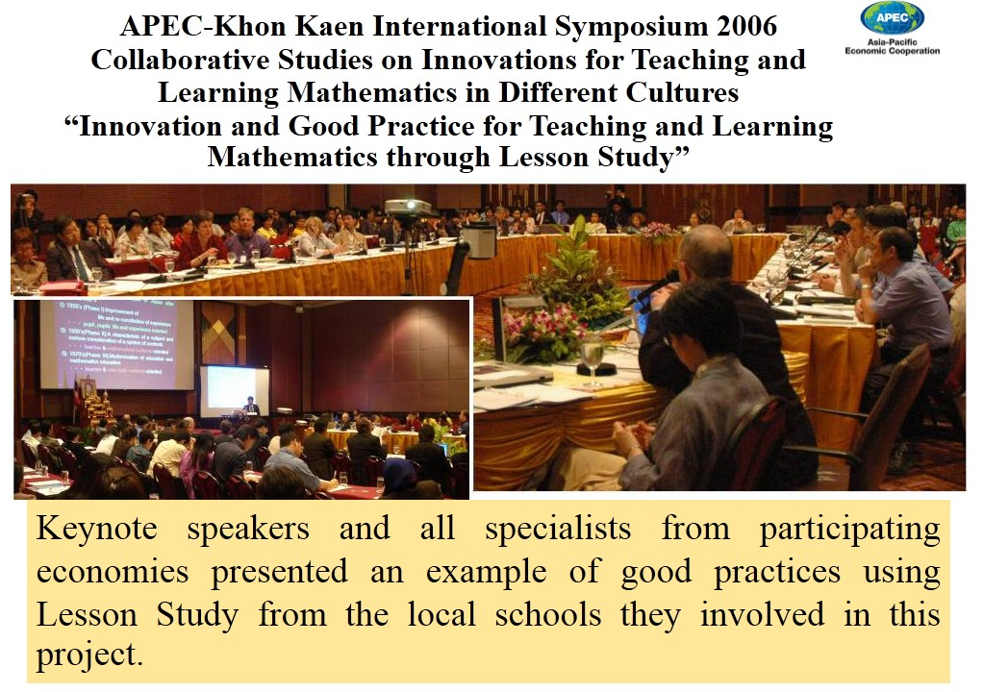
UNESCO UNITWIN
Seminar Program
APEC Lesson Study Project 2006: Get Started

Slide 16

The 30-year Thailand project (2000 - 2030)
Expand Innovations
across the country and region
Strengthen Network (among teacher education Institutes) in using Innovations
Invested in HRD (PhD) and R&D on Innovations
2000-2010
2011-2020
2021-2030

Slide 17

The 30-year Thailand project (2000 - 2030)
started on how to change the way of teaching focusing on changing the problem we use in mathematical activity
2030
2006
2008
2017
2001
2013
started 4 project schools using "whole school approach" to implement "lesson study" and "Open Approach"
Plane 30 years project (2000 - 2030)
2002
2013 - present expanded to 120 schools across the countries.
first group of student teachers started implementing "open-ended problems" in 7 schools nearby Khon Kaen City
1999
2006 - present started APEC Lesson Study Community in APEC and Non-APEC members economies
Expand across the country and region
Strengthen Network (among TIEs)
Invested in HRD (PhD) and R&D in Innovations
2000-2010
2011-2020
2021-2030
started small community of Lesson Study with a group of student teachers (15 students)
tried the idea of using "open-ended problems" to create mathematical activities with 800 teachers in Khon Kaen Province
expanded to 22 schools in the northeast and northern parts of Thailand
2003
2005
2009
2012
2000

Slide 18
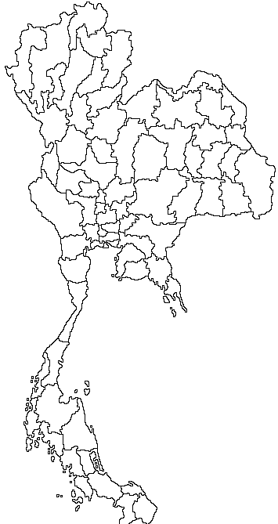





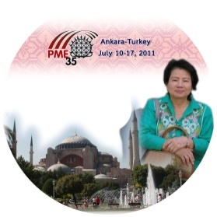








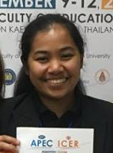

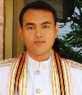

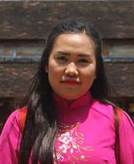
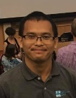

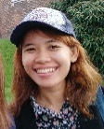
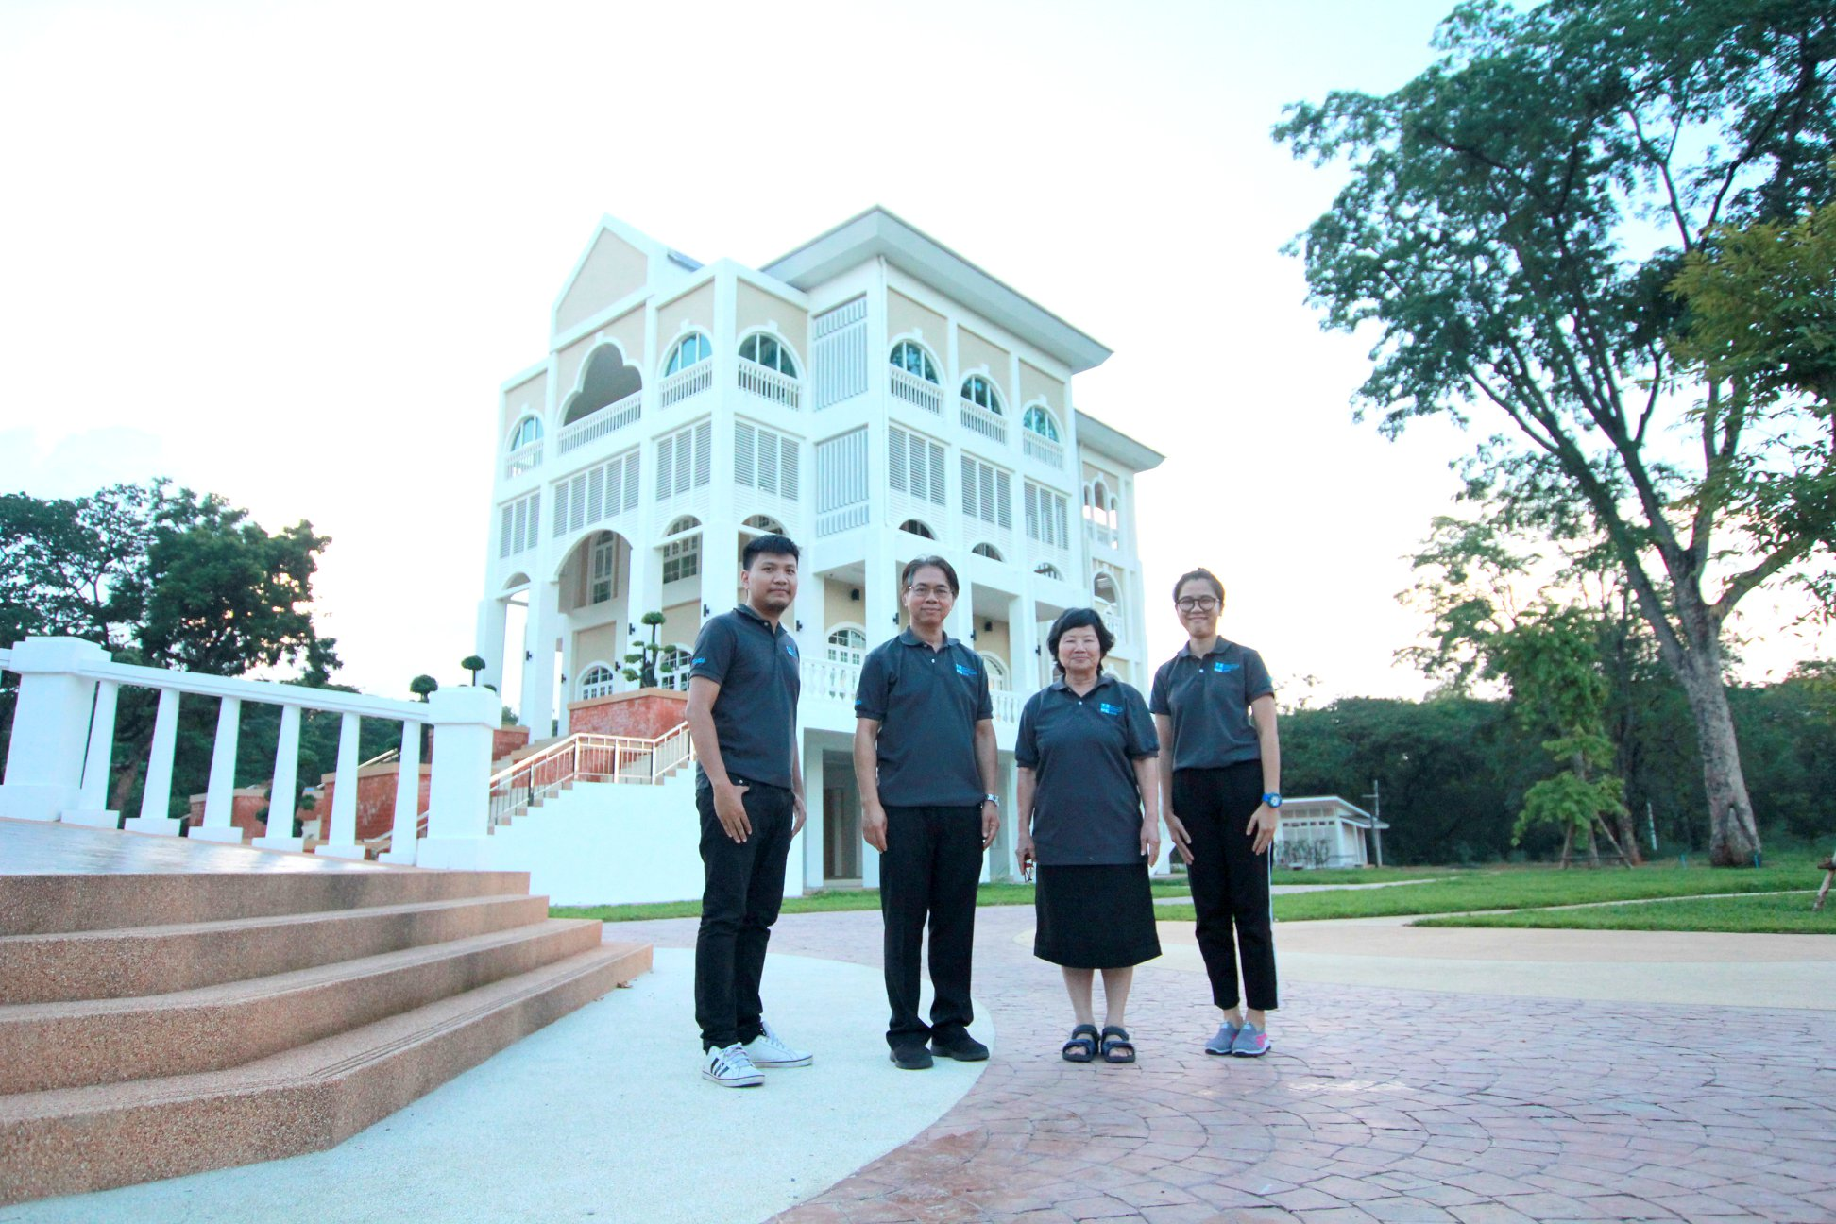





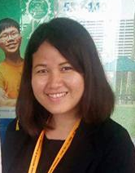












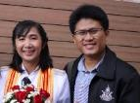


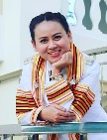



Universities Network
in 30-years Thailand Project
อ.ดร.อาริยา, อ.ภัทรพงศ์ และ อ.ชมพู่ // ม.นครพนม
อ.ดร.ศิวารักข์ // มรภ.เลย
อ.ชนิกาและอ.พิมพ์ผกา // มรภ.ลำปาง
อ.ดร.เจนสมุทร // ม.เชียงใหม่
อ.ดร. รุ่งทิวา // มรภ.เชียงใหม่
อ.เบญจวรรณ //มรภ.กำแพงเพชร
อ.ณัฐวัตร อ.พิมพ์ลักษณ์ และ อ.กาญจนา // มรภ.วลัยอลงกรณ์
อ.ศิริรัตน์, อ.สุพินดา
// มรภ.พระนครศรีอยุธยา
รศ.ดร.ไมตรี, รศ.เอื้อจิตร, อ.ดร.สัมพันธ์, ผศ.ดร.นฤมล,
อ.ดร. สมควร อ.นิศากร อ.ณัฐธิดา // ม.ขอนแก่น
อ.กิตติปกรณ์ // โรงเรียนบ้านไผ่
อ.ศิริขวัญ, อ.ประภาวดี, อ.ศาสตรา อ.ชนินทร, // รร.สาธิต มข. อ.อลิษา // รร.สาธิตแผนกนานาชาติ
จิตรลดา จตุพร สันติ เข็มทอง// นักวิจัย ศูนย์วิจัยฯ
อ.ดร.ขวัญตา
อ.ดร.วาสุกรี // มทร. สุวรรณภูมิ
อ.ดร.ญานิน // มศว.
อ.ดร.ณิศรา // มทร. พระนคร
อ.กิตติพศ // รร.แก้งคร้อวิทยา
อ.กนกนภา // ม.มหาสารคาม
อ.ทองอุ่น //มรภ.ศรีสะเกษ
อ.วีระศักดิ์ // มรภ.อุบลราชธานี
อ.ดร.กตัญญุตา และอ.ดร.กิตติศักดิ์
// มรภ.นครศรีธรรมราช
อ.ดร.ธัญญา อ.ดร.สุทธารัตน์ และอ.ดร.อเนก //มรภ.สุราษฎร์ธานี
อ.ดร.เกษมและ อ.ดร.สุวรรณี // ม.ทักษิณ
อ.ดร.สุดาทิพย์, อ.ดร.จุฬาลักษณ์และ อ.ดร.วิภาพร // มรภ.ภูเก็ต
อ.ดร.รัชดา // ม.สงขลานครินทร์ วิทยาเขตปัตตานี

Slide 19
UNESCO UNITWIN
Seminar Program
During the first phase (1999-2001),
we conducted a contextual study to know "what" and "why", NOT "how",
the contextual reality is.

Slide 20
UNESCO UNITWIN
Seminar Program
It was found that most of the school teachers do not know "what is the content, they are going to teach in the 21st century?" and neither "why they have to teach that content"

Slide 21
UNESCO UNITWIN
Seminar Program
Unfortunately, most of technical training focuses on "how to teach, or training teachers of teachers how to teach?"
Teachers never question "what" and "why" they have to teach those contents.

Slide 22
UNESCO UNITWIN
Seminar Program
In the second phase (2002-2005),
new what, that is, "thinking skills" had been introduced to schools through student teachers (Inprasitha, 2002), and to teachers in schools during 2003-2005.

Slide 23
UNESCO UNITWIN
Seminar Program
Innovation for teaching mathematics had been introduced using open-ended problems embedded in mathematical activity.
The pioneered group of 15 student teachers has been successfully brought innovation into schools without resistance.

Slide 24
UNESCO UNITWIN
Seminar Program
However, when trailed with school teachers, there seem not have a problem with "student learning", BUT the teachers do not know how to develop such
mathematical activities.
Thus, a long-journey for curriculum reform implementation has been realized.

Slide 25
UNESCO UNITWIN
Seminar Program
In the third phase (2006- present), to instiutionalize and organizationalize, community of practices has been implemented in mathematics teacher education program at the faculty of education, Khon Kaen University.

Slide 26
UNESCO UNITWIN
Seminar Program
New master degree students have been trained to use Open Approach as mathematical activity in order to change teaching approach afterward.
When started "whole school approach" to implement both Lesson Study and Open Approach into schools in 2006, the 5th year students or student interns working with master degree students to collaboratively implementing innovation in the schools.

Slide 27
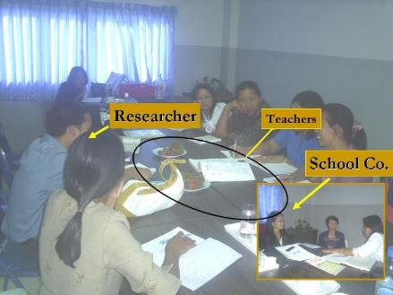
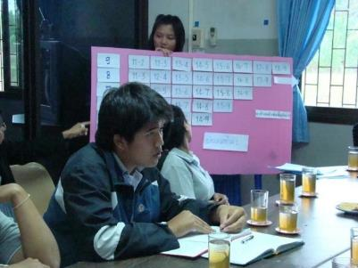
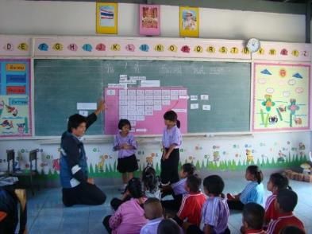
Scenario at 1st year project school
UNESCO UNITWIN
Seminar Program
Kookhampittayasan school
Plan
Plan Lesson on Tuesday
School principal and teachers set schools’ timetable/ schedule for plan, do, see process.
Textbook
See
Student intern
Student intern
DO
Reflect on Thursday
All rights reserved by Center for Research in Mathematics Education, Khon Kaen University

Slide 28
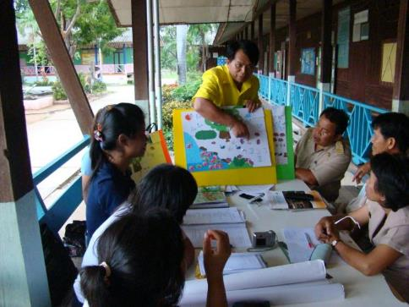
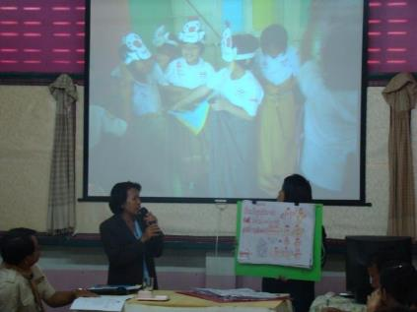

Scenario at 1st year project school
UNESCO UNITWIN
Seminar Program
Chumchonban chonnabot school
Plan
Plan Lesson on Monday
Do
See
Reflect on Wednesday
All rights reserved by Center for Research in Mathematics Education, Khon Kaen University

Slide 29
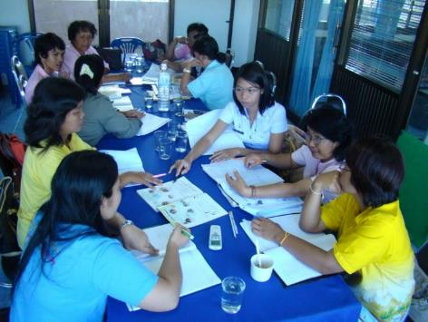
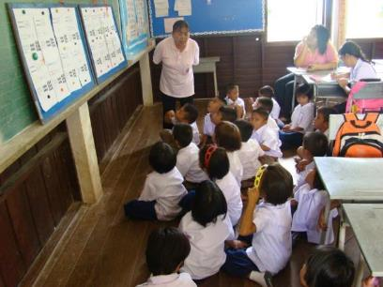
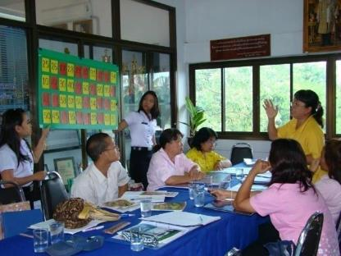
UNESCO UNITWIN
Seminar Program
Scenario at 2nd year project school
Banbuengniumbuengkrainoon school
Plan
Plan Lesson on Tuesday
See
Do
Reflect on Thursday
All rights reserved by Center for Research in Mathematics Education, Khon Kaen University

Slide 30
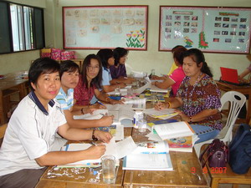
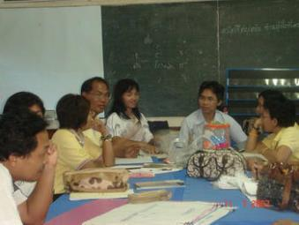


UNESCO UNITWIN
Seminar Program
Scenario at 2nd year project school
Nongtoom Nongngooluem school
Plan
Plan Lesson on Monday
See
Do
See
Do
Reflect on Wednesday
All rights reserved by Center for Research in Mathematics Education, Khon Kaen University

Slide 31
UNESCO UNITWIN
Seminar Program
The steps of Lesson Study process has been adapted to fit the "weekly cycle" of the PDCA.

Slide 32
UNESCO UNITWIN
Seminar Program
The school teachers, master students, and student interns have been working as a Lesson Study team without expert teachers as have in Japan.
Translated Japanese mathematics textbooks have been used like an expert teachers in terms of "what“ and "why"

Slide 33
UNESCO UNITWIN
Seminar Program
The "how" has been rested on the weekly cycle of 3 steps of Lesson Study incorporating with 4 steps of Open Approach.

Slide 34
UNESCO UNITWIN
Seminar Program
During the last 13 years of implementing curriculum reform using two innovations, there are lots of transformations NOT only in schools, but also as a promising innovations for educational reform in Thailand since 1999.

Slide 35
UNESCO UNITWIN
Seminar Program
On top of the implementation of pedagogical innovations and how to institutionalization as mentioned, the organizational has been also implemented. That is, the Faculty of Education, KKU set up the Center of Teaching Profession Training as a one-stop service for every teacher education program to collaborate with the partnership schools.

Slide 36
UNESCO UNITWIN
Seminar Program
The following chart summarizes the functions of the Center to support the implementation of innovations into schools.

Slide 37
UNESCO UNITWIN
Seminar Program
Teaching Professional Experience I
Teaching Professional Experience II
Teaching Professional Experience III
School Internship I
School Internship II
Teaching Professional Experience Courses
Center of Teaching Profession
Schools & Mentor Teachers
Reflections
Classroom Research
University
Professors

Slide 38
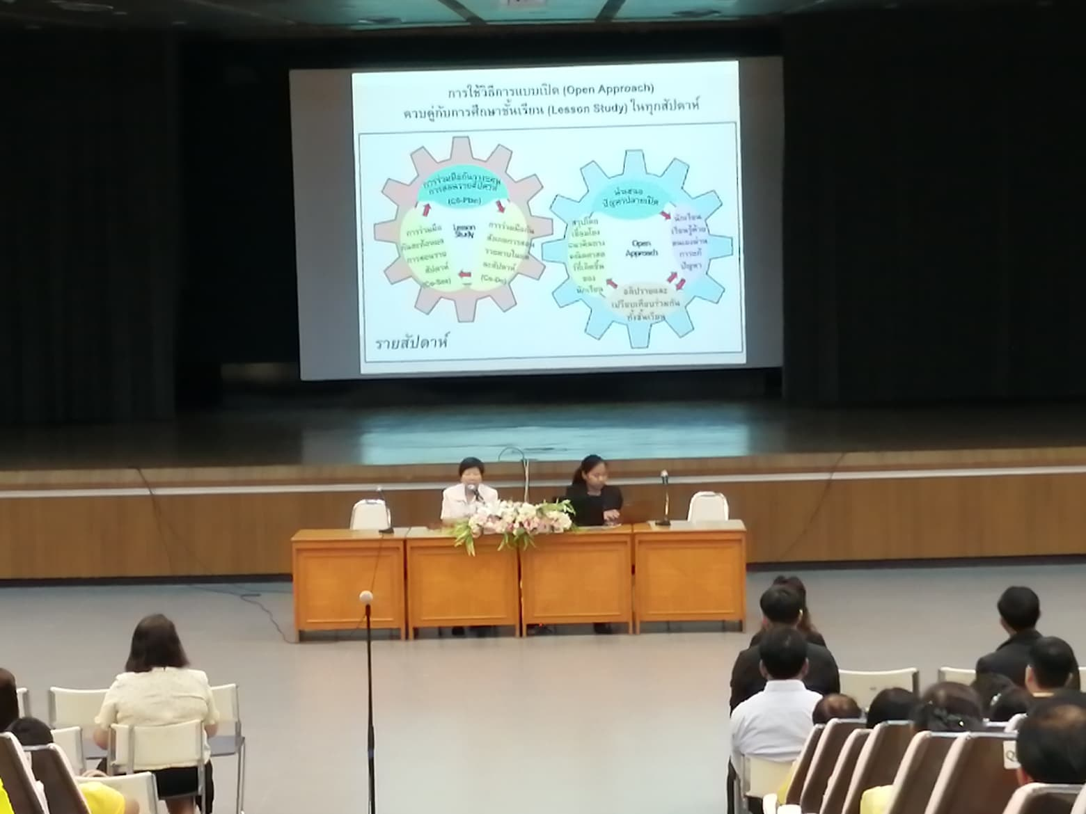
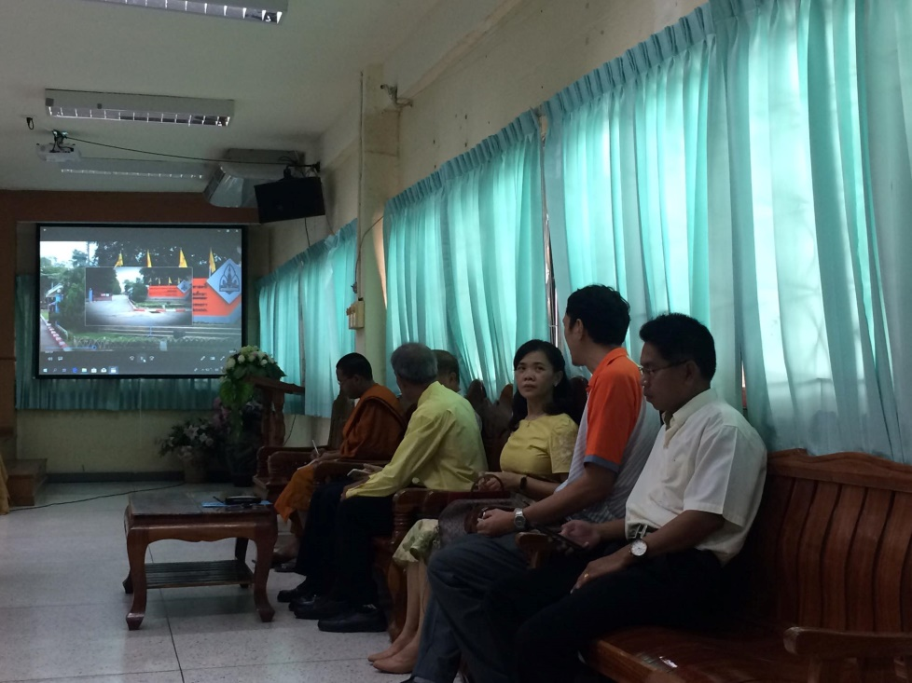
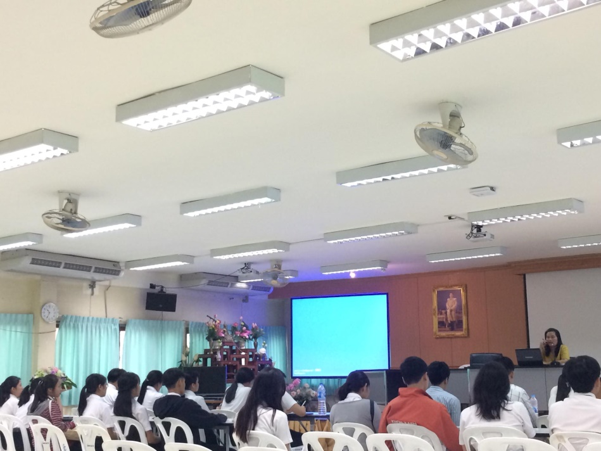
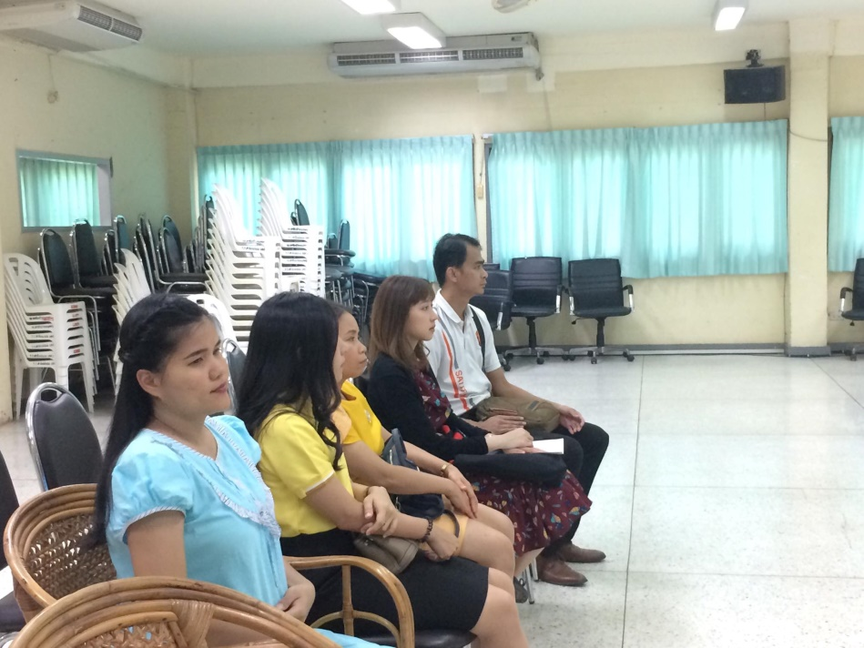
UNESCO UNITWIN
Seminar Program
Orientation and meeting with Schools & Mentor Teachers

Slide 39
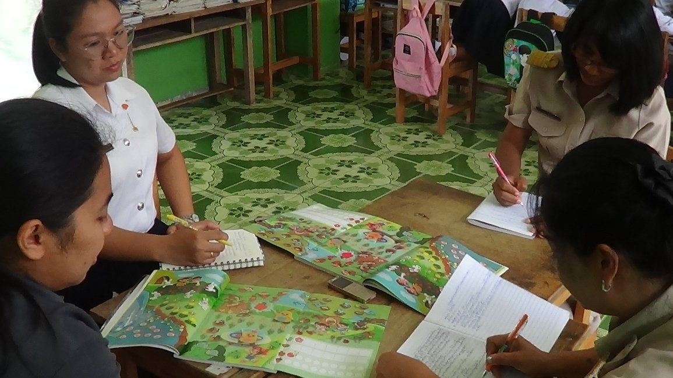
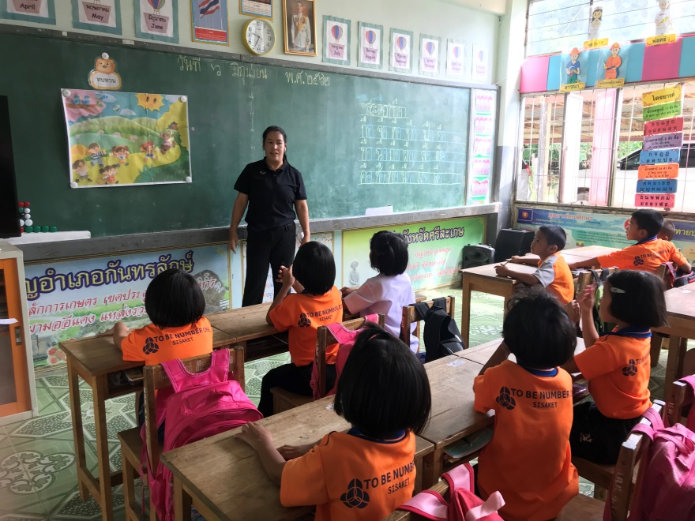
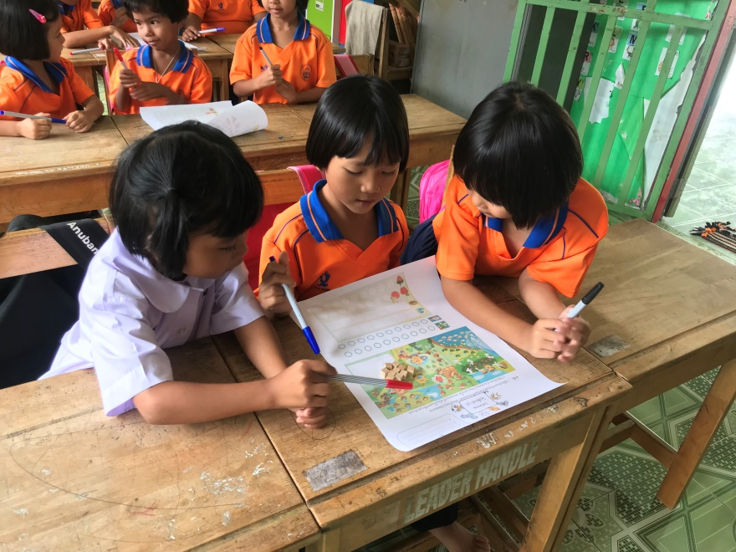
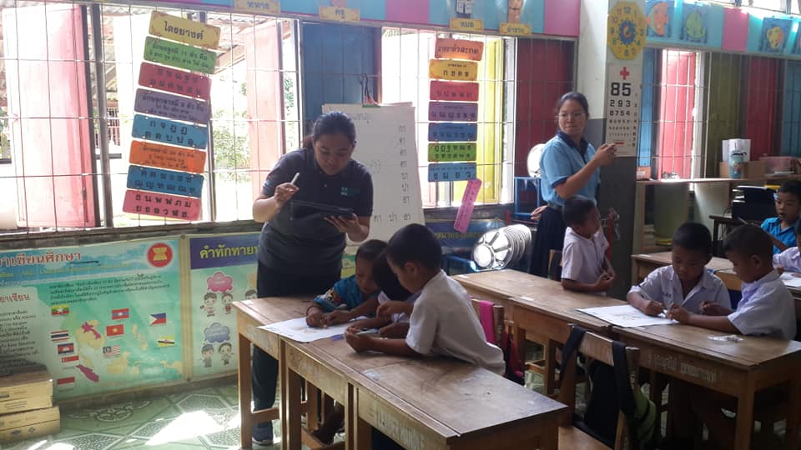
UNESCO UNITWIN
Seminar Program

Slide 40
UNESCO UNITWIN
Seminar Program
To bridge the gap between pre-service and in-service teachers, 4 courses with other activities has been designed as a mechanism to drive the teacher education programs.

Slide 41
UNESCO UNITWIN
Seminar Program
So far, two innovations for curriculum reform implementation, that is Lesson Study and Open Approach are expanded in other teacher education program, not only mathematics education program.
This provide us new platform for teaching thinking skills by NOT restricted to the subjects. This kind of Thinking skills would be the foundation for further specialized thinking skills, such as computational and statistical thinking which are needed for super smart society.

